Slide 1
Accelerator-VC and VC-VC Networks Analysis
Social phenomena interpretation through ecology and economy points of view

Slide 2
Outline
Motivation
Macro Research Question
Methodology
Results and Discussion

Slide 3
Motivation
Complex network relationships between VC-VC and accelerators-VC (co-investiment)
Limited application of network theory to VC-VC and VC-accelerator relationships
Interesting ecology literature (polinizator-plant networks) with potential applicability in such study

Slide 4
Macro Research Question
Which patterns govern the co-investment relationships between accelerators & VCs, and VCs & VCs? How do network structures emerge in this contexts? Which trends can we observe?
Relevant topics to answer it
Data Science (Math, Statistics)
Network Theory
Ecology (polinizator-plant bipartite networks)
Economics

Slide 5
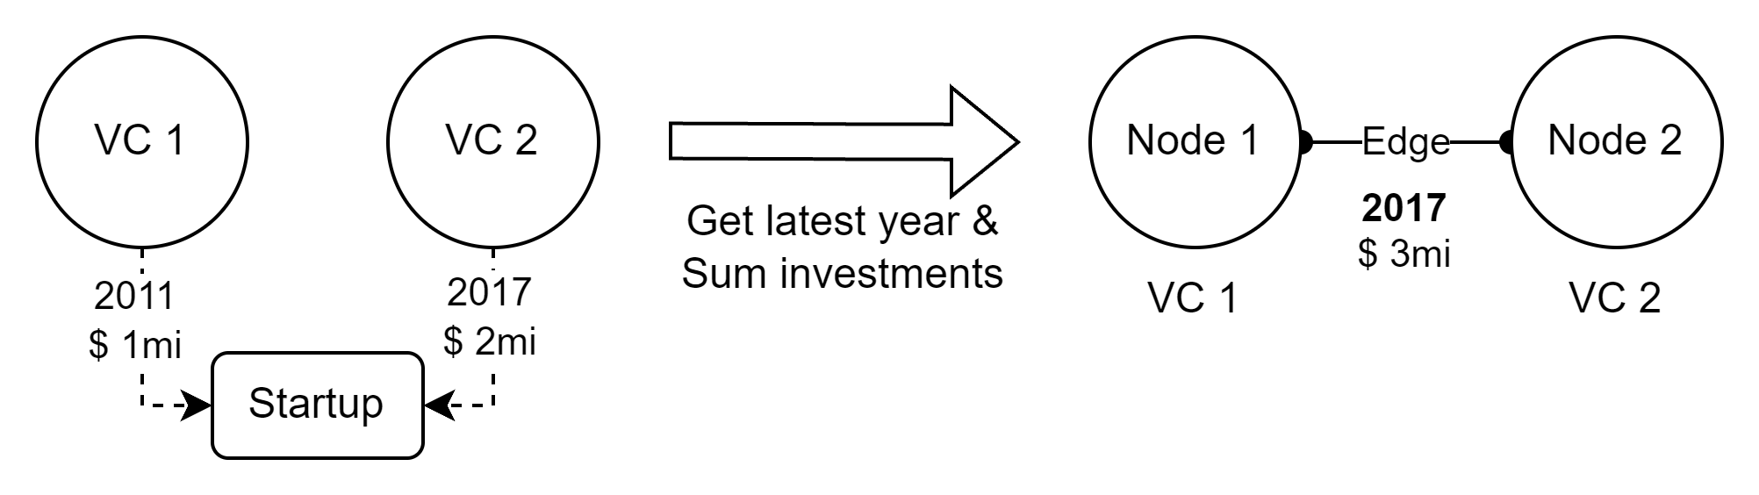
Methodology
Number of edges
Number of nodes
Connectance / density
Modularity / components
Nestedness (bipartite case)
Get data from Crunchbase (US and France)
Clean data (Matthijs and Theo methods)
Build network (Acc-VC and VC-VC) and get metrics
Analyze results through economics and ecology lenses
Propose framework to characterize such networks (on going)

Slide 6
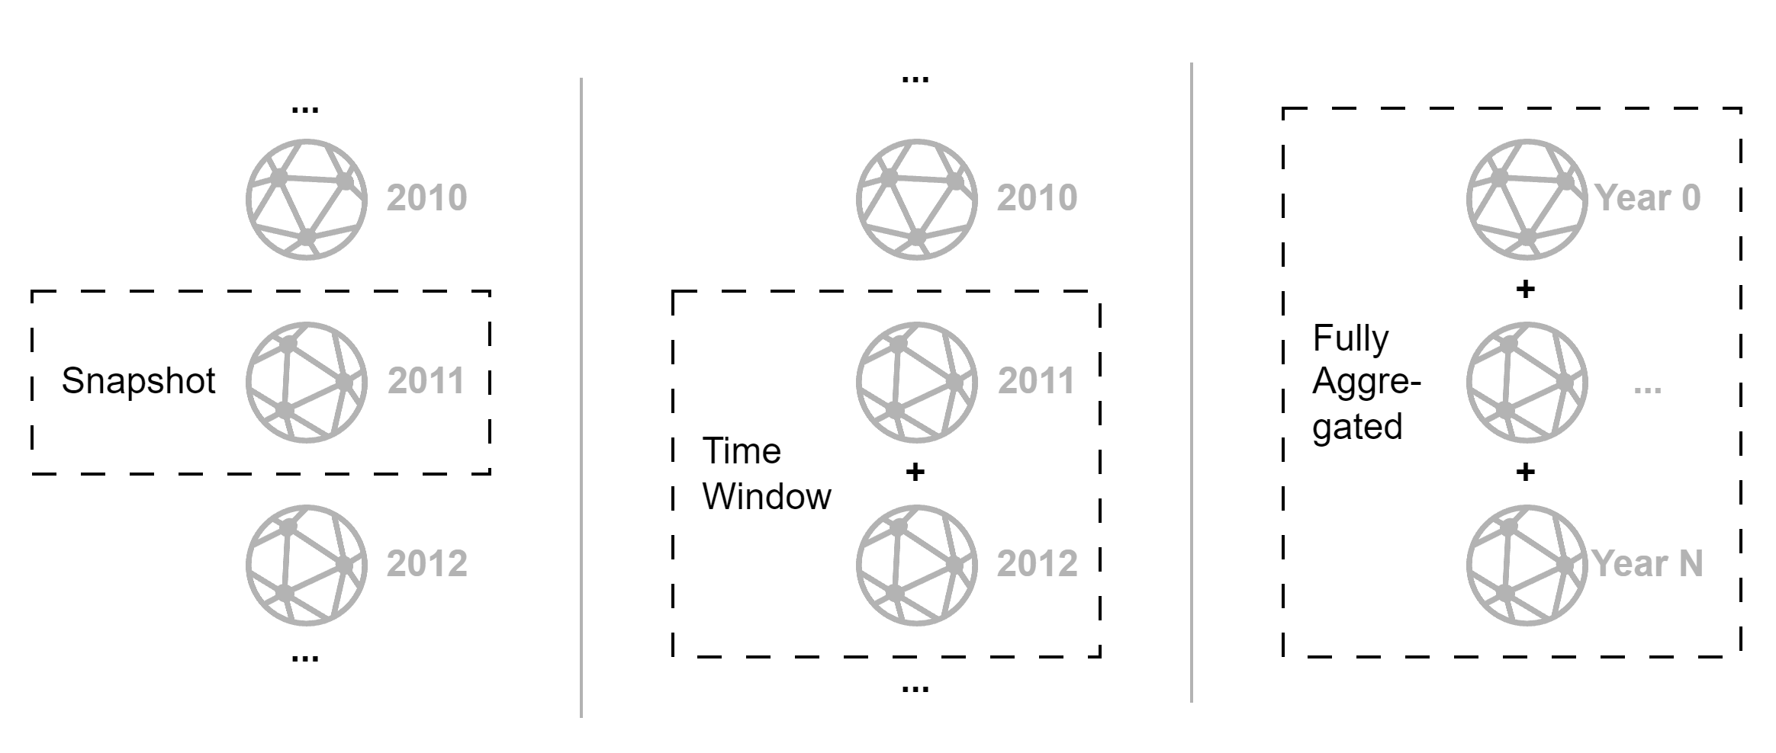
Methodology
3 distinct approaches…

Slide 7
Results – ACC-VC Network
3 different perspectives
Snapshot analysis
Time window
Fully aggregated
4 metrics + correlation matrix
Connectance
Nestedness
Modularity
Network size (nodes and edges count)

Slide 8
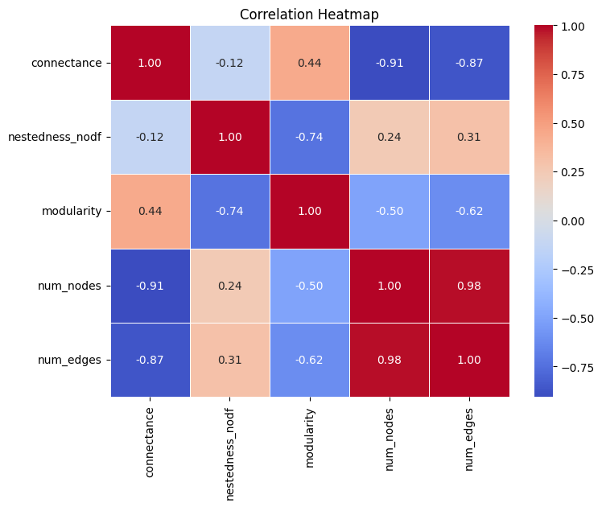
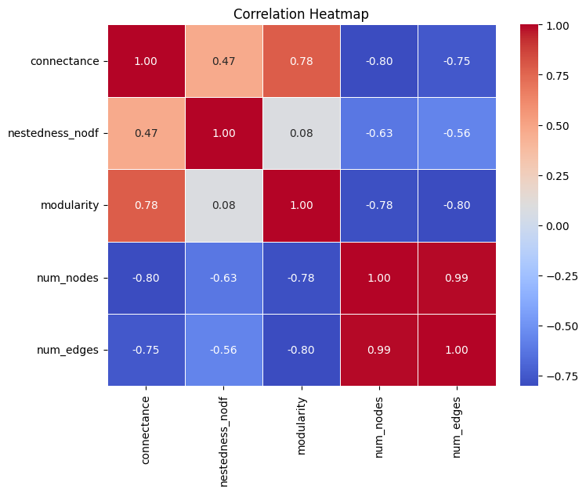


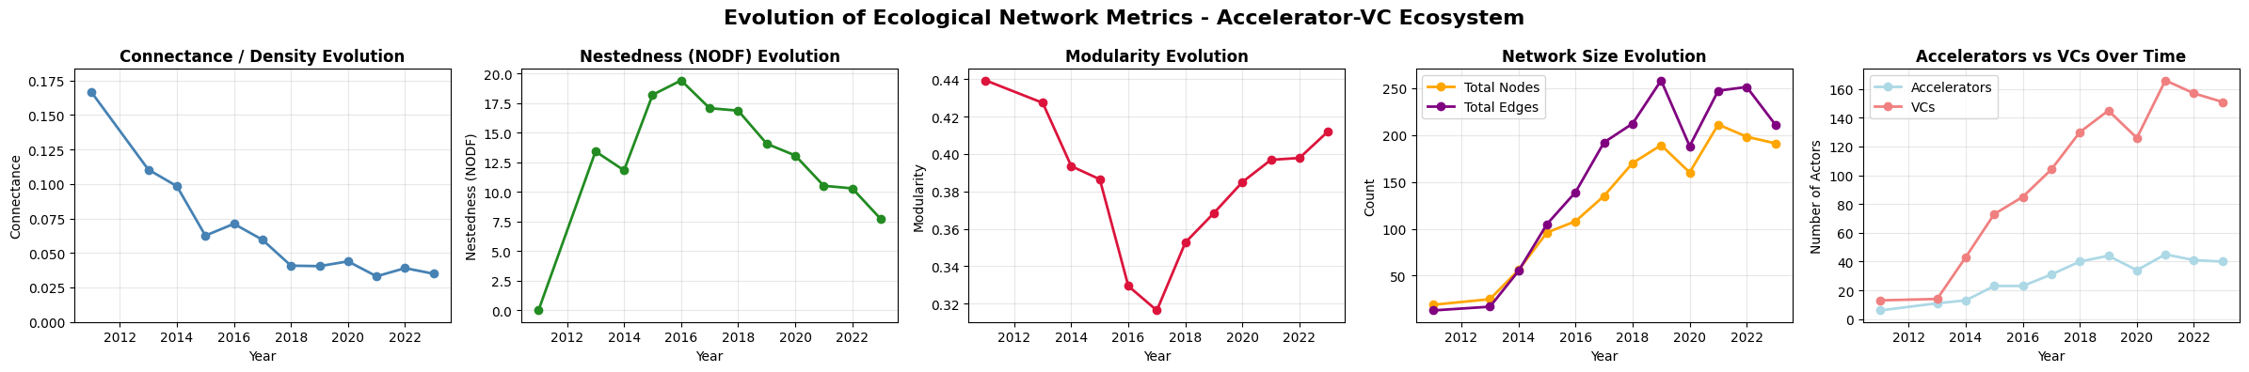
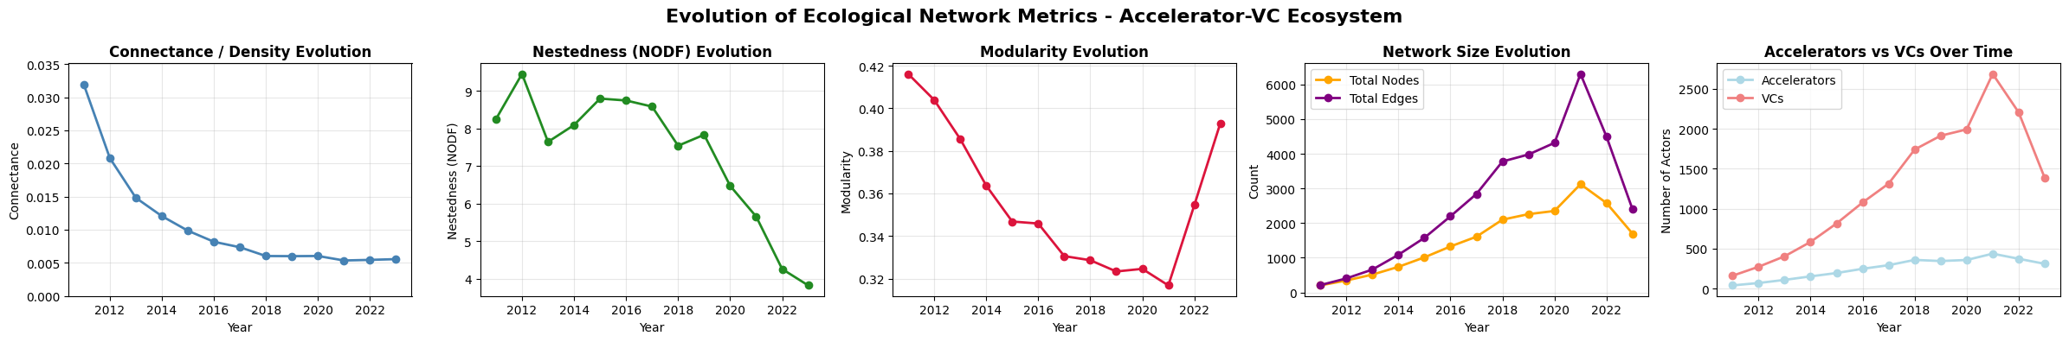
ACC-VC - Snapshots
Notes:
Connectance decreasing in both US and France, but overral values in France are at least 5 times greater than US
Nestedness decreasing in both US and France, France from 20 to 10 (half) in 8 years, US from 9 to 4 (half) in same period
Modularity in U format, decreasing in France until 2017, then increasing, and in US dreseasing until 2021 then increasing. Interesting that modularity have similar amplitudes in both countries (0.4 to 0.3)
Network nodes and edges were increasing until 2021, then decreasing, for both US and France, but US is way bigger (6000 edges and 3000 nodes in the highest volume year in US vs. 250 egdes and 200 nodes in france
Number of ACCs and VCs increasing until 2021, then decreasing. Quantities equamy different in countries

Slide 9
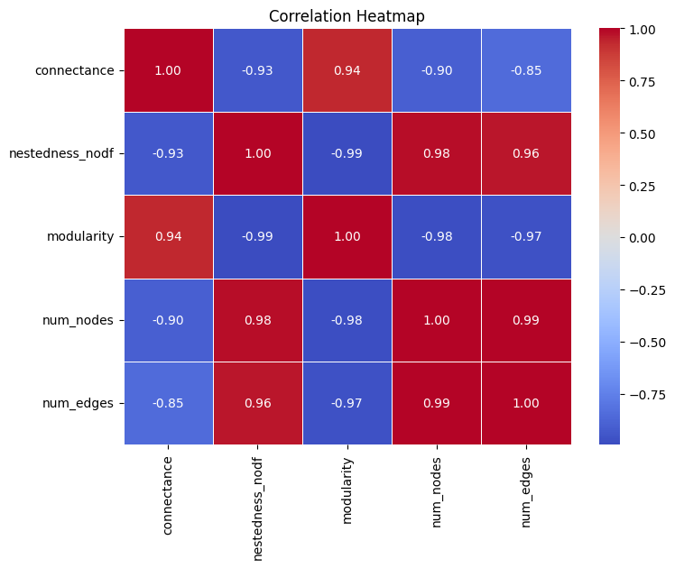
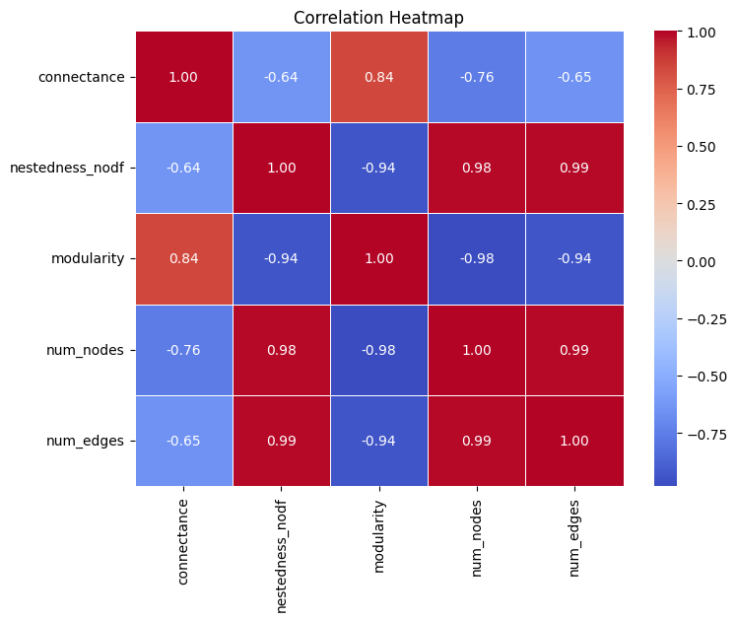
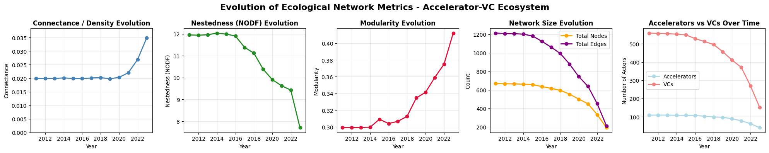
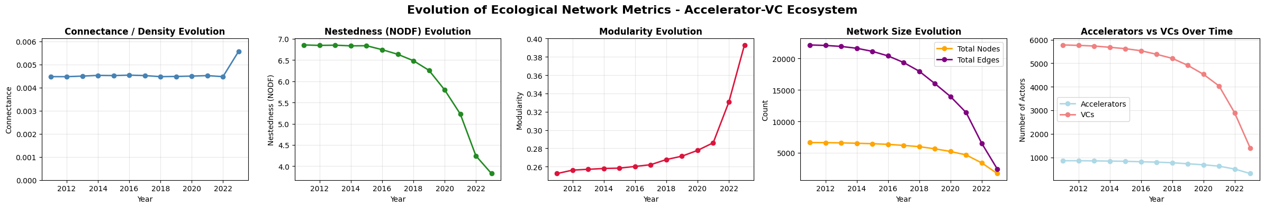
ACC-VC – Time Window (5 years)
Notes:
Stable connectance over year in both countries, then it starts incresing from 2020 on. France is at least 4 or 5 times more connected (0.02 to 0.03 in France vc 0.0045 to 0.0055 in US)
Nestedness decreasing in both countries, in France from 12 to 8, in US frol 7 to 4
Modularity increasing in both countries in similar order of values (0.25 to 0.4)
Network size decreasing in both countries, as well as number of ACCs and VCs

Slide 10
ACC-VC – Fully Aggregated
Nodes: 744 (117 acc + 627 VCs)
Edges: 1352
Connectance: 0.018
Nestedness (NODF): 11.0
Modularity: 0.302
Nodes: 6936 (889 acc + 6047 VCs)
Edges: 23295
Connectance: 0.004
Nestedness (NODF): 6.6
Modularity: 0.246

Slide 11
Results – VC-VC Network
3 different perspectives
Snapshot analysis
Time window
Fully aggregated
3 metrics + correlation matrix
Connectance
Components (number of “separate” subsets)
Network size (nodes and edges count)

Slide 12
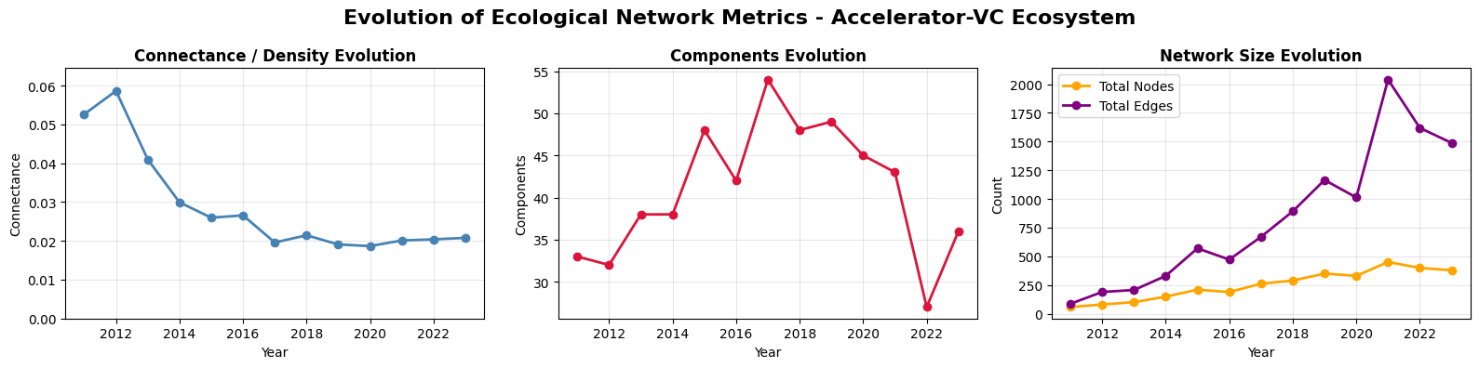
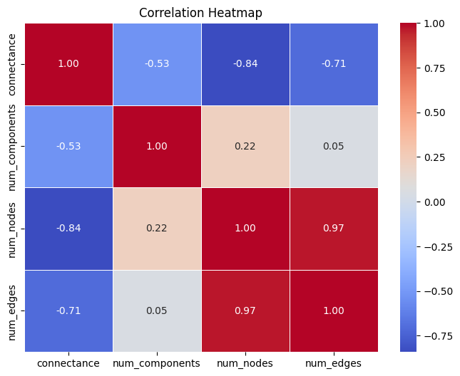
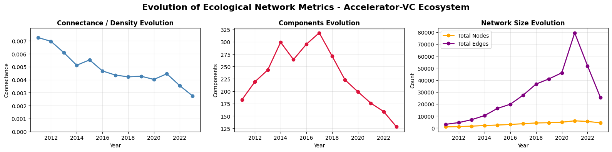
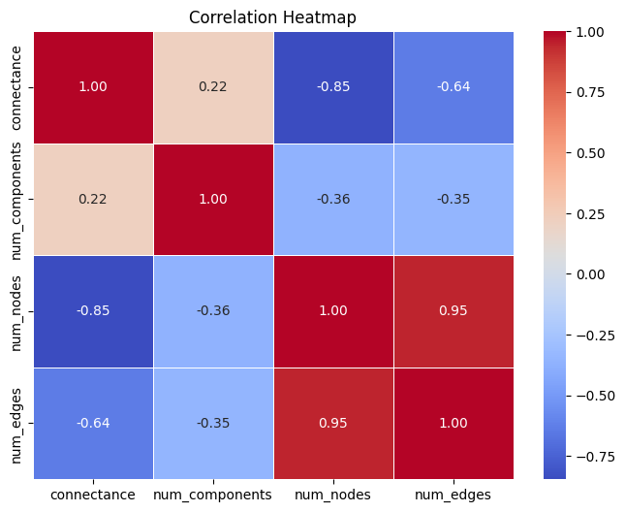
VC-VC - Snapshots

Slide 13
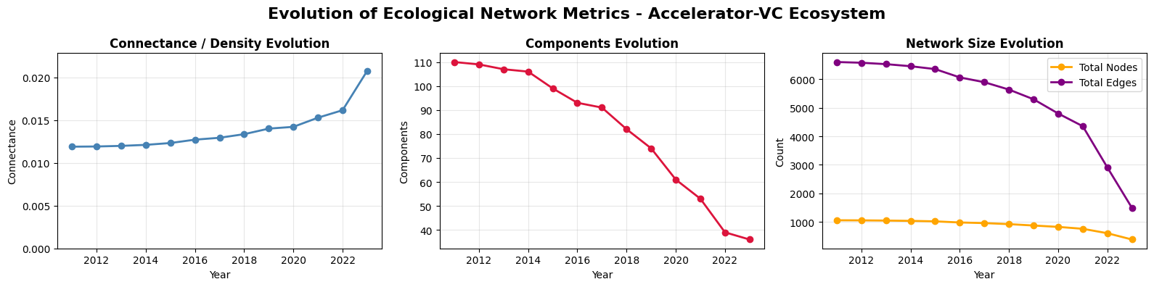
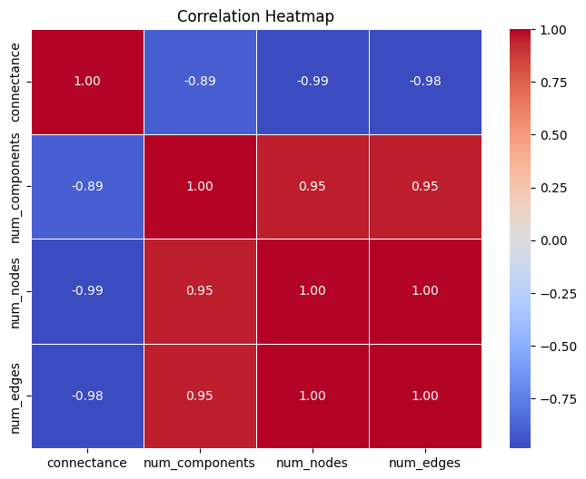
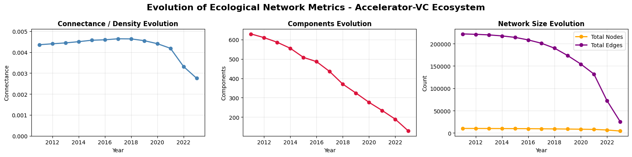
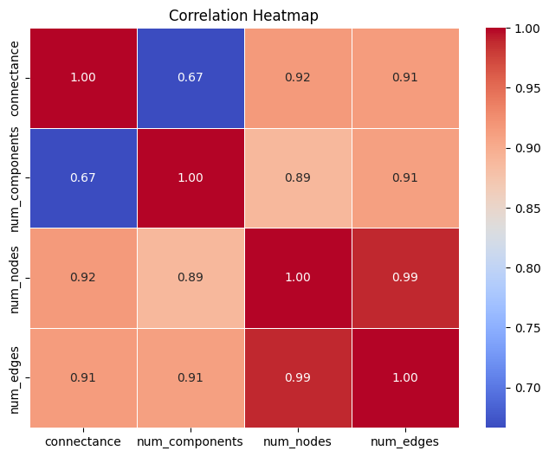
VC-VC – Time Window (5 years)

Slide 14
VC-VC – Fully Aggregated
Unique VCs: 1,180
Partnership edges: 7,360
Connected components: 125
Density: 0.0105
Unique VCs: 11,095
Partnership edges: 238,737
Connected components: 750
Density: 0.0038

Slide 15
Results – VC early-VC late Network
3 different perspectives
Snapshot analysis
Time window
Fully aggregated
3 metrics + correlation matrix
Connectance
Nestedness
Modularity
Network size (nodes and edges count)

Slide 16
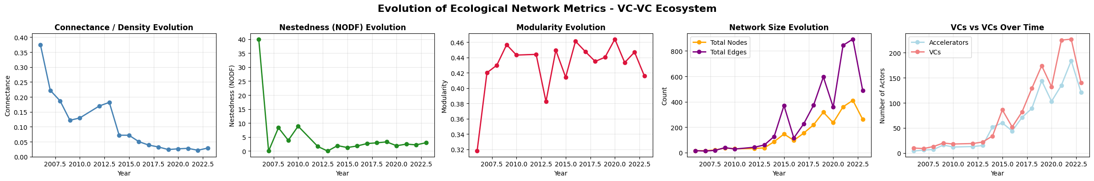
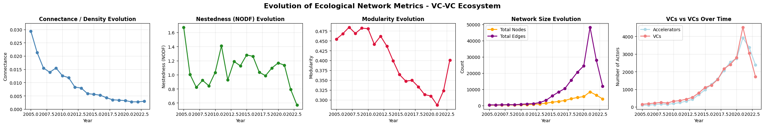
VC early-VC late - Snapshots

Slide 17
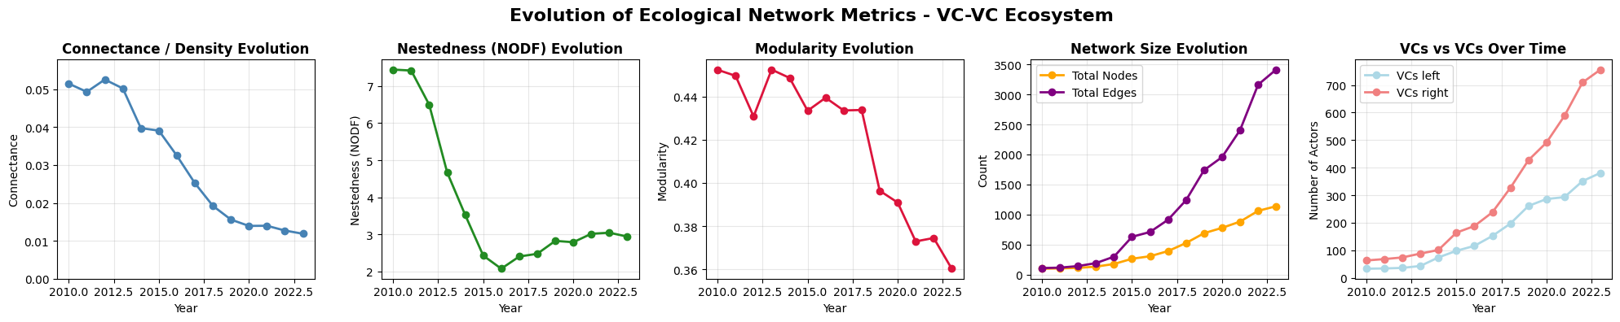
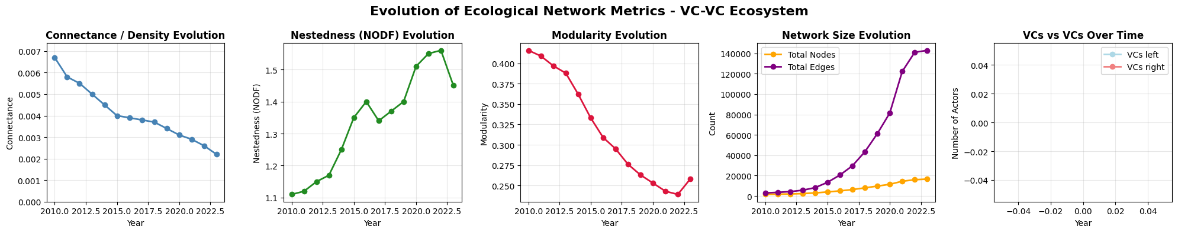
VC early-VC late – Time Window (5 years)

Slide 18
VC early-VC late – Fully Aggregated
Unique VCs: 1,180
Partnership edges: 7,360
Connected components: 125
Density: 0.0105
Unique VCs: 11,095
Partnership edges: 238,737
Connected components: 750
Density: 0.0038

Slide 19
Discussion and Possible Next Steps
Granovetter theories assessment (SWT, embeddedness)
The Problem of Embeddedness, Social Networks and Innovation (Problem to access, maybe get with Theo)
How to statistically assess the significance of differences in nestedness (and the other metrics) between French and American ecosystems
The interpretation of modularity values and their importance for identifying clusters in the network
Confirm the calculation is correct… (Compare with Theo’s algorithm if possible)
The relationship between network structure and resilience/vunerability of the entrepreneurial ecosystem
Exploring sub-networks by sector or by region to refine the analysis
Integrate Theo's concepts on complex networks into entrepreneurial ecosystems in our study
Discuss on differences between ACC-VC and VC-VC networks
Notes:
Modularity in ACC-VC between countries is similar, but in VC-VC this is not true, US is more modular (separate cluster) than France in this network

