Slide 2
ACC-VC Network

Slide 3
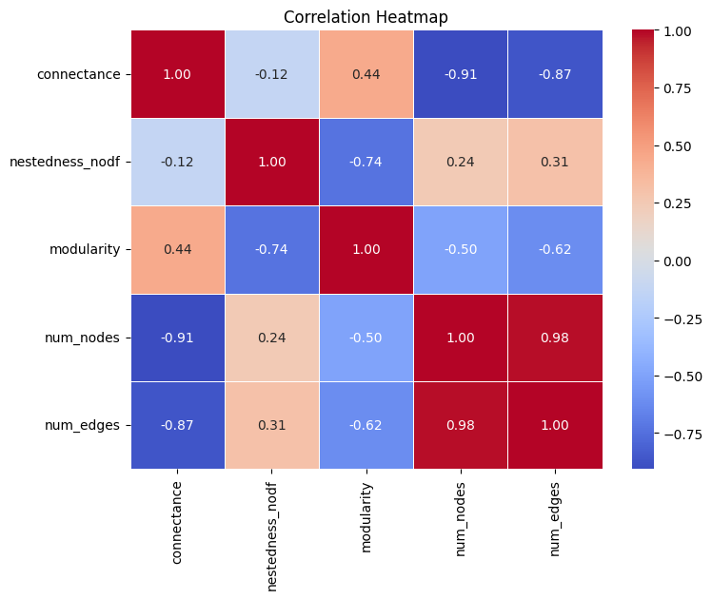
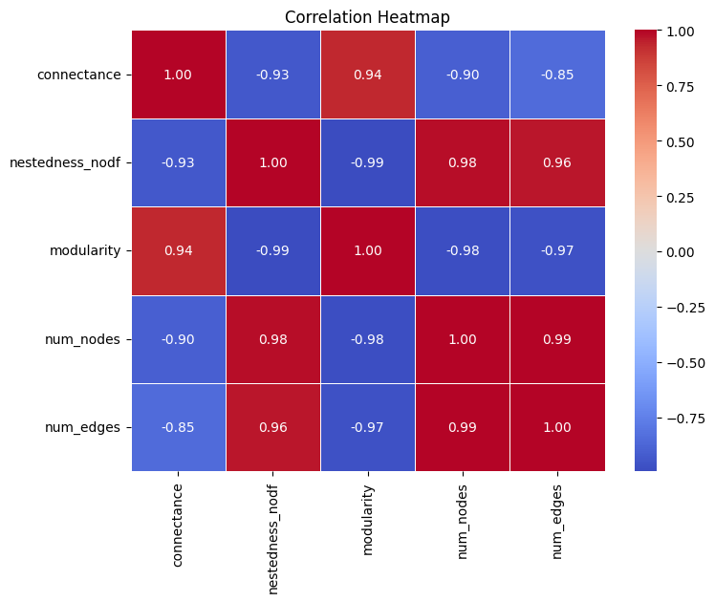


France – Time Series Analysis
Snapshot analysis
Cumulative analysis

Slide 4
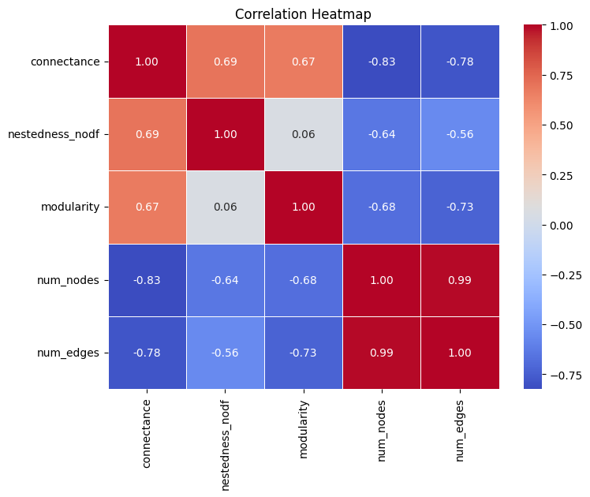
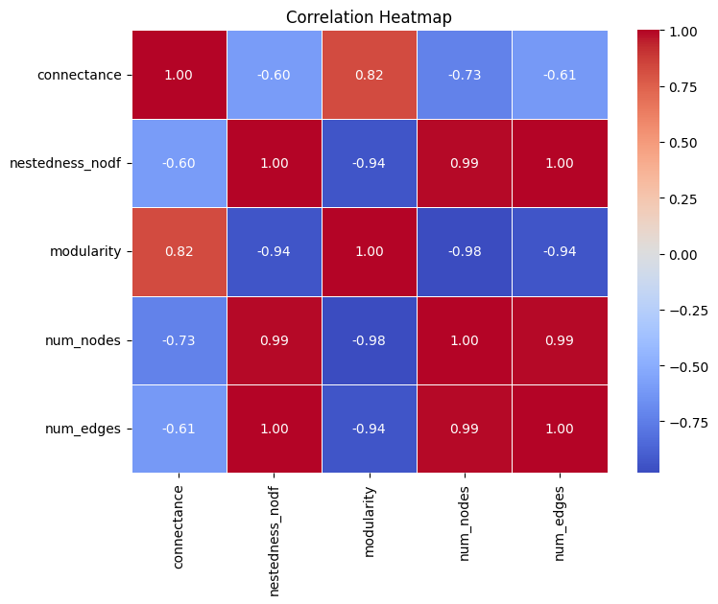


US – Time Series Analysis
Snapshot analysis
Cumulative analysis

Slide 5
FR
US
FR
US

Slide 6
VC-VC Network

Slide 7

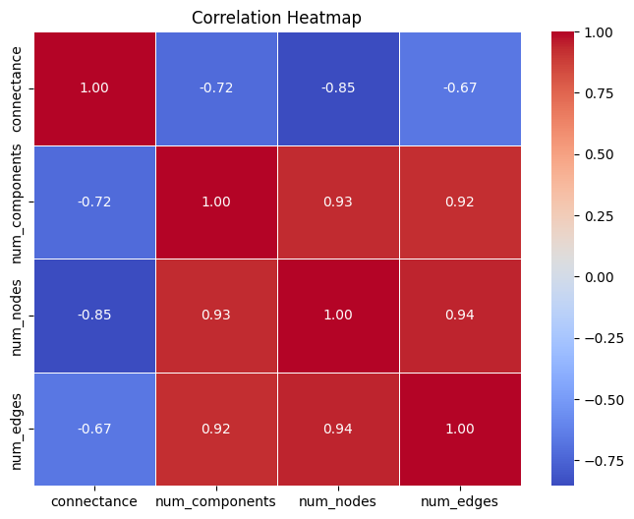

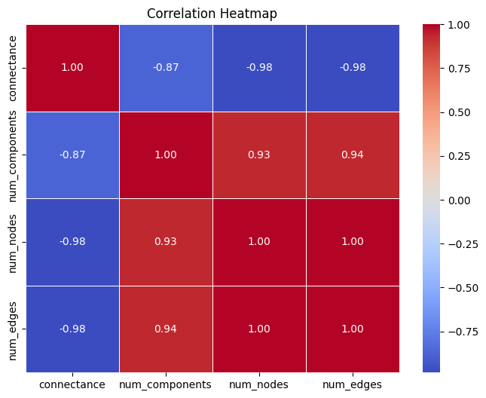
France – Time Series Analysis
Snapshot analysis
Cumulative analysis

Slide 8
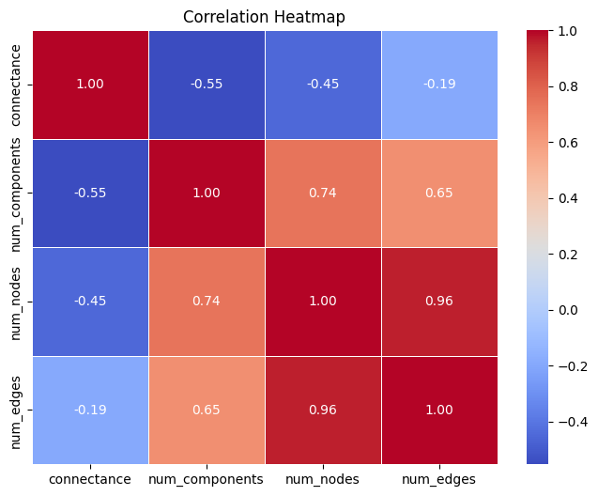

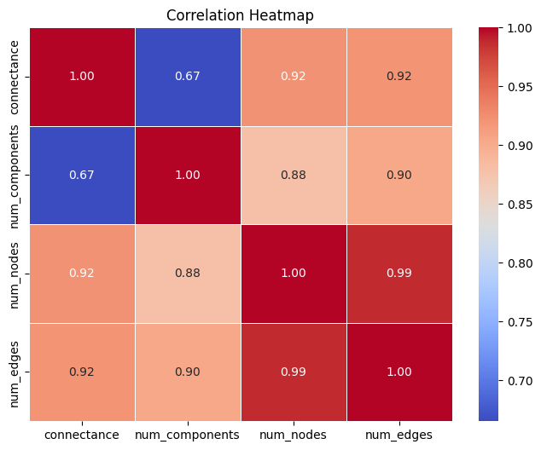

US – Time Series Analysis
Snapshot analysis
Cumulative analysis

Slide 9
FR
US
FR
US

Slide 10
VC-VC Network

