Slide 1
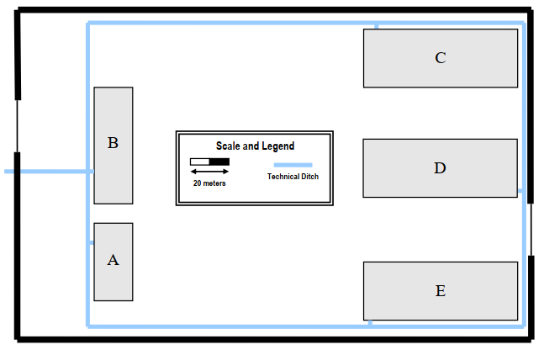
Industrial private closed area
LEGENDA:
- Edifício não considerado para o projeto composto por 4 elementos
- Fibber cable 100GbaseLR10 (fornecedor de telecomunicações)
- Fibber cable 10GbaseLR (Campus backbone)
- Intermediate cross-connect
- Main cross-connect
IC
IC
MC
IC
IC
IC
MC
IC

Slide 2
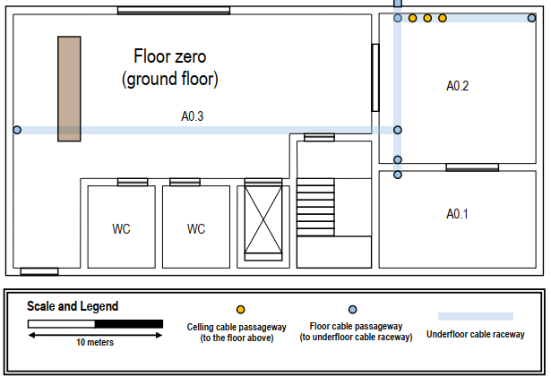
Building A - Ground Floor
LEGENDA:
- Floor outlet
- Floor outlet (double)
- Horizontal cross-connect (HC)
- Fibber cable 10GbaseLR (Campus backbone)
- Fibber cable 100GbaseLR10 (fornecedor de telecomunicações)
- Copper cable CAT6a (horizontal cabling)
- Access point
- Access point range
- Access point range (first floor)
- Fibber cable 100GbaseLR10 (fornecedor de telecomunicações)

Slide 3
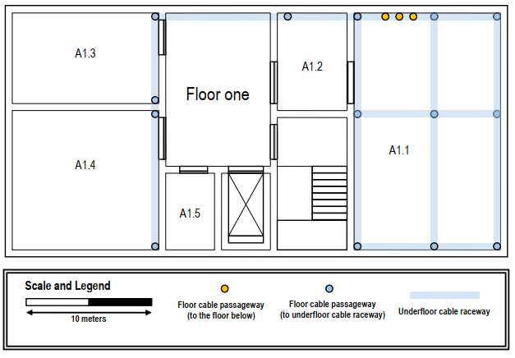
Building A - First Floor
LEGENDA:
- Floor outlet
- Floor outlet (double)
- Horizontal cross-connect (HC)
- Intermediate cross-connect (IC)
- Main cross-connect (MC)
- Fibber cable 100GbaseLR10 (fornecedor de telecomunicações)
- Fibber cable 10GbaseLR (Campus backbone)
- Fibber cable10GbaseSR (Building backbone)
- Copper cable CAT6a (horizontal cabling)
- Access point
- Access point range
- Access point range (ground floor)

