Slide 1
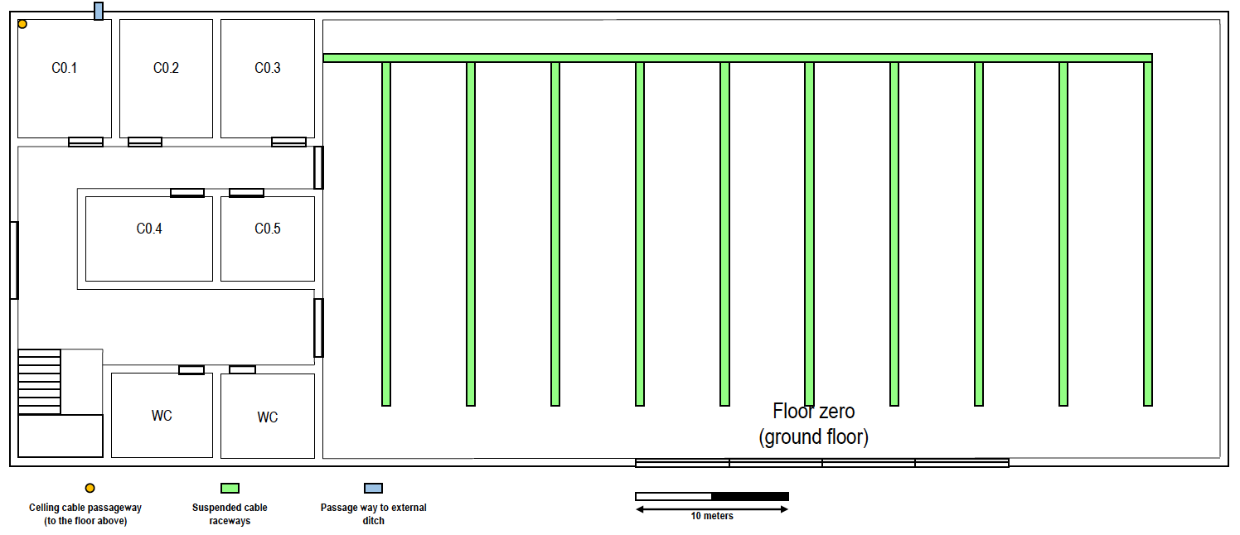
Intermediate cross-connect
Access point + outlet
Fiber cable
Access point range
Horizontal cross-connect
Floor outlet
4 outlets
Copper cable

Slide 2
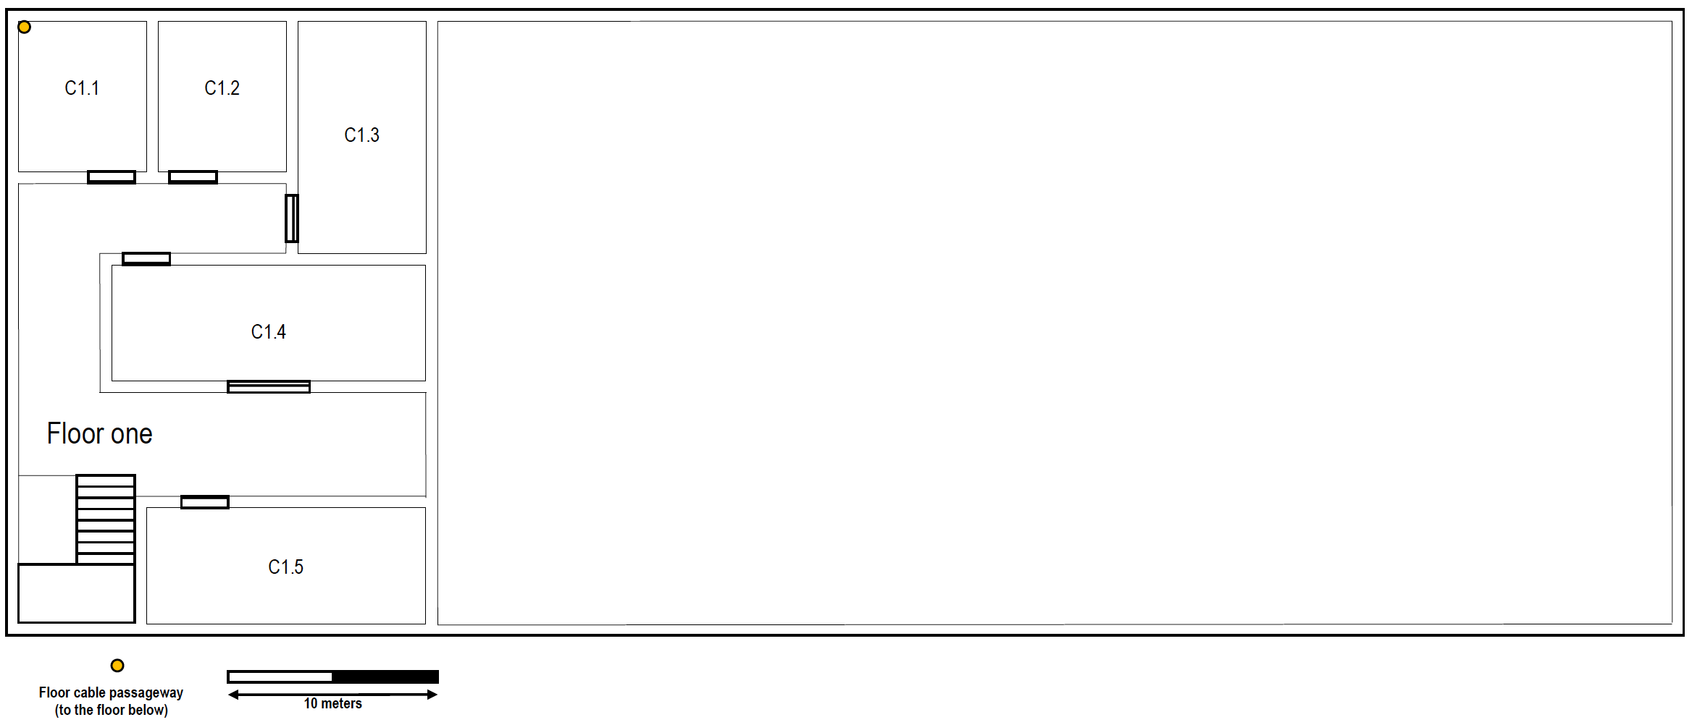
Intermediate cross-connect
Access point + outlet
Fiber cable
Horizontal cross-connect
Floor outlet
Access point range
Copper cable

