Slide 1

Air Travel Flight Management System
AED 2nd Project 23/24
Authors :
João Parada - up201405280
Luciano Ferreira - up202208158
António Cunha - up202208862

Slide 2
Air Travel Flight Management System
Used classes
Airline class: Stores all airline’s data.
Airport class: Stores all airport’s data.
Flight class: Stores all flight’s data.
Filereader class: Parses data from the given .csv files .
FMSGraph class: Our own graph class , implements all our major functions.
Graph class: Given graph class, was changed to fit FMSGraph class.
Menu class: Stores and presents all the FMS in a menu form.

Slide 3
Air Travel Flight Management System
Filereader class : Parsing data
The file reader class is responsible to parse given .csv data.
We decided to read from it and implement 3 functions : addFlights() addAirports() and airlineMap() . All of these parse data from the flights.csv ,airports.csv and airline.csv respectively .
We then call these functions from the main method on the system boot to add the parsed information to the globalGraph ( an FMSGraph object ) .
We place the airline info on a graph field called “airlineMap “ , with the flight info being added as edges and the airport as vertices of the graph .

Slide 4
Air Travel Flight Management System
FMSGraph class
FMSGraph class is a version of the graph class we created to ease the coding of our project .
We decided to replace the name of the functions (add/remove/find vertex/edge to airport/flight ) . This came to be a great way to simplify and make our code more readable overall.
We also decided to create some auxiliar functions to help the main methods such as tooRadians() , lowestNumberOfStops() and findAllShortestPathsBetweenAirports()

Slide 5
Air Travel Flight Management System
Main Methods I
airportFlightCount() : Returns he global number of airports and the global number of flights. TimeC = O(N)
flightsPerAirport() : Returns the global number of flights per airport. TimeC = O(N)
flightsPerCity() and flightsPerAirline() : Returns the number of departures/flights per city/airline . TimeC=O(N)
numOfDestinationsCity() and numOfDestinationsAirport() : Returns the number of different countries that an airport/city connects to. TimeC=O(N*(M+K))

Slide 6
Air Travel Flight Management System
Main Methods II
airportDestinations() : Returns the number of destinations that an airport has connections to . TimeC = O(N*log(N))
reachableDestinationsInXStops() : Returns the different airports/countries/cities an airport can get to within X stops . TimeC = O( V+E )
maxTrip() : Returns the pairs that have the most connections between them. TimeC = O( N*(V+E))
topAirports() : Returns the top K airports with more traffic . TimeC = O(V+E+V*log(V))
essentialAirports() : Returns the essential airports to the networks circulation capability . TimeC = O(V+E)

Slide 7
Air Travel Flight Management System
Main Methods III
bestFlightOption() : Returns a list the paths from one airport to another, ordered by the shortest distance and the lowest number of stops .
applyAirlineFIlter() : Returns the filtered graph with or without the selected airlines .

Slide 8
Air Travel Flight Management System
Menu Usage
Our menu includes 3 submenus the user can choose from . The statistics menu , the flight menu and the filter menu.
The stats menu gives the user access to previously mentioned methods that give out stats about our network or a specific airport/city/country.
The flight menu provides the user with the best flight path if it desires the quickest flight between two places.
The filter menu helps the user to be more specific with how he to choose his flight from one place to another.

Slide 9
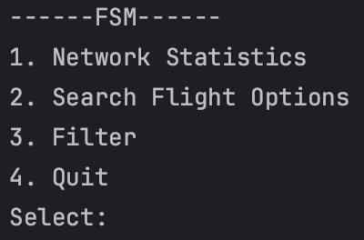
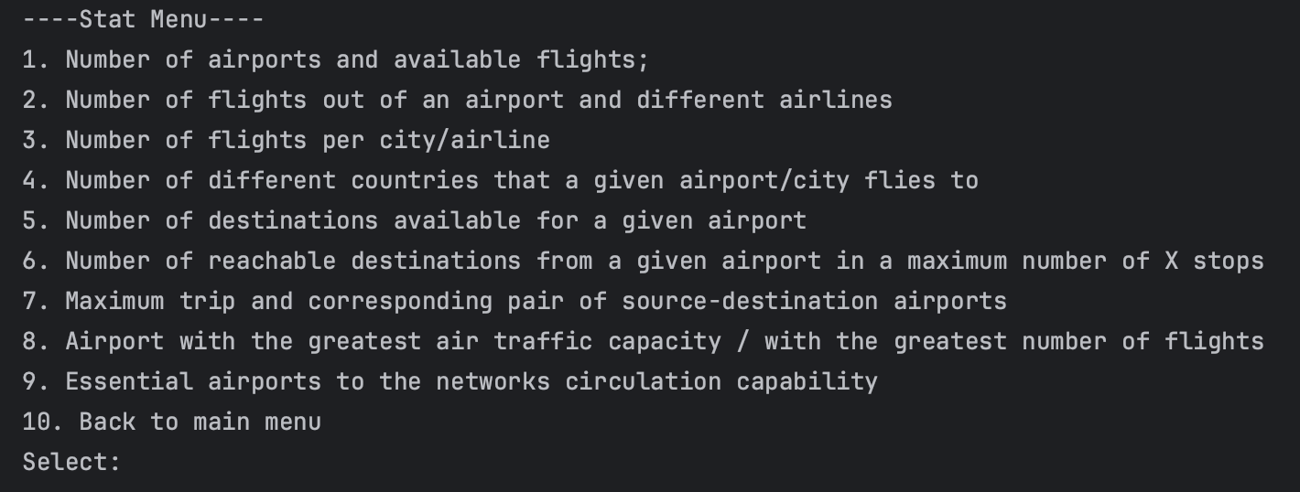
Air Travel Flight Management System
Menu Usage
This is our MainMenu
Stat Menu

Slide 10
Air Travel Flight Management System
Best functionalities
Our best and more complex functionalities evolve around the flight and filter menu methods which mainly include the bestFlightOption() function. Implementing this function required us to apply the knowledge we got throughout the semester such as graph search and connected components .
As we concluded the projected , we noticed that our previous graph knowledge was essential and as a group we consider this project a great way to further it .

Slide 11
Air Travel Flight Management System
Main difficulties faced
Throughout the project's duration, each group member actively contributed to its completion.
As we progressed through each step of the project, we faced increasing levels of difficulty. Nonetheless, our most challenging task was applying filters to the bestFlightOption.

