Slide 1
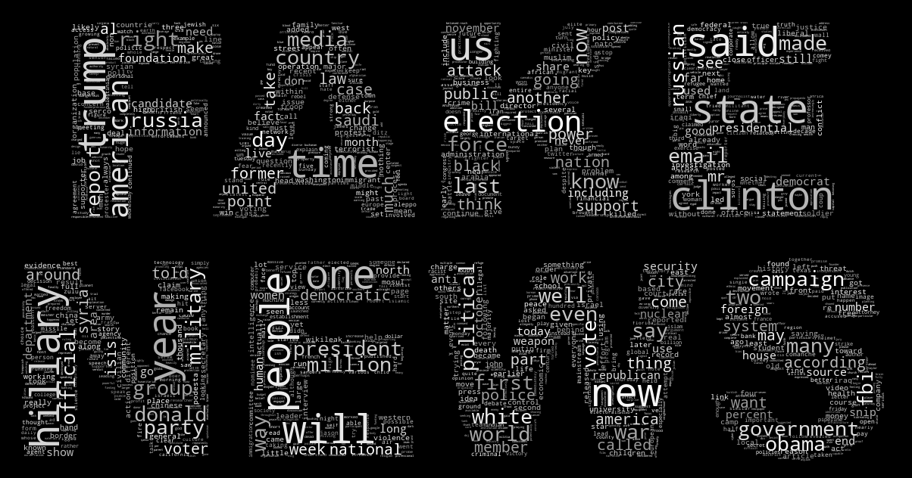
Cleaning Online Media with Machine Learningleaning Online Media with Machine Learning
João Eira

Slide 2
Context
Fake news have been on the agenda at least since the 2016 US Presidential Campaign
Back on the headlines in the context of the COVID-19 pandemic, as rumours and disinformation are quickly spreading
Effective ways to identify and eliminate fake news are essential in a modern democracy
Machine Learning plays a key role in this effort
CONTEXT

Slide 3

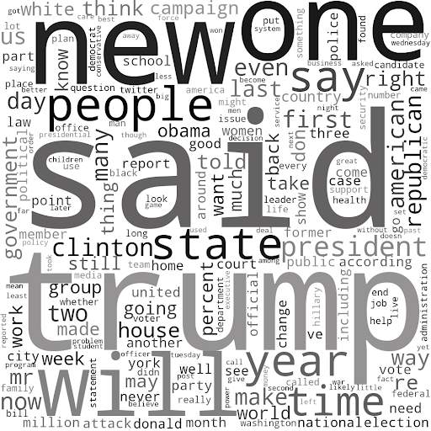
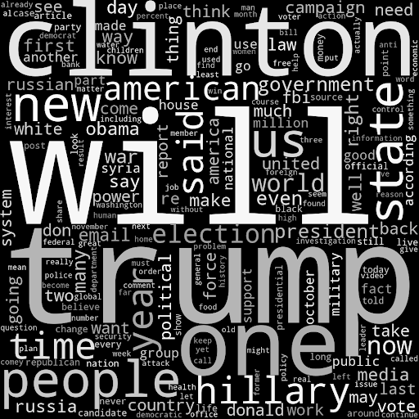
Datasets
DATASETS
Real News
All-the-News Dataset
150K news from 15 online US news organizations
12K samples randomly taken
Timeline: January 2016 – July 2017
Fake News
Fake News Dataset
12K samples from 244 sources
Timeline: October/November 2016

Slide 4
Models
MODELS
bag of words &
naive bayes
logistic regression
svm
decision tree
random forest
gradient boost
3 scenarios for each model
article title as feature
article text as feature
both

Slide 5
Results – Accuracy(%)
RESULTS – ACCURACY (%)
Model | Article Title | Article Text | Both
NB | 76.95 | 85.58 | 86.87
Logistic Regression | 76.87 | 93.31 | 92.99
SVM | 75.99 | 92.10 | 91.70
Decision Tree | 72.60 | 84.05 | 81.14
Random Forest | 78.40 | 87.19 | 88.48
GBoost | 73.41 | 91.70 | 91.86
The title by itself is not a good enough predictor of a fake news (<80% accuracy)
The text of the article introduces a significant increase in performance
Using both title and text does not introduce gains versus using only the text

Slide 6
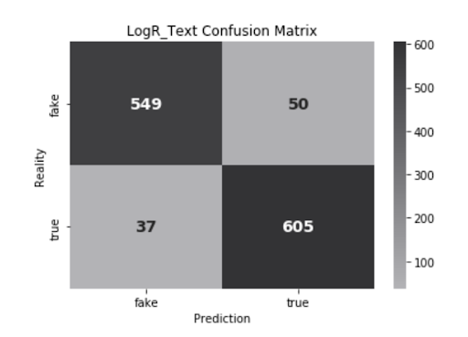
Best Model
Best model is Logistic Regression using only article text as a feature – 93% accuracy
Simple model – not very demanding in terms of computing power
Confusion matrix shows fairly balanced results between classes

Slide 7
COVID-19 Fake News
Given the unprecedented COVID-19 crisis, the model was tested with a small set of COVID-19 related news.
Is the model robust enough to handle a completely different news cycle?

Slide 8
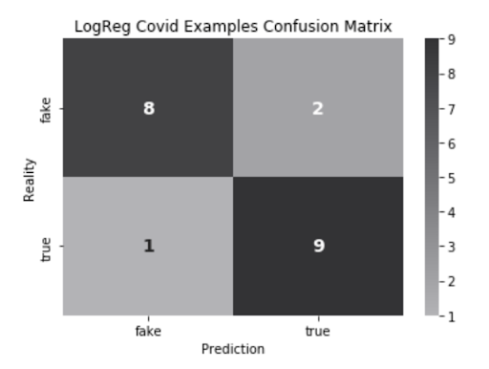
COVID-19 Fake News
Due to time constraints 20 examples – 10 fake and 10 true were tested
Accuracy is lower (85%) than the original test result (93%)
Given the time disparity, the model is robust to new content

Slide 9


COVID-19 Fake News Model Prediction Examples
PREDICTION EXAMPLES
News Summary | Fake/True | Model Prediction
Cristiano Ronaldo Turns His Hotels Into Coronavirus Hospitals
American Airlines will ground about half its fleet next month
Man Drops Dead In Middle Of Street – Suspected Coronavirus!
Monaco’s Head of State Prince Albert II Contracts Coronavirus
US state department warns against all Americans leaving country amid pandemic

Slide 10
Conclusions & Future Work
Able to predict fake news with an accuracy of 93%, using a very simple logistic regression model
01
Very good performance (85%) with a small set of different news
It should be tested with a larger sample when possible
02
Further improvements:
03
Inspect wrong examples - identify patterns
Test more complex models – deep learning
Retrain model with more recent data
CONCLUSIONS & FUTURE WORK

Slide 11
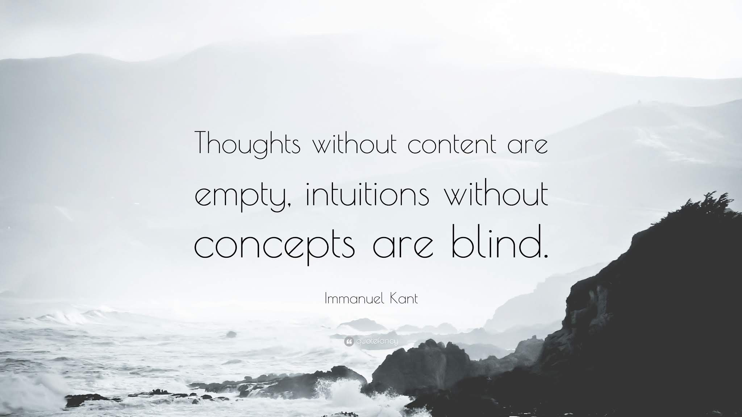
Any questions ?

