Slide 1
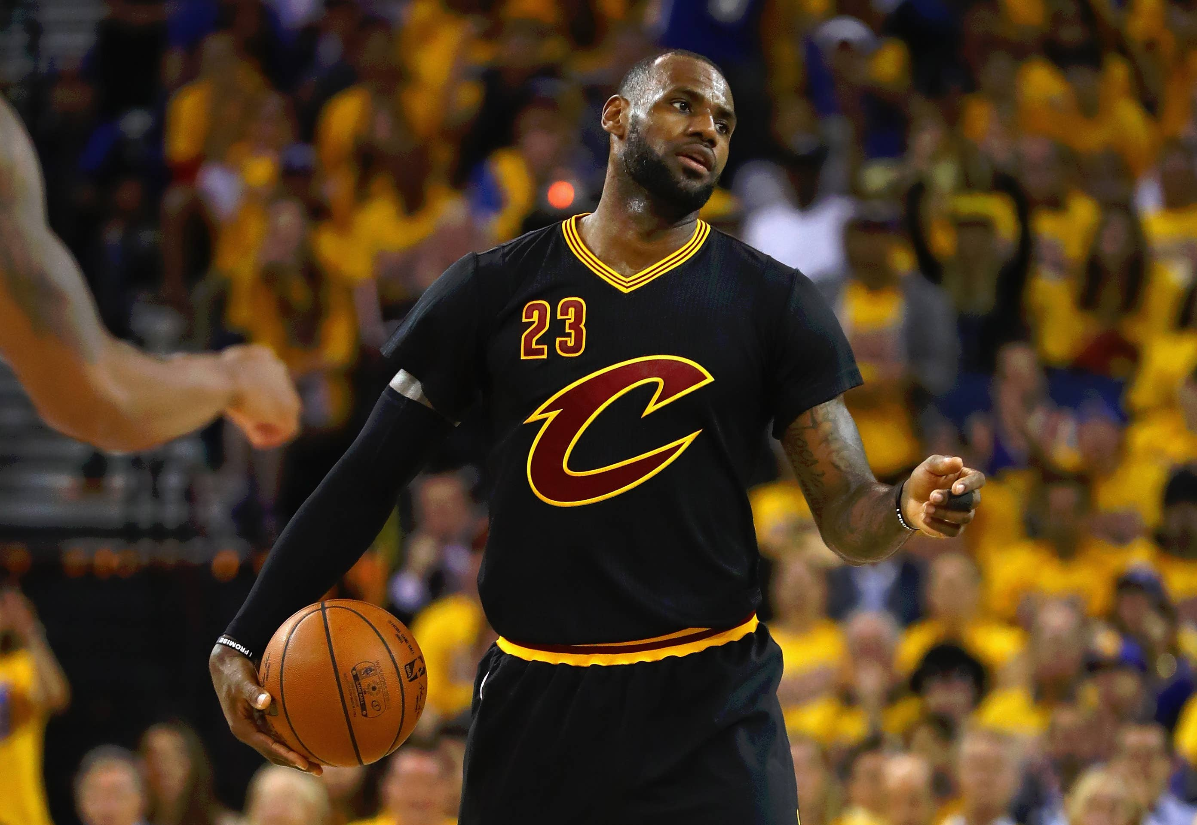
Lebron = GOAT
Lebron is considered for many, the greatest basketball player of all time

