Slide 1
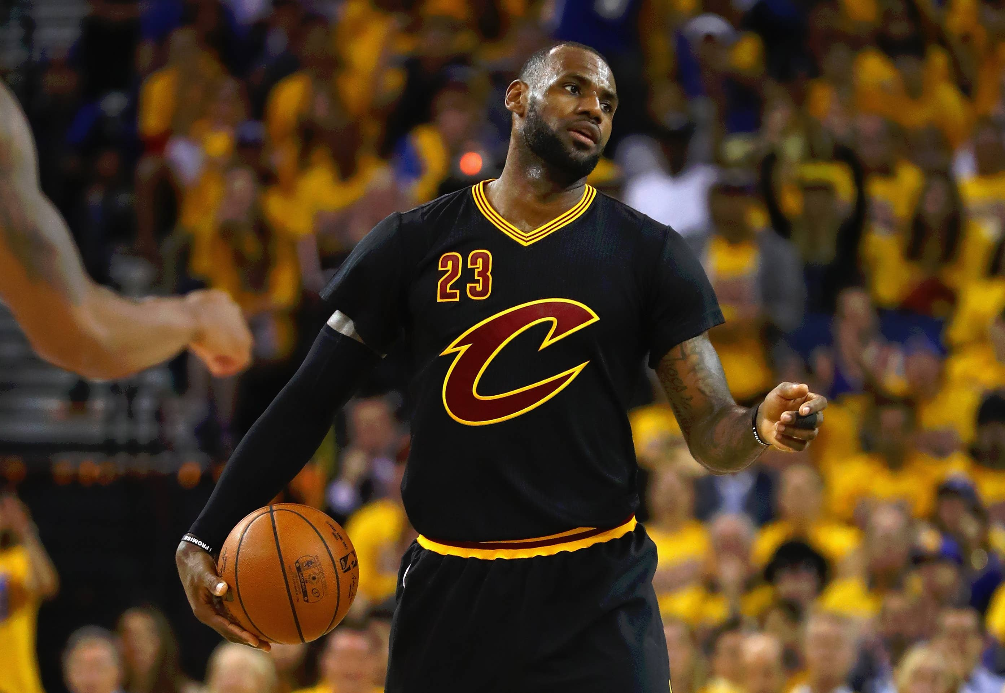
Lebron the GOAT of NBA
Lebron is considered for many the greatest basketball player of all time
There people who compare him to Michael Jordan, but everyone knows who is the goat

