Slide 1
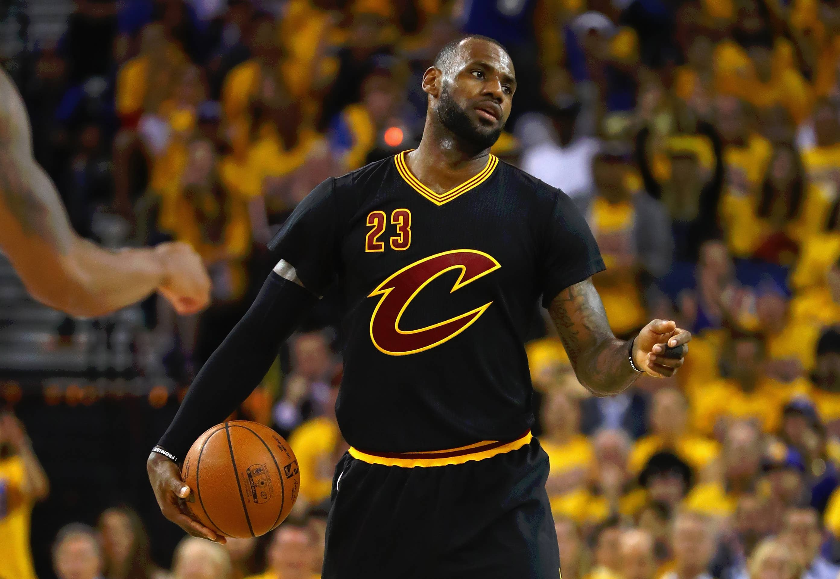
Test
Discussion on LeBron James being a top basketball player who has played for multiple teams and won titles during the pandemic bubble.
Mention of his career including stints with Cleveland Cavaliers, Miami Heat, and current team LA Lakers.
Comparison with Jordan, asserting LeBron's greatness in basketball.

