Slide 1
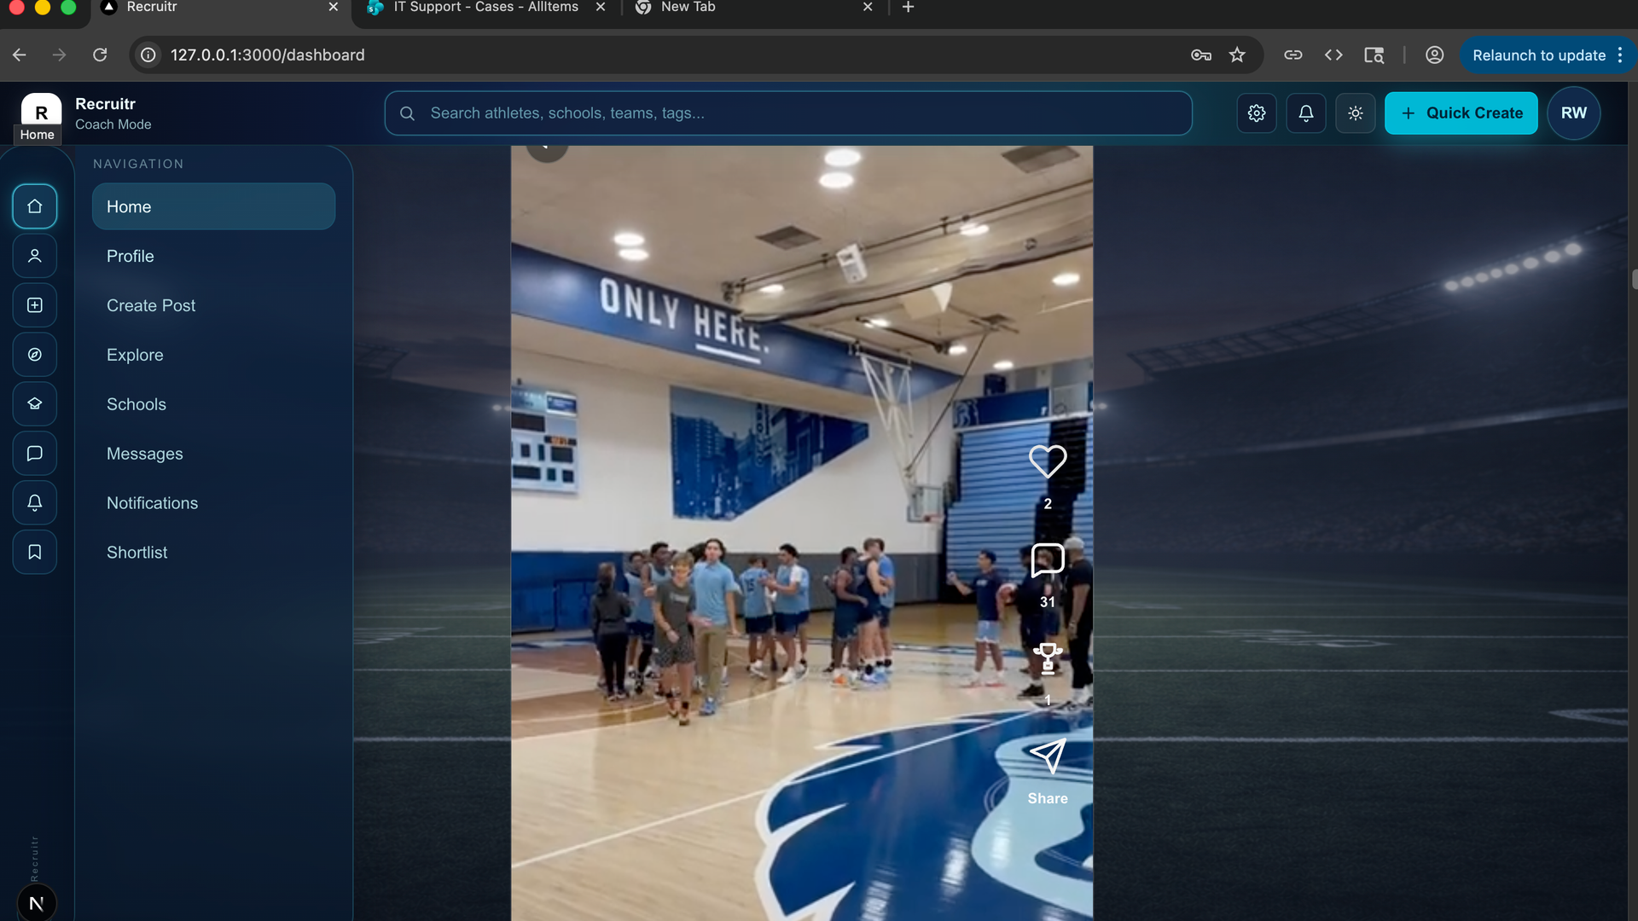
RECRUITR PRODUCT DEMO
Coach-first recruiting in one live feed
A short walkthrough of how a coach discovers athletes, evaluates fit, builds a shortlist, and moves a player toward signing.
Discover
Evaluate
Shortlist
Sign
R
Recruitr
Source imagery: live local app screenshots and provided mobile recording

Slide 2
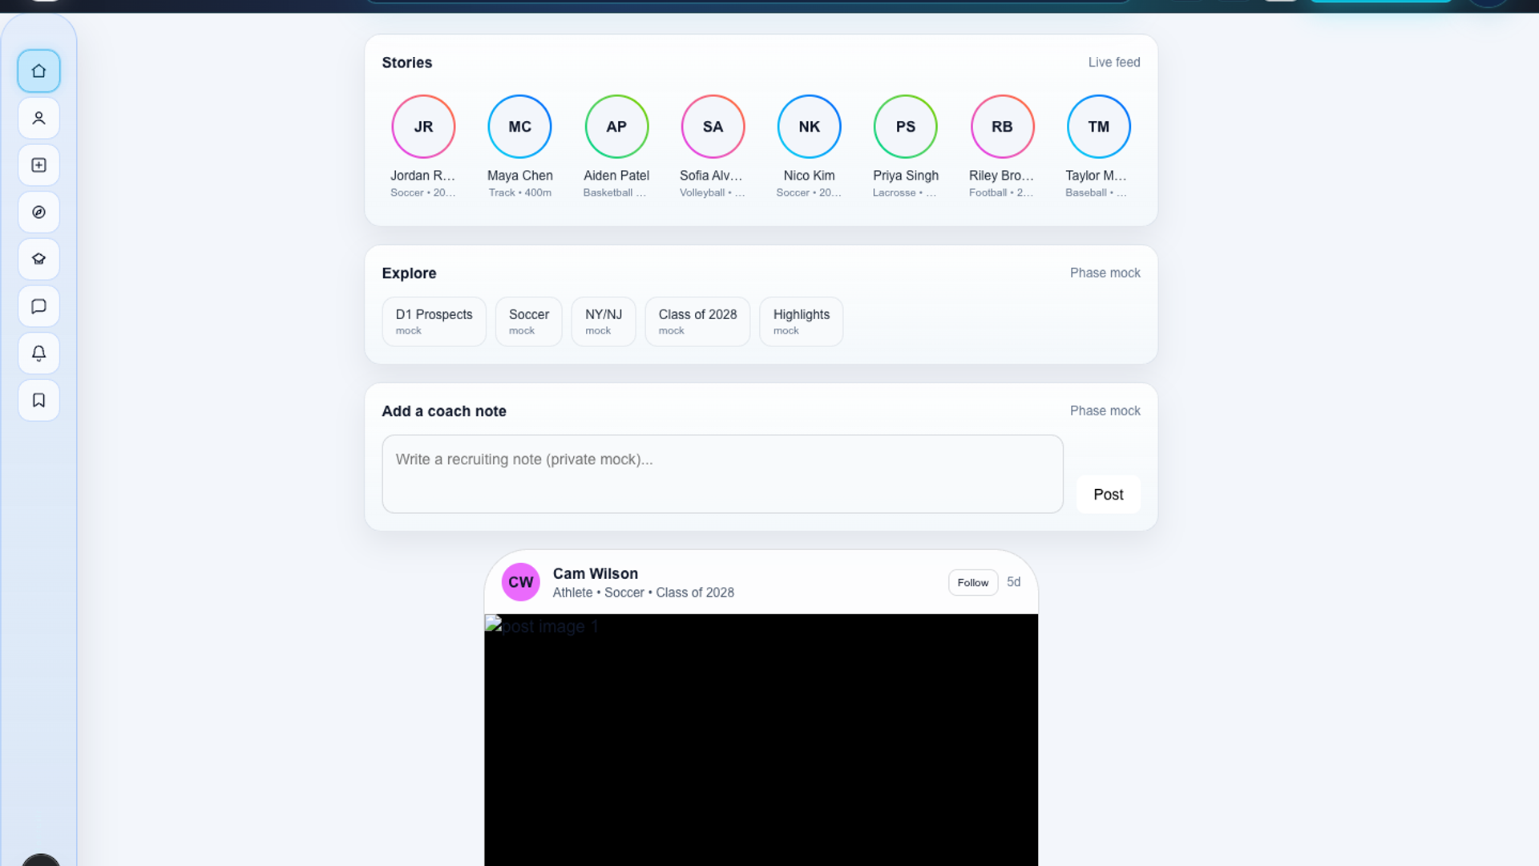
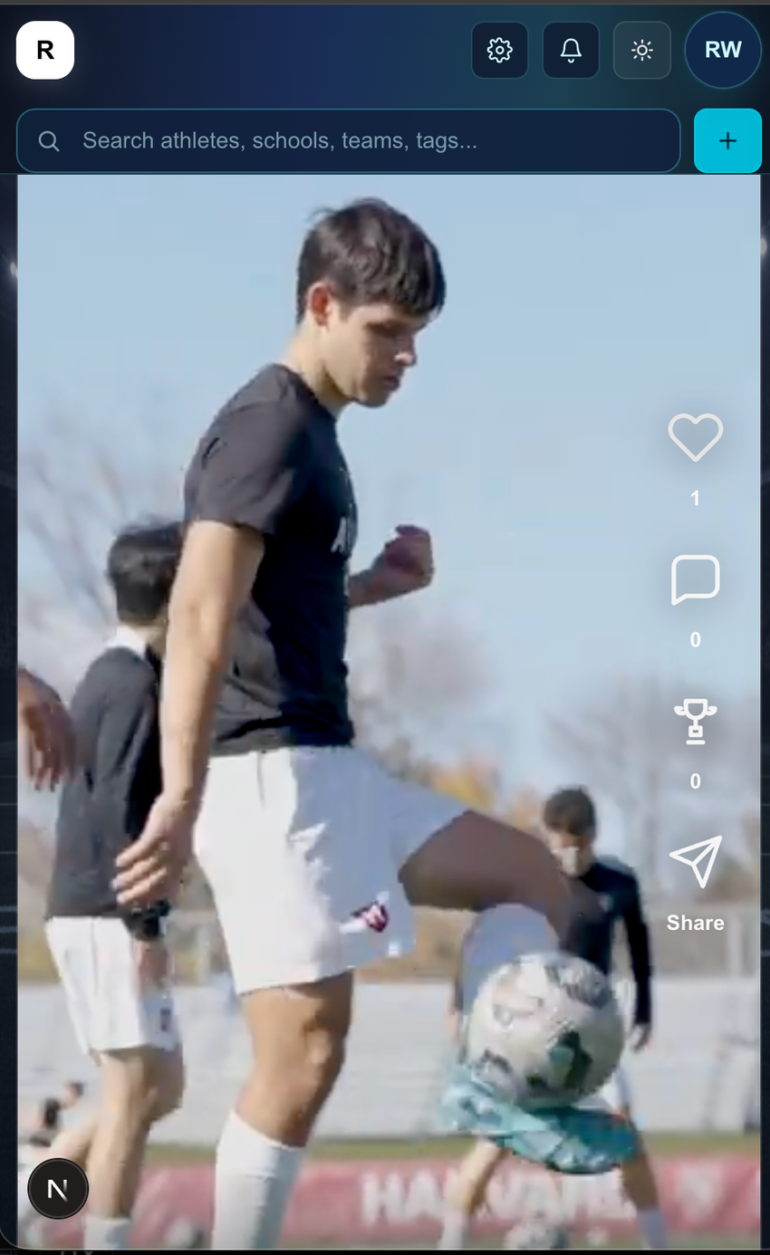
1. DISCOVER ATHLETES
Scroll the highlight feed like a recruiting board
Coaches browse vertical athlete clips, search the ecosystem, and keep key actions one tap away.
1
Watch real highlight clips
2
Use engagement signals
3
Search athletes, schools, teams
Recruitr demo workflow

Slide 3
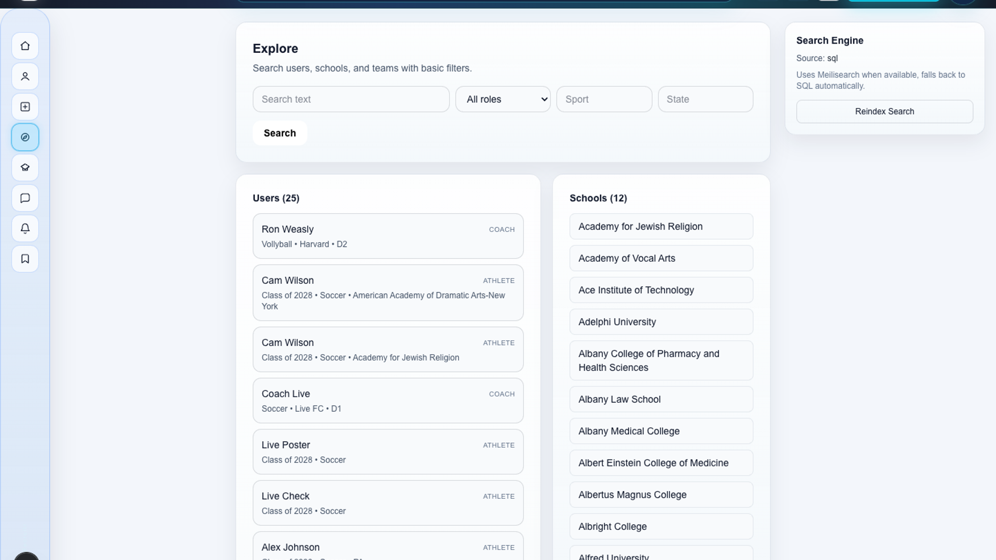
2. EVALUATE FIT
Search, filter, and open the right profile fast
Search athletes, schools, teams, tags
A coach can move from broad discovery to specific recruiting intent by sport, role, school, team, or tag.
Profiles
Teams
Schools
Recruitr demo workflow

Slide 4
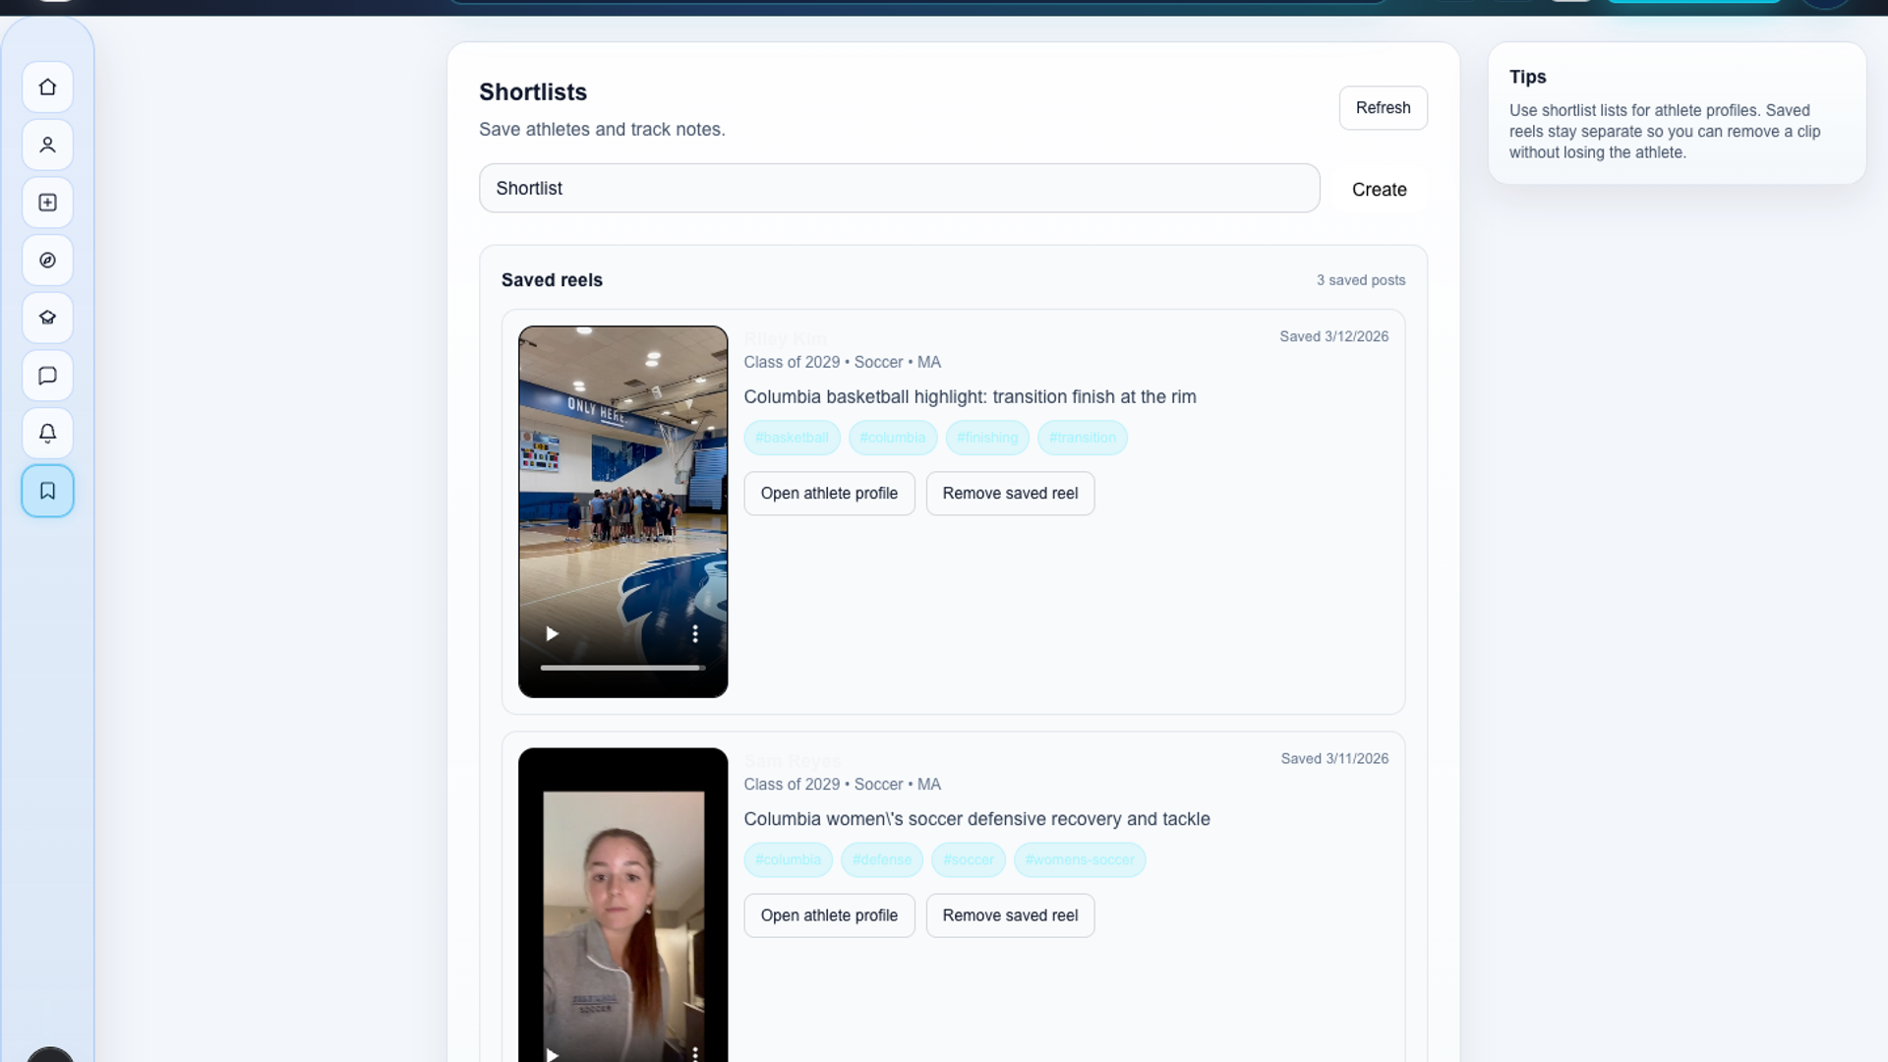
3. BUILD THE SHORTLIST
Save prospects and keep recruiting context together
1
Save athlete from feed
2
Compare notes and status
3
Move to outreach
Ready for next step
Recruitr demo workflow

Slide 5
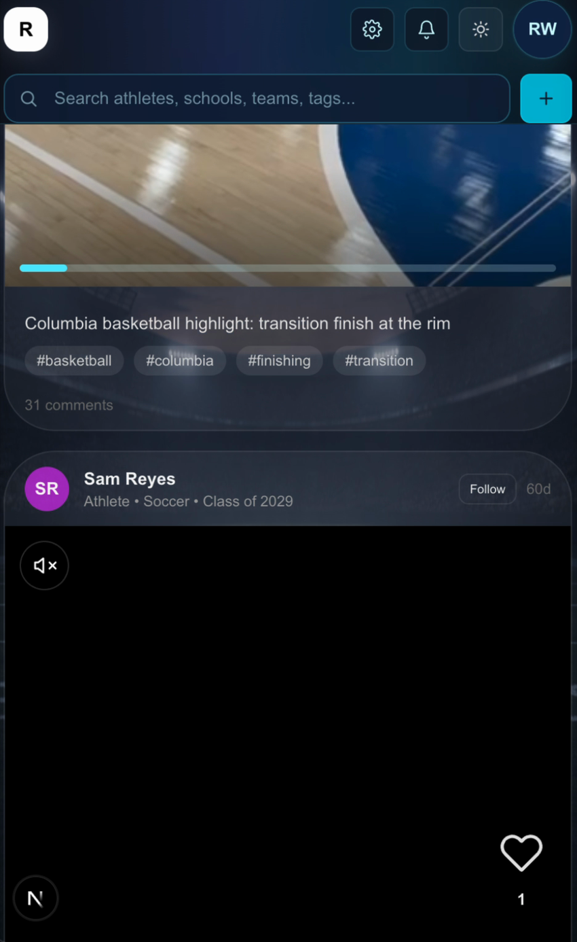
4. SIGN THE ATHLETE
Turn evaluation into a signed recruit
The story ends with a clear recruiting decision: the coach selects the athlete, sends the offer, and confirms the signing.
Recruiting action
SIGNED
1
Review final profile
Offer accepted
Roster spot confirmed
Coach notified in Recruitr
2
Send signing offer
3
Athlete accepts
Final slide can be swapped for an actual signing screen once that UI is finalized

