Slide 1
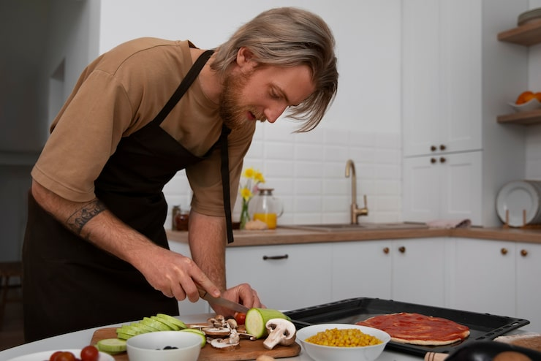
How to Become a Good Amateur Cook
Learn simple things that can improve your everyday cooking!
Freepik. Amateur Cook Preparing Food in a Home Kitchen. Photograph.
Accessed January 15, 2026. https://www.freepik.com.

Slide 2
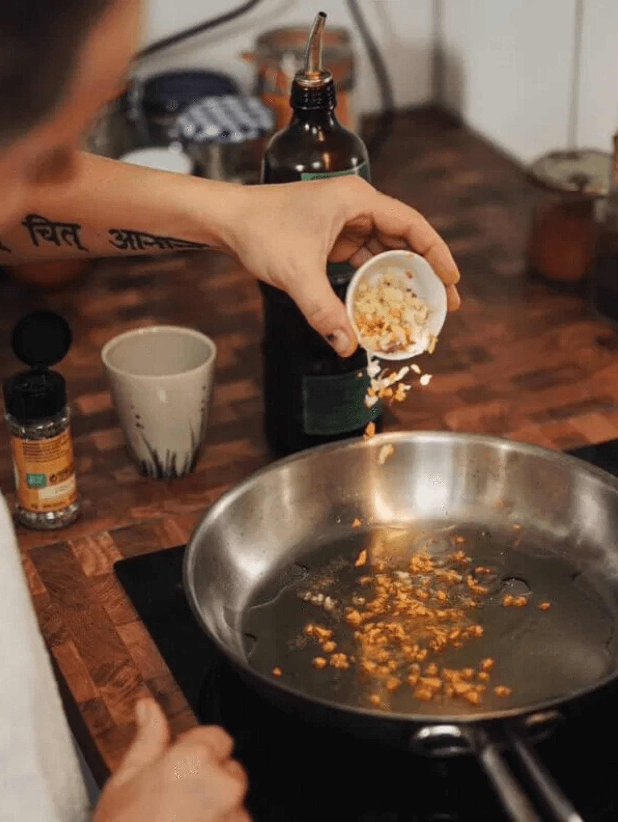
Cooking is a Skill Anyone Can Learn with Practice and Patience
Cooking is not an innate talent but a learnable skill that improves with repetition
Mistakes are part of the learning process and provide valuable lessons
Start simple and gradually build confidence with basic recipes
Enjoy the journey rather than focusing solely on perfect results
TasteToronto. (n.d.). Sanjeev Masala Co. launches in memory of legendary restaurateur. Retrieved January 15, 2026, from https://www.tastetoronto.com
02

Slide 3
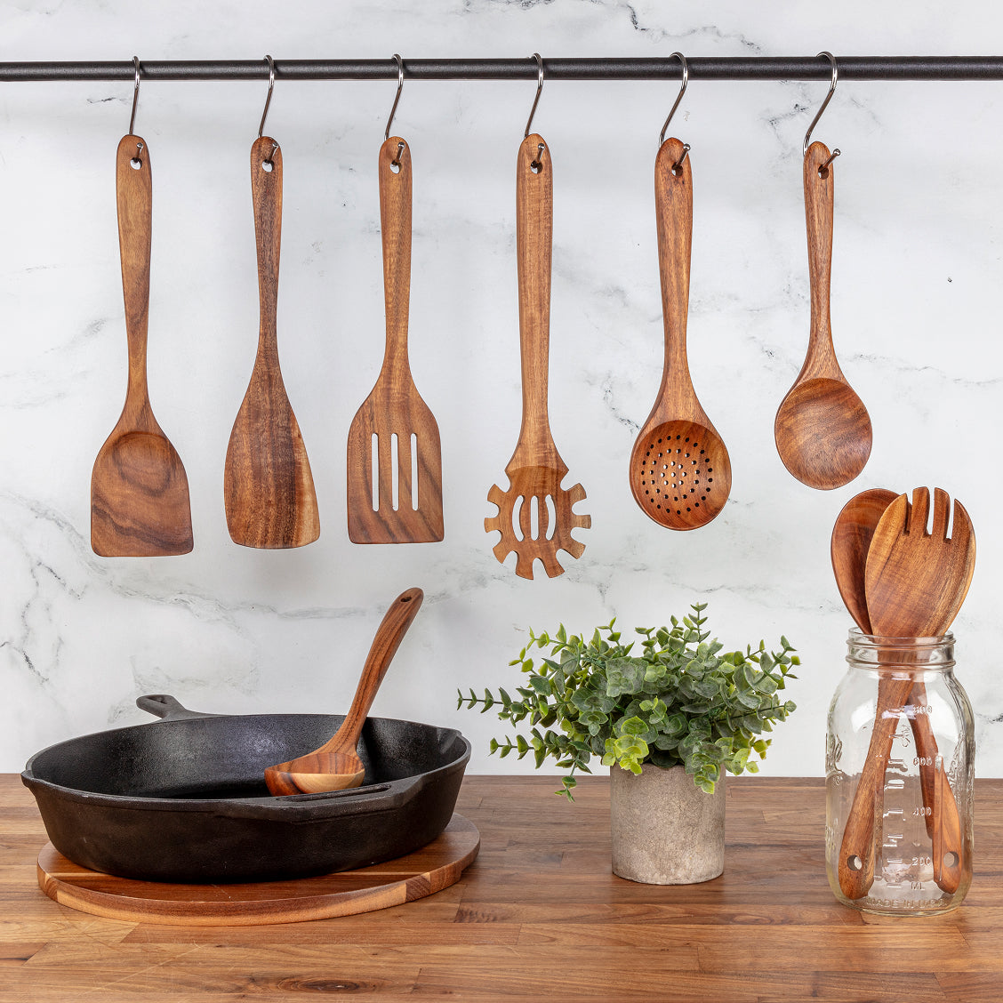
Quality Basic Tools Make Cooking Easier and More Enjoyable
A good chef's knife is the most important tool in any kitchen
Essential tools include cutting board, measuring cups, mixing bowls, and pots and pans
Start with basics before buying specialized
equipment
Quality tools last longer and perform better than cheap alternatives
03
Zulay Kitchen. Teak Wood Utensils Set. Product photograph. Accessed January 15, 2026. https://www.zulaykitchen.com

Slide 4
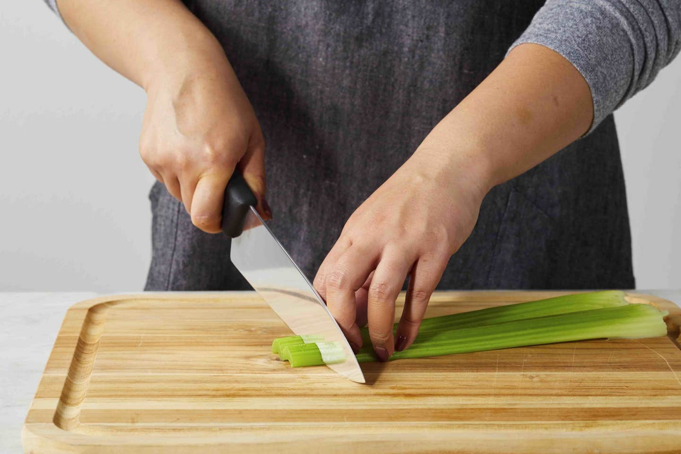
Proper Knife Techniques Improve Safety, Speed, and Consistency
Learn fundamental cuts: dice, mince, julienne, and chop
Keep knives sharp as dull knives are more dangerous than sharp ones
Practice cutting techniques with vegetables like onions, carrots, and peppers
Forks Over Knives. Knife Skills for Beginners: A Visual Guide to Slicing, Dicing, and More. Photograph.
Accessed January 15, 2026. https://www.forksoverknives.com
04

Slide 5
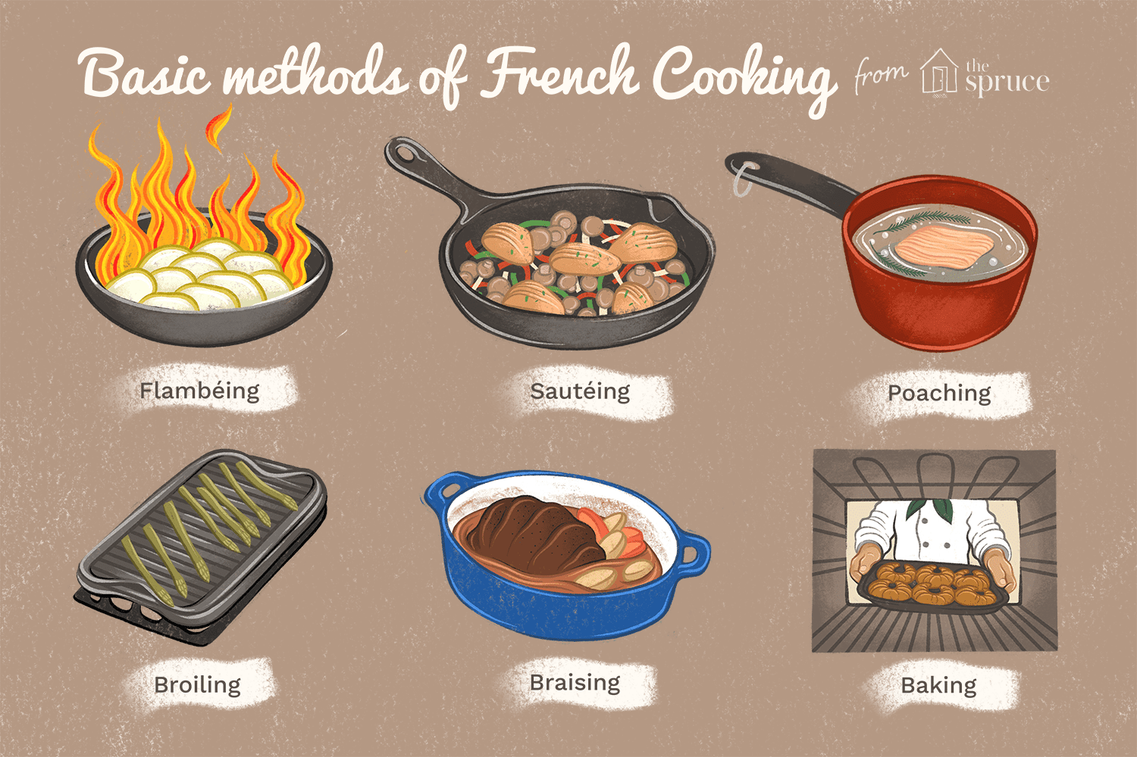
Mastering Core Techniques Unlocks Countless Recipe Possibilities
Learn essential methods: sautéing, roasting, boiling, steaming, and baking
Each technique brings out different flavors and textures in ingredients
Understanding heat control is crucial for proper cooking
Practice one technique at a time until comfortable
The Spruce Eats. Basic French Food Cooking Methods. Illustration.
Accessed January 15, 2026. https://www.thespruceeats.com.
05

Slide 6
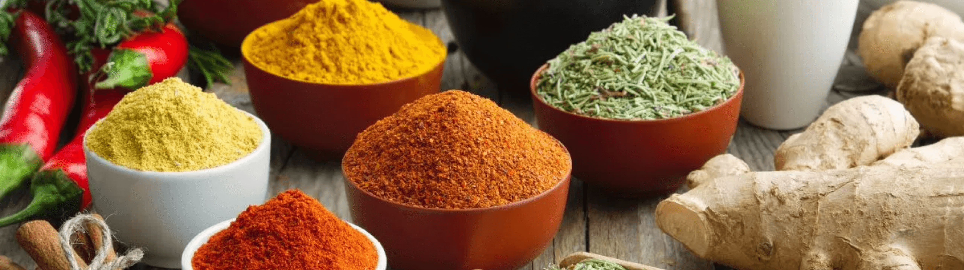
Center for Nutrition Studies. Spices and Herbs. Photograph. Accessed January 15, 2026. https://nutritionstudies.org
Proper seasoning transforms good food into great food!
Salt enhances natural flavors and should be added in layers throughout cooking
Taste food frequently and adjust seasoning before serving
Build a basic spice collection: salt, pepper, garlic powder, paprika, cumin, and herbs
Acids like lemon juice and vinegar brighten flavors and balance richness
Season with confidence but start conservatively and add more as needed
06

Slide 7
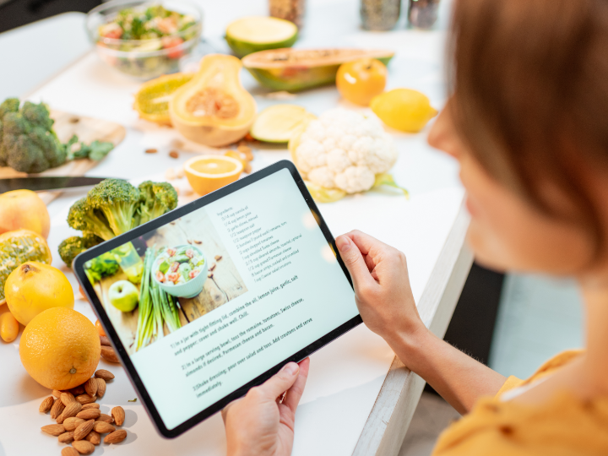
Recipes are Learning Tools that Teach Cooking Principles
Read the entire recipe before starting to understand the process
Follow recipes closely when learning but note why each step matters
Understanding principles allows you to adapt recipes and improvise
Keep a collection of reliable recipes that work for your skill level
Gradually experiment with substitutions and modifications as confidence grows
Adobe. How to Make a Recipe Book: Create a DIY Cookbook. Photograph.
Accessed January 15, 2026. https://www.adobe.com.
07

Slide 8
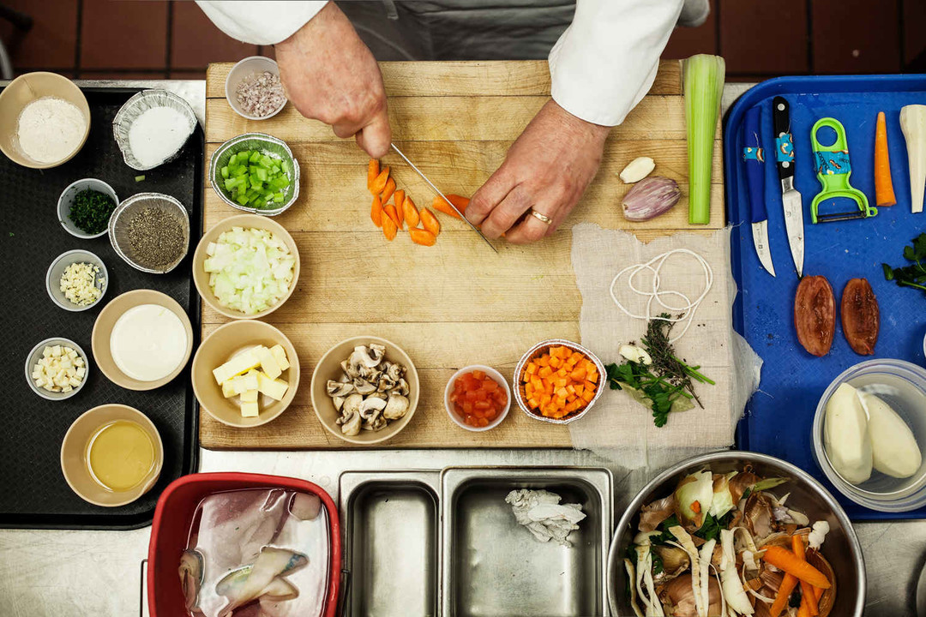
Practice Mise en Place
Preparation Before Cooking Reduces Stress and Prevents Mistakes
Mise en place means "everything in its place" in French
Prepare and measure all ingredients before turning on the heat
Organization prevents burning, overcooking, and forgotten ingredients
Clean as you go to maintain an organized workspace
Proper preparation makes cooking feel calm and controlled
LinkedIn. Mise-en-Place: A System for Getting Organized. Photograph.
Accessed January 15, 2026. https://www.linkedin.com.
08

Slide 9
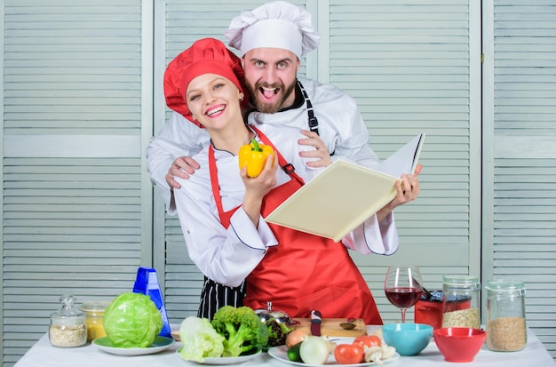
Cook Regularly and Try New Things
Consistent Practice Builds Skills Faster than Occasional Cooking
Cook at least several times per week to build muscle memory
Try one new recipe or technique each week to expand your repertoire
Learn from different cuisines to understand diverse flavor profiles
Track your progress by revisiting recipes you struggled with initially
09
Freepik. Book Recipes: Woman Chef and Man Cooking Food Together. Photograph.
Accessed January 15, 2026. https://www.freepik.com.

Slide 10
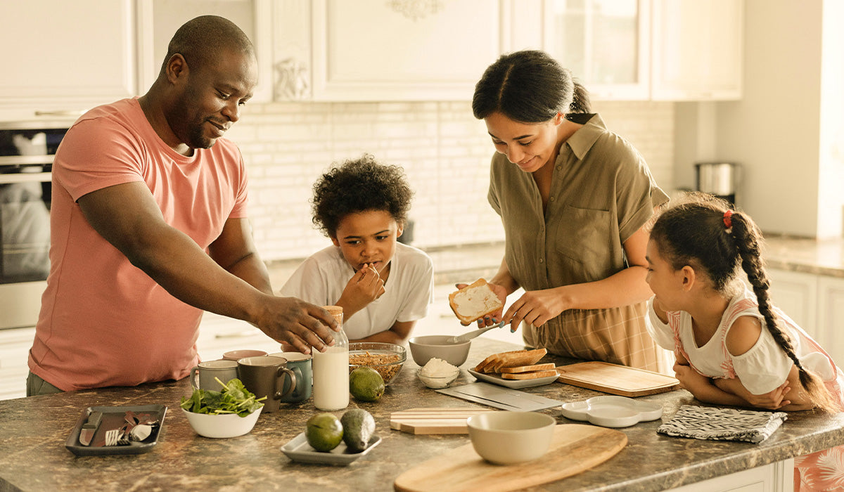
Cooking Becomes Rewarding When You Share It with Others
Cooking for others adds purpose and motivation to practice
Sharing meals creates connections and memorable experiences
Accept compliments graciously and learn from constructive feedback
Remember that becoming a good cook is a lifelong journey, not a destination
Happy Cooking!
Biora. 4 Cooking Tips for Delicious and Nutritious Family Meals. Photograph. Accessed January 15, 2026. https://www.biora.com.
10

