Slide 1
HLT Paths for VBF Higgs Study
João Pela

Slide 2
Introduction & Motivation
New HLT Paths have been developed and deployed with the aim of studying VBF Higgs Invisible decay
Two paths currently online:
  HLT_DiPFJet40_PFMETnoMu65_MJJ600VBF_LeadingJets_v*
  HLT_DiPFJet40_PFMETnoMu65_MJJ800VBF_AllJets_v*
Fluctuation in the rate of this HLT Paths was observed and needed to be explained.
Looking at the reconstructed objects in order to validate the triggers from an offline point of view.

Slide 3
Run Selection
Selected biggest run from each fill since ECAL spike cleaning got turned on again.
  No official certification available at the time
Run List: 190895, 190906, 190949, 191062, 191086, 191202, 191226, 191247, 191264, 191277, 191700, 191718, 191811, 191830

Slide 4
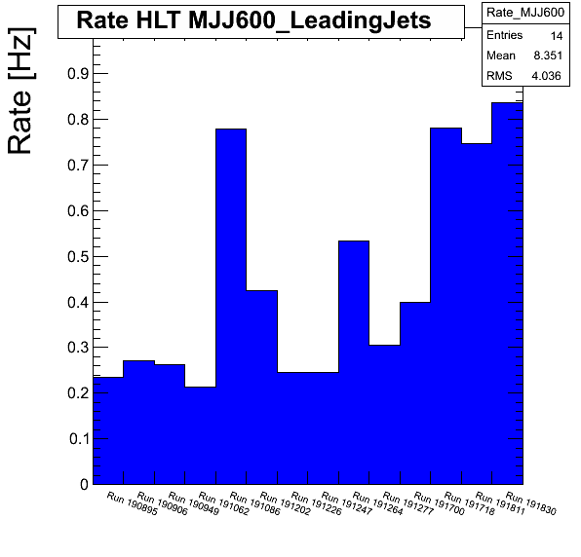
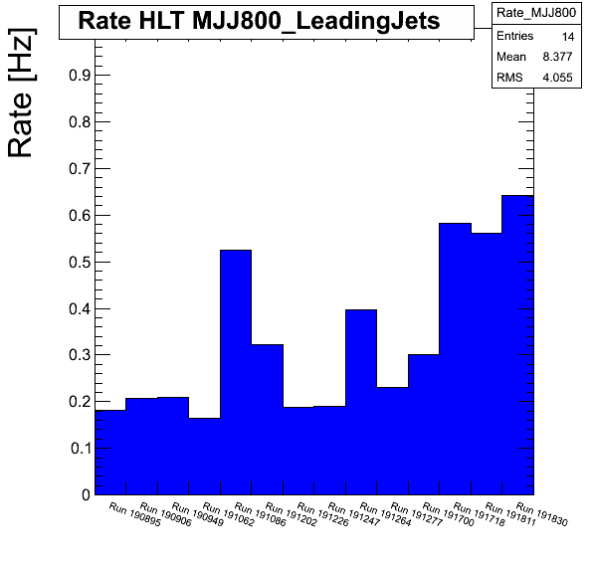
HLT Rates
Rate increased with the ramping of instant luminosity and pileup.

Slide 5
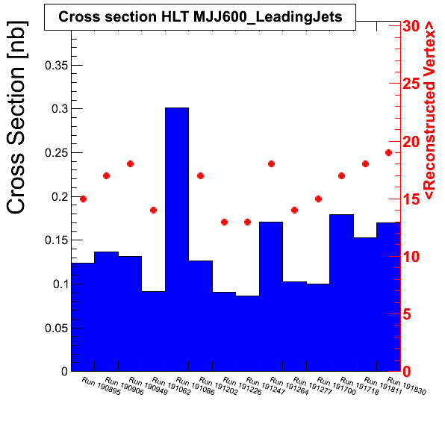
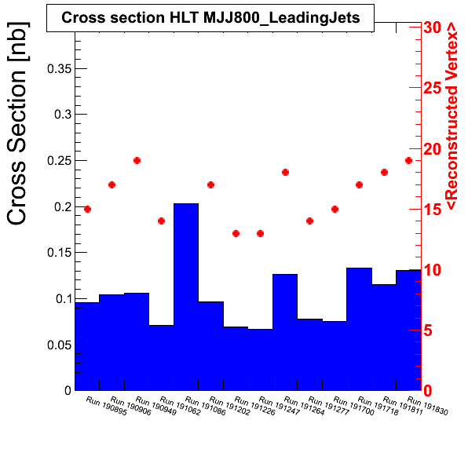
HLT Cross Sections
We can see a correlation between <PU> and Cross Section Variations. Also the problematic run shows no Vertex (found Pixels were off)

Slide 6
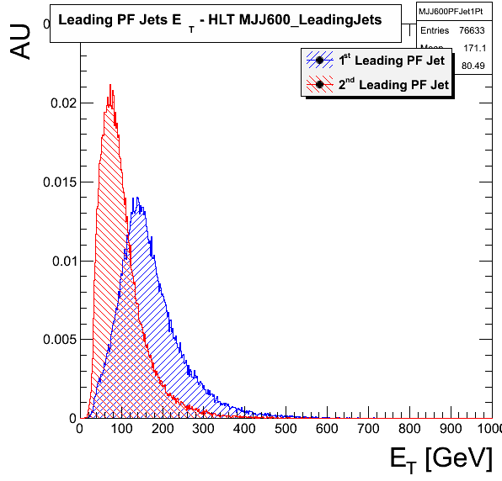
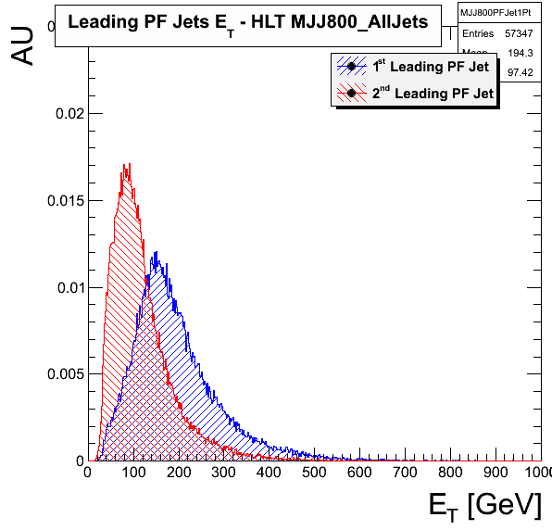
Jet pT
As expected 2nd Jet peaks at a much lower pT.

Slide 7
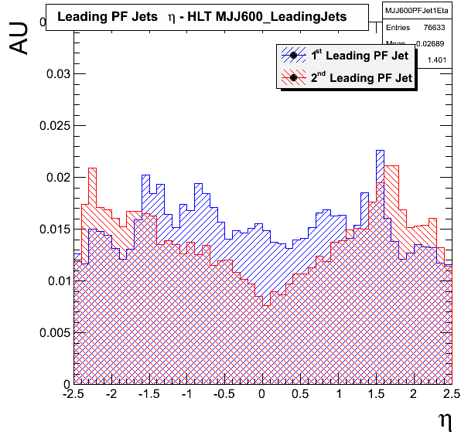
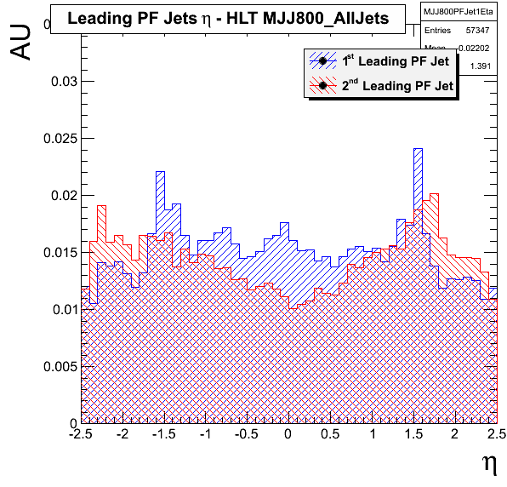
Jet Eta
Some asymmetry and spikiness that needs further investigation.

Slide 8
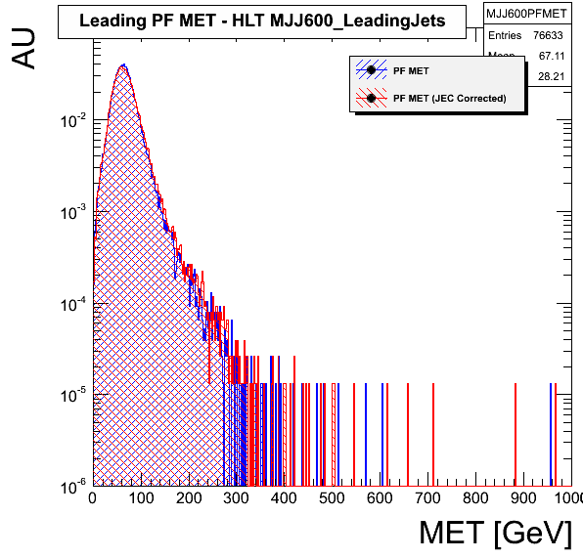
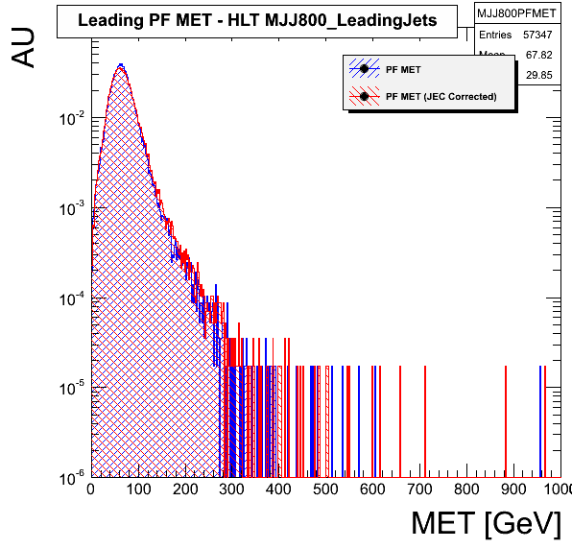
MET
Apparently Corrected MET differs more at High eT, will look into this.

Slide 9
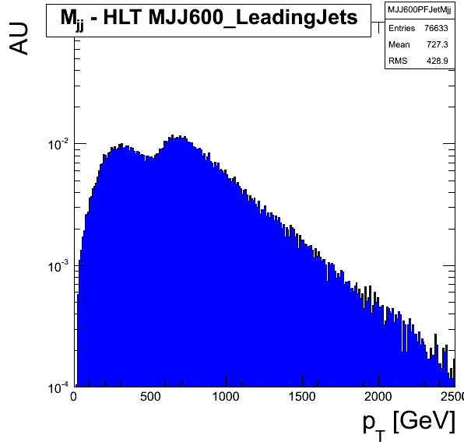
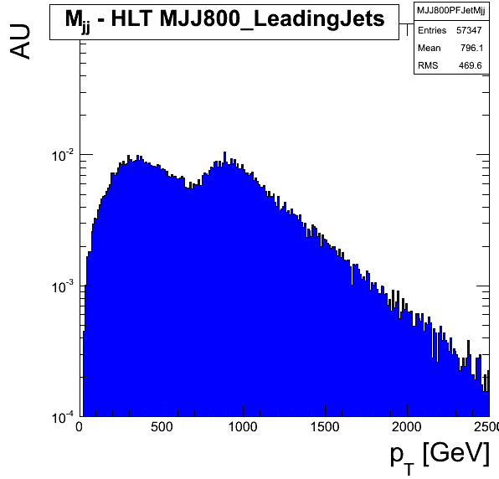
Leading Jet Invariant Mass
2 distributions in each plot:
  Leading jets == HLT Mjj selected jets
  Leading jets != HLT Mjj selected jets

Slide 10
Conclusions
Found the reason for the variation of HLT Path rate, it's mainly due to PU.
Basic reco variables seem to validate the HLT Paths, but further study should be done.
Some indications that we should use PF MET Type 1 Corrected specially for high MET events.
Next study of HLT objects and their matched reco objects.

