Slide 1
Spin Studies Status
J. Pela, M.Kenzie, D. Futyan, C. Seez
Imperial College London

Slide 2
Since last week...
Dropped the “two μ” analysis
  Results would be difficult to interpret.
  Plugin to existing tools not straight forward.
New approach, combined simultaneous fit to all categories
  Single μ for each model (SM Higgs and Graviton)
  Uses shape and relative yields information
  Can be directly plugged in to “combine” using existing two signal tests.

Slide 3
The procedure
Fit Signal Model to MC (SM Higgs or Graviton) independently in each category (BDT and Spin)
  Currently 3 Gaussian
Fix all parameters after the fit.
Create Extended PDF where the yield will be a product of:
  The total number of MC events passing cuts in that category
  Signal strength (same variable across all categories)
Create Sig+Bkg model
  With the already fitted Signal Model
  Add Background Model, currently a Pow2
Fit Sig+Bkg Model to to data simultaneously to all categories
Extract μ, fits parameters and yields.

Slide 4
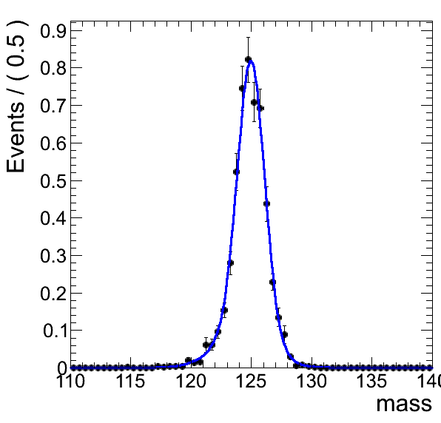
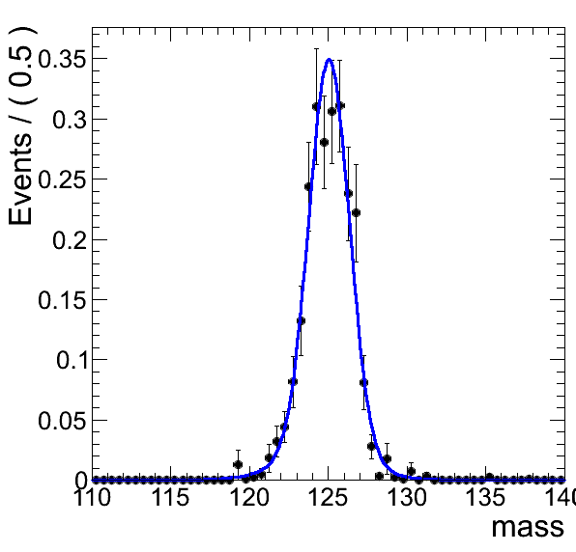
Signal Fits
SM Higgs
BDT0 Spin0
Graviton
BDT0 Spin0
Rest of plots here:

Slide 5
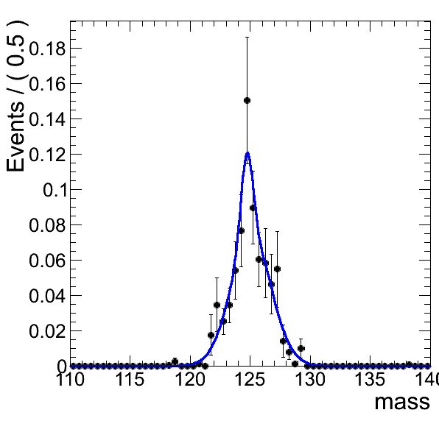
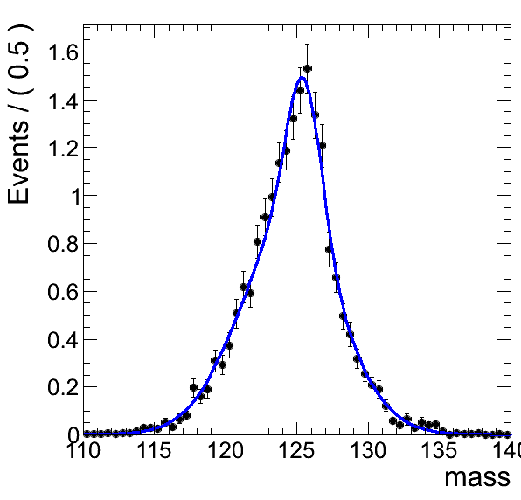
Some Strange/Pathological Fits
Graviton
BDT0 Spin1
Graviton
BDT3 Spin0

Slide 6
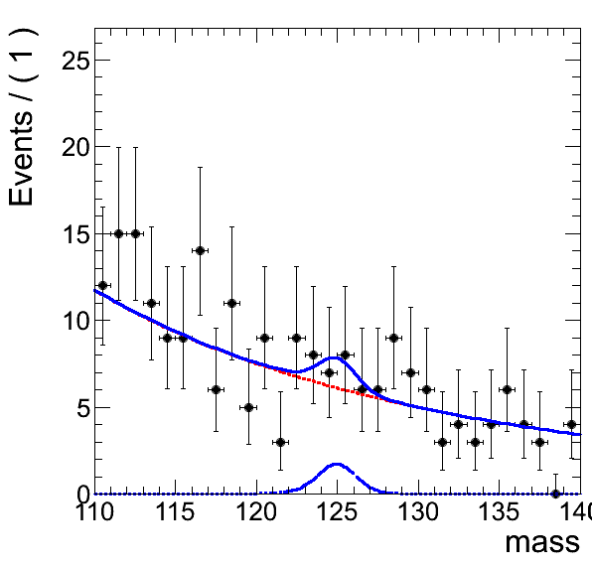
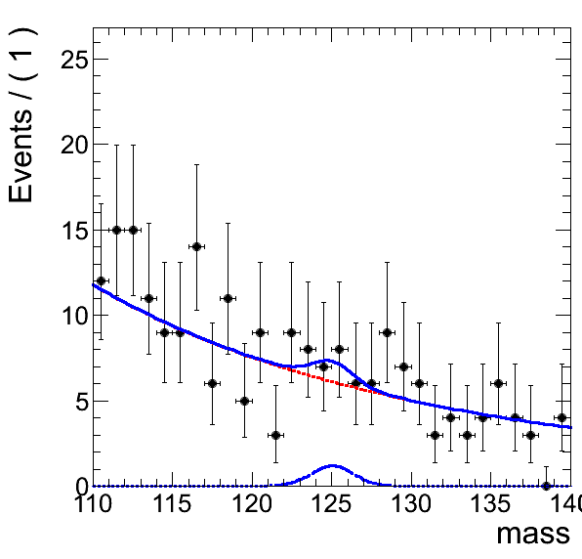
Fits to Data
Data
SM Model+Bkg Fit
BDT0 Spin0
Data
Graviton+Bkg Fit
BDT0 Spin0
Rest of fits:

Slide 7
Extracted μ
The results for 5.2fb-1 signal strength are:
  SM Higgs: 1.0862 +/- 0.0199645
  Graviton: 0.824353 +/- 0.0340936
This result assumes initial graviton cross section the same of SM Higgs, implies:
  Different total/relative yields of events across categories
  Since we are using simultaneous fit to all categories μ will be correlated with graviton cross section.
This results do not include systematics

Slide 8
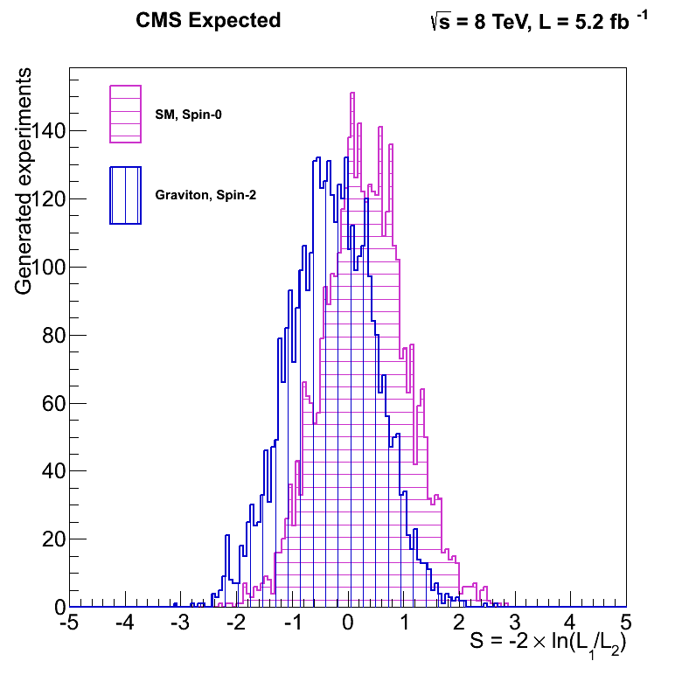
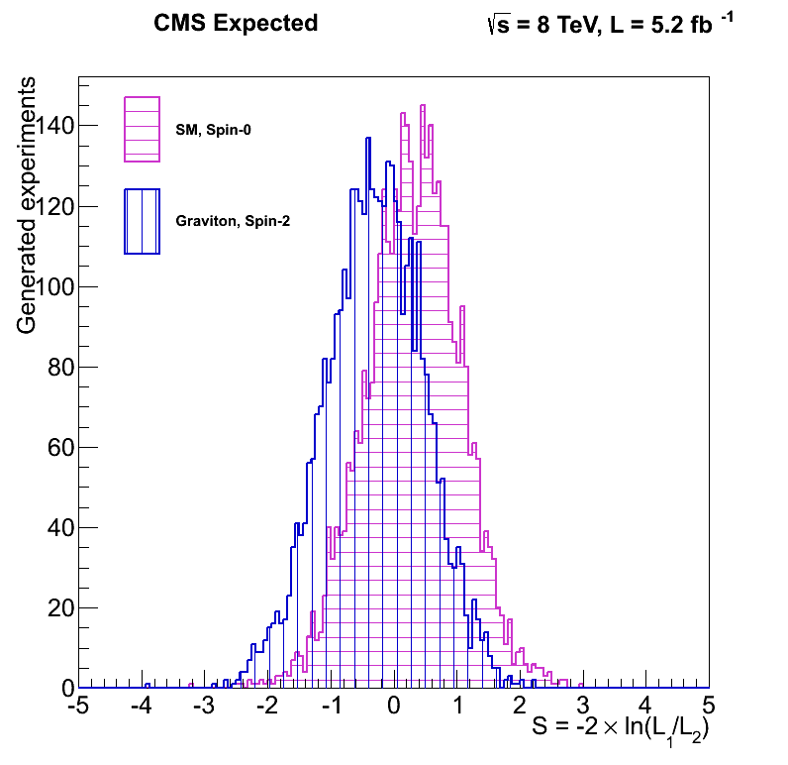
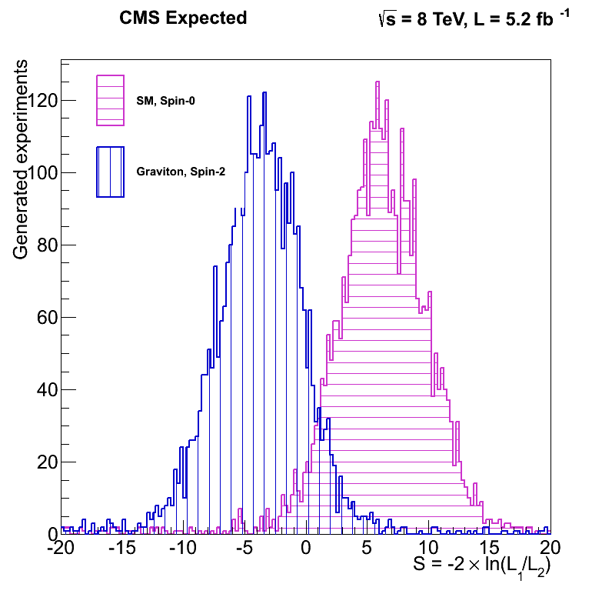
Signal Separation
Sig Separation Cut/Count (Refit)
Prob( q < median(P) | S ) = 0.2235 (0.760426 sigma)
Prob( q > median(S) | P ) = 0.24425 (0.692697 sigma)
Sig Separation Cut/Count (S/B Fit)
Prob( q < median(P) | S ) = 0.2055 (0.822135 sigma)
Prob( q > median(S) | P ) = 0.21775 (0.779815 sigma)
Sig Separation Parametric
Prob( q < median(P) | S ) = 0.0173936 (2.11083 sigma)
Prob( q > median(S) | P ) = 0.0102564 (2.31683 sigma)

Slide 9
Extrapolation
Basic implementation attempted
  Generate toys from Sig+Bkg Fit for 30fb-1 and fit each set with both hypothesis
Results
  Toys SM fit, SM Model Hyp.: 1.47751 +/- 0.213791
  Toys SM fit, Graviton Model Hyp.: 0.973175 +/- 0.211463
  Toys Graviton fit, SM Model Hyp.: 1.45687 +/- 0.21363
  Toys Graviton fit, Graviton Modelc Hyp.: 0.971839 +/- 0.211487
Code still under development (possibly buggy)
Other possibility generate toys from bkg only fit and inject signal from MC fits

Slide 10
Conclusions
Analysis progressing fast now
More work to be done in the signal extrapolation
Some open questions to deal with

