Slide 1
Spin Status
J. Pela
Imperial College London

Slide 2
Proposed binning method
A “simple” grid search for the best possible binning should able to find good results.
  Keep diphoton BDT categories, optimize in cos(Theta*)
Maximize a variable which shows the separation in terms of the errors (statistical and/or systematics) associated with the test models (A and B) and the backgrounds in the signal area(s)
Use where possible data information
  Background contribution in each category
  Expected signal Yield(?)

Slide 3
Maximized Variable
In order to define the best binning we must define a variable that reflects how much each bin is able to separate Models A and B.
Systematics like fit uncertainty or MC statistics can be include to see the influence in the end result
Currently the background estimation, from fitting side bands on data, is not implemented so we get:

Slide 4
Combinations
Found some articles from ~1970, where algorithms for getting all the combinations from a set of elements are described
Implemented a version of such algorithm, which is based on the ideia:
  11100
  11010
  11001
  10110
  (…)
  00111

Slide 5
Normalization and Models
Since both models will typically have different acceptances on experiment and all samples weights where calculated assuming SM Higgs cross section, implemented Normalization to of Model B to Model A (SM Higgs), by:
  BDT bin
  Global number of entries
This can in principle be done to the data yield in terms of the extracted signal from fit.
Tested both available models on official samples: 2PM and 2LP

Slide 6
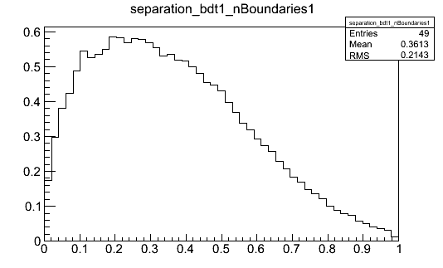
Example of running over Models
Single boundary study for 0P versus 2PM on Diphoton BDT bin 1
Axis
  X axis: Boundary position
  Y axis: Value of test variable
This is the expected behavior so implementation looks correct

Slide 7
Conclusions
First function implementation of the code.
  Results out (very) late last night. Still digesting...
  Indications that some improvements will come from this method.
Implementation of background estimation from data underway.
Next systematics study.

