Slide 1
L1 DQM Tests Summary
J. Pela, P. Musella
LIP Lisbon

Slide 2
What's new
New version of the L1T DQM Online tests is ready and being tested for deployment.
New features:
  L1T Occupancy Monitoring (will be on trial for some time so we can define thresholds for the test)
  Re-implementation of L1T Rates Monitor in order to be sure all information taken correctly from SCAL
  Manual shift of GT Rates LS number (to correct from bug in SCAL side)
  New L1T DQM Summary plots for all preformed plots.

Slide 3
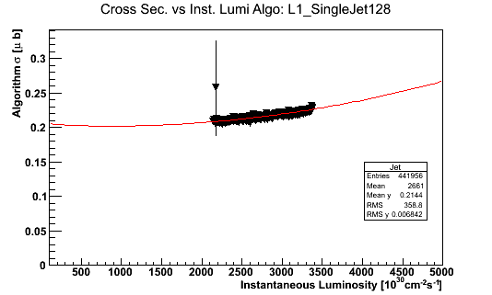
Monitored variable
We Monitor variables and plots associated with the level 1 trigger
Currently we monitor rates, occupancy and occupancy

Slide 4
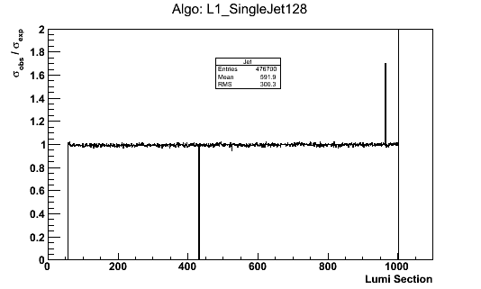
Test Result
For each monitored variable we produce a plot with the test result per luminosity section

Slide 5
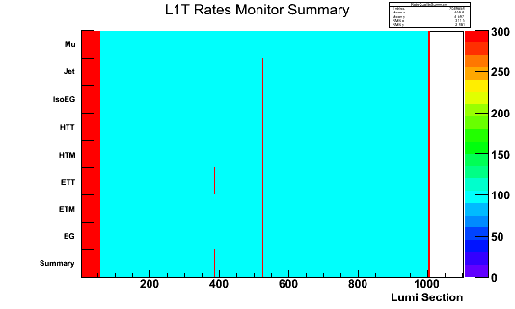
Test Summary
A summary of all tested objects/plots of a given test is now produced

Slide 6
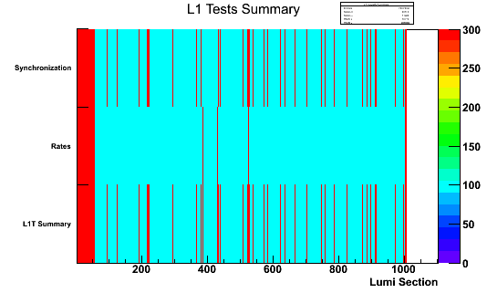
L1T DQM Tests Summary
A global summary of all tests is produced
Global Flag is the worst of all tests preformed for that LS

