Slide 1
Current L1 Calorimeter
Trigger Weakpoints
L1 Calorimeter Trigger already limits some physics reach
  Tau, multi-jet, H_{T} triggers and single electrons at 14 TeV, 2 x 10³⁴
Taus are kludge on jets
  12x12 region sums are way too large making tau trigger impossible to use already
Multi-jet and H_{T} trigger suffer from pileup
  Latest GCT firmware fix helps some, but we could do better
Jets in HF region are dominated by pileup
  Currently using coarse granularity at high eta
Isolation regions are too narrow around eGamma
  Can we benefit by larger isolation cones?
  Can we subtract off pileup contribution if using larger cones?
2015 Intermediate upgrade option attempts to fix some of these issues
Sridhara Dasu (Wisconsin)

Slide 2
Adiabatic Upgrade Plan
Every shutdown should result in tangible improvements
  2012 Examples
    RCT eGamma isolation, GCT jet seed
  2015 Possibilities with partial upgrade (using prototypes)
    Tau using narrow regions (2x1) feeding off eGamma path
    Better lepton – jet separation
    Pileup mitigation for lepton isolation
    Pileup mitigation for jets
    Improved P_{T} and position resolution for jets at GT
    PU jet cleanup in HF region for VBF tag jets
  2018 Goals with fully upgraded CaloTrigger + HCAL
    Full plans outlined in Technical Proposal
    Half-tower resolution
    Much less constraints on potential algorithms
Sridhara Dasu (Wisconsin)

Slide 3
2015 System
Copper
DTTF
x1
Global Trigger
microTCA
GT
Optical
GMT
RPC
GMT
Concentrator
CSCTF
New GT algo part with all objects in one chip!
Wheel Cards
x1
Leaf Cards
microTCA
Layer 1 (GCT)
Old system continues to work as now
oRSC
x1
microTCA
Layer 0 (RCT)
JSC
EIC
RC
New CT system in parallel provides improved algorithms: PU subtraction, forward tag jets…
ECAL
HB/HE
micro HF
Sridhara Dasu (Wisconsin)

Slide 4
2015 Algorithms
2x1 candidate is e/γ/τ using
E+H & dropping H/E cut
L-Isolation (local) for e/γ/τ
If 4x4 is EM rich it is e/γ candidate (reprogramming RCT LUTs with H/E)
PU Correction by 4x4 truncated mean
Core Relative isolation:
(4x4 – PU – 2x1) / 2x1 < cut
Jet defined by 12x12
Using PU corrected 4x4
Relative Jet Isolation:
(12x12– 2x1) / 2x1 < cut
Sridhara Dasu (Wisconsin)

Slide 5
2015 Algorithms
Input (by reprogramming current RCT)
  1x2 or 2x1 cluster energies iso/non (for e/γ & τ EGTCands)
    Combine E+H goes to EIC with H/E disabled
    The EGT candidates are formed with optional L-isolation
  1-bit classification of 4x4 region as EM rich or not
    To separate e/γ & τ
    Define EM active towers with E > threshold + H/E < cut
    Use existing τ-veto logic to find regions that are EM rich by requiring that EM energy is confined to 2x2 tower patterns
  4x4 region energies pileup corrected
    For computing jets (12x12) / MET and also isolation of e/γ & τ
    Compute relative isolation in both 4x4 regions and 12x12 jets
    Finer granularity HF information for jets
Output (compatible with old or new GT)
  Jets, MET, isolated and non-isolated e/γ & τ
Sridhara Dasu (Wisconsin)

Slide 6
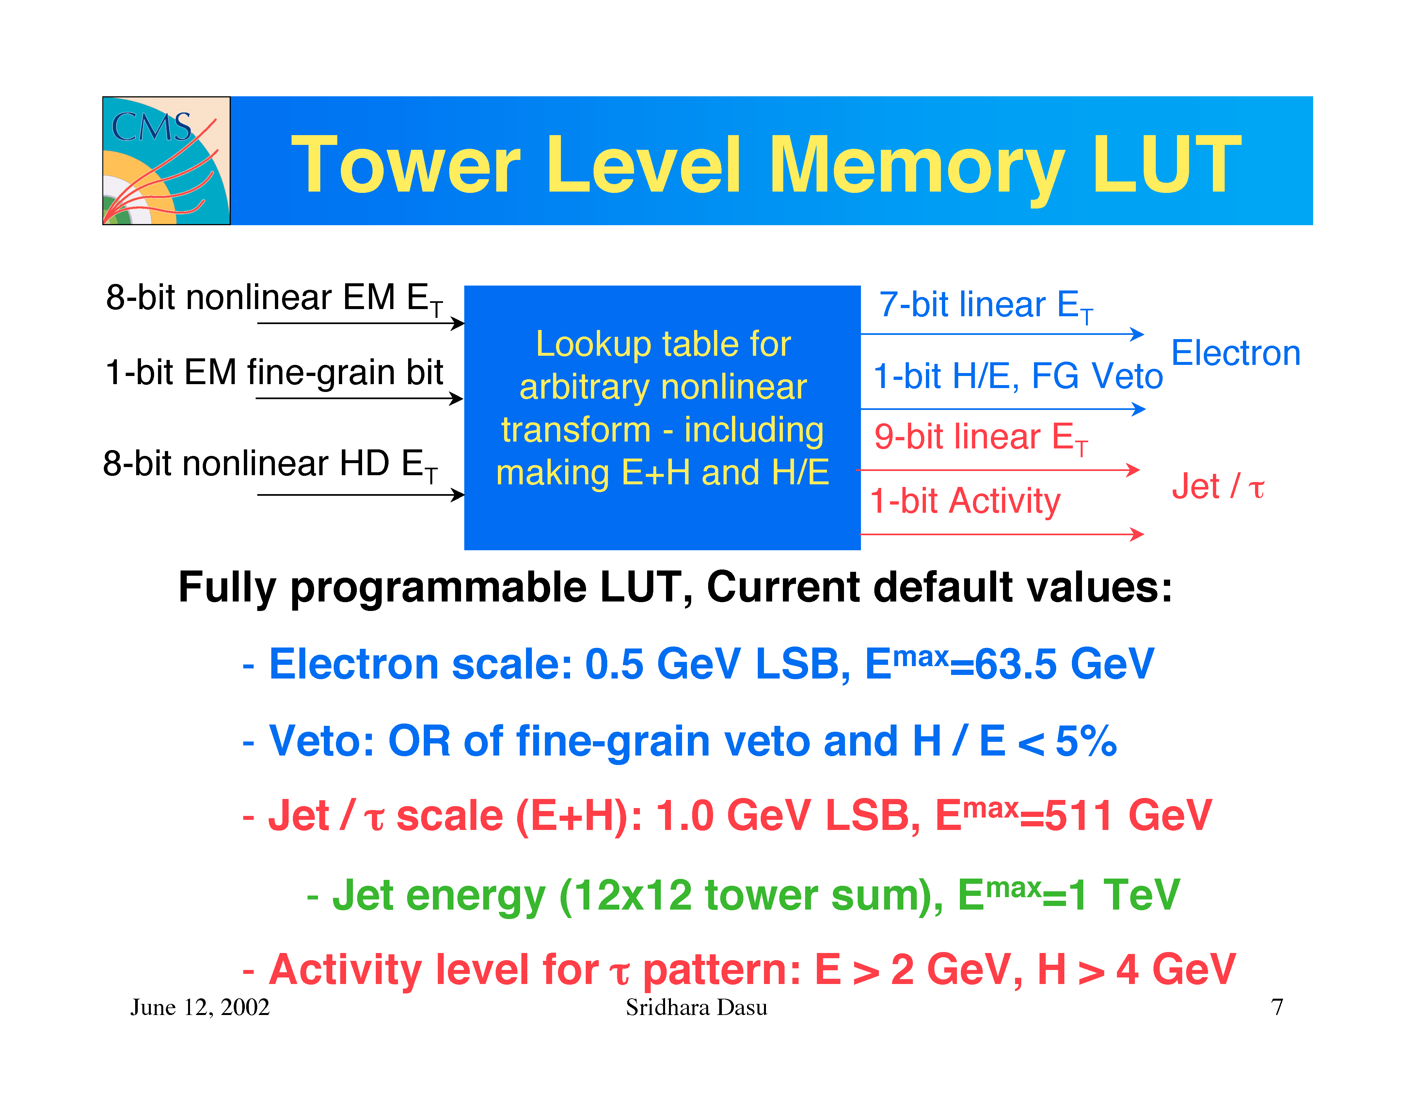
Current RCT LUT (from 2002)
Sridhara Dasu (Wisconsin)

Slide 7
2015 RCT Configuration
Scale for e/γ/τ (E+H): 1 GeV LSB, E^{max} ⁼ 127 GeV at tower level
  May need to use HSB to preferentially sort e/γ to top
H/E and FG Veto: Turned off so that e/γ/τ work
  EIC ASIC/card computes 1x2 or 2x1 cluster with E+H w/ L-iso, so it can be used for electron/tau
Jet scale (E + H): 1 GeV LSB, E^{max}=511 GeV at tower level
EM activity bit calculation: Use only E > 2 GeV, H/E < 0.05 to identify EM rich regions
  Existing tau logic identifies patterns in 2x2 as EM rich -- now used for splitting e/γ from τ
  Both EIC information and 4x4 E_{T} and region activity bit (for ID) and energy (for isolation) information need to be in one place
  Present GCT leaf cards get either EIC or 4x4 E_{T} information ☹
  New CTP card gets all of this information from the entire RCT in one FPGA ☺
    Use isolation based on Pileup subtracted 4x4 or 12x12 regions for “extreme” isolation
Sridhara Dasu (Wisconsin)

Slide 8
Simulation Status
First version of UCT2015 Implemented
  UserCode/dasu/UCT2015
  It is a simple analyzer to try out algorithms
  Proposed algorithms for |η| < 3 implemented
  Input from current RCT emulator
    Can run on available TPGs from real RAW data
  Requires small change to RCT
    Head of L1Trigger/RegionalCaloTrigger
    Implements UCT L1RCTLookupTable configuration with a kludge to work with upgrade or not
Initial results (< a day old) today – more later
  Tuning of parameters is needed
Sridhara Dasu (Wisconsin)

Slide 9
Pileup Correction
Uses truncated mean to subtract pileup
void UCT2015::puSubtraction()
{
puLevel = 0;
int puCount = 0;
for(L1CaloRegionCollection::const_iterator newRegion =
newRegions->begin();
newRegion != newRegions->end(); newRegion++){
if(newRegion->et() <= puETMax) {
puLevel += newRegion->et(); puCount++;
}
}
puLevel = puLevel / puCount;
}
Sridhara Dasu (Wisconsin)

Slide 10
Jet Finding
3x3 PU subtracted sums of 4x4 regions requiring central region greater than a threshold and neighbor region E_{T}s, avoiding double counting
if(regionET > jetSeed) {
if(regionET > neighborN_et &&
regionET > neighborNW_et &&
regionET > neighborWR_et &&
regionET > neighborSW_et &&
regionET >= neighborNE_et &&
regionET >= neighborE_et &&
regionET >= neighborSE_et &&
regionET >= neighborS_et) {
unsigned int jetET = regionET +
neighborN_et + neighborS_et + neighborE_et + neighborW_et +
neighborNE_et + neighborSW_et + neighborSE_et + neighborNW_et;
…
jetList.push_back(L1GObject(jetET, jetEta, jetPhi, "Jet"));
Sridhara Dasu (Wisconsin)

