Slide 1
VBF H(inv) - Trigger Strategy 2015
J. Pela on behalf of the VBF H(inv) analysis members

Slide 2
2012 Trigger
We ran a suite of triggers with different thresholds and variations in logic
  With the main goal of robustness
The trigger used for the signal region was :
L1
  MET > 40 GeV
HLT
  Di-jet pair : pT > 40 GeV, fwd/bkwd, Δη > 3.5, Mjj > 800 GeV
  METNoMu > 65 GeV
Use of METNoMu provides samples of W(mu) and Z(mumu) for background estimation
We also ran parked triggers with reduced jet pT and Mjj thresholds
  Will not replace these in 2015

Slide 3
2015 Strategy
Signal Trigger
  HLT
    As for 2012 with raised thresholds
    Some possible additions to minimise threshold increase :
      PU jet removal
      QCD rejection using Δϕ(jet, MET)
  L1
    Need to add jet conditions to reduce MET threshold
    See next slides
Control Trigger
  One issue from 2012 analysis was stat. uncertainty in trigger efficiency measurement
  Anticipate prescaled control trigger for measuring signal trigger efficiency
    eg. di-jet + MET (with no VBF conditions)
  Need to study requirements : sample size, thresholds, prescale

Slide 4
Level 1
2012 signal trigger seeded by L1_ETM40
  Slow trigger turn-on results in offline threshold of 130 GeV
  Anticipate threshold of 70 in 2015 (PU40bx25)
Upgrades
  L1 will be upgraded during 2015 and 2016, increasing capabilities at each step
  Aim to study 1-2 options for each scenario (Legacy, 2015, 2016)
Legacy
  MET
  (Di)jet + MET + Δϕ(jet, MET)
  Dijet + MET + Δη(jet, jet) ?
Stage 1 (2015)
  MHT/HTT
Stage 2 (2016)
  Dijet + MET + Mjj
VBF selection, may be ineffective due to PU
QCD rejection

Slide 5
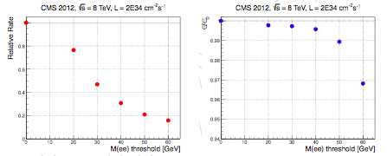
Invariant Mass
Full L1 trigger upgrade (2016) will include invariant mass calculation
Already shown to be useful in di-EG and di-muon triggers (L1 Upgrade TDR)
Past studies (J Pela) have indicated this can be useful for VBF H(invisible)

Slide 6
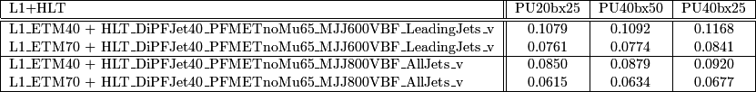
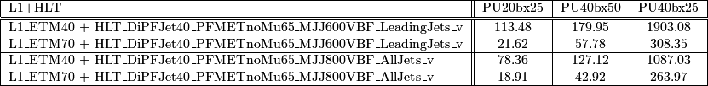
Legacy system (baseline )
We can define a baseline by just updating the seed of our HLT paths to the lowest unprescaled L1 ETM available trigger.
  In the current draft menu this is L1_ETM70
With the help of neutrino gun samples we can calculate VBF H(inv) signal efficiency:
By raising the seed from L1_ETM40 to L1_ETM70 we lose ~30% signal efficiency.
  This is a tolerable efficiency loss but we aim at improving algorithms both on the L1T and HLT sides
We can now calculate the expected pure HLT rates for this paths.
HLT pure rates drop significantly to ~20Hz on first scenario
  HLT PU subtraction should further lower this rates.
At the last PU scenario rates become too high. We can again do the exercise of raising the seed, but at this point we should have in place a better trigger with more options.

Slide 7
Plan
Study L1 seed options
Implement the path in HLT ConfDB
Run on data / MC
  Trigger efficiency
  Purity after analyses cuts
  Rate estimates
  CPU timing measurements
Strategy & code for validation of the triggers
  how ? if not using DQM, why not ?
Strategy for efficiency estimates from data
  which samples will be used ?
  which other triggers will it rely on ?
Aim for baseline triggers & implementation by October TSG Workshop
Joao
Jim
Jim / Chayanit
Expand existing VBF DQM code - Phat
Single muon +
our own control trigger

