Slide 1
Spin Studies Status
J. Pela and the IC Spin People
Imperial College London

Slide 2
Since last week...
A bit busy on other stuff
  I am the L1 DoC for this week (last time for 2012...)
  PhD 9 Months report... done
On the Spin analysis
  Looked at the contribution of Endcaps to:
    Each signal category
    Contribution to signal mass “shapes”

Slide 3
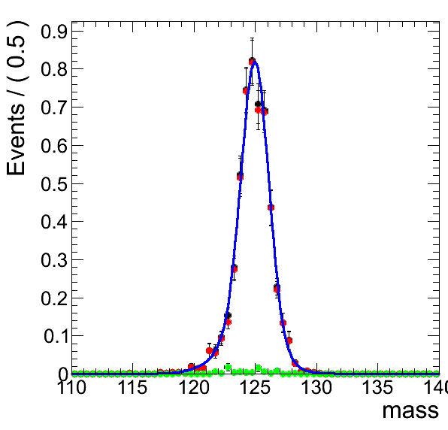
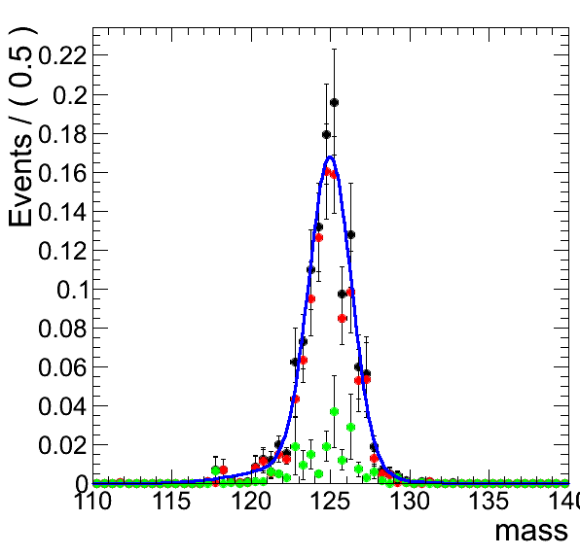
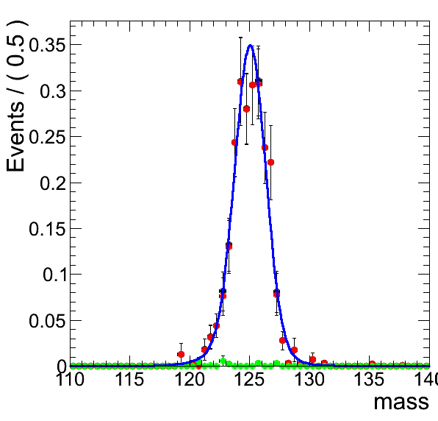
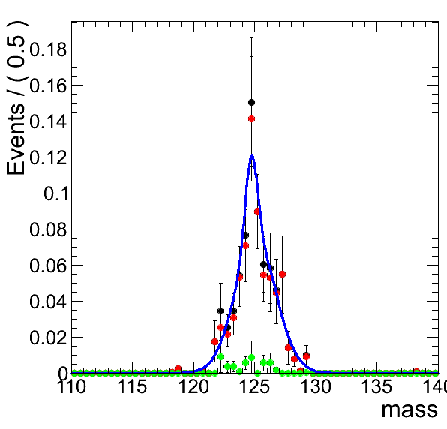
BDT Bin 0
SM Higgs
Practically no contribution to cos(Theta*) bin 0 in both samples.
Some minimal contribution of EX on cos(Theta*) bin 1
cTh =0
cTh =1
cTh =0
cTh =1
Graviton

Slide 4
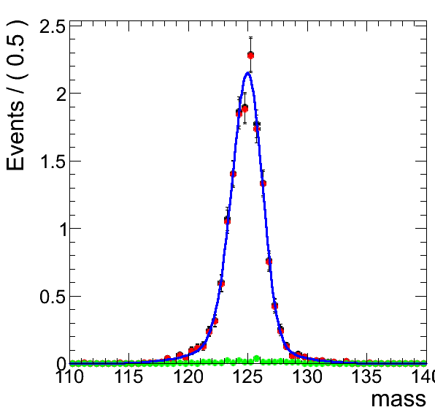
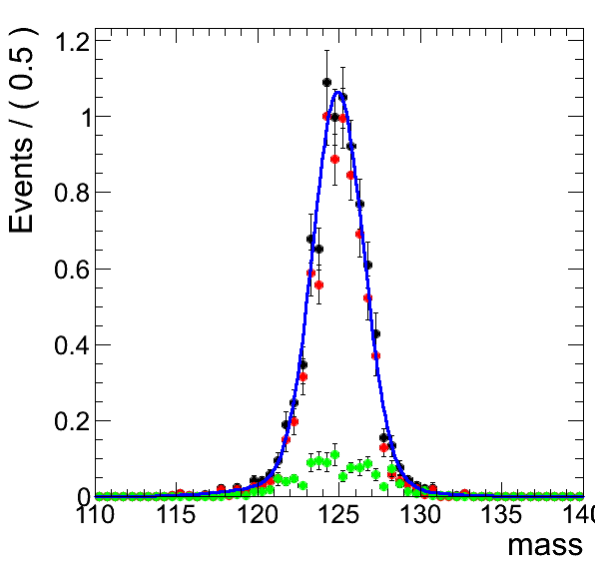
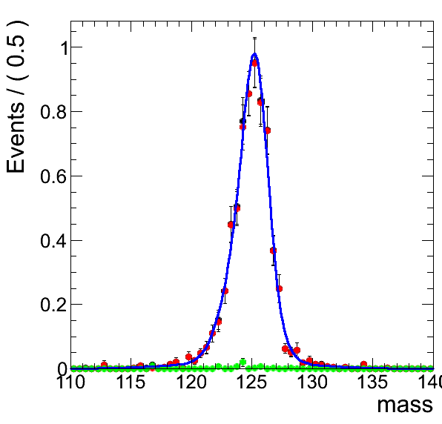
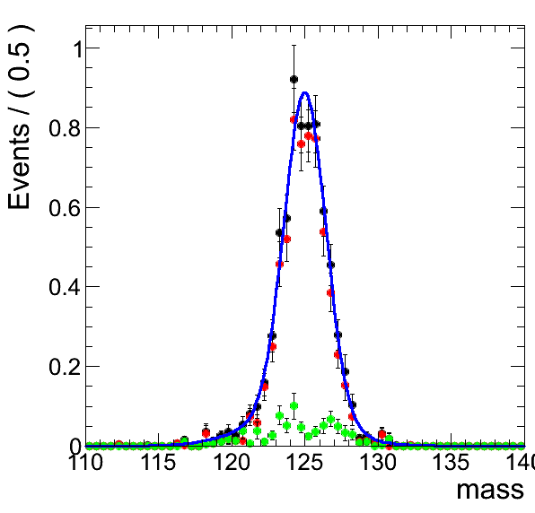
BDT Bin 1
SM Higgs
Practically no contribution to cos(Theta*) bin 0 in both samples.
Some minimal contribution of EX on cos(Theta*) bin 1
cTh =0
cTh =1
cTh =0
cTh =1
Graviton

Slide 5
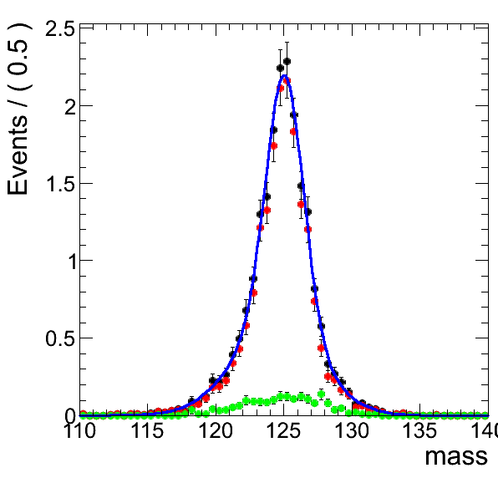
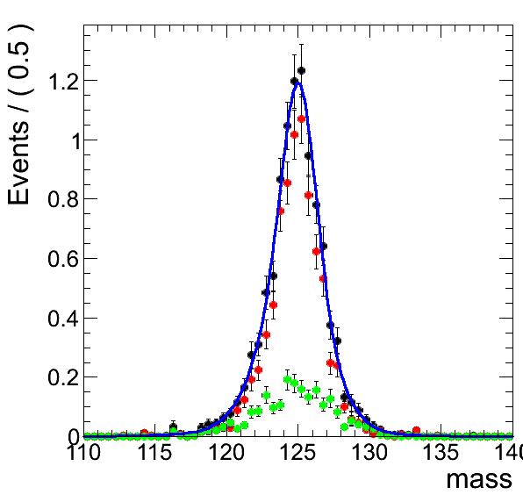
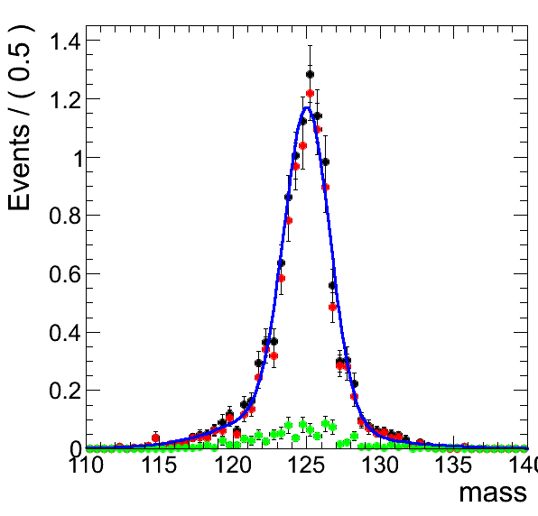
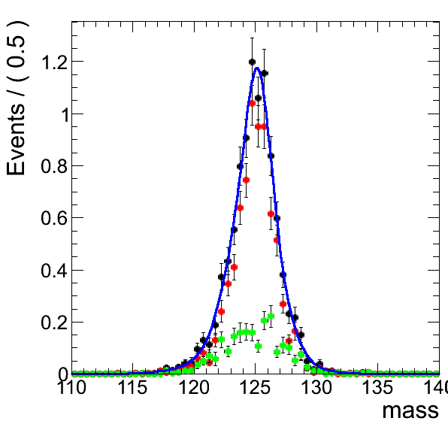
BDT Bin 2
SM Higgs
Some minimal contribution to cos(Theta*) bin 0 in both samples.
EX Contribution started to be relevant to cos(Theta*) bin 1
Graviton looks more asymmetric, high mass side.
cTh =0
cTh =1
cTh =0
cTh =1
Graviton

Slide 6
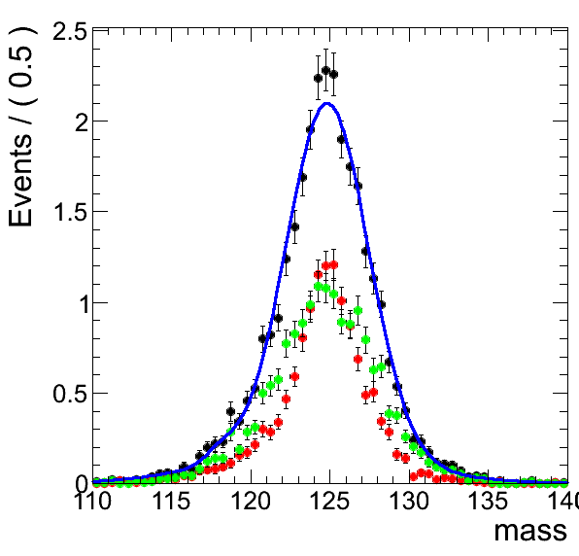
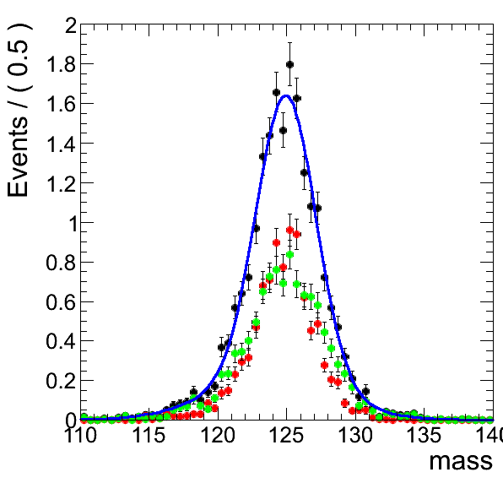
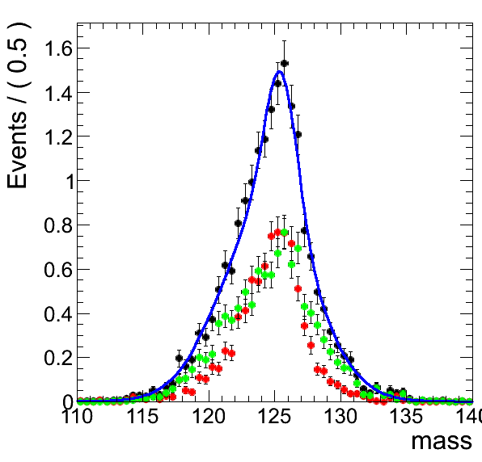
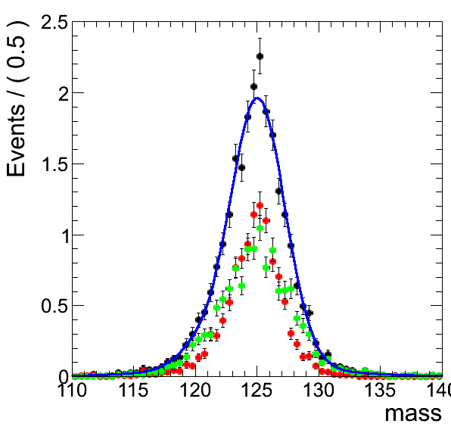
BDT Bin 3
SM Higgs
EX is significant cos(Theta*) bin 0/1 in both samples.
Graviton again looks more asymmetric, high mass side, only visible on endcap part.
cTh =0
cTh =1
cTh =0
cTh =1
Graviton

Slide 7
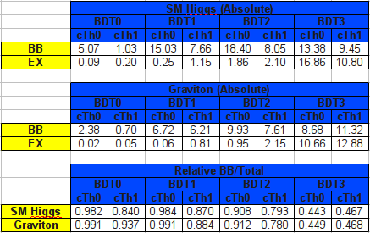
Plots in Numbers
Relative yields between BB and EX are very similar across all categories.
Absolute values are different due to same initial cross section and different BDT signal efficiency

Slide 8
For next week
Look at other control plots
Look at relative contribution from each category
Do the analysis without the relative yields constraint (Paul suggestion?)

