Slide 1
L1TBPTX Status
João Pela
Imperial College London

Slide 2
Introduction
Concerns about the good performance and efficiency of the BPTX system exist since it started to be used to veto events in 2011 (pre-BPTX veto).
This concerns escalated with 2 events of BPTX system problems during 2012 one of which caused +1h data loss.
I suggested to build a tool that would compare the LHC bunch structure to the BPTX firing, which would start working at RAMP and could trigger an alarm.

Slide 3
Tests implemented
The following tools/monitors were implemented:
  BPTX Efficiency (compared with LHC Bunch Structure)
  BPTX Miss-Fire (compared with LHC Bunch Structure)
  BPTX Rate (stability test)
This tools test every event that they see on the DQM and GT event window (-2 to +2 events)

Slide 4
Problems found
In the first version of the tool I noticed that we were only getting information on the bunch structure at STABLE BEAMS even that I specifically designed the tool to start working at RAMP.
Further investigation showed the database was only updated with bunch structure at STABLE BEAMS
Contacted WbM people (responsible for the DB table I am using) to ask if it could be updated at RAMP.
  After a few days the were able to make change and now the tools are fully functional.

Slide 5
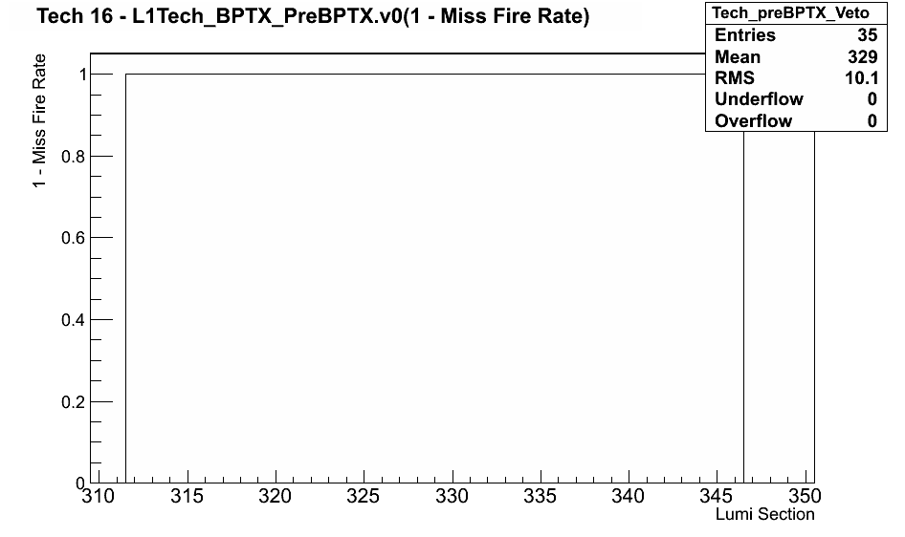
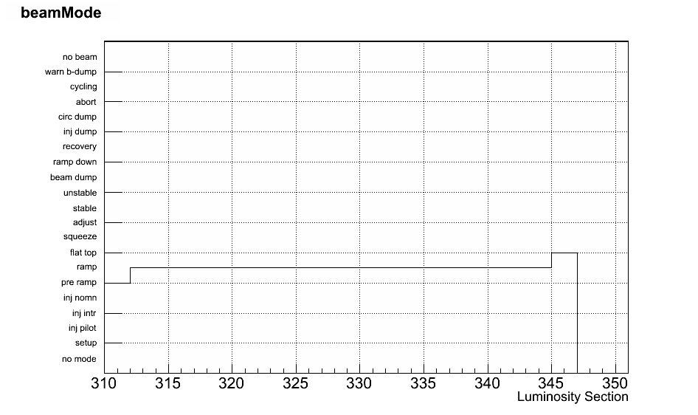
Problem Solved
RAMP LS 312
DUMP LS 316
Tool start LS 312
Tool stop LS 346
After WbM intervention, L1TBPTX starts and stops working at the correct times.
As it can be seen at run 202386 the tool starts and RAMP and stops at beam dump

Slide 6
Next Steps
Field test between RAMP and STABLE BEAMS is necessary to ensure tool detects BPTX being in a bad state.
  This will be done as soon as the technical stop is finished.
Create an alarm client for the L1TDQM connected to the Summary plot like discussed before with Vasile and others.
  Implement BPTX test into the new alarm client.

