Slide 1
Looking at new variable to attack QCD
J. Pela

Slide 2
Strategy
Trying to find variables combining the dijet and MET information to further suppress QCD, currently looking at:
  Vectorial sum of Dijet and MET pT
    Should be “zero” to events where dijet and MET are the only products from the primary interaction
  Scalar sum of Dijet and MET
    Should be high for signal
    Can be used in conjunction with other variables (like with alphaT)
  Dijet pT over Total pT (dijet+MET)
    Should peck at 0.5 for signal
    Very similar to alphaT can be re-written to have same behavior (sharp fall at 0.5) and can be made better with cut in HT+MET
    Talked with alphaT people the have some data driven method to estimate QCD contamination using HT bins which we could adapt.

Slide 3
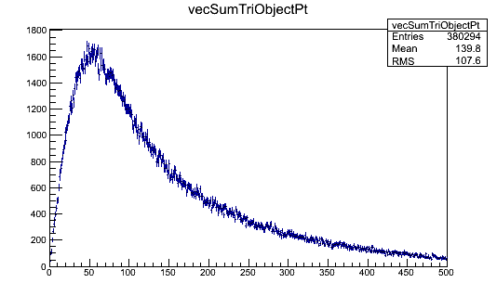
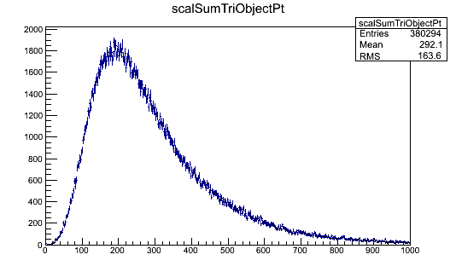
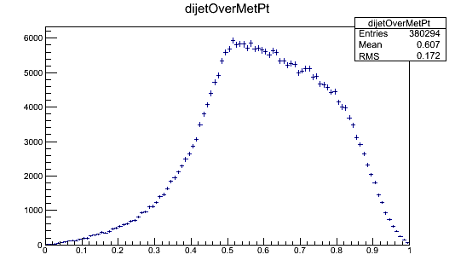
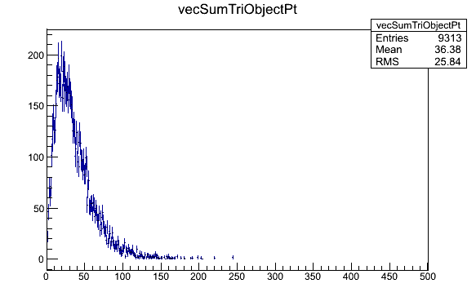
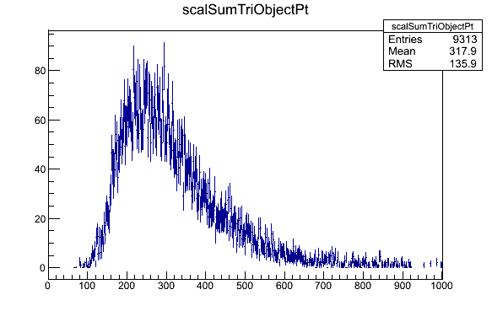
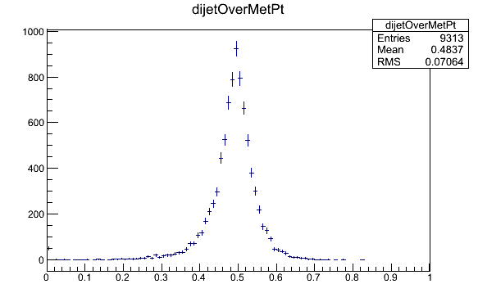
After Trigger Selection
Q CD
Vector Sum
Scalar Sum
Dijet pT fraction
VBF Inv 120

Slide 4
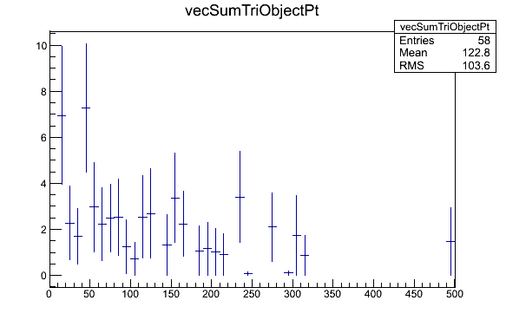
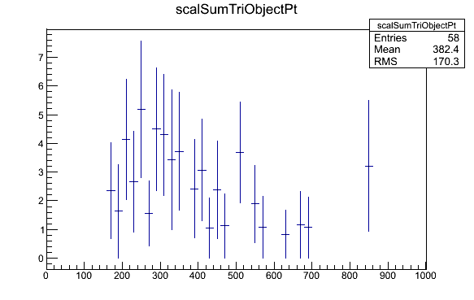
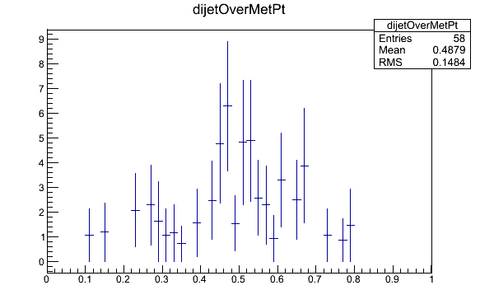
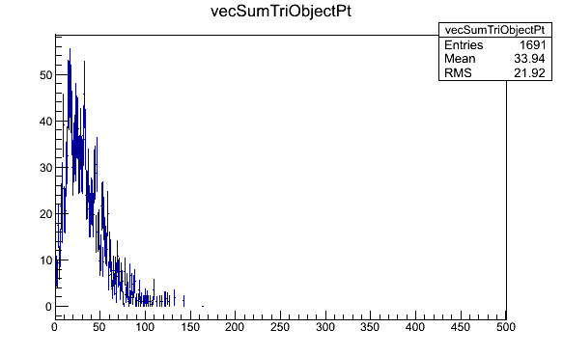
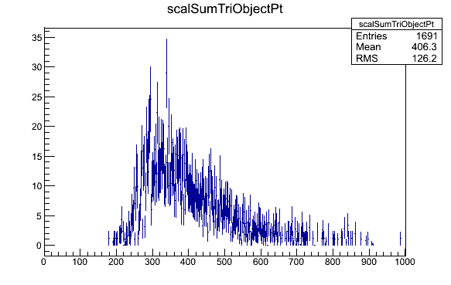
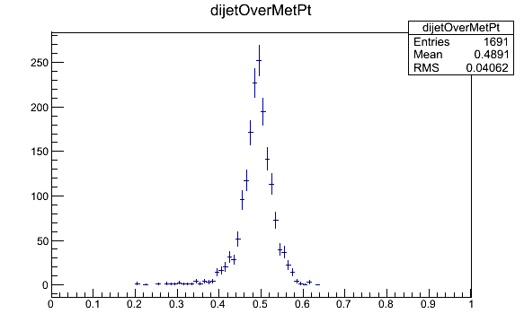
After Mjj>1200
Q CD
Vector Sum
Scalar Sum
Dijet pT fraction
VBF Inv 120

Slide 5
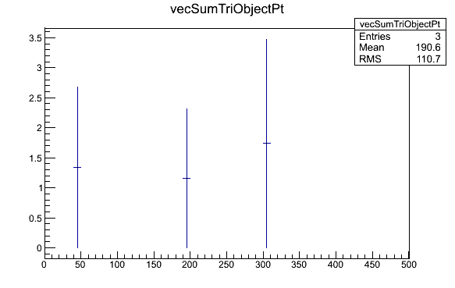
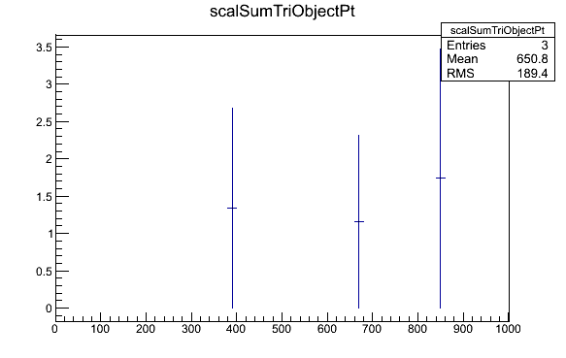
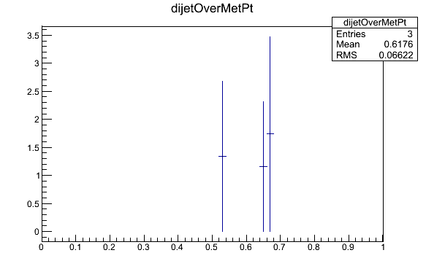
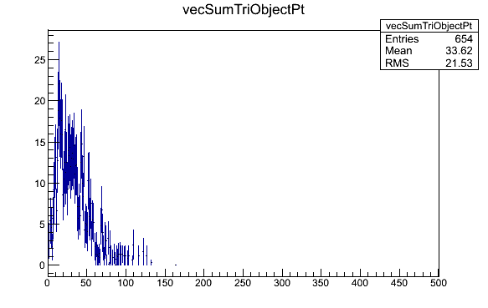
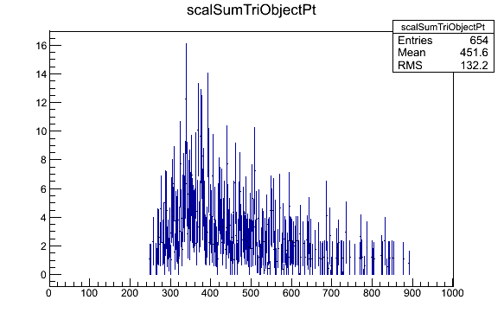
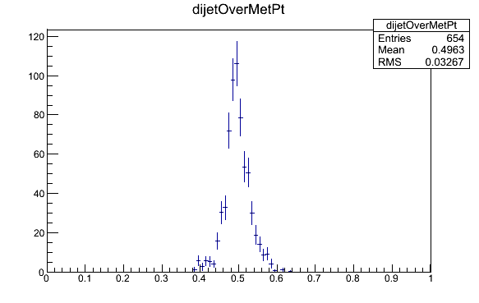
After Delta(phi)<1.0
Q CD
Vector Sum
Scalar Sum
Dijet pT fraction
VBF Inv 120

