Slide 1
Level 1 Trigger – DQM
J. pela (LIP) on behalf of the L1 Trigger Group

Slide 2
Status
New L1T DQM tools for rate and synchronization monitoring now 2 month online
Several improvements, comments and corrections being developed and will be deployed soon.
New tool to monitor L1T Occupancy is now being developed (Summer Student: Thomas Schaefer).

Slide 3
Level 1 Trigger Data Certification
For L1T Data Certification we test:
  Rates
  Synchronization
  Occupancy
  Efficiency (between L1T and offline candidates)
The lowest unprescale single object trigger for each object category in use to validate each object/sub-system that takes part in L1T

Slide 4
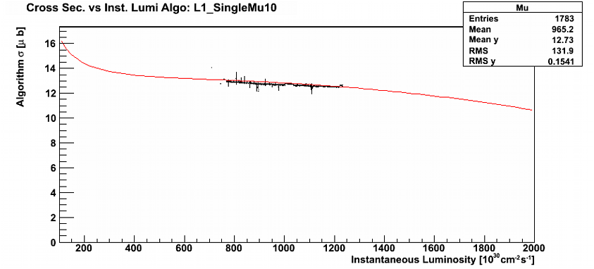
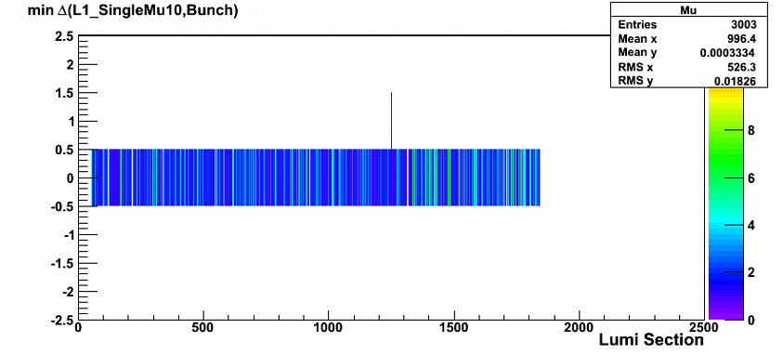
Status
Trigger shifters already using currently implemented tools for manual certification.
L1TRate Monitor compares observed triggers cross section with predictions from previous runs (produced by WbM)
L1TSync Monitor compares triggers bx against LHC filling scheme

Slide 5
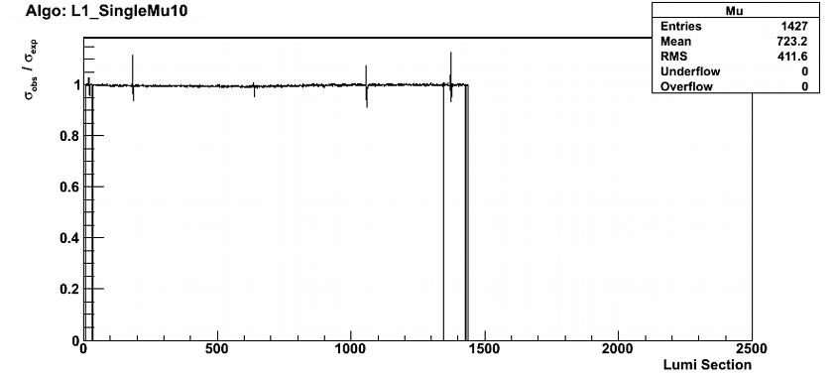
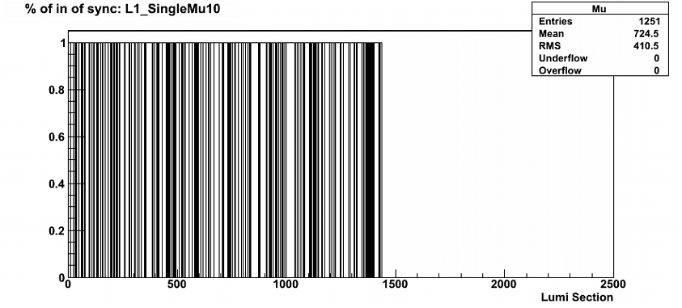
Status
A single number is
produced per single
object trigger per LS
1 being the correct
value for the test
Now stored in TH1,
we will use floats
with LS flag.
Fraction

Slide 6
L1TOccupancyClient: test method
Thomas
Schaefer
” ”
C
S
A
” ”
We want to test L1T occupancy by exploiting phi-symmetry/eta-”parity”-symmetry in the test
We use the information of a whole phi-strip (A) to test each cell on the opposite side (C) of the symmetry axis (S)
If the tested bin is above a given threshold -> “Bad” cell

Slide 7
Statistical test
Assumption: Poissonian distribution of number of counts P(x;µ_{i})
  around µ₀ for bins without error (e.g. µ₀=10)
  around µ₁ for bins with error (e.g. µ₁=0.5µ₀=5)
Define Chi²-like measure for deviation (per bin):
Define fixed confidence level for finding hot or dead channels (”efficiency”)
Determine bin statistics such that the ”fake rate” is below threshold
We tested several efficiencies (0.95/0.99), fake rates (0.05/0.01) an histogram sizes (from 72 to 9216)
Thomas
Schaefer

Slide 8
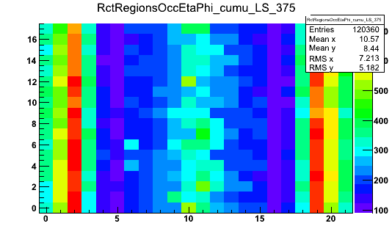
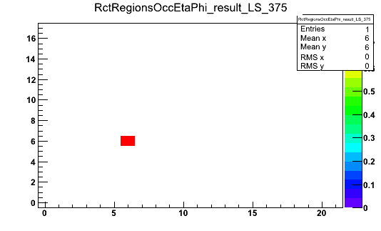
L1TOccupancyClient: Current Status
Thomas
Schaefer
Systematically tested on run 166950 changing the occupancy by hand.
Looking for problematic channels in the 2011 dataset.

Slide 9
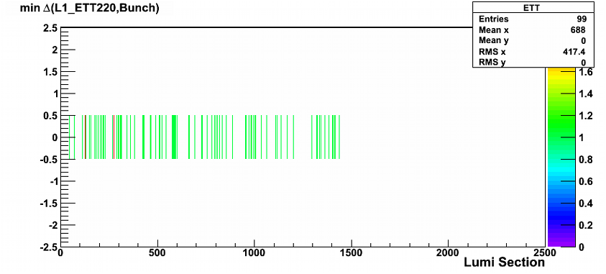
Block Certification
Some tests are statistically limited. To produce a significant result we need to integrate several LS (Block Certification)
L1T Synchronization already uses this method. Block sizes are determined by integrated statistics.
Issues:
  Some cases need O(100)
  LS to produce test results.
  For consistency blocks need
  to be of consecutive LS and
  have same conditions
  (ex. beam status)
  Current method works online (with output to histograms), but requires careful implementation for flags associated with each LS and offline (where several jobs are done in parallel, blocks must be done in the end)

Slide 10
Questions from central DQM
Performance (memory, cpu usages, etc.):
  Nothing to report
Improvements and Feature requests:
  Support for block certification

Slide 11

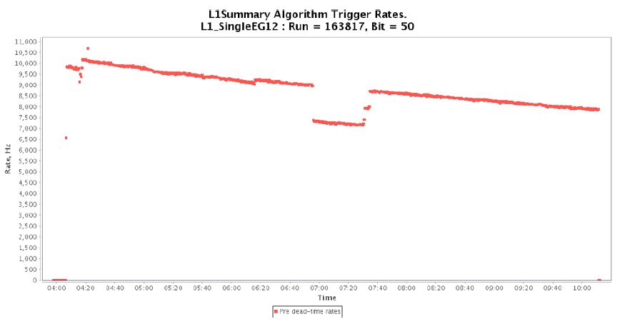
Reason L1T is marked bad
Big chunks of runs due to detector issues (eg ECAL HV going down, etc) [most of lumi loss, but it's not "L1T" issue!]
Few lumi-sections within
several runs due to specific trigger issues (usually very high rate spikes due to links between trigger primitives and regional triggers or hot towers showing up in calorimeters) [small lumi loss]
Very few times it happened a wrong configuration was set and we had to declare BAD [very small lumi loss]
EE HV problem lead to rate
problems and
consequentially made
some LS to be marked bad

Slide 12
Conclusions
New L1T tools now in production and being used for certification.
Further upgrades to current tools will be deployed soon.
Significant development in occupancy tests which soon will put into production.
L1T normally is not a direct cause for big data losses at certification.

