Slide 1
Spin Analysis Update
J.Pela

Slide 2
New Implementation
Two new methodologies:
Fit each category individually
  Yields in each category float, we lose the extra information from the relative signal between categories
Fit all spin bin 0(1) at the same time
  Simultaneous fit of 4 bins
  Preserves relative yields information
  Final results are 2 signal strengths
Both cases simple sig+bkg model Pow2+Gaussian

Slide 3
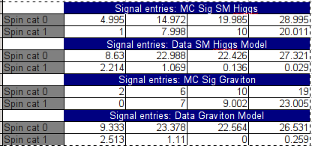
Fitting Individually
Consistent with what was expected but:
Some categories read zero signal events
Would imply infinite fractions
Possible solution... Simultaneous Fit of Spin Bins

Slide 4
Simultaneous Fit
Spin bin X
Mean
Sigma
Cat Yield
1st
MC Sig Cat 0
RooGaussian
RooExtendedPdf
RooSimoultaneous
Sig Model
Green: Vary
Red: Fixed (=1)
Pow2
Global Yield
Data Cat 0
RooAbsPdf
RooAddPdf
Mean
Sigma
Cat Yield
2nd
MC Sig Cat 1
RooGaussian
RooExtendedPdf
RooSimoultaneous
Sig+Bkg Model
Green: Fixed
Red: Vary
Pow2
Global Yield
Data Cat 1
RooAbsPdf
RooAddPdf
(...)

Slide 5
Results
SM Higgs
Signal Strength (Spin bin 0): 11.3426 +/- 6.14177
Signal Strength (Spin bin 1): 1.91316 +/- 0.214445
Graviton
Signal Strength (Spin bin 0): 14.8998 +/- 7.1576
Signal Strength (Spin bin 1): 2.23636 +/- 0.194562

Slide 6
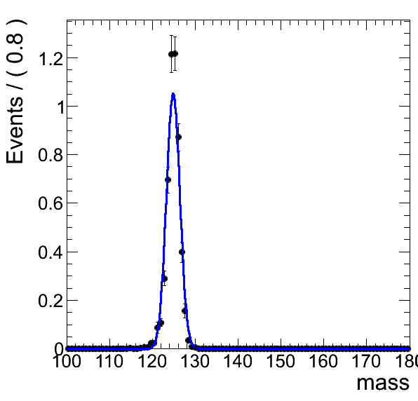
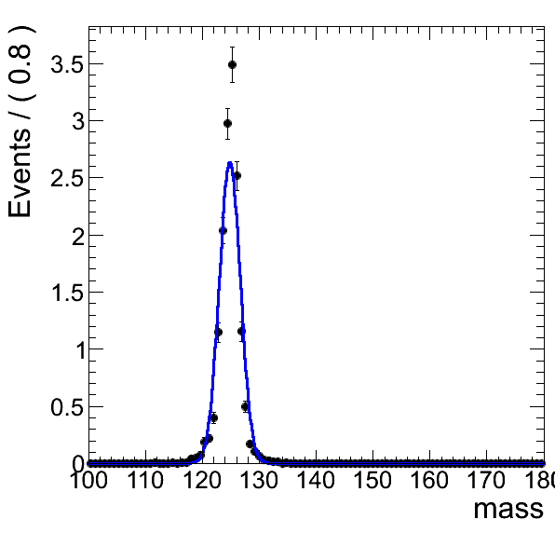
Strange Behaviour I
MC SM Higgs Cat 0 Spin 0
MC SM Higgs Cat 1 Spin 0
MC plots look resonable (for a single Gaussian fit...)

Slide 7
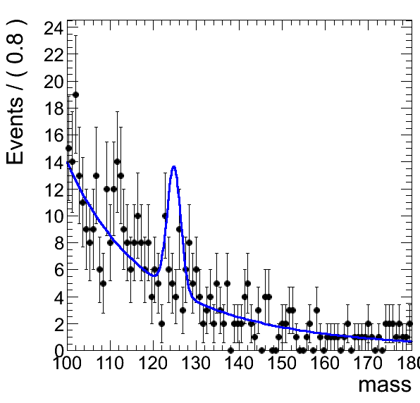
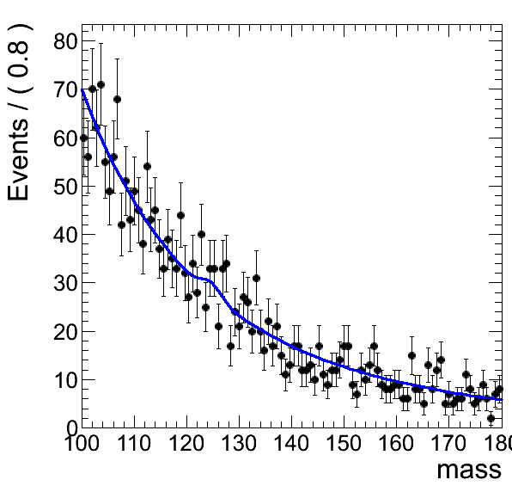
Strange Behavior I
Data Cat 0 Spin 0
Data Cat 1 Spin 0
Good fit on Data Cat 1 Spin 0 forcing signal strength up?

Slide 8
Next
Run cross checks on all code
Try to find reason for disagreement

