Slide 1
VBF H(inv) - 2015 Trigger Status Update
J. Pela

Slide 2
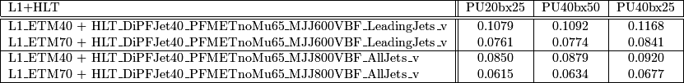
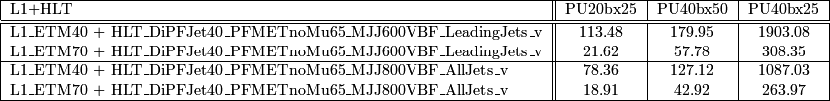
Legacy system (baseline )
We can define a baseline by just updating the seed of our HLT paths to the lowest unprescaled L1 ETM available trigger.
  In the current draft menu this is L1_ETM70
With the help of neutrino gun samples we can calculate VBF H(inv) signal efficiency:
By raising the seed from L1_ETM40 to L1_ETM70 we lose ~30% signal efficiency.
  This is a tolerable efficiency loss but we aim at improving algorithms both on the L1T and HLT sides
We can now calculate the expected pure HLT rates for this paths.
HLT pure rates drop significantly to ~20Hz on first scenario
  HLT PU subtraction should further lower this rates.
At the last PU scenario rates become too high. We can again do the exercise of raising the seed, but at this point we should have in place a better trigger with more options.

Slide 3
First look over SUSY algos
For convinience on the code building I implemented first:
L1_DoubleJetC60_ETM60 (SUSY algo)
L1_DoubleJet60_ETM60 (extension to all calorimeter
We can calculate signal efficiency:
L1_DoubleJetC60_ETM60 : 0.0750326
L1_DoubleJet60_ETM60 : 0.104578
In both cases the additional double jet condition kills more signal than the
reduction of threshold in ETM. Unless we drop both and add aditional conditions
this does not seem to work.

