Slide 1
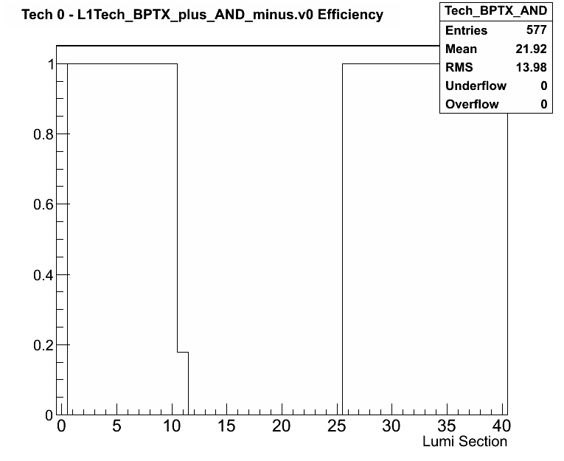
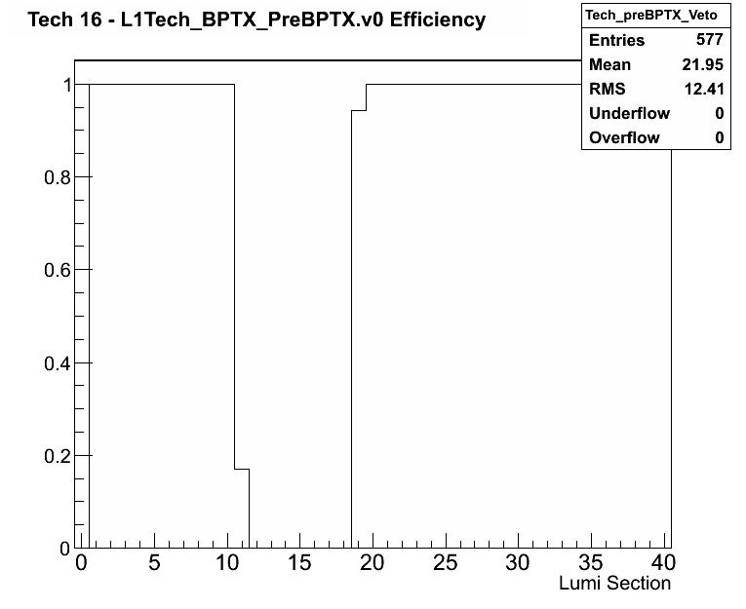
L1TBPTX test
Yesterday we were able to do the L1TDQM BPTX test (by disabling the inputs to GT)
Test was successful and the Monitoring tools correctly identified the changed in the system.
Now tool will be included in the alarms at P5.

Slide 2
Notes
What the L1TBPTX module will detect:
  Efficiency changed on the BPTX_AND and preBPTX veto
  Miss fire rate changes on the BPTX_AND and preBPTX veto
What the L1TBPTX module will NOT detect:
  preBPTX veto firing 100% of the times (since not events will go to DQM)
A possible solution would be to trigger an alarm if no events end up in this module in a LS. But this could make the alarm fire when beams are dumped.

