Slide 1
Level 1 Trigger – DQM
P. Musella and J. pela

Slide 2
Status
New L1T DQM tools for rate and synchronization monitoring now 1 month online
Several improvements, comments and corrections being developed and will be deployed soon.
New tool to monitor L1T Occupancy is now being developed.

Slide 3
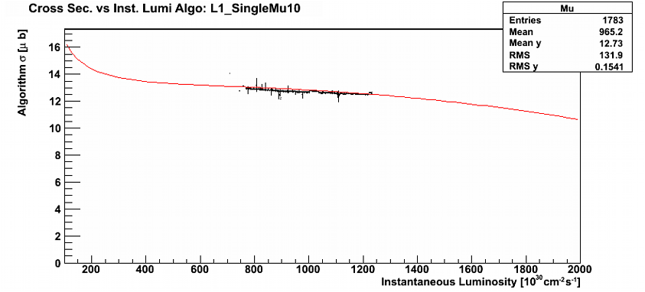
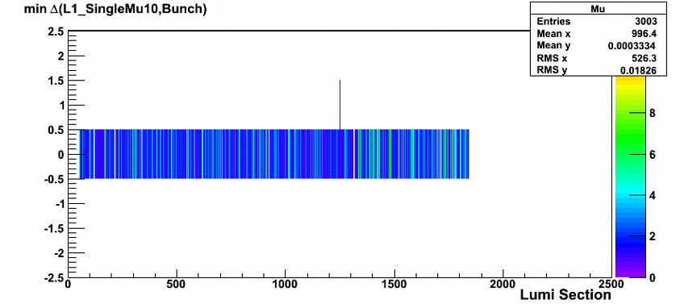
Status
Trigger shifters already using currently implemented tools for certification.
L1TRate Monitor compares selected triggers observed cross section with predictions from WbM fits from previous runs
L1TSync Monitor compares triggers bx against LHV filling scheme

Slide 4
Block Certification
Since some tests some times lack proper statistics to reach a significant conclusion in a single LS we need to make LS blocks for certification
We implemented in L1T Synchronization certification by LS blocks. Block size depends on statistics contained in it self
Problems we found:
  Online current problems will be detected only when block is finished.
  For consistency blocks need to be of consecutive LS under the same conditions (ex. beam status)
  Current methods work for online, but require careful implementation offline (several jobs in parallel, block must be done in the end)

Slide 5

Reason L1T is marked bad
Big chunks of runs due to detector issues (eg ECAL HV going down, etc) [most of lumi loss, but it's not "L1T" issue!]
Few lumi-sections within several runs due to specific trigger issues (usually very high rate spikes due to links between trigger primitives and regional triggers or hot towers showing up in calorimeters) [small lumi loss]
Very few times it happened a wrong configuration was set and we had to declare BAD [very small lumi loss]

Slide 6
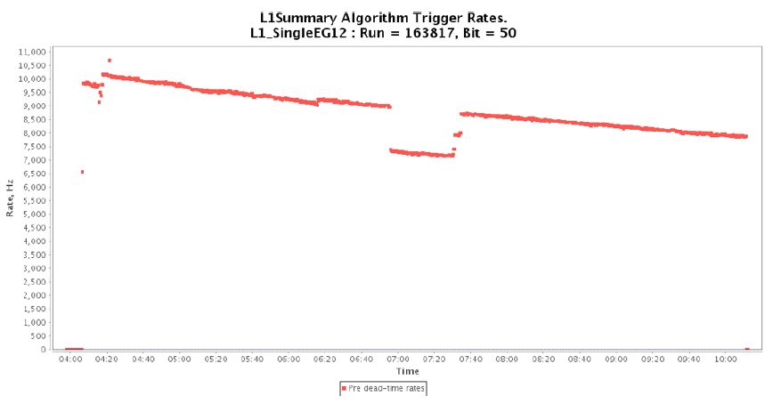
Reason L1T is marked bad
EE HV problem lead to rate problems and consequentially made some LS to be marked bad

Slide 7
Conclusions
New L1T tools now in production and being used for certification
Further upgrades to current tools will be deployed soon
L1T normally is not a direct cause for big data losses at certification

