Slide 1
Muon Trigger Issue
J. Pela, P. Musella
LIP Lisbon

Slide 2
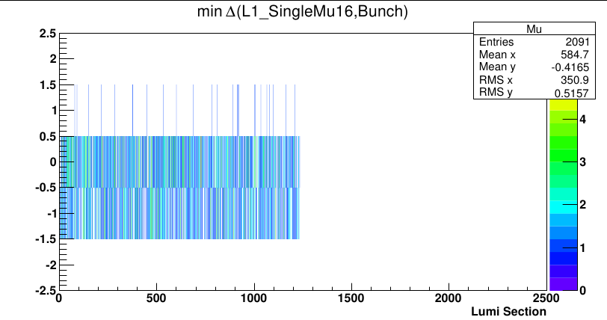
What & How
During the implementation of new way to monitor L1T Synchronization we have found +25% SingleMu events out of time

Slide 3
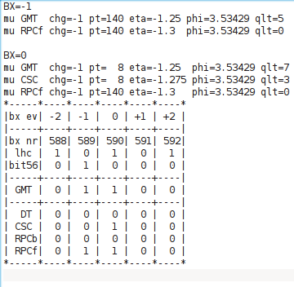
Example event
Events taken by RPC at BX=0 are also present at BX=-1
But if another system sees muon in BX=0 with better quality then pT will be taken from that sub-system.
Then inf pT in BX=0 and -1 are above and below a trigger threshold then trigger only fires in bx=-1
This is not a problem now because of BPTX veto but for consistency value in bx=-1 should be equal to the one in bx=0 for the same muon.

