Slide 1
L1T DQM Introduction/Status
João Pela
Imperial College London

Slide 2
Purpose of the L1T DQM
Provide online/offline monitoring of the Level 1 trigger
  Spot possible problems
  Help diagnose reasons for issues
  Ensure quality of the L1T operation
Data certification
  Provide handles to monitor data quality
  Return a global flag for data quality LS-by-LS for the L1T

Slide 3
Tools Online
L1TRate
  Monitors L1 Trigger Rate and compares with expectation from WbM fits
L1TSync
  Monitors L1 Trigger Synchronization by comparison with the LHC Bunch Structure
L1TOccupancy
  Monitor occupancy plots to spot hot towers or dead channels
L1TTestsSummary
  Summarizes all tests above.

Slide 4
Status and Plans
All tools have are online now.
L1TOcupancy and L1TTestsSummary have been available since the beginning of the 2012 ion run but on “commisioning” mode.
New developments on L1TSync underway... (study made but not yet implemented)
  Use calo trigger to monitor mu triggers and vice-versa instead of using L1 Pass Troughs.

Slide 5
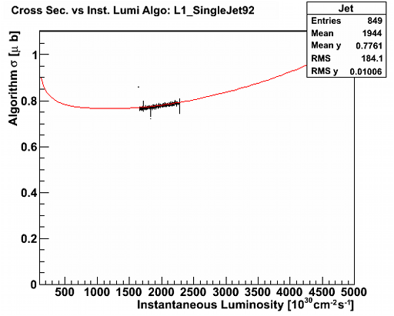
L1TRates
Monitors L1 rates from Lowest Unprescaled Single Object Triggers
Running for several months now.
Used frequently for online diagnosis and certification
Every LS outputs observed rate over expected (from fit) for the current instantaneous luminosity
More information

Slide 6
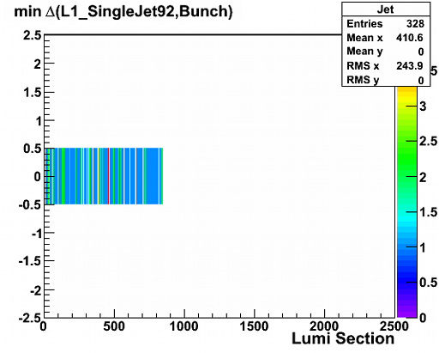
L1TSync
Monitors L1 Synchronization for Lowest Unprescaled Single Object Triggers
Running for several months now.
Used frequently for online diagnosis and certification
Effort being done to get more statistics in a unbiased way without depending on L1 Pass Throughs
Every LS Block outputs fraction of in time (compared with LHC Bunch Structure) triggers
More Information

Slide 7
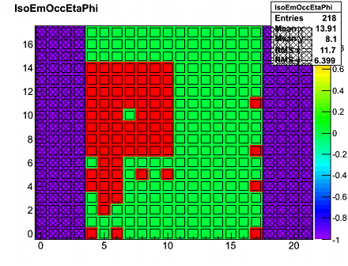
L1TOccupancy
Online for some months.
Monitors occupancy of predefined plots
To be fully functional needs:
  Calo plots to implement min Pt on their trigger primitives
  Mu plots that have absolute trigger primitive counts
Every LS Block outputs fraction of bins that are not masked and fail the test.
More Information

Slide 8
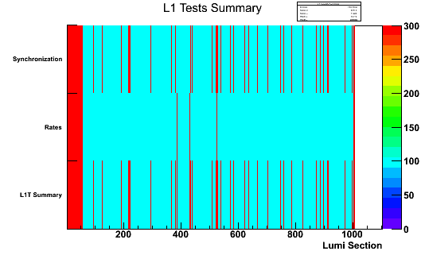
L1TTestsSummary
Online for a few months.
Summarizes all tests preformed in L1TRate, L1TSync (and in the future L1TOccupancy)
Allows to spot problems by looking at a single plot
Every LS outputs the status of all tests and merges them into a single quality flag

Slide 9
Implementation Offline
L1TRate
  Requires saving Monitored trigger rate every LS
L1TSync
  Requires saving number of triggers on/out-of time per LS
  Requires Central DQM providing block certification capability in the offline environment
L1TOccupancy
  Requires saving differential snapshots of the monitored plots every LS
  Requires Central DQM providing block certification capability in the offline environment
L1TTestsSummary
  Must be run after all other tests are finished.

Slide 10
Conclusions
All foreseen tools for the L1T online DQM are implemented and currently running online. But still some things to be done:
  Remove the dependence of L1 Pass Troughs for L1TSync
  Make monitored trigger selection capable to recognize BPTX AND triggers. (Ion Runs)
For this tools to get to their full potential some action is required by the sub-systems
  Some plots need to be produced differently (i.e normalization) by the mu sub-systems
  Calo systems filling their plots with primitives above a given threshold.

