Slide 1
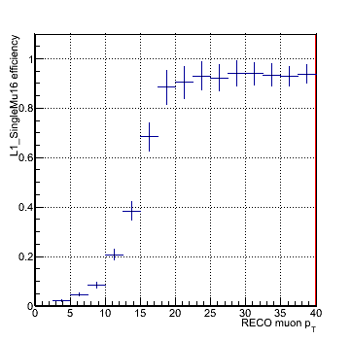
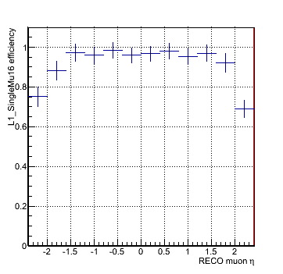
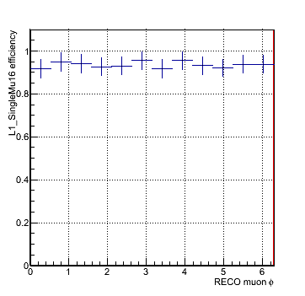
New L1T DQM Offline Tag
A new tag for the L1T DQM Offline is now undergoing test and validation for deployment on the CMSSW_6_2_0 cycle.
  This release is the current development version of CMSSW and is targeted to upgrades studies.
  If important tools are deployed requests may be maybe to back-porting to CMSSW_6_1_X to be used in any DQM reprocess of 2012 data.
Code includes besides minor debugging new Module to calculate muon efficiencies and resolutions.

Slide 2
CMS Monitoring Upgrade Meeting
Report
First CMS Monitoring Upgrade Meeting happened 28th March.
  Discussion about definition of the common interface/API/aggregator for CMS monitoring.
  The aim is to simplify data flow between information producers and monitoring tools for CMS as a whole
  Several options discussed including reusing code already available in the experiment (from the CSC group) and expanding it.
  Meeting will become periodic and I will be reporting shortly after.

