Slide 1
L1 DQM and certification tools
J. Pela, P. Musella
LIP Lisbon

Slide 2
Purpose of the L1T DQM
Provide online/offline monitoring of the Level 1 trigger:
  Spot possible problems.
  Help diagnose reasons for them.
  Ensure quality of the L1T operation.
Data certification:
  Use L1T DQM information to assess quality of data.
  Ultimate goal: provide a global flag reflecting the data quality LS-by-LS for the L1T.

Slide 3
Structure
Online L1T DQM:
  Online tests using the DQM Stream.
  Monitor trigger rates, synchronization and occupancy.
Offline L1T DQM:
  Online tests and additional object efficiency test.
  Both data and MC validation.
  Runs at every RECO of data/MC.
This presentation focuses on the tools to be used for automatic certification.
  Most of the tools have been developed in 2011.

Slide 4
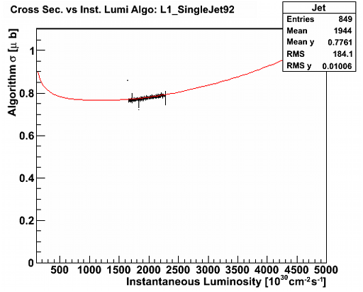
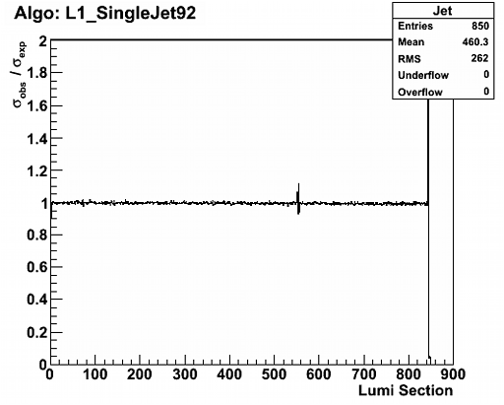
Rate Monitoring
Comparison between observed and expected rates.
  Expected rates from WBM fits of trigger cross sections in previous runs:
    Online: Retrieve from parametrization stored in OMDS
    Offline: Needs O2O of information. To be done.
Test all L1 Single Object Lowest Prescale Triggers.

Slide 5
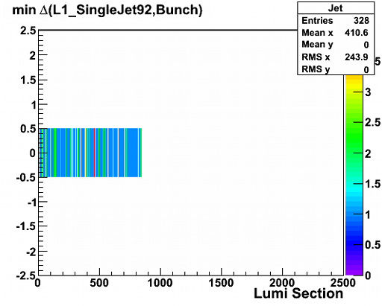
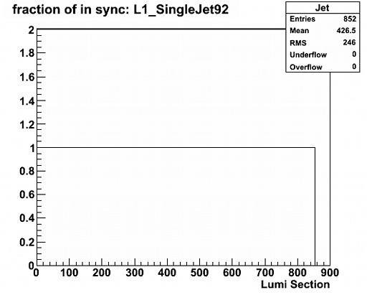
Synchronization Monitoring
Comparison between bx where triggers fired and LHC Bunch Structure.
Test all L1 Single Object Lowest Prescale Triggers.
“LS Block certification”
  Test for a single LS is statistically limited
  To reduce fluctuation we need to integrate (in some triggers) several LS

Slide 6
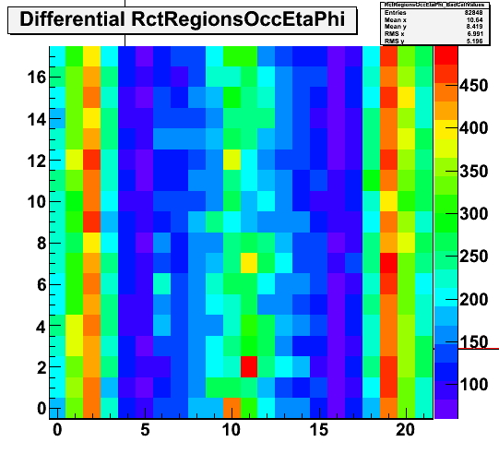
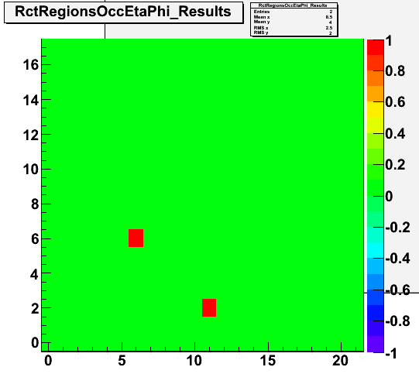
Occupancy Monitoring
Exploits Eta-Phi symmetry to find problematic spots
  Based on statistical test assuming Poisson Statistics. Therefore need absolute counts per bin.
Differential analysis LS-by-LS of a given plot.
  Plots should not be reset during the run.
Block Certification (like defined for L1TSync)
NOTE: Currently only Calorimeter based histograms fulfill the described requirements.

Slide 7
L1T DQM Offline
L1ExtraDQM (L1Extra monitor)
  It is currently running (Vasile); several tools to be reused
L1ExtraRecoDQM (L1 vs Reco)
  Run on prompt reco, re-reco, data RelVals
  DQMOffline/L1Trigger
L1ExtraGenDQM (L1 vs MC generated)
  Run on RelVals and MC production
  Validation/L1Trigger
L1RecoGenDQM (Reco vs Gen)
  To check Reco with L1 choices of collections and binning
The complete set useful to:
  Online monitoring of trigger objects
  Efficiencies with Express and PromptReco DQM
  Release Validation

Slide 8
Status
Both Rate and Synchronization Monitor are online since several months.
  Monitored online and used for certification.
New tag deployed recently (Oct 4)
  Error monitoring.
  Rate Monitoring: bug fixes and updated.
  Synchronization Monitoring:
  Now fully functional (LS Block Certification).
Occupancy Monitoring
  Currently in final testing phase.

Slide 9
Plans
Online
  Provide a single data quality flag per L1 object.
    Summarize all tests for each LS.
Offline DQM
  Develop O2O of necessary data form DB to event.
  Adapt online code for the offline workflow:
    Multiple jobs, merging, flag assignment.
  Efficiency Monitoring using L1TExtra
  (first version to be ready by the end of the year).

Slide 10
Data Certification
Monitoring tools currently used by humans (shifters/experts) doing data certification.
  Gained operational experience.
  Debugged data certification inputs.
We would like to have automatic certification where possible.
  Time-scale: 2012.
Few developments are still needed.
  Support for block certification in DQM framework.
  Existing tools should be adapted to offline DQM.

Slide 11
Summary
L1T DQM provides tools to monitor the performance of L1 Trigger.
In the Online DQM, a set of tools aimed at data certification was developed in 2011.
  Part of them are being routinely used since long time online (Rate/Synchronization).
  Few more are currently being developed (Occupancy).
The development of new tools in Offline DQM is starting.
Final goal is to automatize the data certification procedure.
  Good operational experience gained already.
  Some more work is needed to make the automation technically possible.

