Slide 1
L1T monitoring status
João Pela
Imperial College London

Slide 2
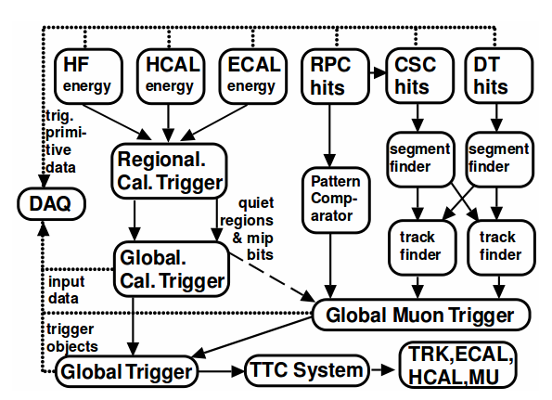
L1T Structure
The Level 1 Trigger is a complex system with several sub-systems and monitoring tools, currently:
  Subsystem specif monitoring
  L1 specif web based monitoring (l1 page)
  DQM Monitoring
  Experiment wide WbM (L1T tools also)

Slide 3
Subsystems manpower dedicated to monitoring:
  RCT: 1-2 persons (~0.1-0.4 FTE)
  GCT: 1 person (part time)
  GT/GMT: 1 person (part time)
  Unknown for other subsystems
L1T DQM dedicated team
  4 people (~1.5 FTE)
WbM central team
  Depends on amount of work necessary to update current tools

