Slide 1
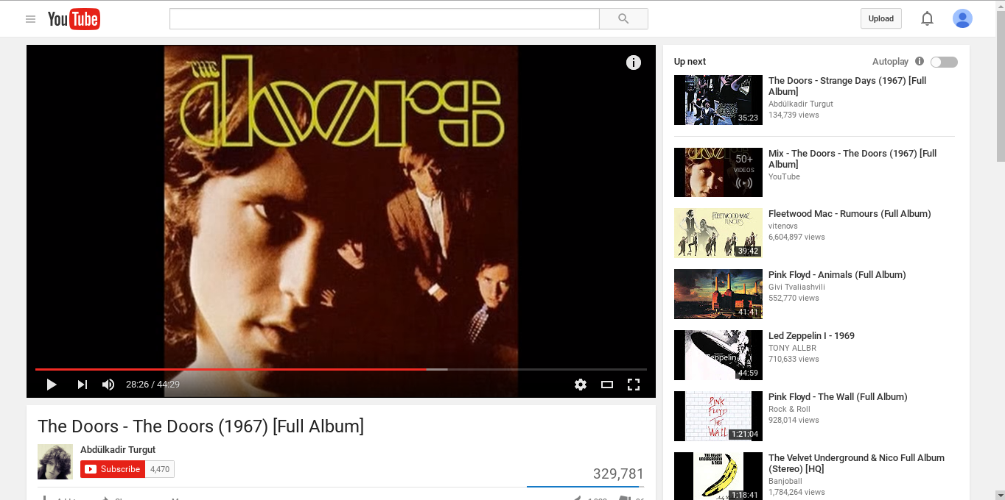
Help us caption this
Write your captions here

Slide 2
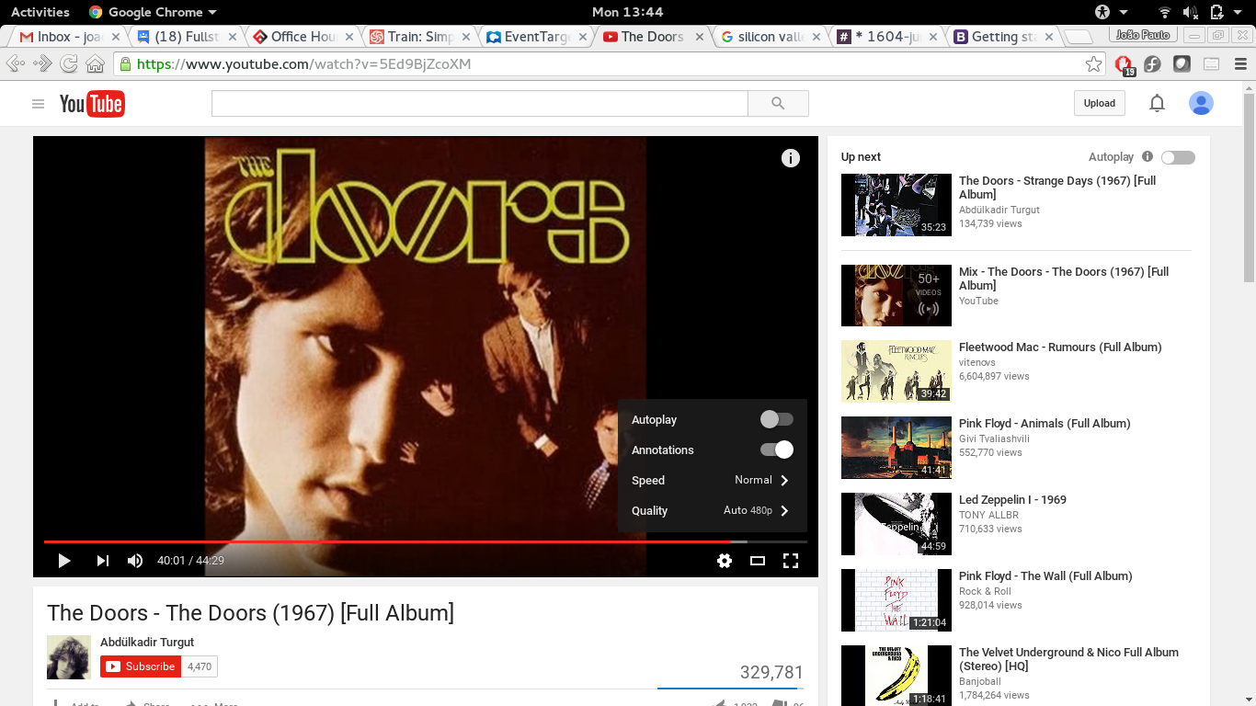
Captions PT

