Slide 1
Insurance & Banking: BlingBank
Network and Computer Security
Diogo Pereira 110996 | João Santos 110947 | João Matos 110846

Slide 2
Secure Document Format

Slide 3
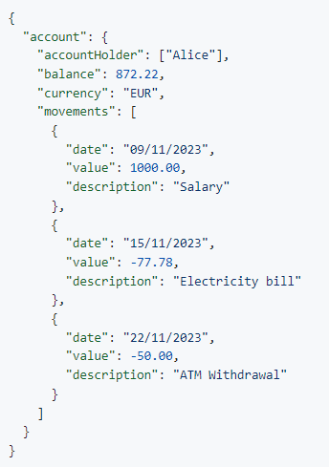

Secu﻿re Document Format
The protected document must ensure the authenticity and confidentiality of the account data.
Assumption: user and the service share a secret key.

Slide 4

Secu﻿re Document Flow
protect (twoLayer == true )
JSON
accountHolder: “alice”
balance: SqdFYB5wT
movements: {
value: CDT8Q4K5jDM==
date: ZGS4a2oMtzO31=
description: lOskTiyTHWRTJ
}
Server
encrypt with the
account_symmetric_key
plain_text_json
(first layer)

Slide 5
Secu﻿re Document Flow
protect (twoLayer == true )
JSON
accountHolder: “alice”
balance: SqdFYB5wT
movements: {
value: CDT8Q4K5jDM==
date: ZGS4a2oMtzO31=
description: lOskTiyTHWRTJ
}
Server
encrypt with the
account_symmetric_key
encrypt with the
server_db_shared_key
JSON
CDT8Q4K5jDMS4lOskTiyTHWRTJa2oMlOskTiyTHWRTJtz==
plain_text_json
(first layer)
(second layer)
send with
Server Signature
DataBase

Slide 6
Secu﻿re Document Flow
protect (twoLayer == true )
JSON
accountHolder: “alice”
balance: SqdFYB5wT
movements: {
value: CDT8Q4K5jDM==
date: ZGS4a2oMtzO31=
description: lOskTiyTHWRTJ
}
Server
encrypt with the
account_symmetric_key
encrypt with the
server_db_shared_key
JSON
CDT8Q4K5jDMS4lOskTiyTHWRTJa2oMlOskTiyTHWRTJtz==
plain_text_json
(first layer)
(second layer)
send with
Server Signature
DataBase
JSON
accountHolder: “alice”
balance: SqdFYB5wT
movements: {
value: CDT8Q4K5jDM==
date: ZGS4a2oMtzO31=
description: lOskTiyTHWRTJ
}
unprotect (twoLayer == false)
decrypt with the
server_db_shared_key
check signature
(external layer)

Slide 7
Secu﻿re Document Flow
protect (twoLayer == true )
JSON
accountHolder: “alice”
balance: SqdFYB5wT
movements: {
value: CDT8Q4K5jDM==
date: ZGS4a2oMtzO31=
description: lOskTiyTHWRTJ
}
Server
encrypt with the
account_symmetric_key
encrypt with the
server_db_shared_key
JSON
CDT8Q4K5jDMS4lOskTiyTHWRTJa2oMlOskTiyTHWRTJtz==
plain_text_json
Server
(first layer)
(second layer)
send with
Server Signature
send with
DataBase Signature
DataBase
protect (twoLayer == false)
JSON
accountHolder: “alice”
balance: SqdFYB5wT
movements: {
value: CDT8Q4K5jDM==
date: ZGS4a2oMtzO31=
description: lOskTiyTHWRTJ
}
unprotect (twoLayer == false)
encrypt with the
server_db_shared_key
decrypt with the
server_db_shared_key
check signature
(external layer)
(external layer)

Slide 8
Secu﻿re Document Flow
protect (twoLayer == true )
JSON
accountHolder: “alice”
balance: SqdFYB5wT
movements: {
value: CDT8Q4K5jDM==
date: ZGS4a2oMtzO31=
description: lOskTiyTHWRTJ
}
Server
encrypt with the
account_symmetric_key
encrypt with the
server_db_shared_key
JSON
CDT8Q4K5jDMS4lOskTiyTHWRTJa2oMlOskTiyTHWRTJtz==
plain_text_json
Server
(first layer)
(second layer)
send with
Server Signature
send with
DataBase Signature
DataBase
protect (twoLayer == false)
JSON
accountHolder: “alice”
balance: SqdFYB5wT
movements: {
value: CDT8Q4K5jDM==
date: ZGS4a2oMtzO31=
description: lOskTiyTHWRTJ
}
unprotect (twoLayer == false)
encrypt with the
server_db_shared_key
decrypt with the
server_db_shared_key
check signature
(external layer)
(external layer)

Slide 9
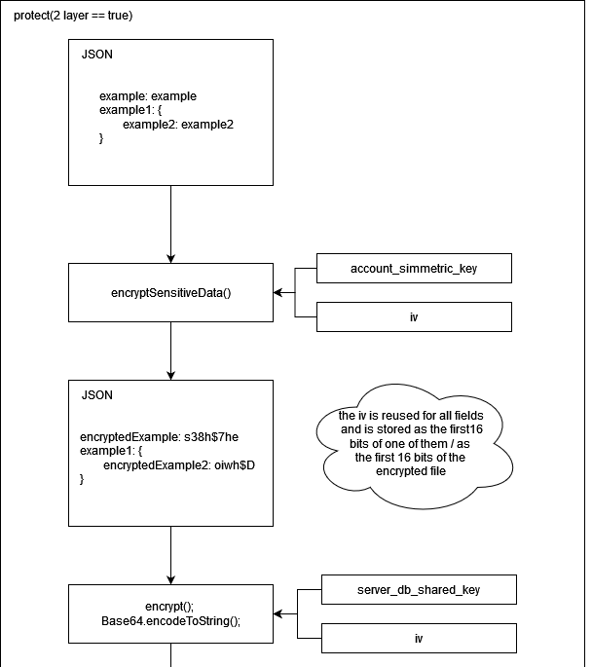
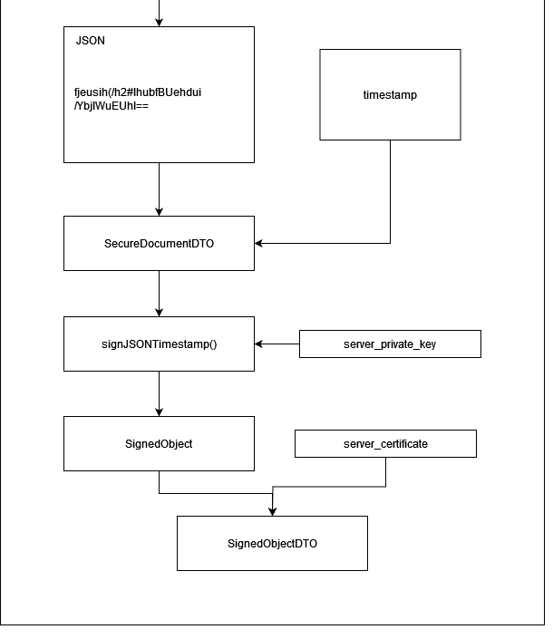
AES algorithm in CBC (Cipher Block Chaining)
account_symmetric_key

Slide 10
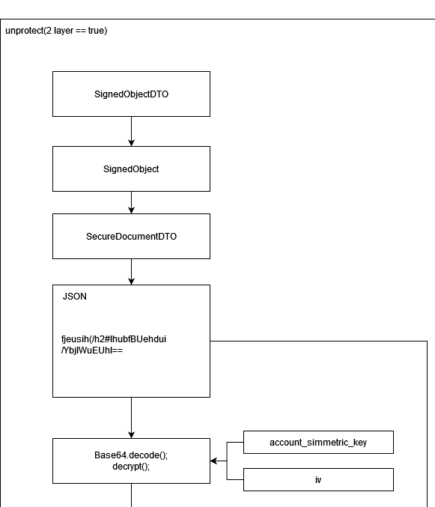
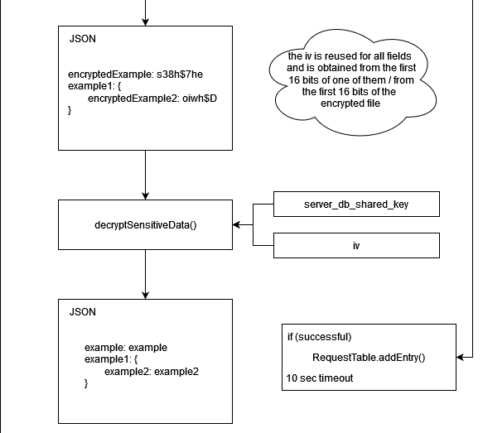

account_symmetric_key
server_db_shared_key

Slide 11
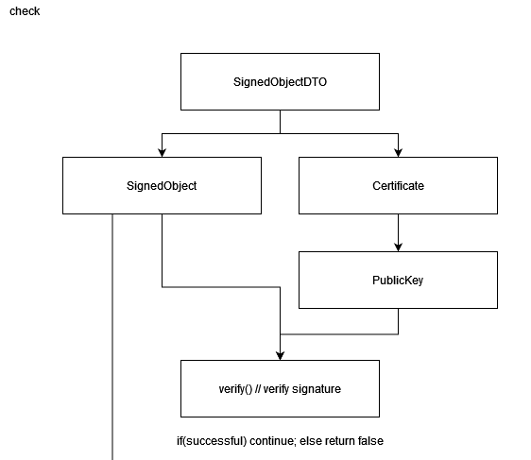
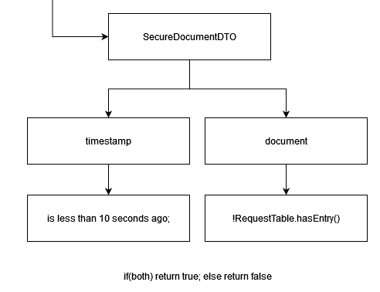

Slide 12
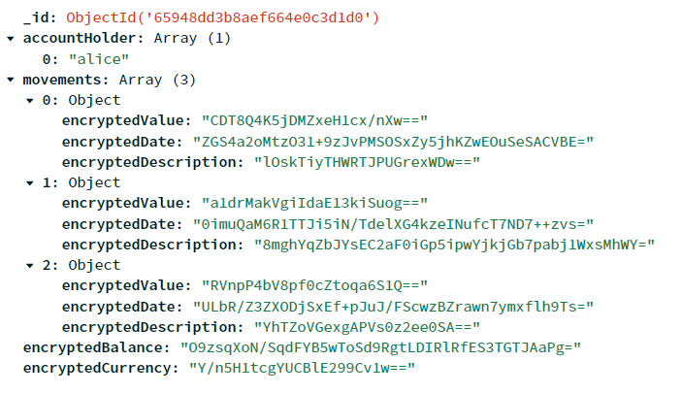
Secure Document in DataBase

Slide 13
Built Infrastructure

Slide 14
Infrastructure
The infrastructure is composed of the Database Server, SSL Server and the external clients
Database Server stores an accesses data on MongoDB
SSL Server handles client requests

Slide 15
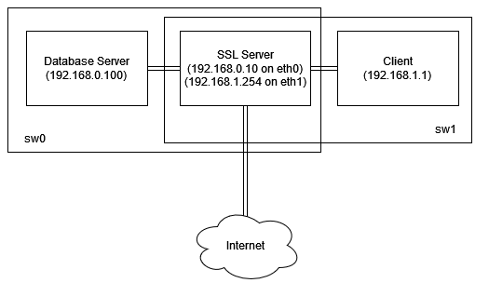
Infrastructure

Slide 16
Key Distribution

Slide 17
Key Distribution
RSA keys in Server and DataBase, Secret Key shared between both, Certificates changed by the admin
Clients obtain Server Certificate in CA
Secret Key in Server for each Account and Payment Account
Automatic generation of RSA keys for each client in first connection
Assumed Secret Key between Server and Client
Client sends Certificate to Server using HMAC, calculated with the Secret Key shared with Server

Slide 18
Secure Channels

Slide 19
Secure Channels
SSL sockets were used for Client -> SSL Server and SSL Server -> DataBase Server communications
Truststores are used to store certificates of known entities
Keys used during communication are stored on Keystores

Slide 20
Secure Channels
For communications between clients and the SSL Server, a new cryptographic library was created: Secure Message Lib
Messages are encrypted using the shared key, then signed with the private key
In decryption, the signature is validated using the public key, then, the content is recovered using the shared key

Slide 21
Security Challenge

Slide 22
Security Cha﻿llenge
Guarantee confidentiality, authenticity, and non-repudiation
Freshness measures using timestamps and Request Table

Slide 23
Main Results and Conclusions

Slide 24
Main R﻿esults and Conclusions
Robust Cryptography
ensures confidentiality, integrity, authenticity and non-repudiation of transmitted data.
Server-Database Communication Security
Bilateral authentication with certificates for Server and Database
Client-Server Communication Security
HMAC calculation for Client Certificate enhances integrity.
Secure generation and transmission of asymmetric keys for new device connections.
Effective prevention of replay attacks

Slide 25
Live Demonstration

