Slide 1
R
RoboReviews
Sentiment
Clustering
Generative AI
LoRA fine-tuning
João Santos
Harn Zhin Chong
Product Reviews Project · 2026

Slide 2
46,538 reviews
→ 4 clean meta-categories
→ 4 ready-to-publish recommendation articles
Same base model (Qwen 2.5-1.5B) powers Tasks 1 and 3. Runs on a laptop.
2 / 12

Slide 3
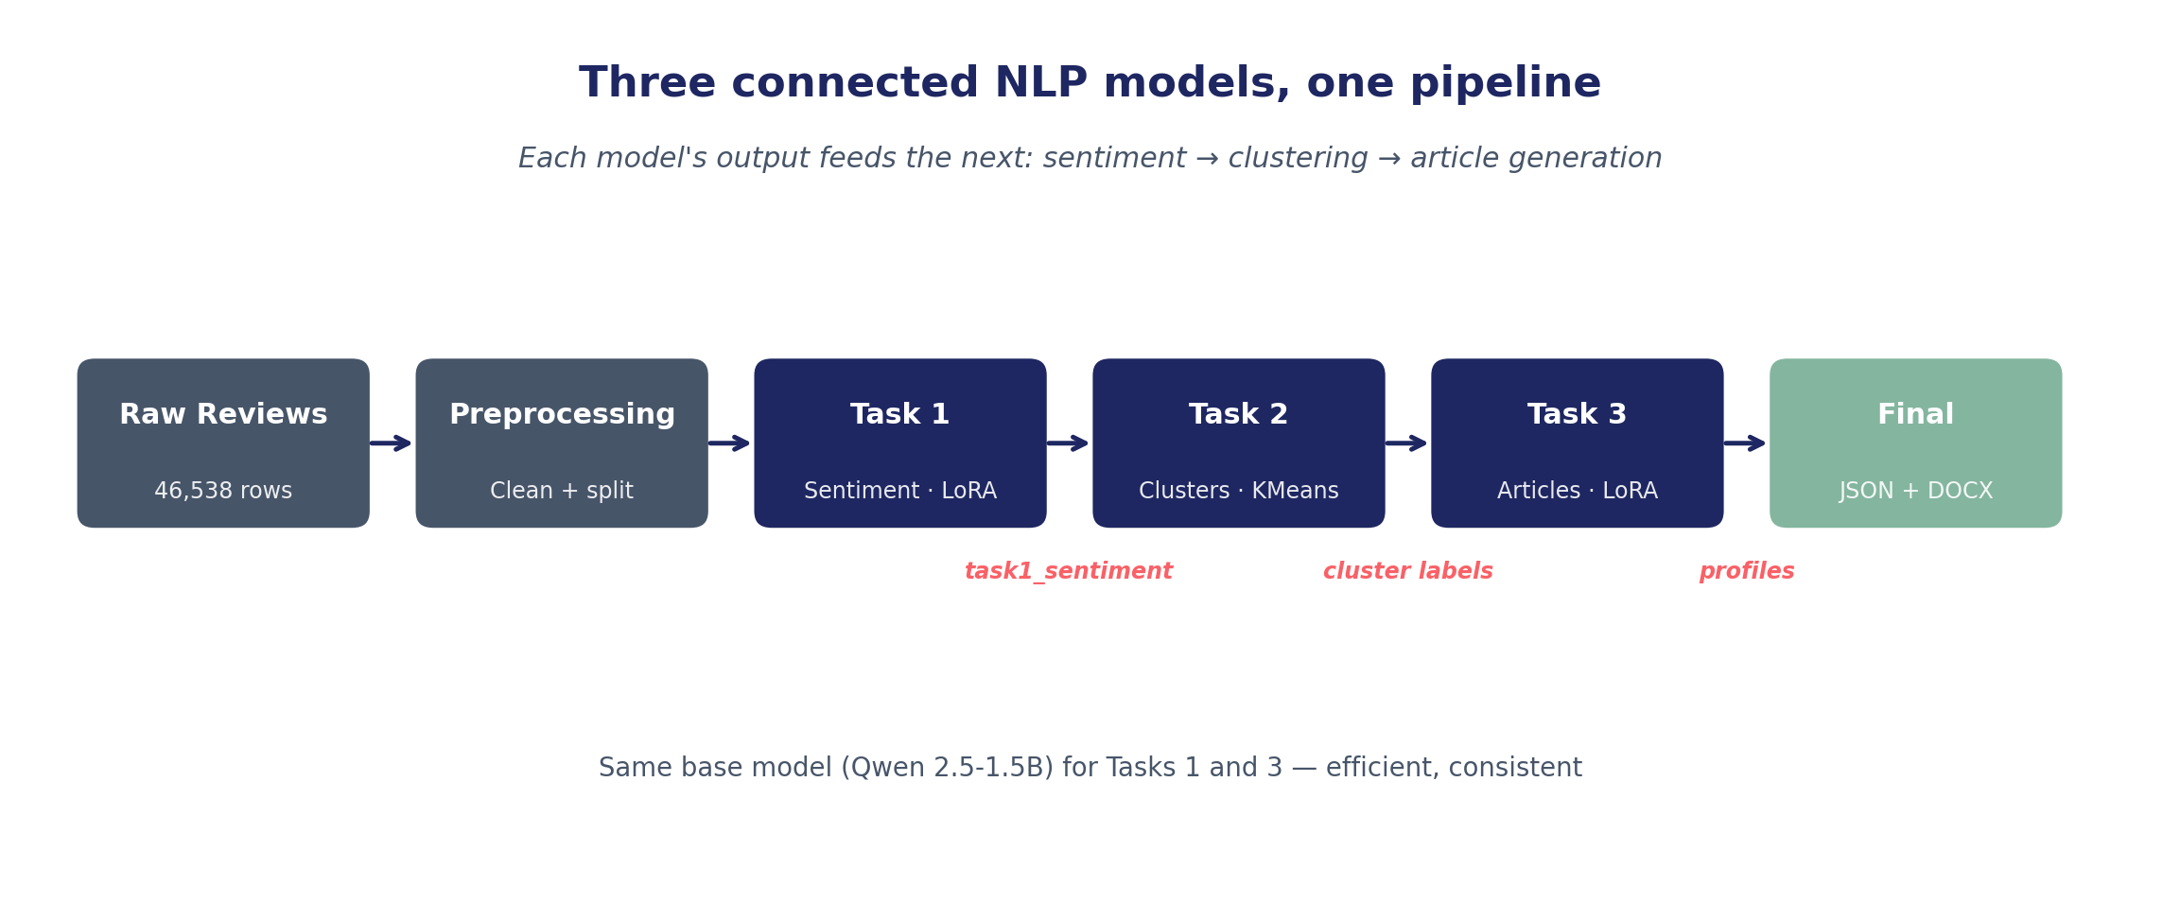
Introduction
Three connected models, one coherent application
Connected
Reusable
Honest
Each model's output feeds the next
Same Qwen backbone for Task 1 + 3
Statistical tests, held-out reference
3 / 12

Slide 4
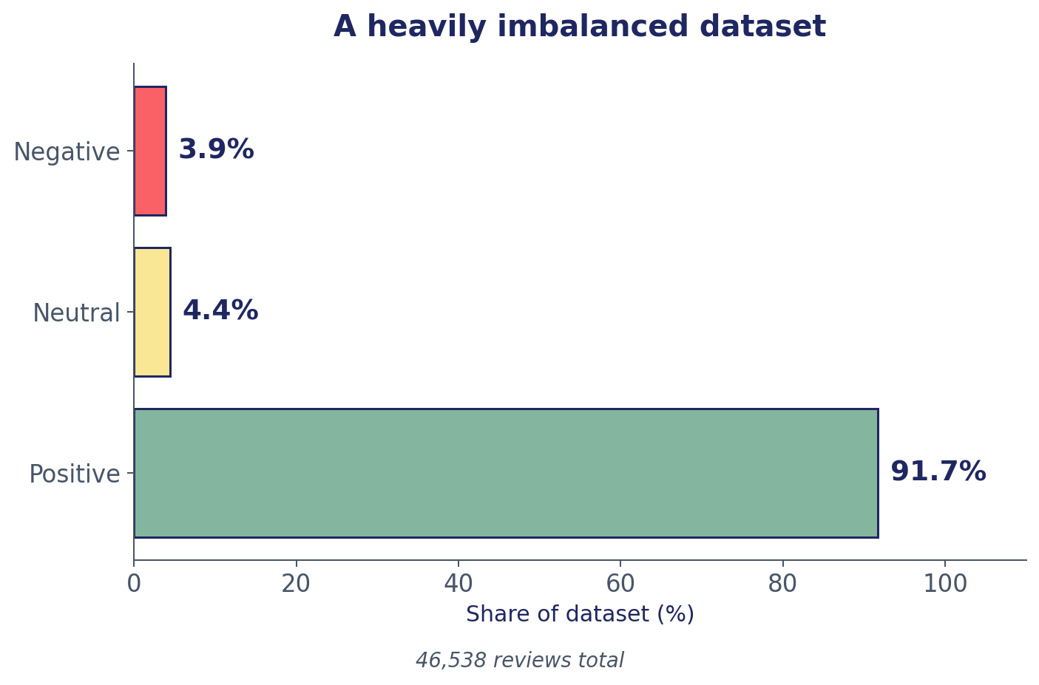
Methods
Dataset · preprocessing · evaluation strategy
3
datasets merged
46,538
rows after delete duplicated
37,230 / 9,308
split train/test
Preprocessing pipeline
Merge
›
Delete duplicated
›
Clean text
›
Rating → label
›
split
4 / 12

Slide 5
Model 1 — Sentiment Classification
Classify reviews as positive, neutral, or negative
The challenge
1
Zero-Shot
92% positive class — heavy imbalance
Rating-based labels are noisy: low-rating customers often write 'love it'
Neutral class is hard — overlaps with both ends of the spectrum
Goal: produce a usable label for downstream Tasks 2 & 3
Plain prompt
2
N-Shot
8 in-context examples
3
LoRA fine-tune
1500 balanced examples · r=8
5 / 12

Slide 6
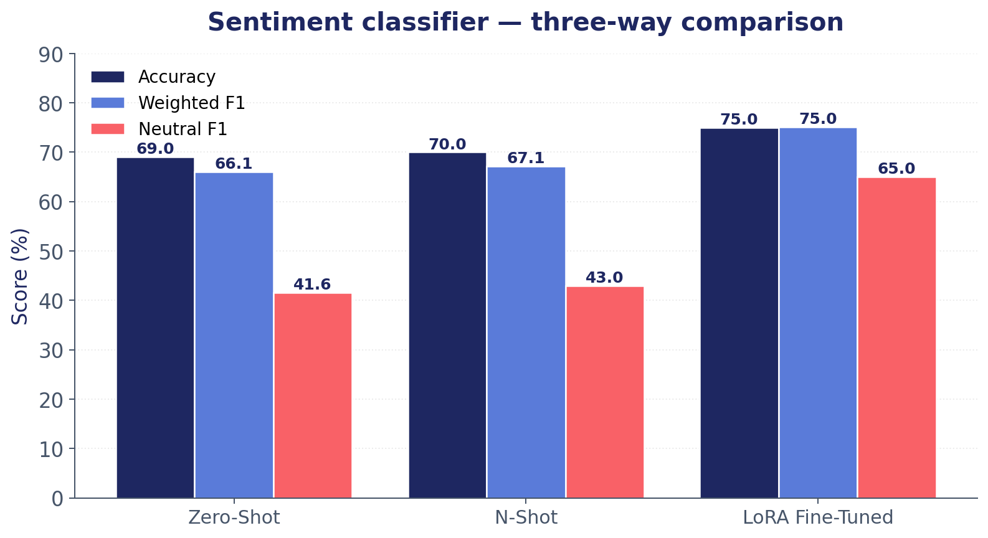
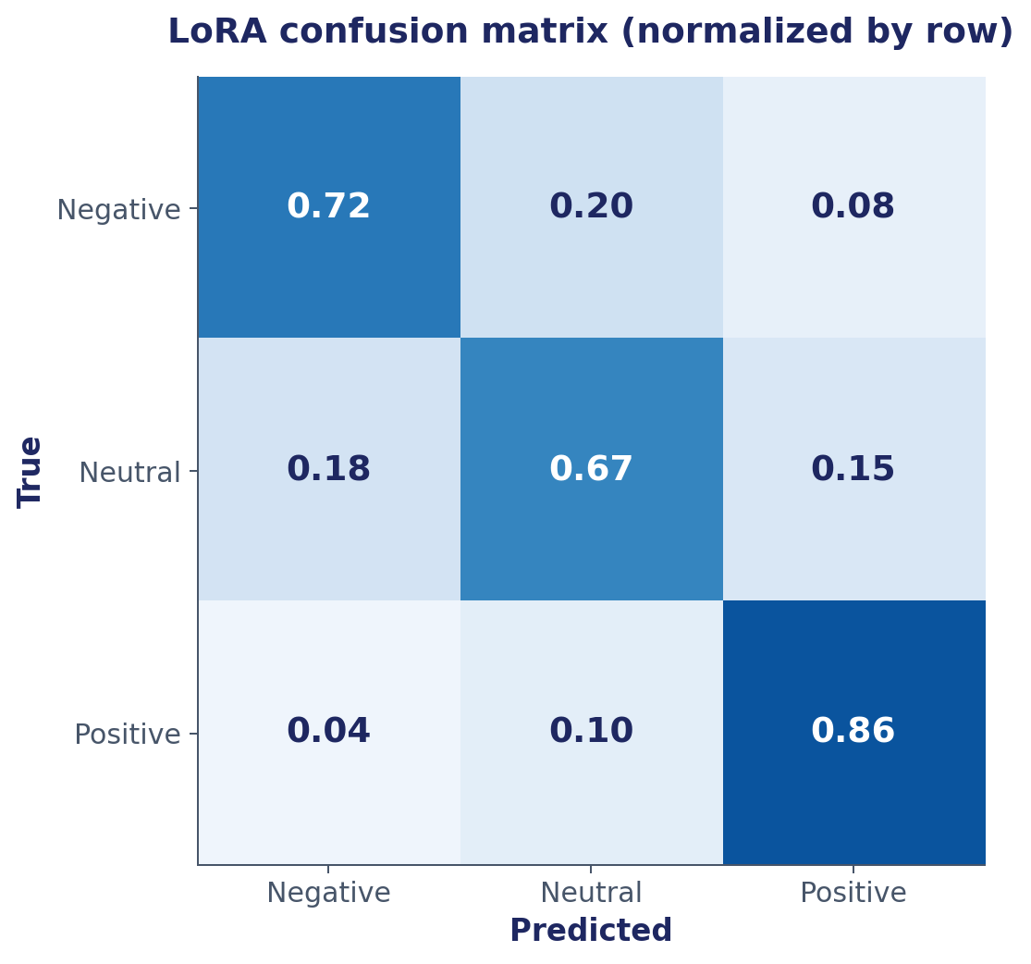
Model 1 — Evaluation
LoRA wins, and the gain is statistically real
+6 pts
+0.23 F1
accuracy gain (LoRA)
neutral class recovery
6 / 12

Slide 7
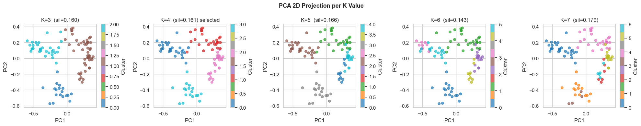
Model 2 — Category Clustering
Compress noisy product taxonomy into 4–6 meta-categories
The challenge
Option A — TF-IDF
Many fragmented sub-categories in raw data
Need 4–6 broad groups for downstream article generation
Unsupervised — no ground-truth labels
Trade-off: math-optimal K vs business-readable K
Bag-of-words baseline
Fast, interpretable
5,000-feature vectorizer
Option B — Sentence Embeddings
all-MiniLM-L6-v2 + KMeans
Captures semantic similarity
384-dim vectors
7 / 12

Slide 8
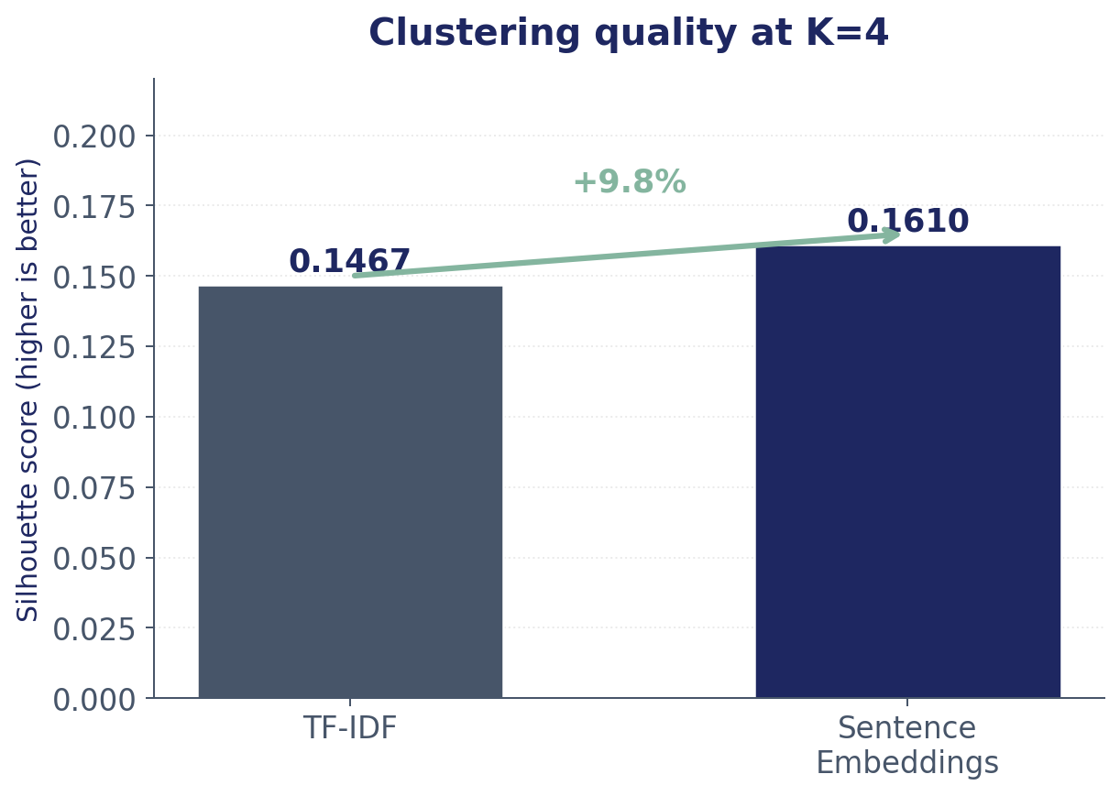
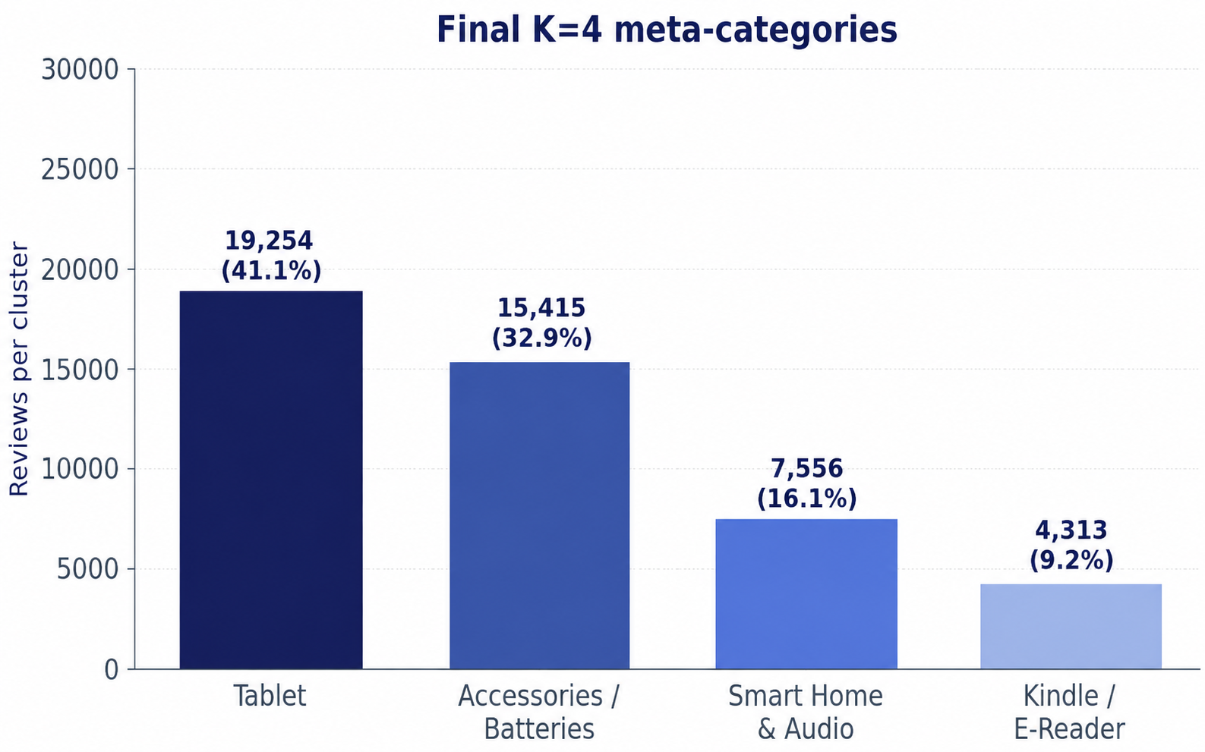
Model 2 — Evaluation
Sentence embeddings won. Then we picked K=4 for humans.
Accessories / Batteries
Kindle / E-Reader
Tablet
Smart Home & Audio
19,254 reviews
15,415 reviews
7,556 reviews
4,313 reviews
8 / 12

Slide 9
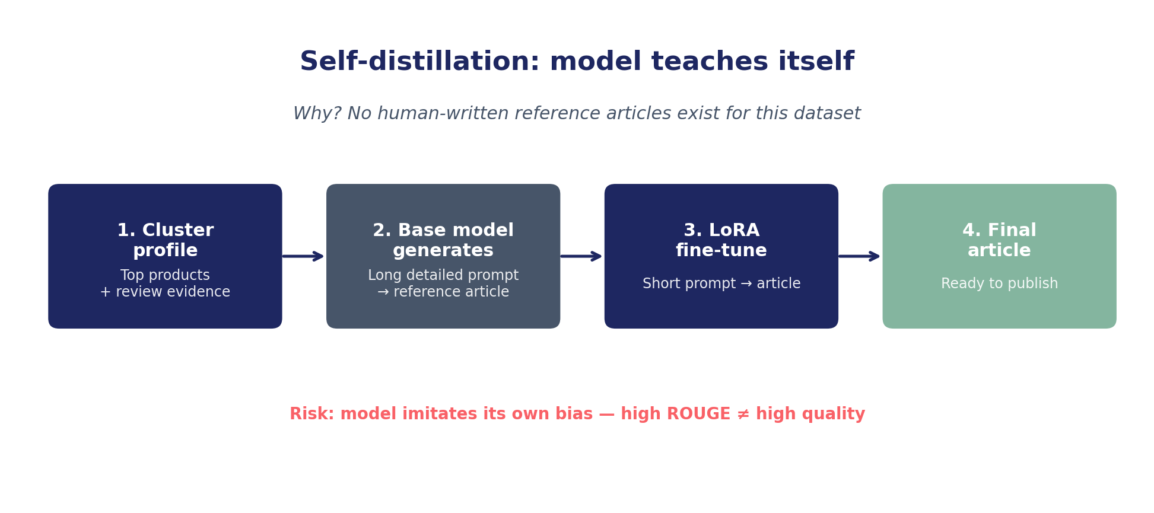
Model 3 — Article Generation
From cluster profile to a publishable recommendation article
Base model
Adapter
Training data
Eval metric
Qwen 2.5-1.5B-Instruct
LoRA r=16 · q/k/v/o_proj
Self-distilled references
(4 categories)
ROUGE-1 / 2 / L
vs held-out reviews
9 / 12

Slide 10
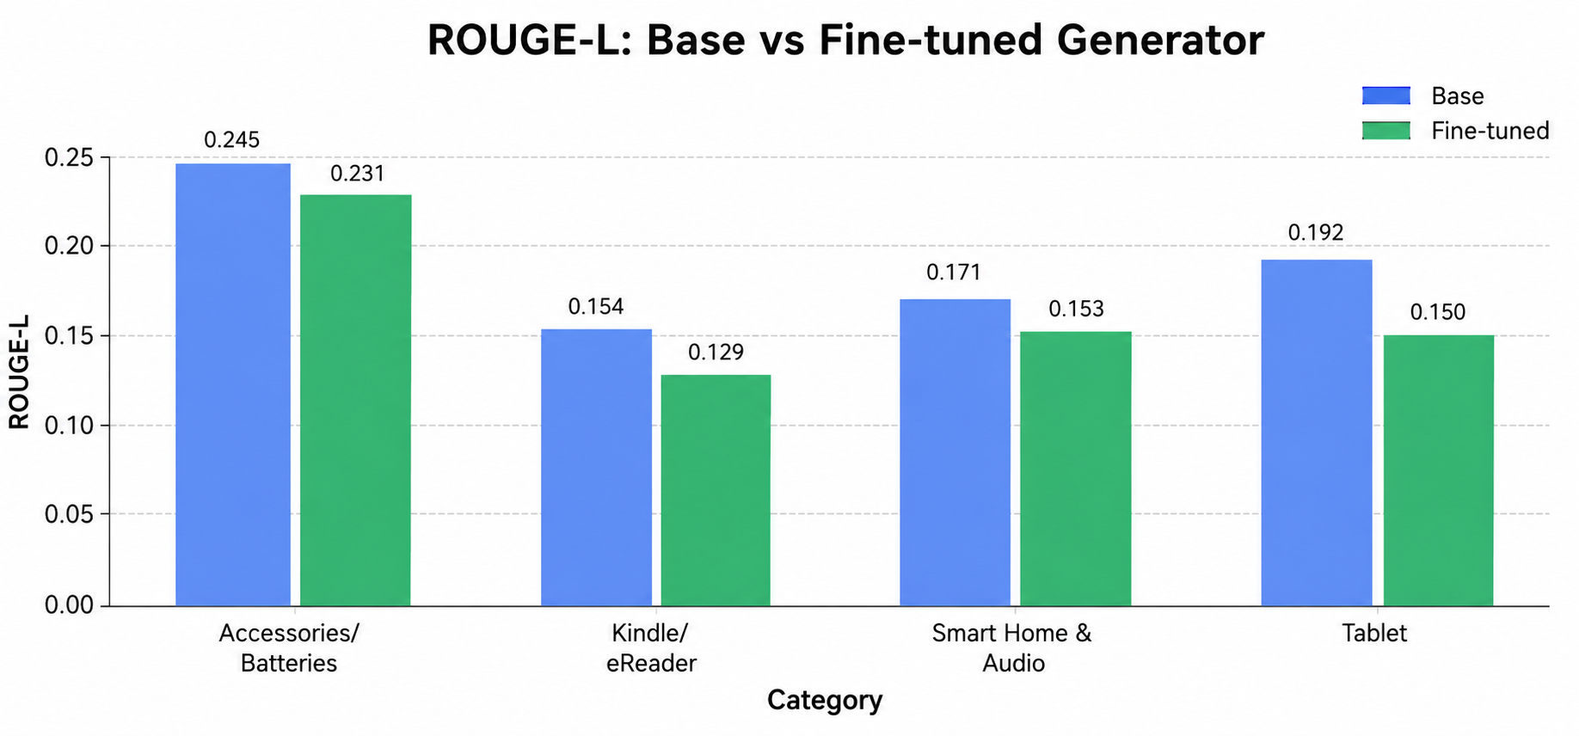
Model 3 — Evaluation
Mixed picture: gains on 2 of 4 categories
Honest read
Average ROUGE-L decreased from 0.191 to 0.166 (-0.025 pts)
All 4 categories scored lower after generator LoRA in this rerun
Grounding checks: 0 hallucination flags; average product grounding 75%
Interpretation: fine-tuning changed wording/structure but did not improve lexical overlap
Average ROUGE across all categories →
Base 0.191
→
Fine-tuned 0.166
(-2.5 pts)
10 / 12

Slide 11
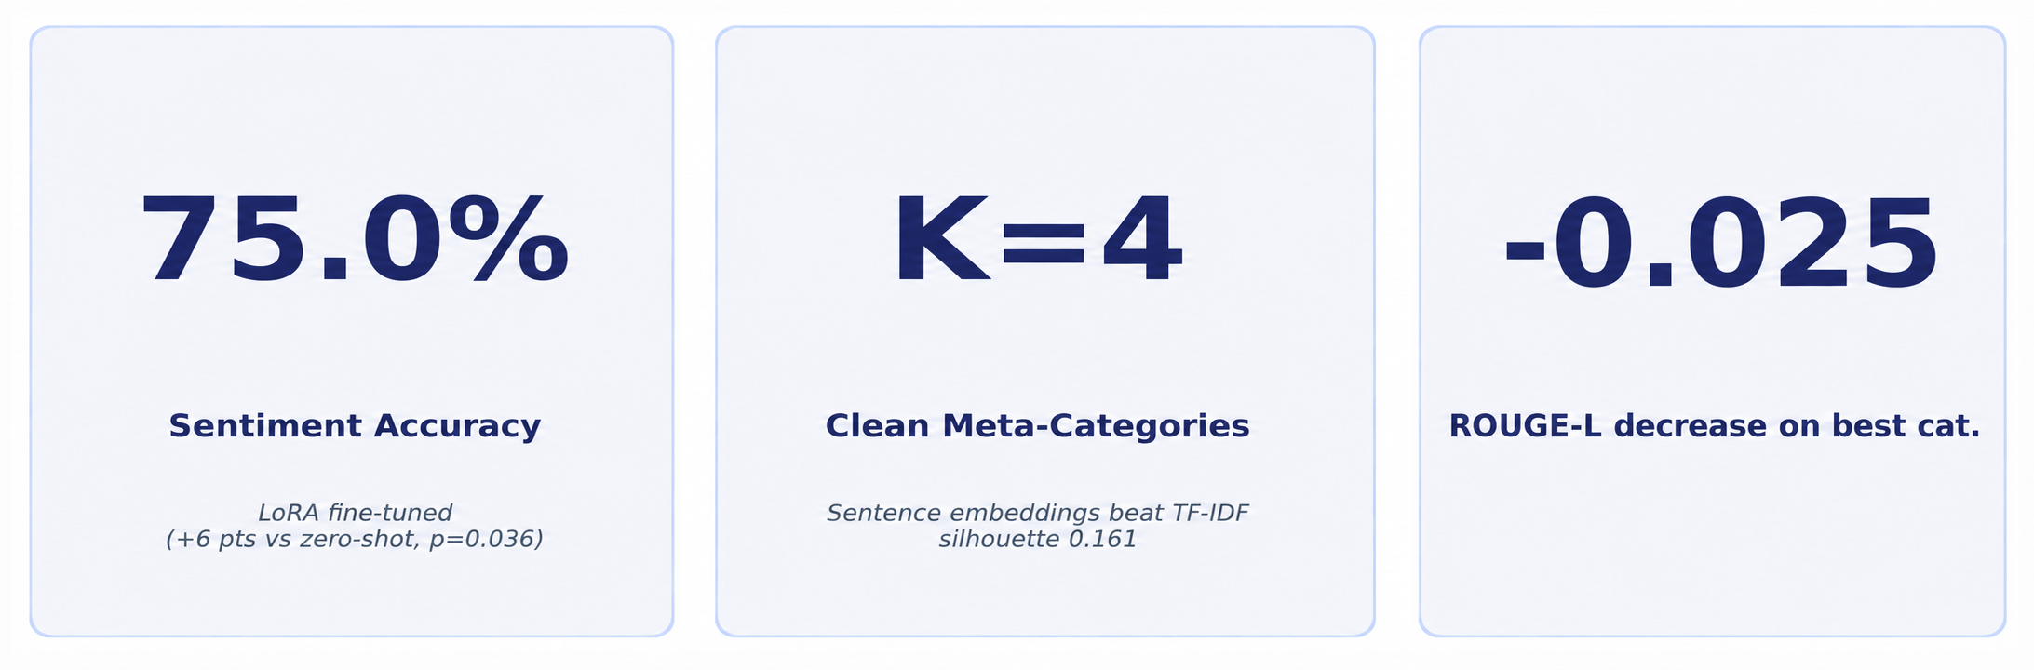
Takeaway
What we built, what worked, what didn't — and the medal
What worked
What's still open
LoRA → +6 pts accuracy, statistically significant
Strict no-leakage train/test split + handoff checks
K=4 categories were usable
Gradio demo connects the pipeline
No classical baseline (LogReg + TF-IDF) for Task 1
ROUGE alone doesn't capture article quality (Manual article review still matters)
Self-distillation can amplify base-model bias
11 / 12

