Slide 1


Project Report LAPR2
Make and manage payments to freelancers
Team 41 _ Class 1DKL
1190523 _ Diogo Domingues
1190633 _ Gonçalo Jordão
1190699 _ João Osório
1190995 _ Ricardo Mesquita
1191045 _ Rui Soares
Teachers/Advisors
Ana Barata (ABT)
Teresa Araujo (TPA)
Álvaro Teixeira (ACT)
Rosa Reis (RMR)

Slide 2
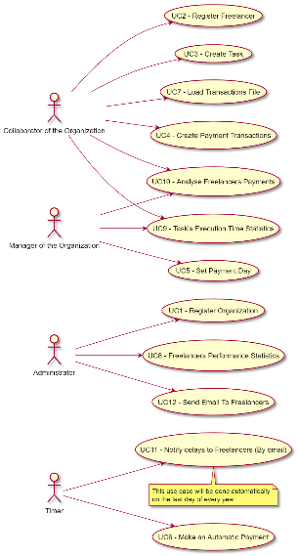
INTRODUCTION
We started by dividing the project into 11 different Use Cases, although in the end of the project we had to add another one (UC12).
Each of us was assigned 2 different UCs, with some adjustments.
1190633 _ Gonçalo Jordão (UC1/2/3)
1191045 _ Rui Soares (UC4/5)
1190995 _ Ricardo Mesquita (UC6/7)
1190699 _ João Osório (UC8/9)
1190523 _ Diogo Domingues (UC10/11/12)
After that, we all made the report together.

Slide 3

PROBLEM
The main goal of this project is to develop an application that allows organizations to make and manage payments to freelancers.

Slide 4
SOLUTION
Log In
Register Organization
Register Freelancer
Create Task

Slide 5
SOLUTION
Payment Transaction
Set Payment Day
Make an Automatic Payment
Load Transactions File

Slide 6
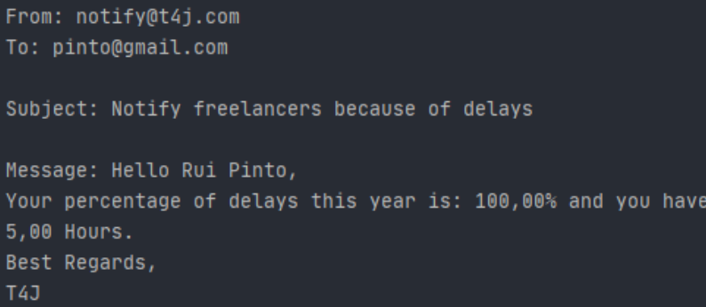
SOLUTION
Freelancers Performance Statistics
Task Execution Time Statistics
Analyse Freelancer Payments
Notify delays to Freelancers (By email)/Send Email to Freelancers

Slide 7
CONCLUSION
POSITIVE
All the functionalities were made.
Each member fulfilled the due date for each task.
The program does not open many windows at the same time.
NEGATIVE
Some methods were a little hard to make.
Some questions became unanswered.
Issue with Bitbucket since the beginning.

