Slide 1
HPC Repast Project

Slide 2
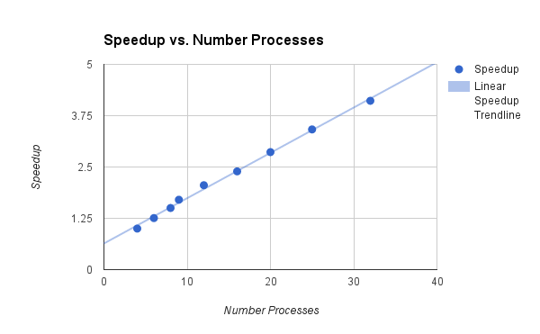
MPI Testing

Slide 3
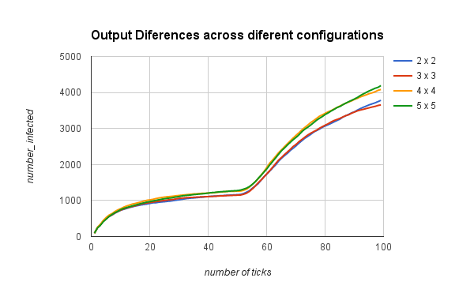
Output Analysis - Is the solution valid?
Same problem size in different configurations deeply affects the end result.
Over 10% in the the cases analysed.

Slide 4
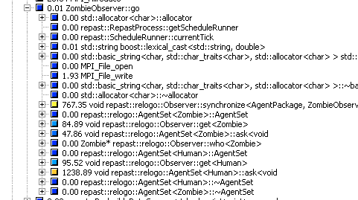
Initial Profiling
Two main hotspots.
Synchronization between agents
&
Agent Action Processing

Slide 5
Changed Functions
Removed extra code from Human::step() ✓
Added OpenMP Parallel For to Observer - turtleOn ✓
Added OpenMP Tasks to ZombieObserver - go ✓
Added OpenMP Parallel For to Observer - maxOneOf ✗
Added OpenMP Parallel For to AgentSet - ask ✗

Slide 6
Removed extra code from Human::step() ✓
Change with the most impact.
Speedups of up to 5.7 !
 | 2 * 2 | 3*3 | 4*4 | 5*5 | 4*8
Default Version | 730.37 | 521 | 311.63 | 202.15 | 151.24
Removed extra code from Human::Step | 162.86 | 90.07 | 61.16 | 41.05 | 33.09

Slide 7
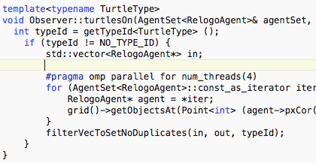
Added OpenMP Parallel For to Observer - turtleOn ✓
Small impact. Noticeable at larger problem sizes
Speedups of up to 1.2

Slide 8
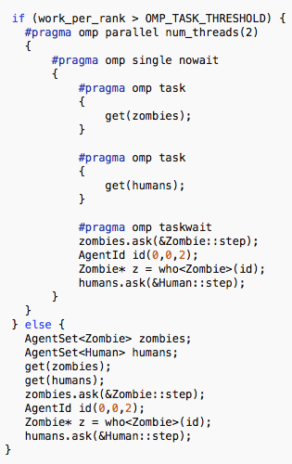
Added OpenMP Tasks to ZombieObserver - go ✓
Small impact. Noticeable at larger problem sizes. Worst performance at smaller work per rank. Threshold used to prefer the sequential version for smaller problem sizes.
Speedups of up to 1.7 for 1M Problem size

Slide 9
Added OpenMP Parallel For to maxOneOf ✗
Crash with segmentation fault.
Probably some race condition in memory access prevents use of threads.

Slide 10
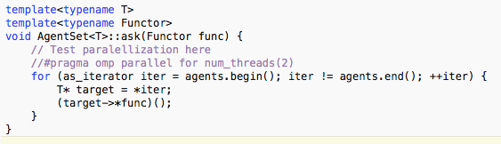
Added OpenMP Parallel For to AgentSet - ask ✗
Made it twice as slow.

Slide 11
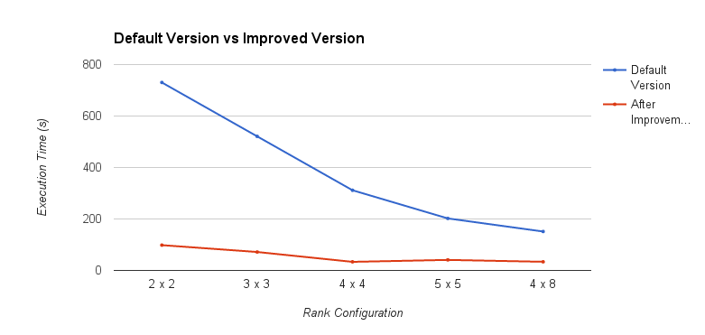

Slide 12
Thanks.

