Slide 1
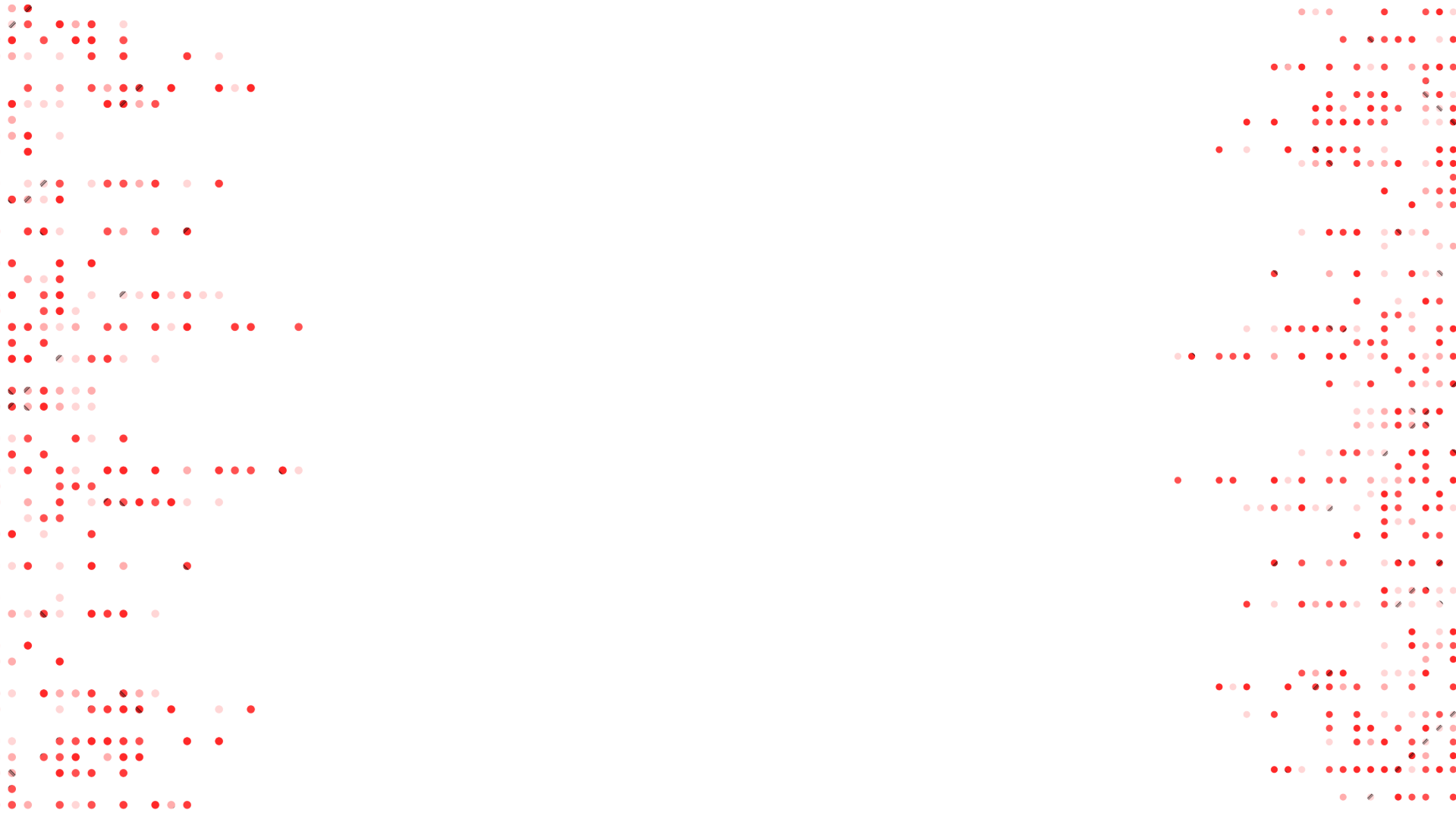
Saliency Maps
João Vítor C. Pessoa, Breno de Lima Galves
Universidade Federal do Rio de Janeiro (UFRJ)
Notes:
1

Slide 2

CONTENT
01
DEFINITION
02
TYPES OF SALIENCY MAPS
03
DEMO
04
EXPERIMENT
05
RESULTS
2

Slide 3





DEFINITION
A saliency map is a visualization technique that highlights the pixels in an image that are most influential for a neural network’s classification decision for a specific class. Saliency maps answer the question:
Which pixels does the network focus on when making its suggestion?
Cat.
That’s everything! Except a cat.
3
3
3
Notes:
1

Slide 4

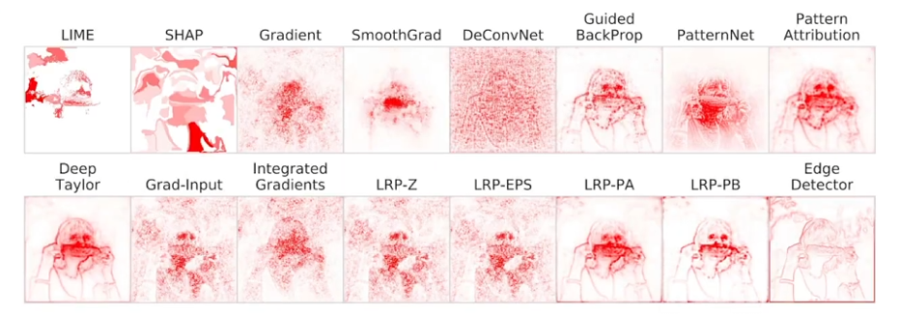
TYPES OF SALIENCY MAPS
Corn
4

Slide 5

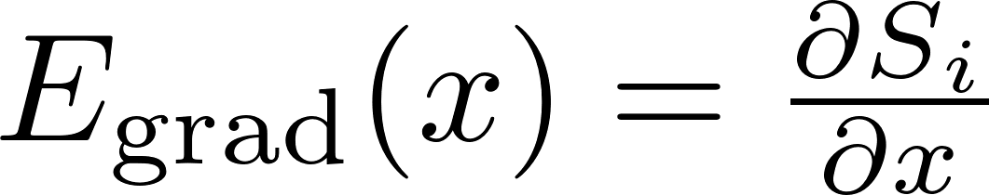
TYPES OF SALIENCY MAPS
Dog
Gradient
Perturbation direction of fastest ascent for the class logit
5

Slide 6
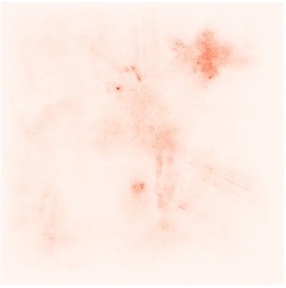
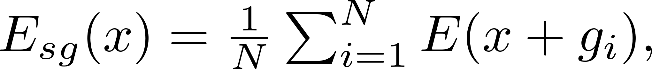
TYPES OF SALIENCY MAPS
Dog
SmoothGrad
Average saliency using inputs with Gaussian noise
6

Slide 7
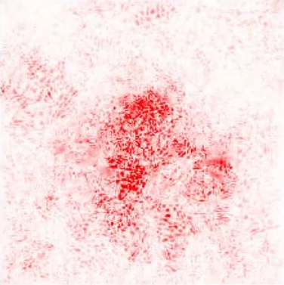
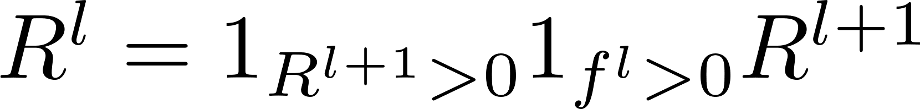
TYPES OF SALIENCY MAPS
Dog
Guided BackProp
Backprop with intermediate negative activations and gradients zeroed out
7
Notes:
1

Slide 8
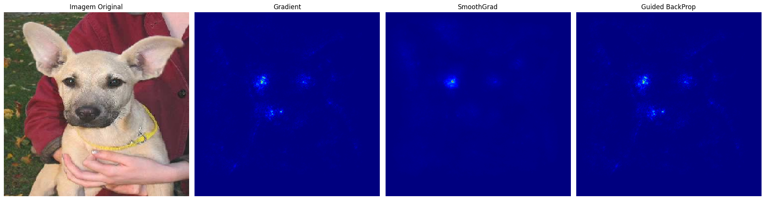
DEMO
Original
Gradient
SmoothGrad
Guided Backprop
7
Notes:
1

Slide 9
RESULTS
Gradient saliency maps show pixels that influence the output. It's worth noting that:
- Flat regions receive little or no assignment
- While important, these areas can be ignored by the gradient
- The importance of a pixel is measured by how much the model's output changes if it is changed
- Pixels that barely affect the output are considered irrelevant, even if they are semantically important
Gradients capture local sensitivity: how much each pixel affects the output
- Global completeness requires that the sum of the importances reflect the total output
- It is impossible to satisfy both simultaneously
- Globally important pixels may have zero gradient locally
7
Notes:
1

