Slide 1

Deep Inside Convolutional Networks
Visualizing Image Classification Models and Saliency Maps
Karen Simonyan, Andrea Vedaldi, Andrew Zisserman
Visual Geometry Group, University of Oxford

Slide 2




Understanding Deep Learning Models
Deep Convolutional Networks (ConvNets)
have become the architecture of choice for large-scale image recognition tasks,
achieving state-of-the-art performance on challenging datasets like ImageNet.
Understanding
why ConvNets make certain decisions
is crucial for building trust in AI systems, debugging model behavior,
and improving performance through informed architectural choices.
This paper introduces
two gradient-based visualization techniques
to interpret what ConvNets learn and how they process
visual information:
Class Model Visualization:
Generates images that represent what the network associates with a class
Image-Specific Saliency Maps:
Highlights which pixels in an image are most important for classification

Slide 3



What Are Saliency Maps?
Definition
The Gradient-Based Approach
A
saliency map
is a visualization technique that
Saliency maps are computed by calculating the
gradient of the class score
highlights the pixels in an image that are most
influential for a neural network's classification decision
with respect to the input image.
for a specific class.
w = ∂S
c
/ ∂I |
I₀
Key Concept
where
S
c
is the class score,
I
is the input image, and
w
is the
derivative (gradient).
Saliency maps answer the question:
"Which pixels does the network focus on when making its prediction?"
Interpretation
Advantages
The magnitude of the gradient indicates
Requires only a single back-propagation pass (extremely fast)
which pixels need to be changed the least
to affect the class score the
most. These pixels correspond to the object location in the
No additional annotations needed (uses existing trained network)
image.
Image-specific and class-specific insights

Slide 4


Class Model Visualization
Objective:
Generate an artificial image that maximizes the score for a specific class,
revealing what visual features the ConvNet associates with that class.
Key Insight
Method:
Numerical optimization of the input image using back-propagation while
Unlike unsupervised methods, this supervised approach directly identifies the neuron responsible for each class in the final fully-connected layer.
keeping network weights fixed. The optimization finds an L₂-regularized image that
maximizes the class score S
c
(I).
This approach visualizes the
"notion of a class"
as captured by the ConvNet, showing what the
network has learned to recognize for each category.
Examples: Numerically Computed Class Appearance Models
Generated images showing what the ConvNet has learned for classes like dumbbell, cup, dalmatian, bell pepper, lemon, husky, washing machine, computer keyboard, kit fox, goose, ostrich, and limousine.

Slide 5





Computing Saliency Maps
Mathematical Foundation: Taylor Expansion Approximation
For a linear model, pixel importance is straightforward:
S
c
(I) = w
c
T
I + b
c
However, ConvNets are highly non-linear. We approximate S
first-order Taylor expansion
c
(I) with a linear function near image I₀ using
:
S
c
(I) ≈ w
T
I + b
where w = ∂S
c
/∂I |
I₀
Computation Procedure
Step 1
Step 2
Step 3
Compute derivative
back-propagation
w
via
Rearrange elements of vector
w
to match
For RGB images, take
maximum magnitude
through the classification
image dimensions (m × n)
across color channels: M
ij
=
ConvNet
max
c
|w
h(i,j,c)
|
Key Properties
Extremely Fast:
Requires only a single back-propagation
Image-Specific:
Tailored to each individual input image
pass
Class-Specific:
Different maps for different target classes
No Extra Annotations:
Uses only image labels from training

Slide 6

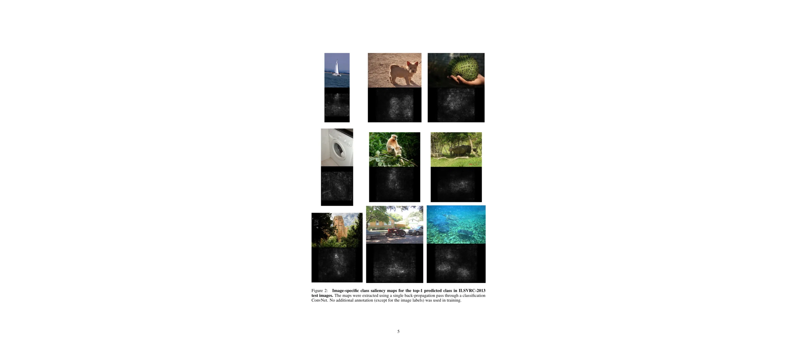
Saliency Map Examples
Visual examples from ILSVRC-2013 test images showing
original images
(top) and their corresponding
saliency maps
(bottom) for
the top-1 predicted class.
Key Observations:
Technical Details:
Saliency maps accurately highlight object boundaries and discriminative features such as the sail of the boat, the shape of animals, and distinctive object parts.
Maps extracted using a single back-propagation pass through the classification ConvNet. No additional annotation beyond image labels was used in training.

Slide 7

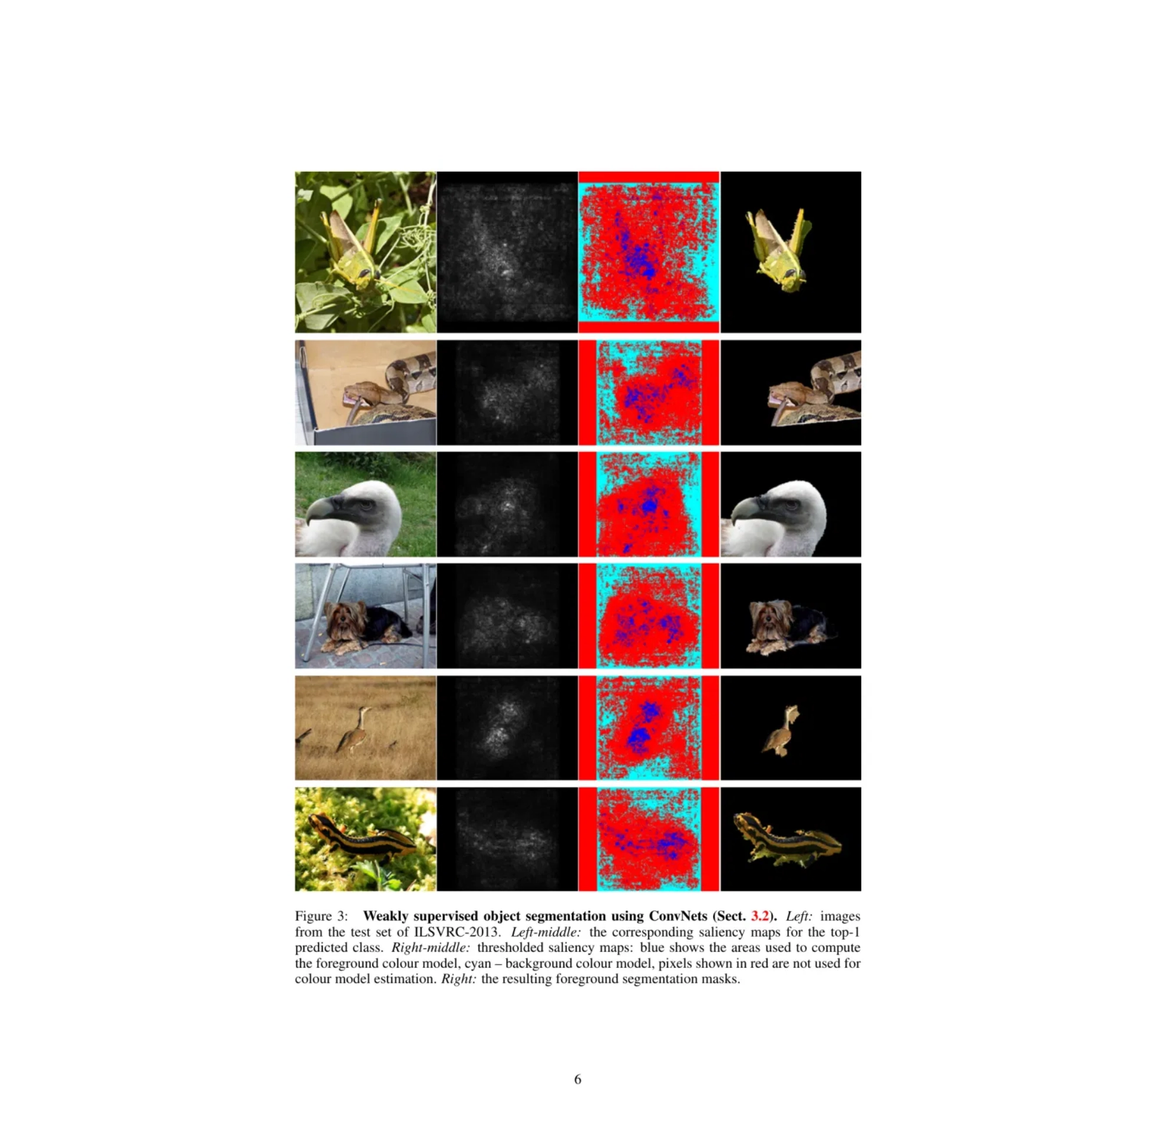

Application: Weakly Supervised Object Localization
From Saliency to Segmentation
Saliency maps implicitly encode object locations within images, enabling weakly supervised object localization without explicit bounding box annotations during training.
Localization Procedure
Compute class saliency map for the top-1 predicted class
Apply GraphCut color segmentation to refine the object mask
Estimate foreground model from high-saliency pixels (95% quantile)
Estimate background model from low-saliency pixels (30% quantile)
Extract largest connected component as final segmentation
Why GraphCut?
Saliency maps may only capture the most discriminative parts of objects. Color segmentation propagates the thresholded map to other object regions using color continuity cues.
ILSVRC-2013 Results
46.4% top-5 error
on the localization challenge, outperforming the
fully-supervised ILSVRC-2012 submission (50.0% error) despite being
weakly supervised.

Slide 8



Relation to Deconvolutional Networks
Theoretical Connection
Gradient-based visualization methods are closely related to
Deconvolutional Networks (DeconvNets)
. The DeconvNet
architecture aims to approximately reconstruct the input of each layer from its output, providing insights into what the
network has learned.
Mathematical Equivalence
Computing the approximate feature map reconstruction using a DeconvNet is
largely equivalent
to computing the derivative
using back-propagation:
Convolutional Layers
Max-Pooling Layers
Convolution with flipped kernel exactly corresponds to DeconvNet reconstruction
Gradient computation uses the same "switch" mechanism as DeconvNet
Exception:
ReLU layers show slight differences in how the sign indicator is computed
Gradient-Based Methods as a Generalization
Gradient-based visualization techniques
generalize
the DeconvNet approach because they can be applied to:
Any layer type
— not limited to convolutional layers
Fully-connected layers
— including the final classification layer
Class score neurons
— directly visualizing what drives the final prediction

Slide 9



Key Contributions and Impact
Two Gradient-Based Visualization Techniques
Class Model Visualization
Image-Specific Saliency Maps
Generates artificial images that are representative of a class, revealing what visual features the ConvNet has learned to associate with each category through numerical optimization.
Highlights discriminative areas in a given image by computing the gradient of the class score with respect to the input, identifying which pixels are most influential for classification.
Practical Applications
Weakly Supervised Object Segmentation:
Saliency maps can be used to initialize
Performance
GraphCut-based object segmentation without the need to train dedicated
segmentation or detection models, achieving competitive results on ILSVRC-2013.
46.4% top-5 error on ILSVRC-2013 localization, outperforming fully-supervised methods from the previous year
Model Interpretability:
These techniques provide insights into what ConvNets learn,
enabling better understanding, debugging, and improvement of deep learning
models.
Theoretical Insights
Future Research Directions
Gradient-based visualization methods generalize the DeconvNet reconstruction procedure, demonstrating that computing feature map reconstruction is largely equivalent to computing derivatives via back-propagation.
Incorporating image-specific saliency maps into learning formulations in a more principled manner, potentially improving both model training and interpretability.

