Slide 1
IEEE International Conference on Acoustics, Speech, and Signal Processing (ICASSP) 2026
TÍTULO
Marcello
Rafael
Breno
Martina
Thiago
João
Universidade Federal do Rio de Janeiro (UFRJ)
Rio de Janeiro
10-07-2025

Slide 2

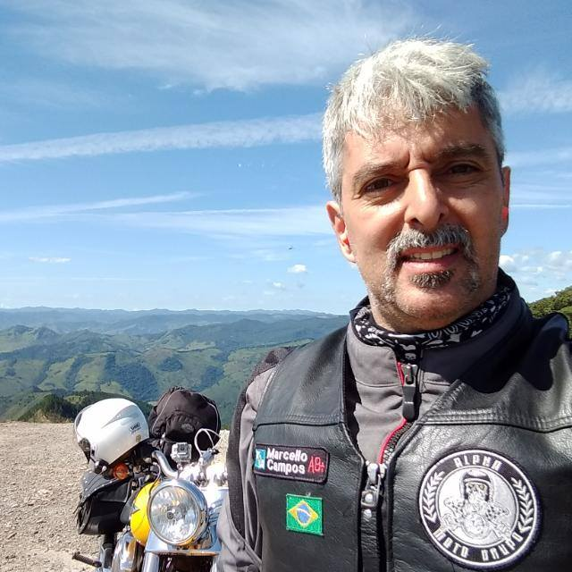
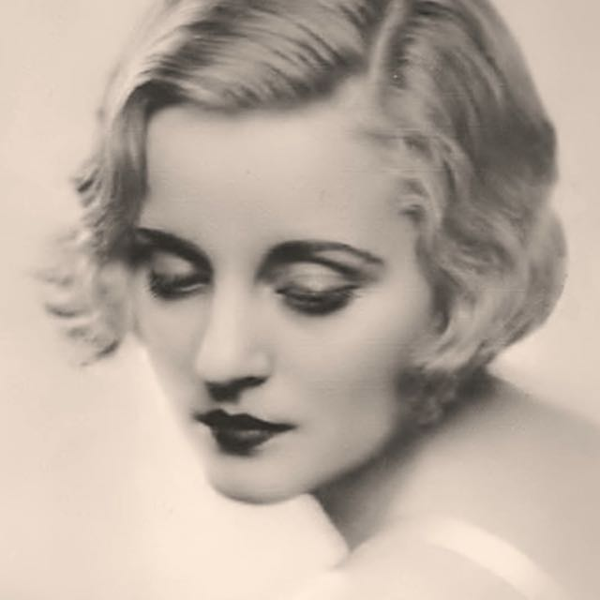
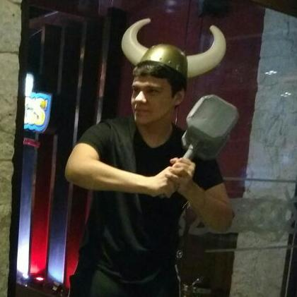
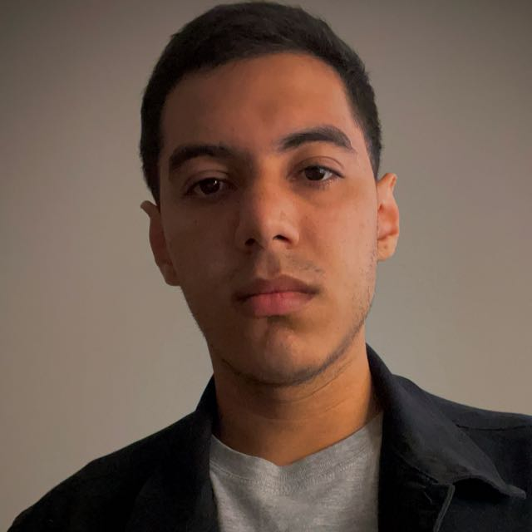
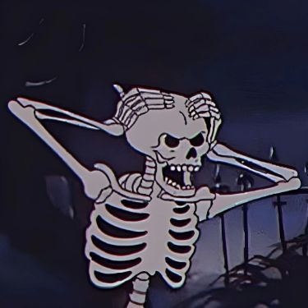


RESPONSIBLE / TEAM
Owner
Research Team
2

Slide 3
BASELINE
Timeline
Week 1
Week 2
Week 3
Week 4
Week 5
Week 6
Status
Reunião kick-off
2

Slide 4
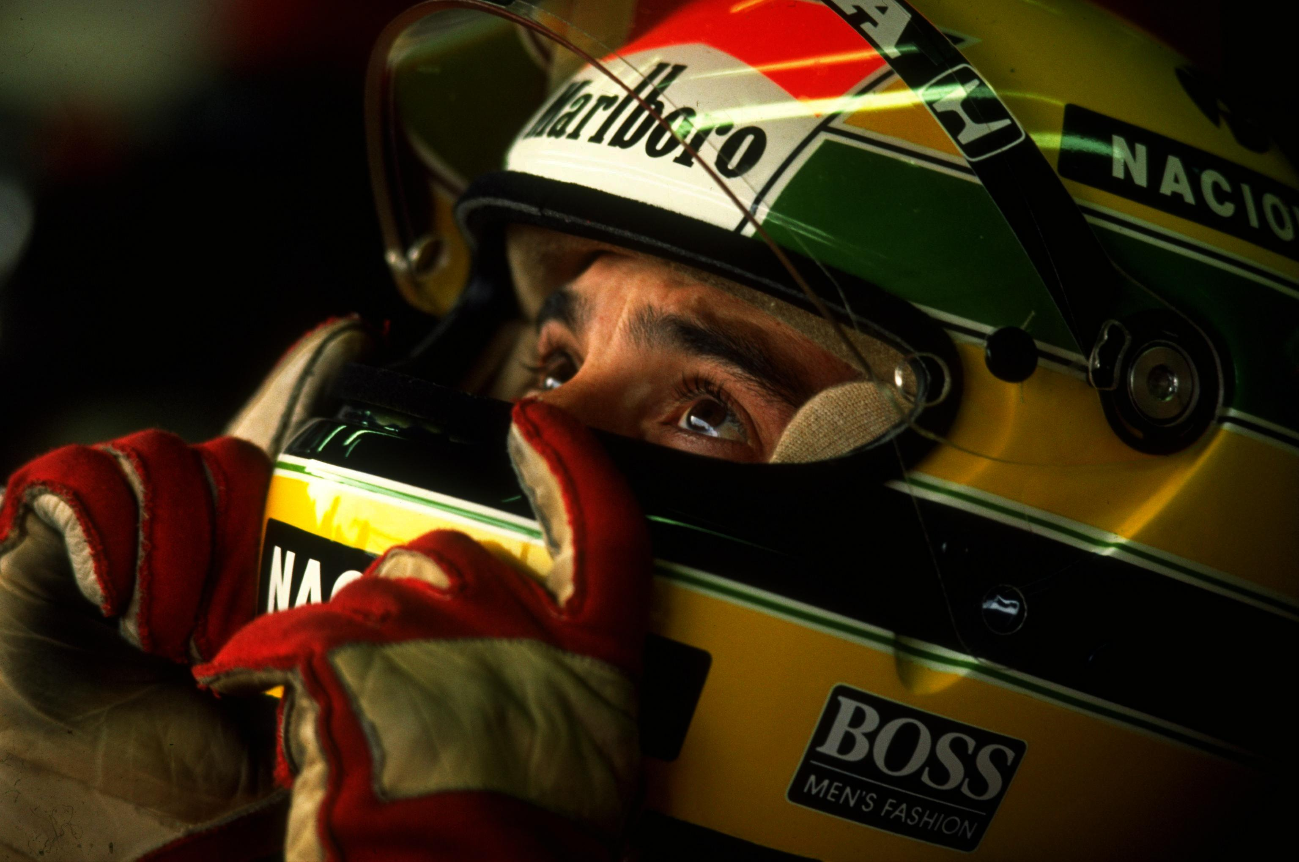

Slide 5




