Slide 1

Universidade Federal do Rio de Janeiro (UFRJ)
Quantization in Deep
Student: João Vítor C. Pessoa
Professors: Rafael da Silva Chaves, Marcello L. R. de Campos

Slide 2
SUMMARY OF THE LAST WEEK

Slide 3
CONTENT
01
LOREM
02
03
04
05

Slide 4
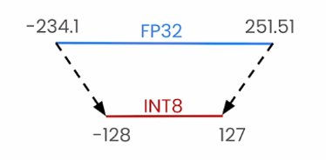
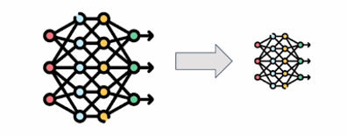
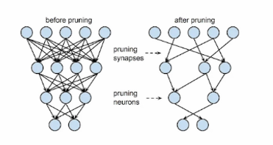
MODEL COMPRESSION
Quantization: Store the parameters of the model in lower precision
Knowledge distillation: Train a smaller model (student) using the original model (instructor)
Pruning: Remove connections (weights) from the model

Slide 5
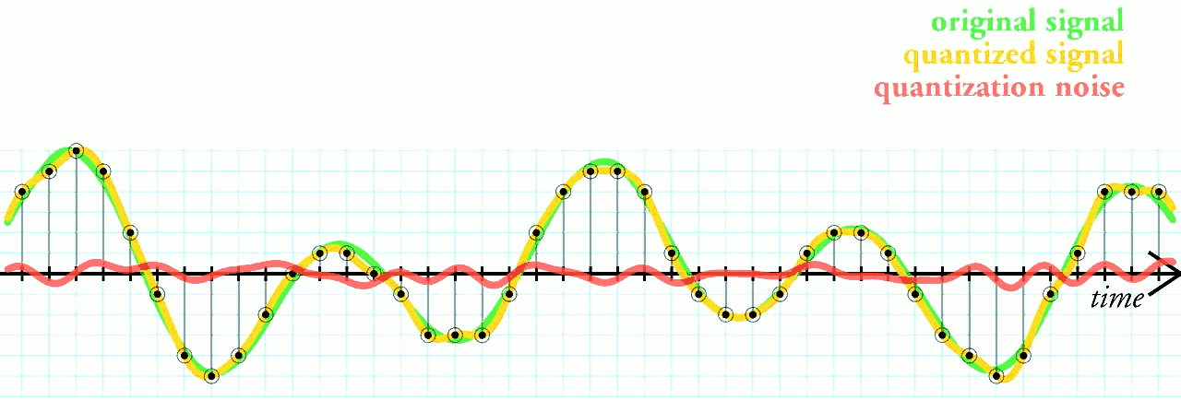
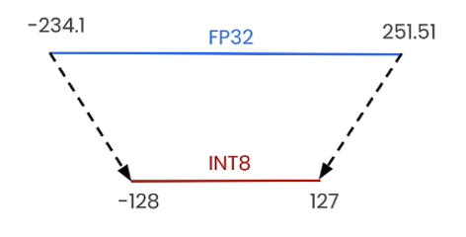
QUANTIZATION CONCEPT
Quantization refers to the process of mapping a large set to a smaller set of values

Slide 6
TYPES OF QUANTIZATION
Linear Quantization:
0
1
2
Levels uniformly distributed across the data range
Simple and fast for hardware
Very efficient on modern GPUs and CPUs
Can waste precision when data clusters are close to zero
Non-Linear Quantization:
0
1
2
Non-uniform quantization intervals
More precision where data are more frequent
Lower quantization error in clustered distributions
Higher computational cost and lower hardware efficiency

Slide 7
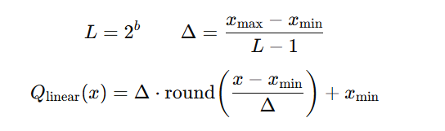
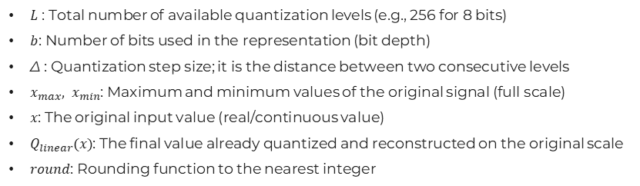
LINEAR INTERPOLATION APPROACH
Linear Quantization:
$L$ : Total number of available quantization levels (e.g., 256 for 8 bits)
$b$: Number of bits used in the representation (bit depth)
Δ : Quantization step size; it is the distance between two consecutive levels
$x_{max}, x_{min}$: Maximum and minimum values ​​of the original signal (full scale)
$x$: The original input value (real/continuous value)
$Q_{linear}(x)$: The final value already quantized and reconstructed on the original scale
$round$: Rounding function to the nearest integer

Slide 8
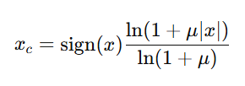


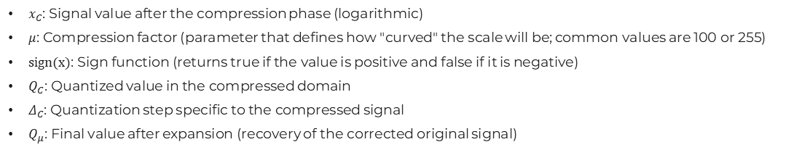
LINEAR INTERPOLATION APPROACH
Non-Linear Quantization:
Compression:
Quantization:
Expansion:
$x_{C}$: Signal value after the compression phase (logarithmic)
$μ$: Compression factor (parameter that defines how "curved" the scale will be; common values ​​are 100 or 255)
$sign(x)$: Sign function (returns true if the value is positive and false if it is negative)
$Q_{C}$: Quantized value in the compressed domain
$Δ_{C}$: Quantization step specific to the compressed signal
$Q_{μ}$​: Final value after expansion (recovery of the corrected original signal)

Slide 9
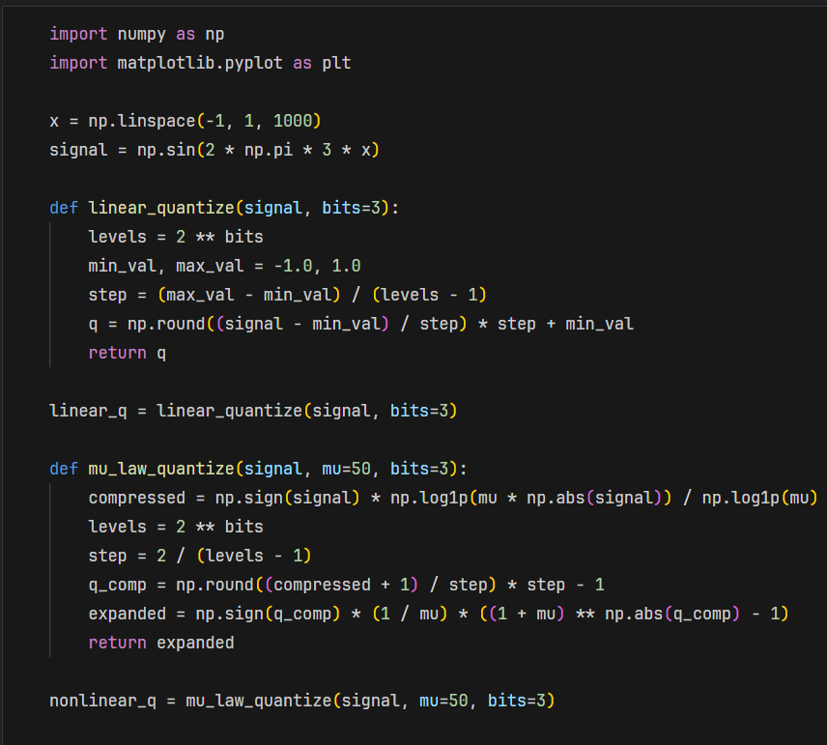
LINEAR INTERPOLATION APPROACH
Code example:

Slide 10
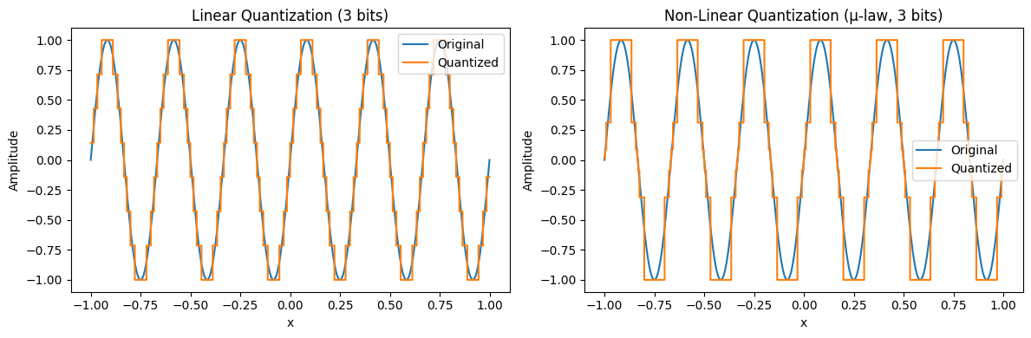
LINEAR INTERPOLATION APPROACH

Slide 11
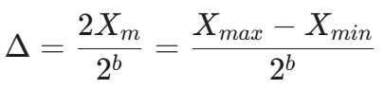
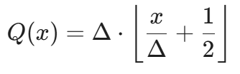

CLASSIC DSP APPROACH
$X_{m}$: It represents the maximum amplitude of the signal (it is generally assumed that the signal ranges from ${−X}_{m}$ to ${+X}_{m}$)
$\left\lfloor …\right\rfloor$: The floor function, which rounds down (used here together with to simulate rounding)
e(n): Quantization error (or noise); the difference between the real signal and the quantized signal
x[n]: Sample of the original signal in discrete time
Obs.: Reference book: Discrete-time signal processing by Alan V. Oppenheim, Ronald W. Schafer

Slide 12
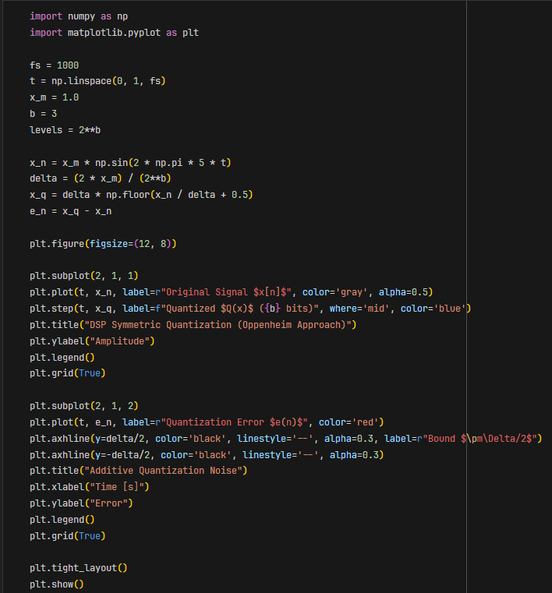
CLASSIC DSP APPROACH
Code example:

Slide 13
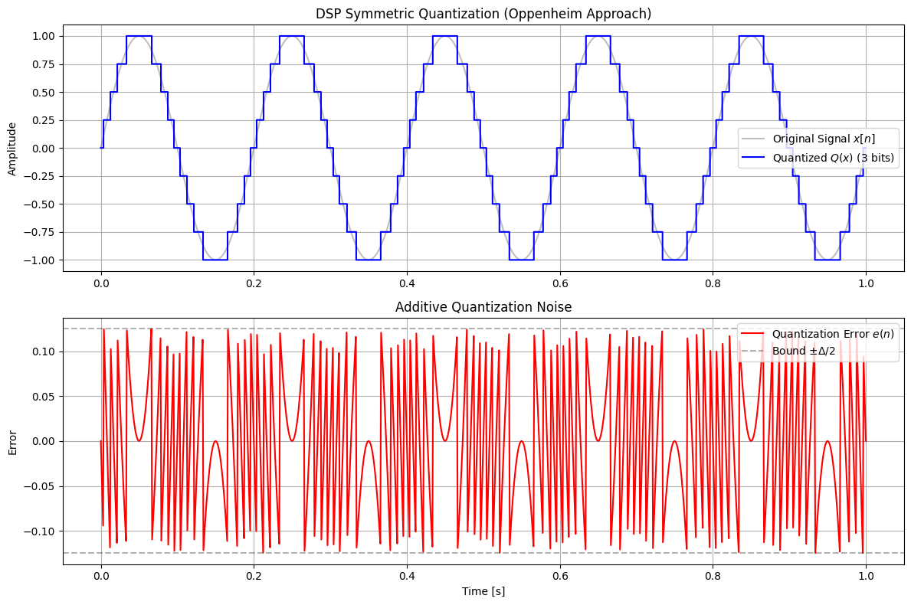
CLASSIC DSP APPROACH

Slide 14
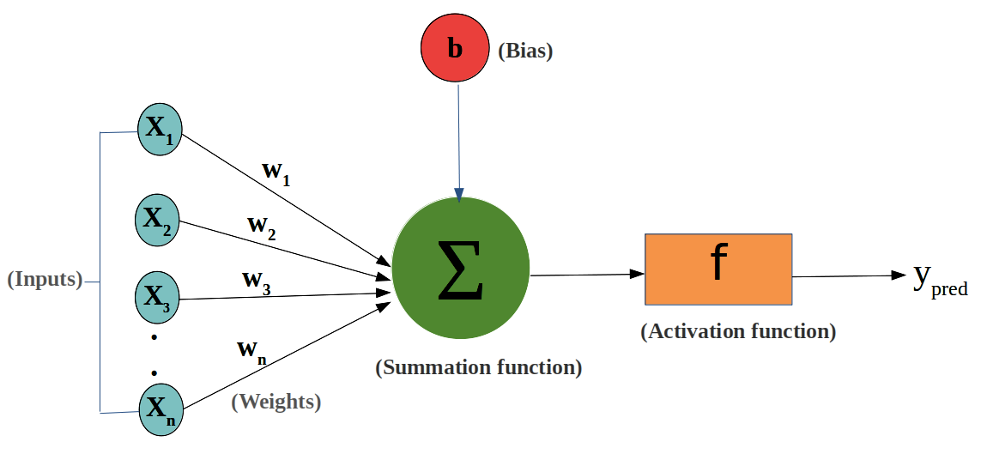
MACHINE LEARNING APPROACH
You can quantize:
The weights: Neural network parameters
The activations: Values that propagate through the layers of the neural network

Slide 15
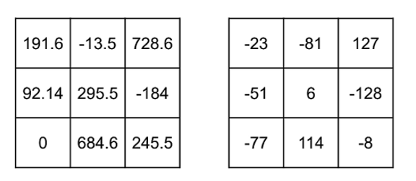
LINEAR QUANTIZATION EXAMPLE
8-bit quantization: map values that are stores in torch.float32 to torch.int8 (e.g. between [-128,127])
Original tensor
Quantized tensor
How do we get the quantized tensor q?

Slide 16
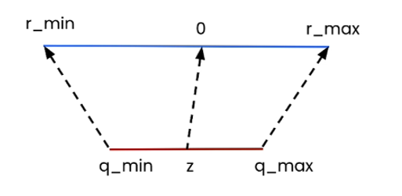
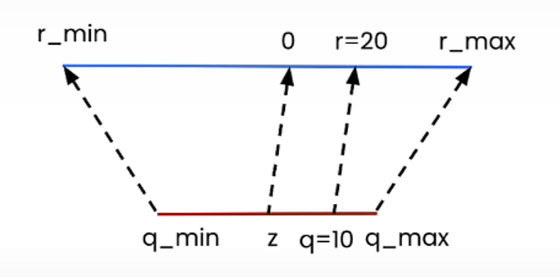

QUANTIZATION
Example with S=2 and Z=0:
we get r = 2(Q - 0) = 2Q
For Q = 10, we gave r = 2 * 10 =20
Idea: linear mapping
Formula:
$$r=s\left(q−z\right)$$
original value
(e.g. in FP32)
quantized value
(e.g. in INT8)
Scale
(e.g. in FP32)
Zero-point
(e.g. in INT8)
How do we get back the original tensor?

Slide 17
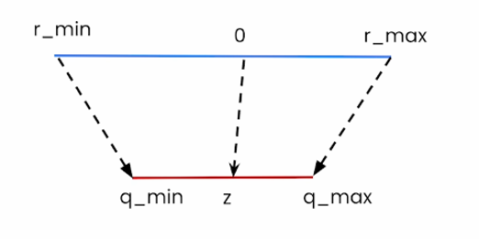





DEQUANTIZATION
$$r=s\left(q−z\right)$$
$\frac{r}{s}= q − z$
$\frac{r}{s}+ z= q$
$q = round\left(\frac{r}{s}+z\right)$
$$q = int\left(round\left(\frac{r}{s}+z\right)\right)$$
How to determine s and z?

Slide 18


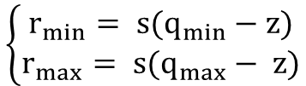
SCALE AND ZERO POINT
Linear quantization maps the floating point range $[r_{min}, r_{max}]$ to the quantized range $[q_{min}, q_{max}]$
If we look that the extreme values, we should get:
$$\left\{\begin{aligned}r_{min}= s(q_{min}−z) \\ r_{max}= s(q_{max}− z)\end{aligned}\right.$$
If we subtract the first equation from the second one, we get the scale s:
$$s=\left(r_{max}−r_{min}\right)/\left(q_{max}−q_{min}\right)$$
For the zero point z, we need to round the value since it is a n-bit integer:
$z=int(round\left(q_{min}−r_{min}/s\right)$)
Why make z an integer?
Represent zero (in the original “r” range) with an integer in the quantized “q” range
E.g. zero-padding in Convolutional Neural Networks use tensors of exactly zero

Slide 19











DERIVATION
$$\left\{\begin{aligned}r_{min}= s(q_{min}−z) \\ r_{max}= s(q_{max}− z)\end{aligned}\right.$$
scale:
zero point:
$$r_{min}−r_{max}= s(q_{min}−z) −s(q_{max}− z)$$
$$r_{min}= s(q_{min}−z)$$
$$= s((q_{min}−z) −(q_{max}− z))$$
$$r_{min}= sq_{min}−sz$$
$$= s((q_{min}−q_{max}− z + z))$$
$$sz= sq_{min}−r_{min}$$
$$r_{min}−r_{max}= s(q_{min}−q_{max})$$
$$z= \frac{sq_{min}−r_{min}}{s}$$
$$\frac{r_{min}−r_{max}}{q_{min}−q_{max}}= s$$
$$z=q_{min}−\frac{r_{min}}{s}$$
$$z=int(round(q_{min}−\frac{r_{min}}{s}))$$

Slide 20
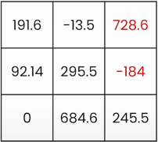

8-BIT EXAMPLE
$$\left\{\begin{aligned}[r_{min},r_{max}]=[−184, 728.6] \\ [q_{min},q_{max}]=[−128, 127]\end{aligned}\right.$$
$$s = (728.6−(−184))/(127−(−128)) = 3.58$$
$$z=int(round((−128)−(−184)/3.58)) = -77$$

Slide 21
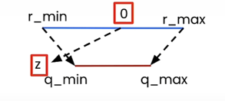
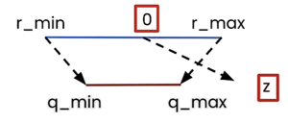


ZERO POINT OUT OF RANGE
Case 1 $(z < q_{min})$: We set $z = q_{min}$
Case 2 $(z > q_{max})$: We set $z = q_{max}$

Slide 22
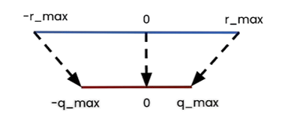
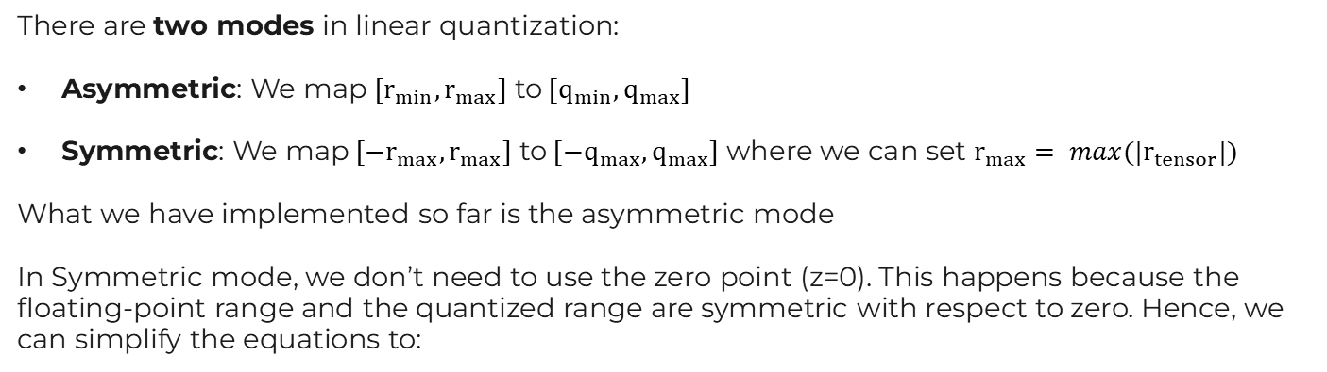

LINEAR QUANTIZATION MODE
There are two modes in linear quantization:
Asymmetric: We map ${[r}_{min},r_{max}]$ to${[q}_{min},q_{max}]$
Symmetric: We map ${[−r}_{max},r_{max}]$ to${[−q}_{max},q_{max}]$ where we can set $r_{max}= max(|r_{tensor}|)$
What we have implemented so far is the asymmetric mode
In Symmetric mode, we don’t need to use the zero point (z=0). This happens because the floating-point range and the quantized range are symmetric with respect to zero. Hence, we can simplify the equations to:
$$\left\{\begin{aligned}q=int(round(r/s)) \\ s=r_{max}/q_{max}\end{aligned}\right.$$

Slide 23
TRADE-OFFS IN QUANTIZATION MODES
Utilization of quantized range:
When using asymmetric quantization, the quantized range is fully utilized
When symmetric mode, if the float range is biased towards one side, this will result in a quantized range where a part of the range is dedicated to values that we’ll never see (e.g RELU where the output is positive)
Simplicity: Symmetric mode is much simpler compared to asymmetric mode
Memory: We don’t store the zero-point for symmetric quantization

Slide 24
QUANTIZATION GRANULARITIES

Slide 25
QUANTIZATION PER TENSOR

Slide 26
QUANTIZATION PER CHANNEL

Slide 27
QUANTIZATION PER GROUP

Slide 28
TRADE-OFFS OF QUANTIZATION
Advantages:
Smaller model
Speed gains
Memory bandwidth
Faster operations
GEMM: General Matrix Multiply (matrix to matrix multiplication)
GEMV: General Matrix Vector Multiplication (matrix to vector multiplication)
Challenges:
Quantization error
Retraining (Quantization Aware Training)
Limited Hardware support
Callibration dataset needed
Packing/unpacking

Slide 29
QUANTIZATION STRATEGIES
Post-Training Quantization (PTQ)
Pre-trained model; weight conversion in the final phase
Advantages: Quick implementation, without requiring the entire training set
Ideal Scenario: Projects with short deadlines where some loss of precision is acceptable
Quantization Aware Training (QAT)
Quantization is simulated during training for model adaptation
Advantages: Lower accuracy loss; INT8 performance close to FP32
Ideal Scenario: Critical applications requiring high precision and sensitivity to quantization

Slide 30
IMPACTS ON HARDWARE
Memory
Data Density: FP32 occupies 4 bytes per parameter, while INT8 occupies only 1 byte
Storage Efficiency: A model with 1 million parameters reduces its size from 4 MB to 1 MB
Bottleneck Reduction: The processor fetches 4 INT8 numbers in the same time it would take for 1 FP32 number
Processing
SIMD (Single Instruction, Multiple Data) technology allows the processor to apply a single instruction to multiple data simultaneously, functioning like a vector. In modern 256-bit registers, the workspace is fixed, but the amount of data processed depends on its precision. By switching from FP32 to INT8, the data density in the register increases dramatically, allowing for much greater parallelism
Accumulator
Although the input is INT8, intermediate results use larger registers, such as INT32
Overflow Prevention: Multiplying two 8-bit numbers generates up to 16 bits; successive sums quickly overflow the original 8 bits
Quality Assurance: The register temporarily "fattens" to prevent excessive loss of precision during calculation
Numerical Integrity: Essential for maintaining the statistical stability of Multilayer Neural Networks (MLP)

Slide 31
HISTORY
Origins
Quantization has migrated from Digital Signal Processing and data compression (MP3, JPEG) to Machine Learning.
Neural networks are resistant to noise, they do not need high decimal precision to identify complex statistical patterns
The Awakening and Proof of Concept (2014-16)
Projects like BinaryConnect have demonstrated the viability of neural networks with extreme precision. Google has initiated the large-scale industrial adoption of INT8 in its TPUs for search and translation services
Expansion to Mobile Devices (2017-18)
The emergence of frameworks like TensorFlow Lite and PyTorch Mobile abstracts away some of the complexity of quantization and allows for efficient deployment on smartphones
Consolidation and Standardization (2019-21)
Post-training INT8 quantization (PTQ) has become a production standard, integrated into pipelines such as TensorRT and ONNX Runtime, bringing the accuracy closer to that of the original models
Expansion to LLMs (2022-2024)
The emergence of new methods (GPTQ, AWQ, and SmoothQuant) allows for the quantization of billions of parameter models with minimal losses. Full integration with compilation and distillation pipelines
Economic Viability (2025)
Quantization has gone from being just optimization to becoming an essential requirement for the production of large-scale language models

Slide 32
QUANTIZATION ERROR
Traditional Assessment Methods
Baseline Analysis (Direct Comparison): Uses the high-precision network as a benchmark to measure post-quantization deviation (e.g., MSE or accuracy degradation)
Bit-Accurate Simulation (Hardware Emulation): Emulates specific hardware behaviors, such as rounding modes and saturation to predict real-world inference effects
Monte Carlo Simulation (Stochastic Modeling): Models stochastic quantization noise to estimate error distribution through multiple simulation runs
Design Space Exploration (Heuristic Search): Evaluates different bit-widths per layer to identify the optimal trade-off between model accuracy and computational cost

