Slide 1
XLIII BRAZILIAN SYMPOSIUM ON TELECOMMUNICATIONS AND SIGNAL PROCESSING - SBrT 2025
On Performance of Massive MIMO Systems with Solid-state Amplifiers
João Vítor Correia Pessoa and D.Sc. Rafael da Silva Chaves
Natal
29-09-2025

Slide 2

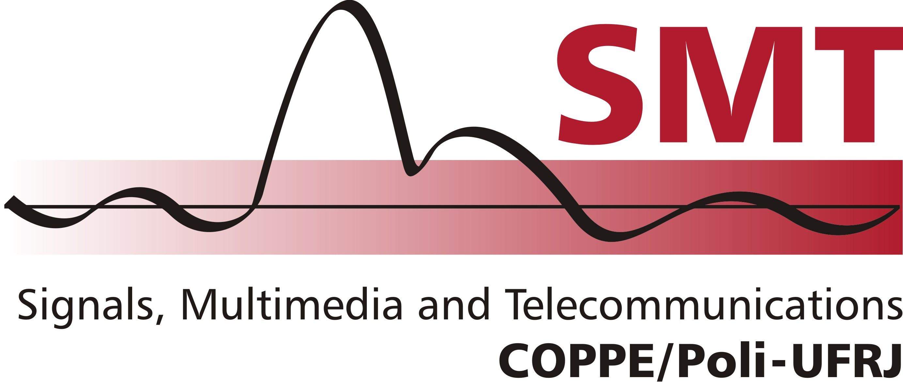
CONTENT
01
INTRODUCTION
02
MASSIVE MIMO SYSTEM MODEL
03
SOLID STATE AMPLIFIER MODEL
04
PROBLEM STATEMENT
05
SIMULATION RESULTS
06
CONCLUSION AND FUTURE WORK
2

Slide 3

INTRODUCTION
What is Massive MIMO?
Multiple-Input Multiple-Output technology with large antenna arrays
Base station (BS) equipped with hundreds of antennas
Serves multiple user equipment (UE) simultaneously
Benefits
Increased spectral efficiency
Enhanced energy efficiency
Improved reliability through spatial diversity
Reduced interference through beamforming
Support for high-speed, low-latency communications
Applications
5G and beyond mobile networks
IoT and smart city infrastructure
High-density wireless deployments
3

Slide 4
PROBLEM STATEMENT
Key Hardware Challenges
Large antenna arrays increase hardware costs
Trade-off between component quality and system cost
Lower-quality hardware introduces nonlinear distortions
Degradation of spectral efficiency and channel reciprocity
Main Sources of Nonlinearity
Power Amplifiers (PAs) - Primary focus of the study
Analog-to-Digital (AD) and Digital-to-Analog (DA) converters
Impact on System Performance
Reduced energy efficiency
Impaired channel estimation accuracy
Degraded beamforming performance
High PAPR signals particularly susceptible to distortion
4

Slide 5

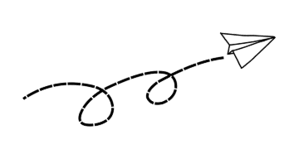
PROBLEM STATEMENT
Paper Contributions
Analysis of Deterministic Physical Modeling of PAs
Uplink and Downlink Impact Analysis
Degradation Quantification
Uplink: SNR ↓ 6.5 dB (BER 10⁻⁵)
Downlink: SNR Loss < 0.3 dB (BER 10⁻³)
5

Slide 6
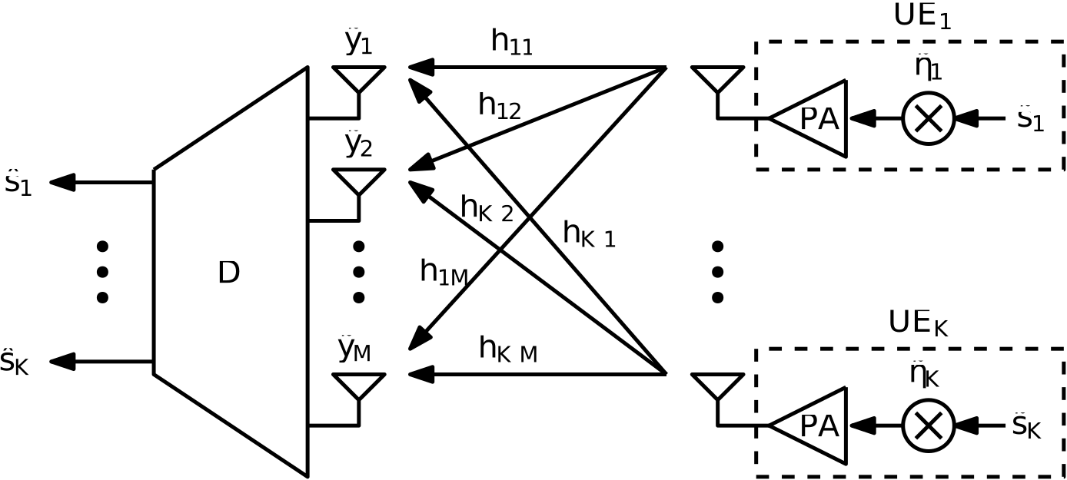
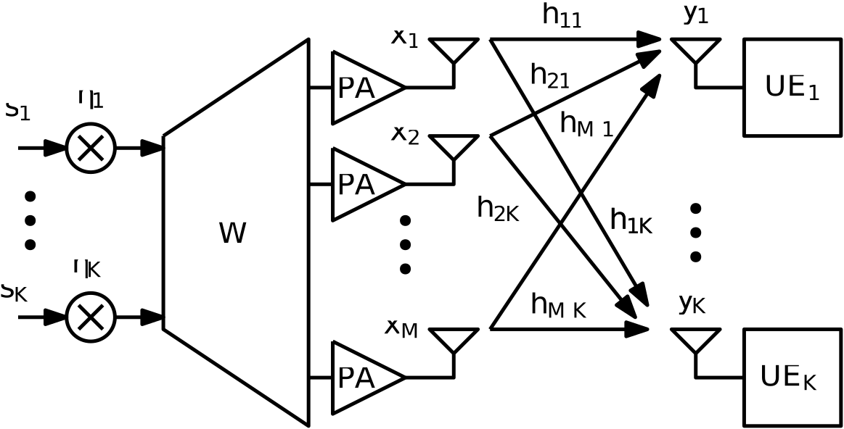
MASSIVE MIMO SYSTEM DIAGRAM
Downlink
Uplink
Signal model for massive MIMO considering the PA nonlinearity
7

Slide 7
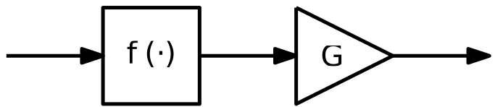
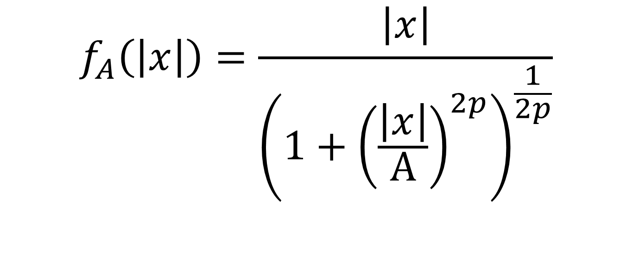
SOLID STATE AMPLIFIER MODEL
Ideal
Amplifier
Nonlinearity
X
Z
$$f_{A}\left(\left|x\right|\right)=\frac{\left|x\right|}{{\left(1+{\left(\frac{\left|x\right|}{A}\right)}^{2p}\right)}^{\frac{1}{2p}}}$$
8

Slide 8
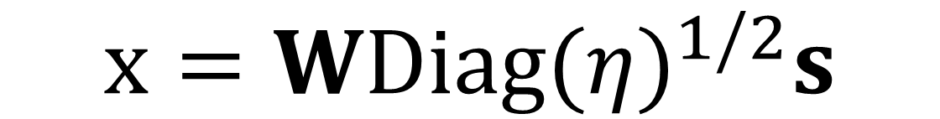
MASSIVE MIMO SYSTEM MODEL
$$x=WDiag{(η)}^{1/2}s$$
6

Slide 9

SIMULATION RESULTS
Simulation Environment
Parameter
Value
Number of antennas (M)
256
1000-radius hexagonal single-cell system
Number of UEs (K)
64, 128, 256
Perfect channel state information (CSI)
Constellation
64-QAM, 256-QAM
Equal power allocation
Number of blocks
500
Performance Metrics
Array geometry
ULA
500
Bit error Rate (BER) vs SNR
Channel model
Rician fading
Constellation distortion analysis
Rician factor
10 dB
SNR loss due to nonlinearity
BS Power
10 W
UE Power
200 mW
BS and UEs Antenna Gain
0 dBi
Noise figure
9 dB
SNR range (Downlink/Uplink)
-10 to 30 dB
Precoding/Decoding
ZF and MMSE
500
Monte-Carlo (UEs position)
10
Monte-Carlo (Small-scale fading)
10
9

Slide 10
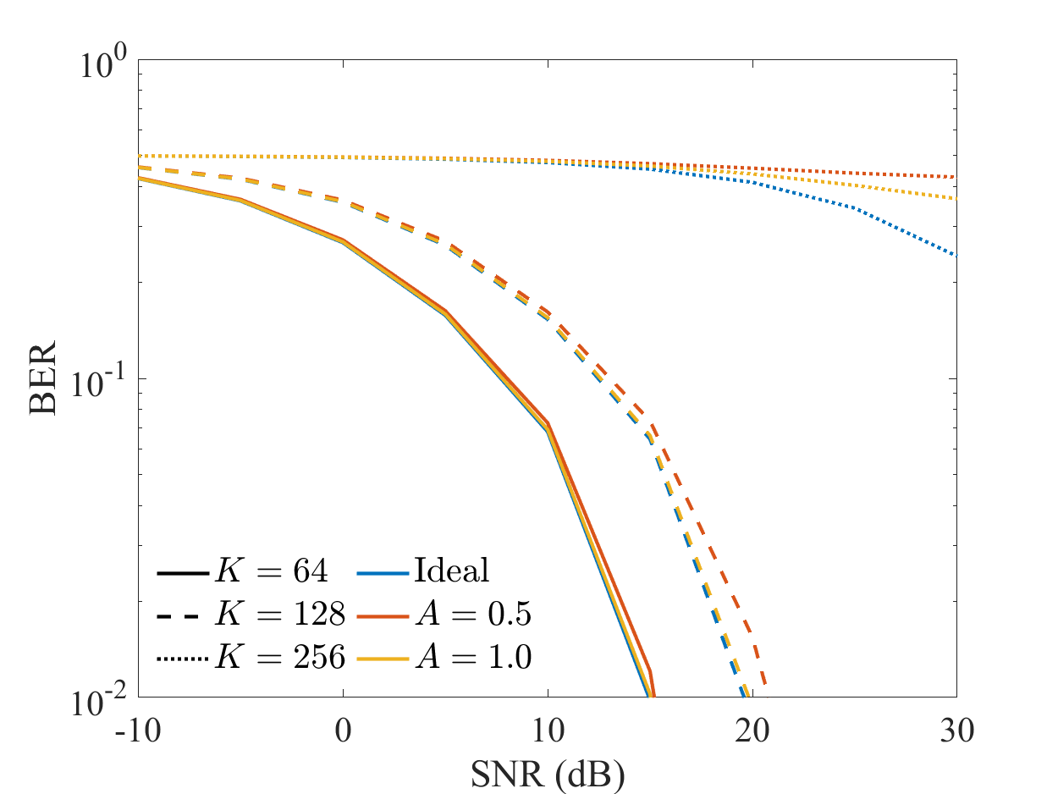
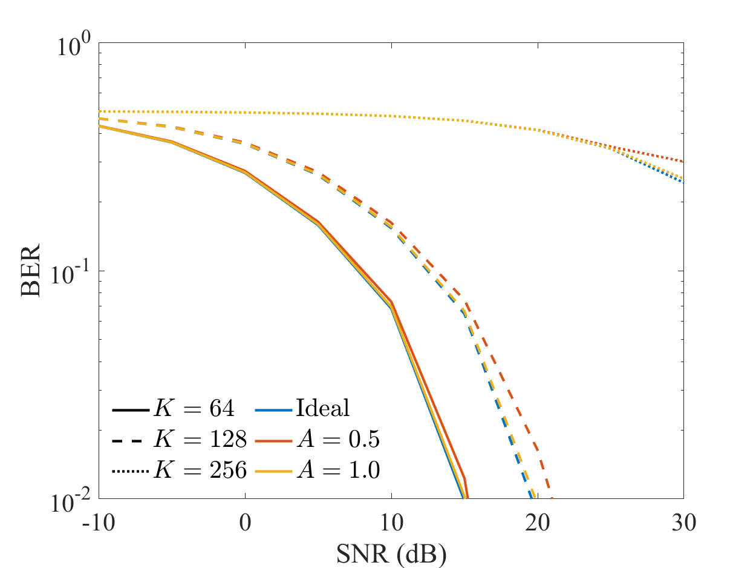
SIMULATION RESULTS – DOWNLINK
ZF
MMSE
BER versus SNR for K ∈ {64, 128, 256}, A ∈ {Ideal, 1, 2}, and ZF and MMSE decoders.
11

Slide 11
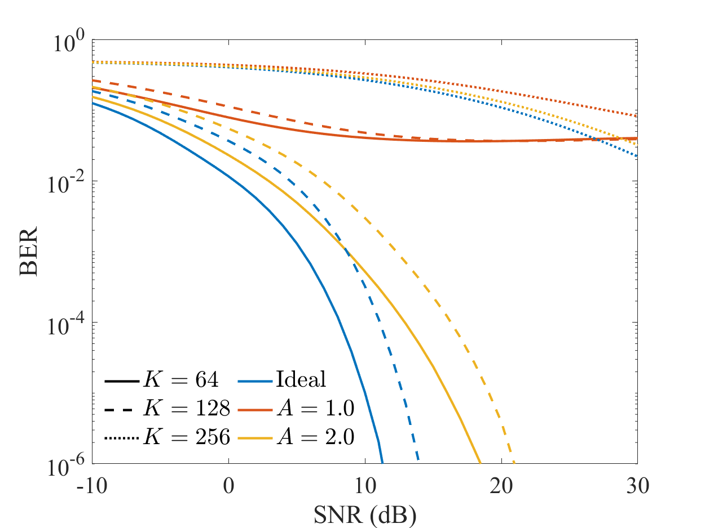
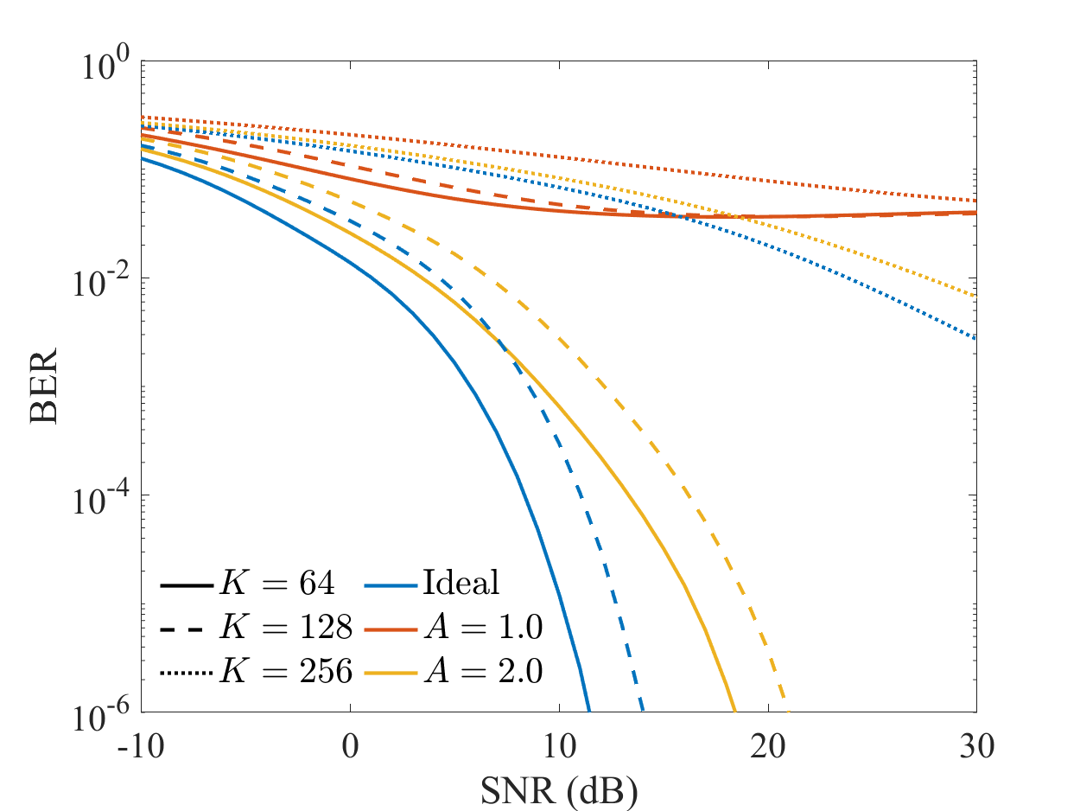
SIMULATION RESULTS – UPLINK
ZF
MMSE
BER versus SNR for K ∈ {64, 128, 256}, A ∈ {Ideal, 1, 2}, and ZF and MMSE decoders.
11

Slide 12
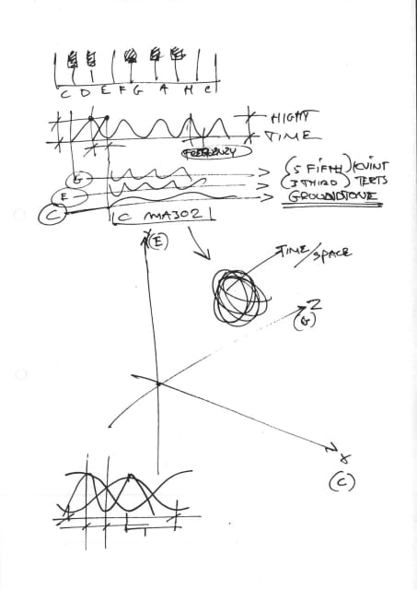
SIMULATION RESULTS
Downlink BER Performance
Downlink exhibits reduced sensitivity to PA nonlinearities compared to uplink
Power allocation and high number of antennas contribute to better resilience
Precoder Performance
ZF and MMSE precoders show similar performance in most cases
For K = 256, MMSE precoder improves performance when nonlinearity is present
System is more robust to nonlinearities in downlink than uplink
Uplink BER Performance
BER degrades with increasing number of UEs (K)
Significant sensitivity to PA saturation level
For A = 1, substantial BER degradation regardless of K and decoding algorithm
Decoder Performance
ZF and MMSE decoders perform similarly in most cases
For K = 256, MMSE decoder provides ~15.8 dB SNR gain at BER of 10
12

Slide 13
SIMULATION RESULTS
ZF
MMSE
Uplink BER versus SNR for K ∈ {64, 128, 256}, A ∈ {Ideal, 1, 2}, and ZF and MMSE decoders.
ZF
MMSE
Downlink BER versus SNR for K ∈ {64, 128, 256}, A ∈ {Ideal, 1, 2}, and ZF and MMSE decoders.
13

Slide 14
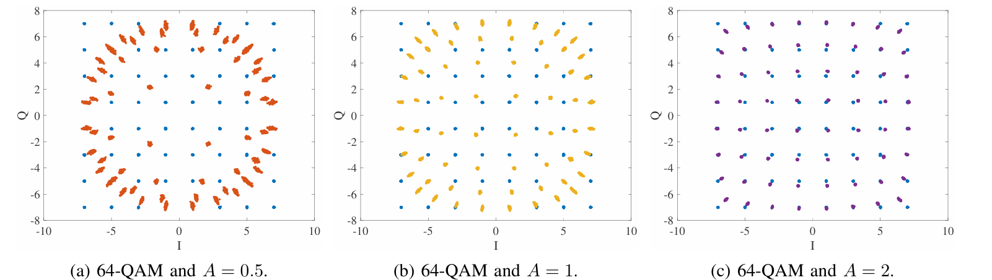
SIMULATION RESULTS
14

Slide 15
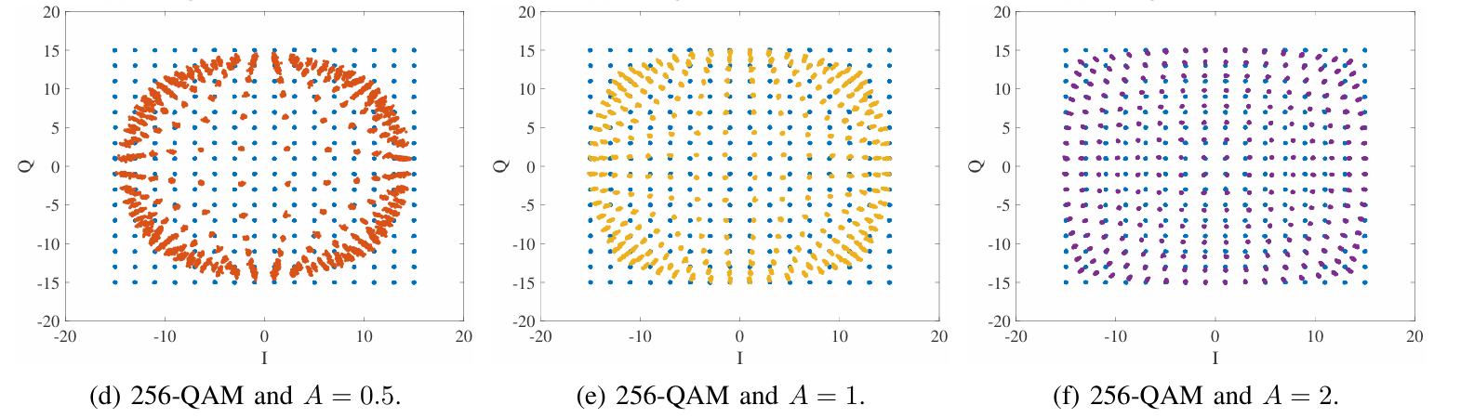
SIMULATION RESULTS
15

Slide 16
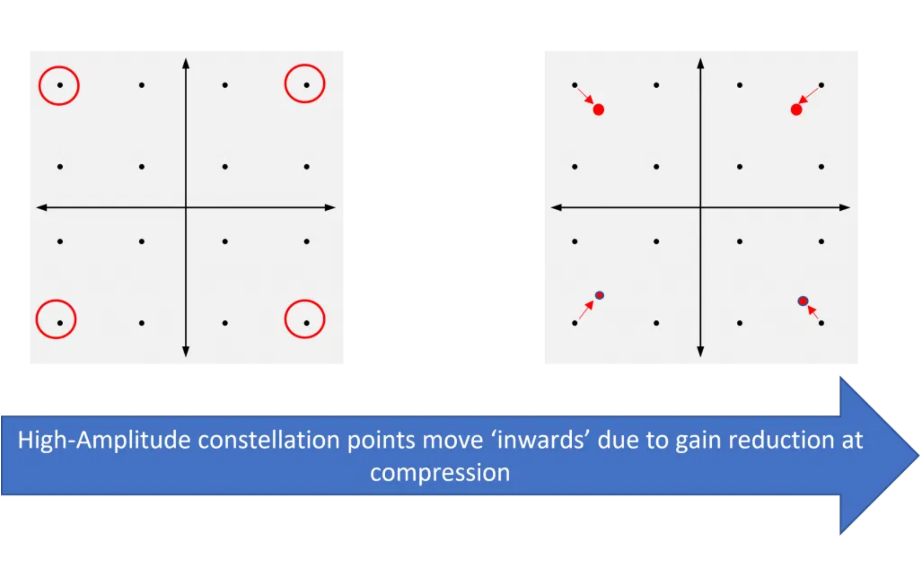
SIMULATION RESULTS
Constellation Distortion Analysis
Analysis focused on uplink decoded signal constellation
64-QAM and 256-QAM modulations evaluated at 30 dB SNR
Observed Effects
Decoded signal shows amplitude attenuation
No phase shift observed (expected with AM-AM only distortion)
Decreasing saturation level A leads to more distortion
Symbols near constellation vertices most affected
Impact on Symbol Detection
Even symbols near constellation center affected
High-Amplitude constellation points move ‘inwards’ due to gain reduction at compression
Higher-order modulations more severely impacted
Decision boundaries compromised, increasing BER
16

Slide 17
CONCLUSION AND FUTURE WORK
Key findings
PA nonlinearities significantly degrade BER performance in massive MIMO systems
SNR losses range from 2.3 dB to 5.1 dB depending on system configuration
Uplink is more sensitive to nonlinearities than downlink
Linear signal processing often insufficient for proper signal estimation
Future research directions
Integration of nonlinear channel estimation techniques
Design of machine learning-based precoders and decoders
Deep learning models for approximating optimal precoding strategies
Mitigation techniques for PA distortions and channel estimation errors
17

Slide 18
Power Amplifier Nonlinearities
Understanding PA Nonlinearity
Power amplifiers operate linearly only within a limited range
Beyond this range, signal distortion occurs
High Peak-to-Average Power Ratio (PAPR) signals are particularly vulnerable
Types of Distortion
AM-AM distortion:
Amplitude-to-amplitude nonlinearity
AM-PM distortion:
Amplitude-dependent phase shifts
Impact on MIMO Systems
Compromises channel reciprocity assumption
Degrades spectral efficiency
Increases bit error rate (BER)
Particularly problematic in OFDM-based systems

Slide 19
Solid-State Amplifier Model
System Model
Nonlinearity Model Assumptions
System Configuration
Memoryless nonlinearities (valid for moderate bandwidths)
Single-cell massive MIMO system using TDD
Focus on in-band distortion, disregarding spectral regrowth
Base station (BS) with M antennas
Only AM-AM distortion considered (no phase shifts)
K single-antenna user equipment (UEs)
PA nonlinearity at BS (downlink) or UEs (uplink)
Solid-State Amplifier Model
Downlink Model
f
A
(|x|) = |x| / (1 + (|x|/A)^(2p))^(1/(2p))
p > 0:
Smoothness parameter (typically 1-3)
y = √ρH
T
f(WDiag(η)
1/2
s) + v
A ∈ R
+
:
Saturation level
s: transmitted signal vector
Higher p values → closer to ideal clipping amplifier
W: precoding matrix
Lower p values → smoother transfer function
η: power allocation vector
f(·): nonlinear PA model
As A → ∞, PA approaches ideal amplifier
Uplink Model
Input-Output Relationship
ỹ = √ρ̃Hf(Diag(η̃)
1/2
s̃) + ṽ
z = f(x) = f
A
(|x|)e^(jφ)
s̃: transmitted signals by UEs
|x|: modulus of baseband signal
η̃: uplink power allocation vector
φ: phase of baseband signal
H: uplink channel matrix

