Slide 1



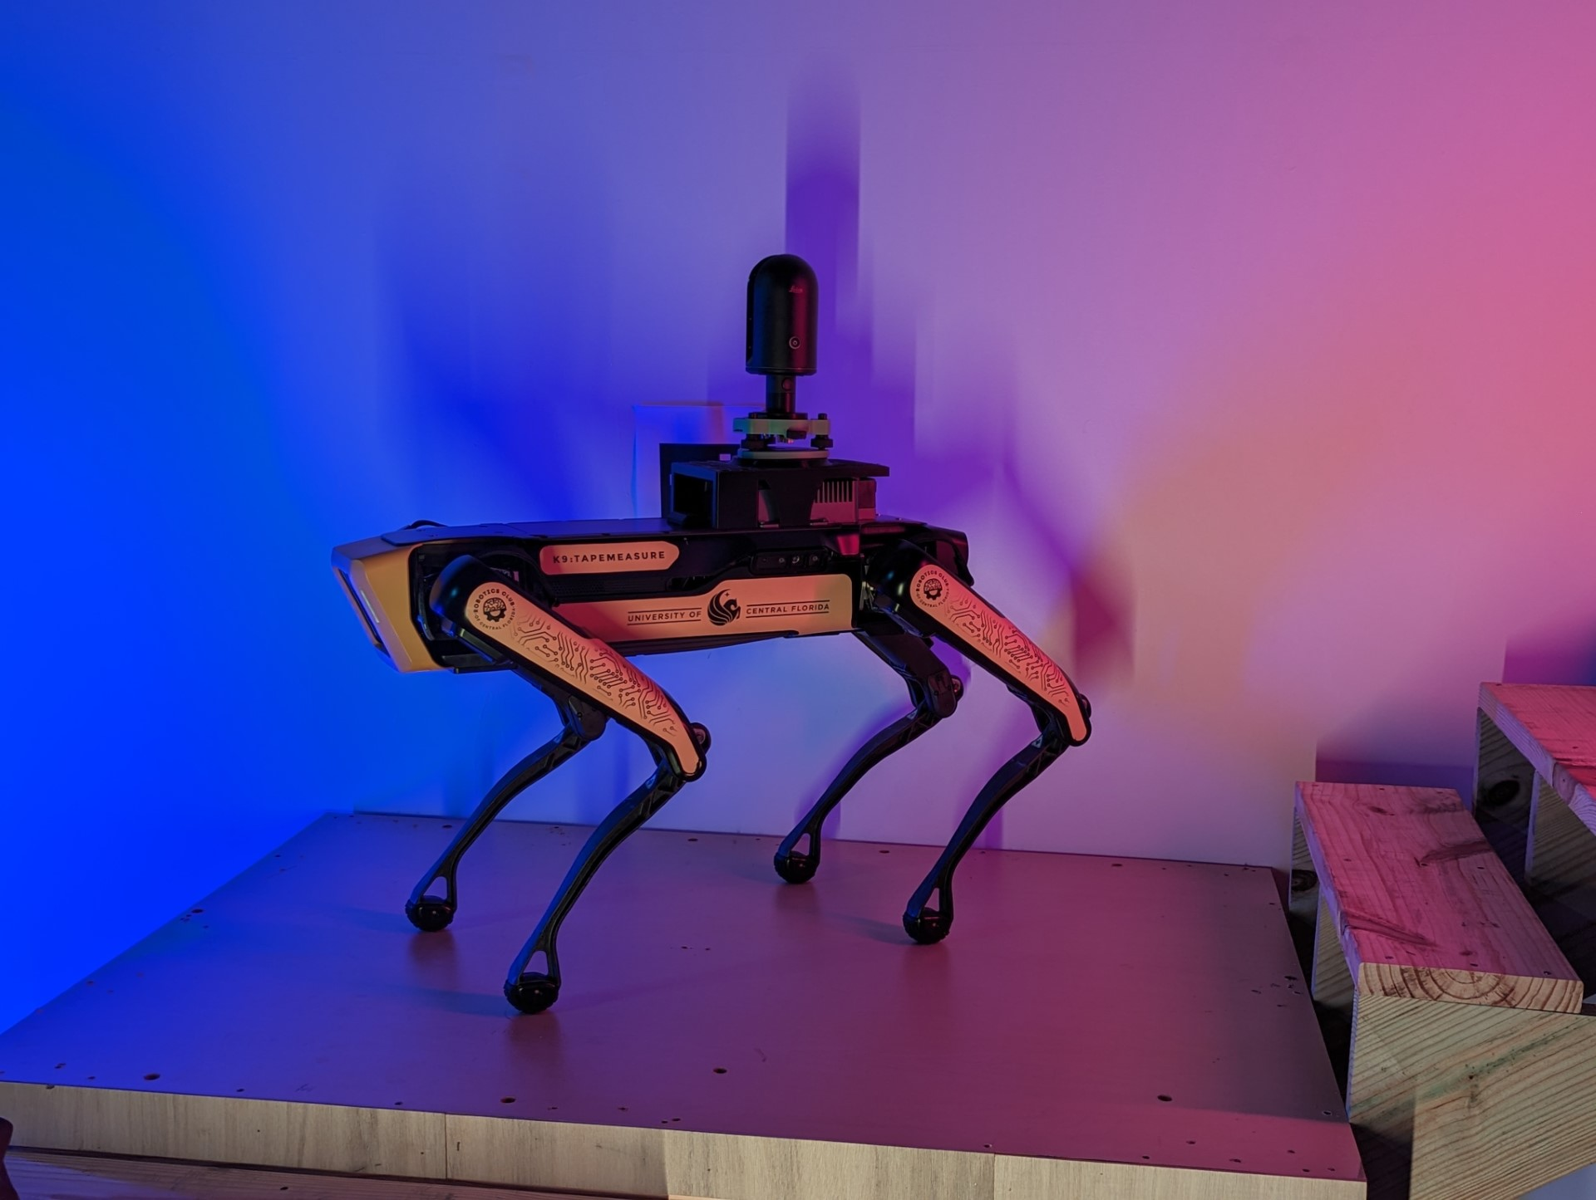
TITLE OF POSTER
Joaquin Castrillon, University of Central Florida
Joseph Kider, Institute for Simulation and Training, University of Central Florida
Author email: jo071622@ucf.edu ; Mentor email : joseph.kider@ucf.edu
Abstract
We have a skills shortage in construction, particularly among non-English speaking labor. Our objective is to realize inclusive and user-friendly learning using AR/VR using Unity and robotic dog cameras. It will need a clear yet professional approach to empower employees and enhance workforce capacities in order to resolve this problem.
Introduction
Methodology / Approach
Graphic / Table / Figure
We hypothesize that by implementing an immersive learning experience through AR/VR simulations controlled via Unity software and robotic dog cameras, we can effectively empower employees within the construction industry, irrespective of language barriers, thereby enhancing workforce capacities and addressing the prevailing skills shortage.
In my research, I delved into practical implementation within Unity, with a specific focus on simulating the movement and behavior of the Spot robot. I started by studying the mechanics of the Spot robot's movements and behaviors, learning how to replicate them realistically within the Unity . This involved experimenting with Unity's animation and physics systems to create lifelike simulations of the robot's actions. Through testing my aim was to develop a virtual representation of the Spot robot(Figure 1) that accurately mirrored its real-world capabilities.
Figure 1: Photograph of the Spot robot by Boston Dynamics
Background
Results / Discussion
Future Work
The construction industry faces a persistent skills shortage, exacerbated by communication barriers among non-English speaking laborers. Traditional training methods struggle to adequately address these challenges, prompting interest in innovative solutions. Augmented reality and virtual reality technologies, along with platforms like Unity, offer promising avenues for immersive, language-independent training experiences. Additionally, advancements in robotics, such as Boston Dynamics' Spot robot, present new opportunities for enhancing training effectiveness. This project aims to use VR technology and Unity software to develop a user-friendly learning platform tailored to the needs of non-English speaking construction workers.
I successfully created a VR simulation of the Spot robot, allowing me to control its movements and interact with its environment in a virtual setting. This simulation provides an immersive experience, enabling people to familiarize with the operation of the robot in a safe and controlled environment. Additionally, to accommodate users without access to VR hardware such as the Quest 3, I integrated a keyboard-compatible version of the simulation. This alternative version allows users to experience controlling the robot using standard keyboard inputs, providing a similar feel and functionality as the VR environment.
In future work, if I have additional time, I would love to expand the capabilities of the simulation. One exciting feature I'd like to add is the ability for users to import their own assets and create custom virtual environments directly within the VR interface, rather than solely relying on Unity's editor. This enhancement would provide users with greater creative control, allowing them to tailor the simulation to their specific needs and preferences. Also, there is an issue with the rotation of the object that I have been not able to fix now.
Table 1: This is the description of the table
Summary / Conclusion
References
Graphic / Table / Figure
Each week brought new challenges and advancements. My initial focus was on understanding the actual functionality of the Spot robot so that I could accurately reproduce it in Unity. After understanding its mechanics, I imported the robot model into Unity and started adding animations and movement capabilities. As the project progressed, I integrated VR controls to enhance the immersive experience, although I encountered issues with the robot's rotation not aligning with the axis. Through continued troubleshooting and tweaking, I was able to resolve this issue late last week, and have also created a keyboard compatible version for users without VR hardware.
Technologies, U. (n.d.). Unity - Manual: Animation. https://docs.unity3d.com/Manual/AnimationSection.htm
Technologies, U. (n.d.-b). Unity - Manual: Articulation Body component reference. https://docs.unity3d.com/Manual/class-ArticulationBody.html
Unity UI: Unity User Interface | Unity UI | 1.0.0. (n.d.). https://docs.unity3d.com/Packages/com.unity.ugui@1.0/manual/index.html
OpenXR Plugin | OpenXR Plugin | 1.11.0. (n.d.-b). https://docs.unity3d.com/Packages/com.unity.xr.openxr@1.11/manual/index.html
Boston Dynamics Support. (n.d.). https://support.bostondynamics.com/s/article/Robot-specifications
Acknowledgements
This material is based upon work supported by the National Science Foundation under Grant Numbers CNS-2137791, HRD-1834620. Any opinions, findings, and conclusions or recommendations expressed in this material are those of the authors and do not necessarily reflect the views of the National Science Foundation.

