Slide 1
DNS Records Enumeration

Slide 2



import dns.resolver: Imports the dns.resolver module from the dnspython library, which is used for DNS resolution and querying DNS records.
target_domain = 'youtube.com': Specifies the domain for which DNS records will be queried.
records_type = ['A', 'AAAA', 'CNAME', 'MX', 'TXT', 'SOA']: Defines a list of DNS record types to query for the target domain.
resolver = dns.resolver.Resolver(): Creates an instance of a DNS resolver, which will be used to perform the DNS queries.

Slide 3
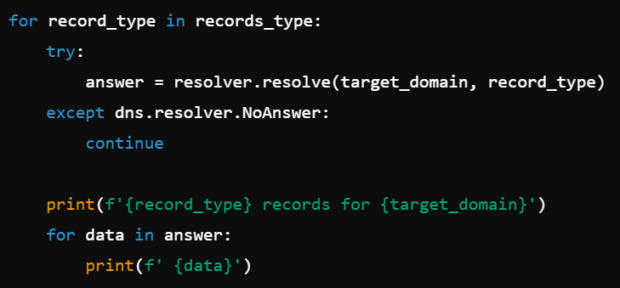
for record_type in records_type:: Iterates over each DNS record type in the list.
try:: Starts a try block to handle potential exceptions during the DNS query.
answer = resolver.resolve(target_domain, record_type): Resolves the specified DNS record type for the target domain.
except dns.resolver.NoAnswer:: Catches the NoAnswer exception, which occurs if the DNS server does not return an answer for the query.
continue: Skips to the next record type if no answer is returned.
print(f'{record_type} records for {target_domain}'): Prints a header indicating the type of DNS records being displayed.
for data in answer:: Iterates over the data in the DNS response.
print(f' {data}'): Prints each DNS record found for the current record type.

