Slide 1
PDF Protection

Slide 2

import PyPDF2: Imports the PyPDF2 library, which is used for working with PDF files, including reading and writing PDFs.
import sys: Imports the sys module, which provides access to some variables used or maintained by the Python interpreter and to functions that interact strongly with the interpreter.

Slide 3
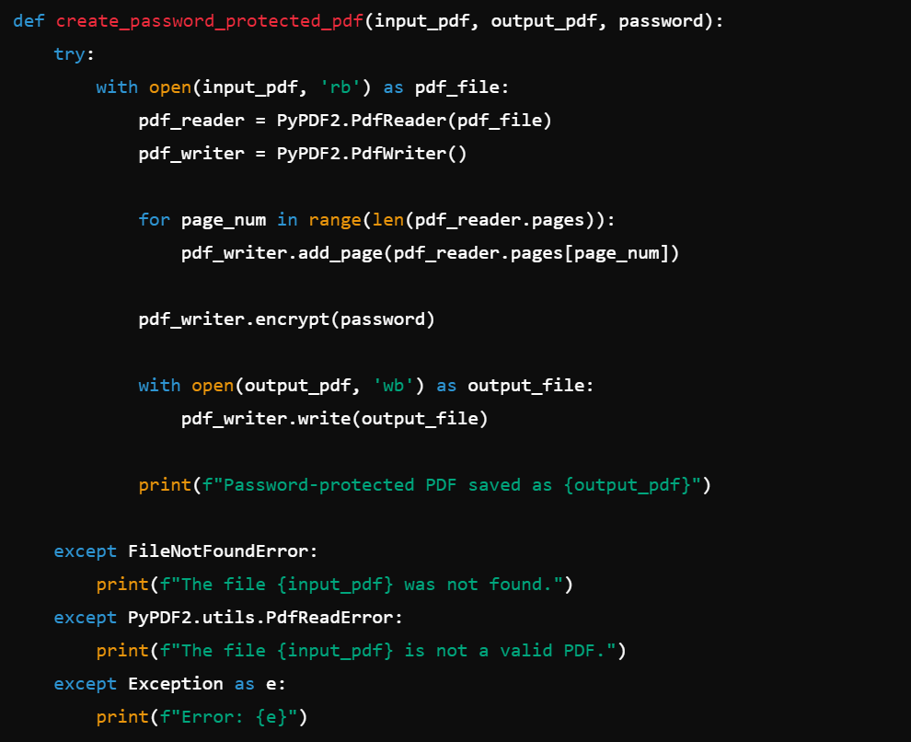
def create_password_protected_pdf(input_pdf, output_pdf, password):: Defines a function that creates a password-protected PDF.
try:: Starts a try block to handle potential errors.
with open(input_pdf, 'rb') as pdf_file:: Opens the input PDF file in binary read mode.
pdf_reader = PyPDF2.PdfReader(pdf_file): Creates a PDF reader object to read the input PDF.
pdf_writer = PyPDF2.PdfWriter(): Creates a PDF writer object to write the new PDF.
for page_num in range(len(pdf_reader.pages)):: Iterates over all pages in the input PDF.
pdf_writer.add_page(pdf_reader.pages[page_num]): Adds each page from the input PDF to the PDF writer.
pdf_writer.encrypt(password): Encrypts the PDF with the provided password.
with open(output_pdf, 'wb') as output_file:: Opens the output PDF file in binary write mode.
pdf_writer.write(output_file): Writes the encrypted PDF to the output file.
print(f"Password-protected PDF saved as {output_pdf}"): Prints a success message with the output file name.
except FileNotFoundError:: Catches the error if the input file is not found.
print(f"The file {input_pdf} was not found."): Prints an error message if the input file is not found.
except PyPDF2.utils.PdfReadError:: Catches the error if the input file is not a valid PDF.
print(f"The file {input_pdf} is not a valid PDF."): Prints an error message if the input file is not a valid PDF.
except Exception as e:: Catches any other exceptions that occur.
print(f"Error: {e}"): Prints a generic error message with the exception details.

Slide 4
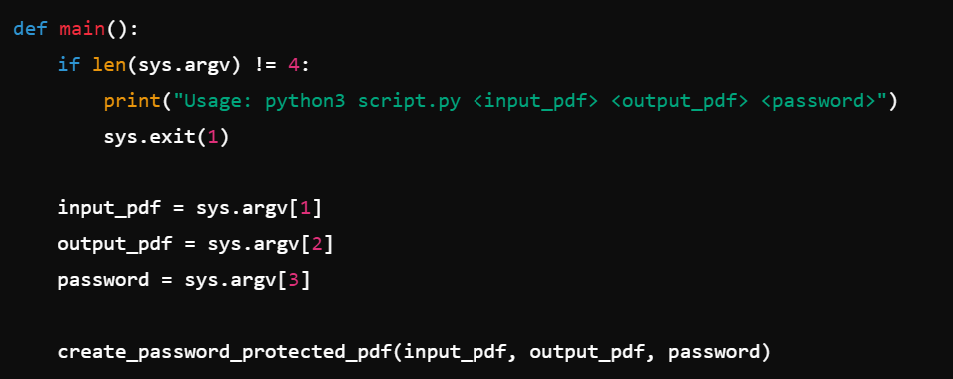
def main():: Defines the main function that handles command-line arguments.
if len(sys.argv) != 4:: Checks if the number of command-line arguments is not equal to 4.
print("Usage: python3 script.py <input_pdf> <output_pdf> <password>"): Prints the correct usage of the script.
sys.exit(1): Exits the script with an error code.
input_pdf = sys.argv[1]: Assigns the first command-line argument to input_pdf.
output_pdf = sys.argv[2]: Assigns the second command-line argument to output_pdf.
password = sys.argv[3]: Assigns the third command-line argument to password.
create_password_protected_pdf(input_pdf, output_pdf, password): Calls the function to create a password-protected PDF with the provided arguments.

Slide 5

if __name__ == "__main__":: Ensures that the following code block runs only if the script is executed directly.
main(): Calls the main function to process the command-line arguments and create the password-protected PDF.

