Slide 1
Subdomain Enumeration

Slide 2

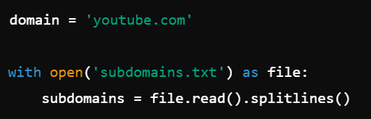
import requests: Imports the requests module, which is used for making HTTP requests.
import threading: Imports the threading module, which is used for creating and managing threads.
domain = 'youtube.com': Specifies the target domain for subdomain discovery.
with open('subdomains.txt') as file:: Opens the file containing the list of subdomains.
subdomains = file.read().splitlines(): Reads the file and splits the content into a list of subdomains, each on a new line.

Slide 3
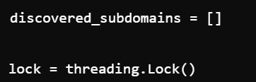
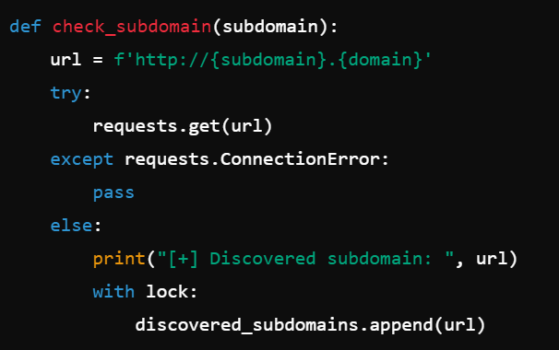
discovered_subdomains = []: Initializes an empty list to store the discovered subdomains.
lock = threading.Lock(): Creates a lock object to ensure thread-safe operations when accessing shared resources.
def check_subdomain(subdomain):: Defines a function to check if a subdomain exists.
url = f'http://{subdomain}.{domain}': Constructs the URL for the subdomain.
try:: Starts a try block to handle potential exceptions during the HTTP request.
requests.get(url): Makes an HTTP GET request to the constructed URL.
except requests.ConnectionError:: Catches the ConnectionError exception, which occurs if the subdomain does not exist or is unreachable.
pass: Does nothing and continues to the next subdomain.
else:: Executes if no exceptions were raised, indicating the subdomain exists.
print("[+] Discovered subdomain: ", url): Prints a message indicating the discovered subdomain.
with lock:: Acquires the lock to ensure thread-safe access to the shared list.
discovered_subdomains.append(url): Adds the discovered subdomain to the list.

Slide 4
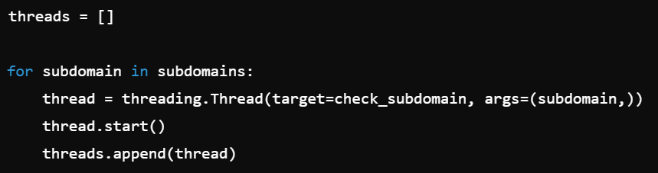

threads = []: Initializes an empty list to store the threads.
for subdomain in subdomains:: Iterates over each subdomain in the list.
thread = threading.Thread(target=check_subdomain, args=(subdomain,)): Creates a new thread to execute the check_subdomain function with the current subdomain as an argument.
thread.start(): Starts the thread.
threads.append(thread): Adds the thread to the list of threads.
for thread in threads:: Iterates over each thread in the list.
thread.join(): Blocks the main program until the thread completes.

Slide 5
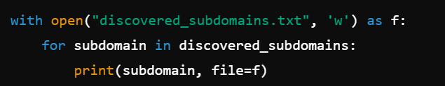
with open("discovered_subdomains.txt", 'w') as f:: Opens a file named discovered_subdomains.txt in write mode.
for subdomain in discovered_subdomains:: Iterates over each discovered subdomain in the list.
print(subdomain, file=f): Writes the subdomain to the file.

