Slide 1
STRENGTHENING SCHOOL LEADERS’ CAPABILITY IN STRATEGIC PLANNING

Slide 2
STRENGTHENING SCHOOL LEADERS’ CAPABILITY IN STRATEGIC PLANNING

Slide 3
Introduction to strategic planning

Slide 4
Session Objectives
To define strategic planning
To learn the phases of plan formulation
To enumerate the types of plans in the Department
To identify the red flags in strategic planning

Slide 5
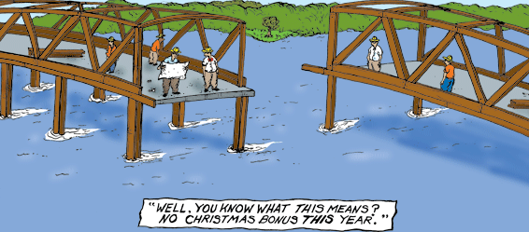
If we relate this image to planning what do you have in mind?
Notes:
Reminder: Just keep your answer to yourself.

Slide 6
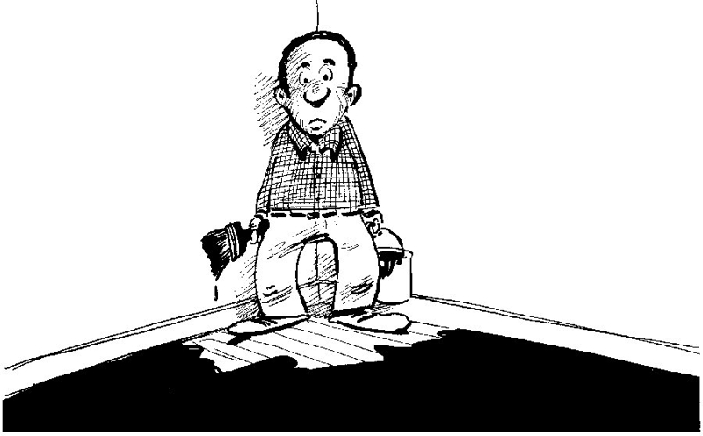
If we relate this image to planning what do you have in mind?
Notes:
Reminder: Just keep your answer to yourself. We might have different opinions on the images presented but I believed we will agree at some point that something must have been done carefully before the bridge construction or floor painting have started right? Ito po ang magiging paksa natin sa umagang ito tatawagin natin itong “strategic planning”. But just exactly what is strategic planning? When can we say that a plan is strategic or not? What for is a strategic plan? These and more are few of the many questions we will discuss po in the entire course of our training.

Slide 7
STRATEGIC PLANNING

Slide 8
Why do we plan for our organization?
Notes:
Before going into the details of strategic planning, ask the participants with this one basic question.
Draw as much as many responses from the participants (free style: first option) . Recognize them all. No right or wrong simply allow allow them to loosen up. Consolidate important keywords, process it before giving the definition taken from a source.
The use of randomizer can be the 2nd option.
Possible answers: to target, prioritize

Slide 9

Why do we plan for our organization?
We want to set our priorities

Slide 10

Why do we plan for our organization?
We want to focus our energy and resources
Notes:
Focus on the present time. Sabi nga ni Ms, Bea Hugotera, “Bakit mo pa kailangang pagla-anan ng panahon ang bagay sa nakaraan ni hindi mo na kailangan”?. As much as possible we want to work on things that is currently contributing or maybe affecting our organization’s performance. Being able to pinpoint these things will make us efficient in terms of delivering our mandate and providing solutions to many and existing challenges, issues and concerns that we are facing.

Slide 11

Why do we plan for our organization?
We want to strengthen
our operations
Notes:
By making everyone involved

Slide 12

Why do we plan for our organization?
We want to work together for a common goal
Notes:
By making everyone involved

Slide 13

Why do we plan for our organization?
We want to establish agreement
Notes:
By making everyone involved

Slide 14

Why do we plan for our organization?
We want to adjust our organization’s direction
Notes:
By making everyone involved

Slide 15
An organizational management activity that is used to set priorities, focus energy and resources, strengthen operations, ensure that employees and other stakeholders are working toward common goals, establish agreement around intended outcomes/results, and assess and adjust the organization’s direction in response to a changing environment. (https://strategymanage.com/resources/strategic-planning-basics/)

Slide 16
Strategic Planning
Phases of Plan Formulation
Investment Planning
Operational Planning
Notes:
-Lecture Method is the mode of delivering the information.
-Input the information through questions. Deliver the input while at the same time reviewing them the concept.
-In deped, plan formulation is divided into three phases namely: a. Strategic Planning b. Investment Planning c. Operational Planning (through TYRP and Annual Plan)

Slide 17
Strategic Planning
Phases of Plan Formulation
Investment Planning
Operational Planning
Which among the three phases provides the strategic direction?
Notes:
-Lecture Method is the mode of delivering the information.
-Input the information through questions. Deliver the input while at the same time reviewing them the concept.
-In deped, plan formulation is divided into three phases namely: a. Strategic Planning b. Investment Planning c. Operational Planning (through TYRP and Annual Plan)

Slide 18
Strategic Planning
Phases of Plan Formulation
Investment Planning
Operational Planning
Which among the three phases provides the strategic direction?
Notes:
-Lecture Method is the mode of delivering the information.
-Input the information through questions. Deliver the input while at the same time reviewing them the concept.
-In deped, plan formulation is divided into three phases namely: a. Strategic Planning b. Investment Planning c. Operational Planning (through TYRP and Annual Plan)

Slide 19
Strategic Planning
Phases of Plan Formulation
Investment Planning
Operational Planning
Provides resources for major programs?
Notes:
-Lecture Method is the mode of delivering the information.
-Input the information through questions. Deliver the input while at the same time reviewing them the concept.
-In deped, plan formulation is divided into three phases namely: a. Strategic Planning b. Investment Planning c. Operational Planning (through TYRP and Annual Plan)

Slide 20
Strategic Planning
Phases of Plan Formulation
Investment Planning
Operational Planning
Provides resources for major programs?
Notes:
-Lecture Method is the mode of delivering the information.
-Input the information through questions. Deliver the input while at the same time reviewing them the concept.
-In deped, plan formulation is divided into three phases namely: a. Strategic Planning b. Investment Planning c. Operational Planning (through TYRP and Annual Plan)

Slide 21
Strategic Planning
Phases of Plan Formulation
Investment Planning
Operational Planning
Focuses on the implementation of the Strategic and Medium-term plans through:
Three-year Rolling Plan and
Annual Plans
Notes:
-Lecture Method is the mode of delivering the information.
-Input the information through questions. Deliver the input while at the same time reviewing them the concept.
-In deped, plan formulation is divided into three phases namely: a. Strategic Planning b. Investment Planning c. Operational Planning (through TYRP and Annual Plan)

Slide 22
Strategic Planning
Phases of Plan Formulation
Investment Planning
Operational Planning
Focuses on the implementation of the Strategic and Medium-term plans through:
Three-year Rolling Plan and
Annual Plans
Notes:
-Lecture Method is the mode of delivering the information.
-Input the information through questions. Deliver the input while at the same time reviewing them the concept.
-In deped, plan formulation is divided into three phases namely: a. Strategic Planning b. Investment Planning c. Operational Planning (through TYRP and Annual Plan)

Slide 23
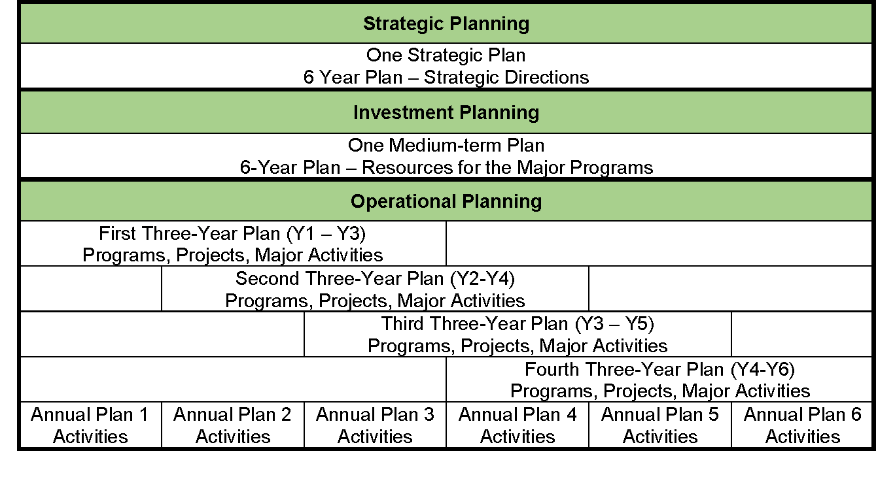
Phases of Plan Formulation

Slide 24
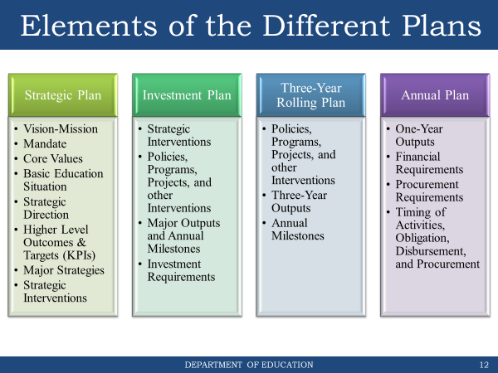
Strategic Planning
Phases of Plan Formulation
Investment Planning
Operational Planning
Which among the three phases provides the strategic direction?
Notes:
-Lecture Method is the mode of delivering the information.
-Input the information through questions. Deliver the input while at the same time reviewing them the concept.
-In deped, plan formulation is divided into three phases namely: a. Strategic Planning b. Investment Planning c. Operational Planning (through TYRP and Annual Plan)

Slide 25


Slide 26
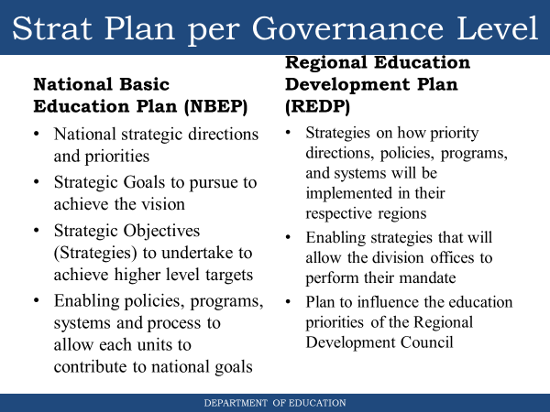

Slide 27
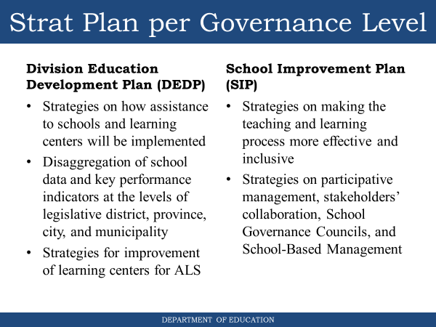

Slide 28
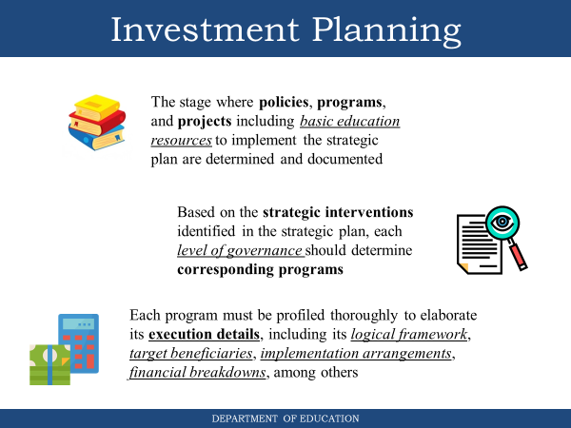

Slide 29
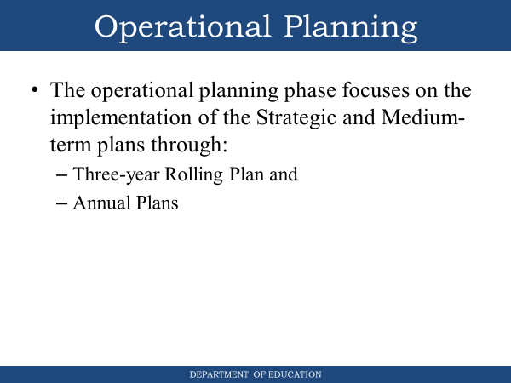

Slide 30
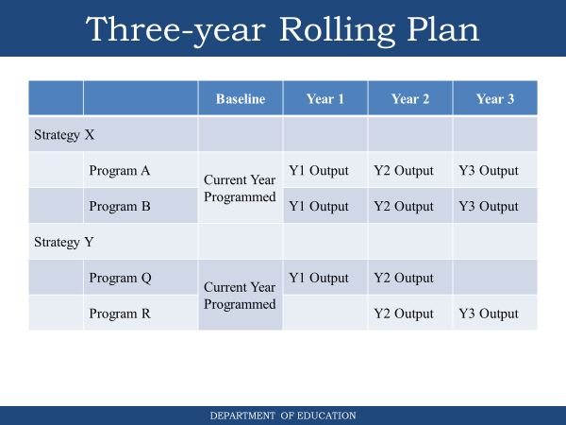

Slide 31
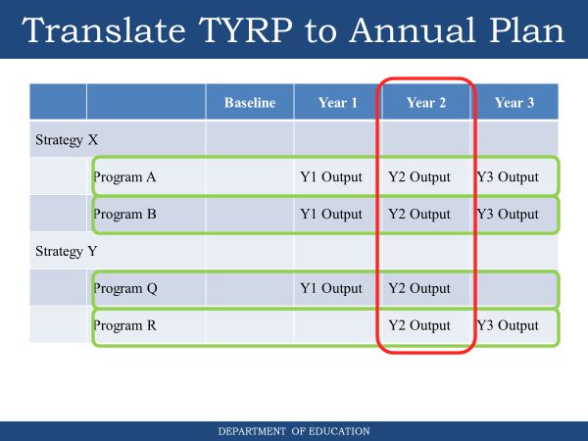

Slide 32
Plan and budget execution

Slide 33
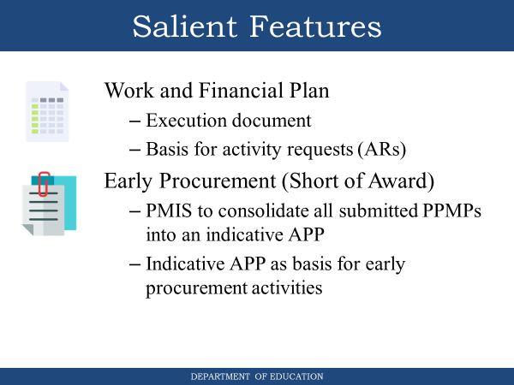

Slide 34
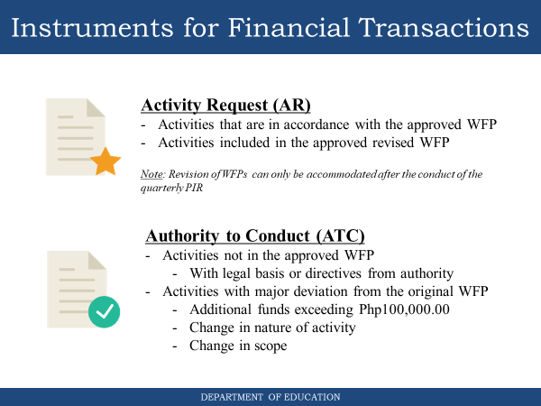

Slide 35
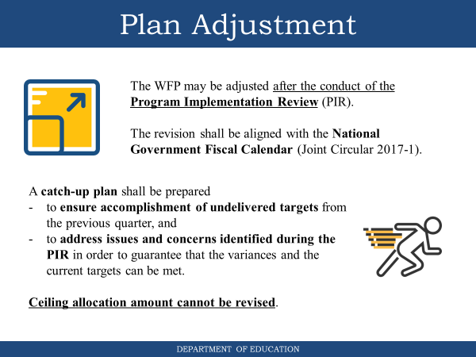

Slide 36
Types of Plans in DepEd
Type of Plan | Description | Document
Strategic Plan | Long-term plan for a desired future based on a thorough situational analysis, provides context for other plans | NBEP / REDP / DEDP / SIP
Investment Plan | Resources needed for the strategic interventions and major programs | Investment Plan
Program Plan | Technical plan on the implementation details of the program including roles, beneficiaries, financial breakdowns, etc. | Program Profile
Operational Plan | Specific plan detailing the outputs, activities, resources, and schedule for the given period | Three-Year Plan WFP PPMP / APP
Plan Adjustment | Contingencies formulated after PIR to adjust the plans in order to keep implementation on track | Catch-Up Plan

Slide 37




Levels of Governance
CO
R
O
S
D
O
S
Formulate policies,
programs, systems
Adapt policies, programs, systems
Provide basic education support services
Deliver basic education services
Overall directions, national strategies
Contextualized programs, policies, systems
Demand-driven technical assistance to schools
Teaching & Learning
School governance
Strategic Directions
Operational Concerns

Slide 38
Strategic Planning

Slide 39
Strategic Planning
Organizing & Mobilizing the Planning Teams
Understanding the Vision, Mission, and Mandate
Gathering, Organizing, and Validating Education Data
Conducting Situational Analysis
Identifying Key and Immediate Challenges
Formulating Strategic Directions
Communicating the Strategic Plan
Writing the Strategic Plan
Appraising the Strategic Plan

Slide 40
How do you know if your strategic plan is not strategic?

Slide 41
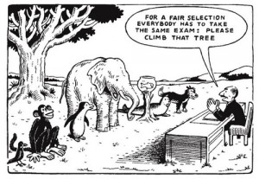
Red Flags
One size fits all analysis
Notes:
Inability to pinpoint and prioritize concerns and issues.
One size fits all programs.
Implementing too many programs.
Do current programs work? Are they still relevant?
One solution to many existing issues and concerns

Slide 42
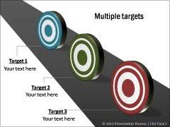
Red Flags
Tendency to target all
Problematic
Not problematic
Not problematic
Notes:
Inability to pinpoint and prioritize concerns and issues may lead to delays in the implementation of programs or projects and Wastage of resources such money and time

Slide 43

Red Flags
You want to do everything
Notes:
Inability to pinpoint and prioritize concerns and issues may lead to delays in the implementation of programs or projects and Wastage of resources such money and time

Slide 44


Red Flags
More of the same
Many names, same solution
Notes:
Inability to pinpoint and prioritize concerns and issues may lead to delays in the implementation of programs or projects and Wastage of resources such money and time

Slide 45

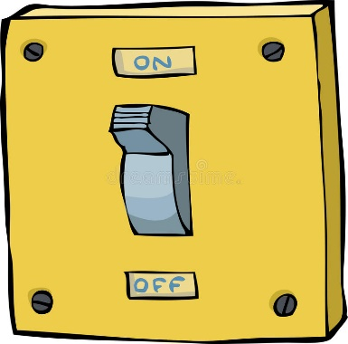
Red Flags
Limited Options
Operate the Ship
Notes:
Inability to pinpoint and prioritize concerns and issues may lead to delays in the implementation of programs or projects and Wastage of resources such money and time

Slide 46

Red Flags
No logical link between strategies and VMO
Notes:
Inability to pinpoint and prioritize concerns and issues may lead to delays in the implementation of programs or projects and Wastage of resources such money and time

Slide 47

Red Flags
Resources are spread too thinly
Notes:
Inability to pinpoint and prioritize concerns and issues may lead to delays in the implementation of programs or projects and Wastage of resources such money and time

Slide 48

Red Flags
Poor timing. No concept of predecessor relationship.
Notes:
Inability to pinpoint and prioritize concerns and issues may lead to delays in the implementation of programs or projects and Wastage of resources such money and time

Slide 49

Red Flags
No affirmative actions, or no focus on marginalized groups
Notes:
Inability to pinpoint and prioritize concerns and issues may lead to delays in the implementation of programs or projects and Wastage of resources such money and time

Slide 50
How to make it strategic
One size fits all situational analysis. | Organize your data. Use different analytical tools. Segment.
Tendency to target all. | Prioritize concerns and segments. Focus on priority areas.
You want to do everything. | Determine strategic directions and priorities before identifying programs & projects.
More of the same. | Prepare an inventory of past interventions, link these with KPIs. Assess.
Limited options. | Explore options per key stage, per segment, per target group, per KPIs, or per concern.
Notes:
Dashboarding
Segmentation and Pareto Analysis

Slide 51
How to make it strategic
No logical link between strategies and VMO. | Establish your theory of change. Make sure interventions are sufficient and necessary to achieve your vision, mission, and objectives
Resources spread too thinly. | Focus your resources on the strategic concerns.
Poor timing. No concept of predecessor relationship. | Strengthen yourself first before implementing programs/projects for your target groups.
No affirmative actions, or no focus on marginalized groups. | Make sure they are in your situation analysis, targets, plans. If they are not, you will not devote resources, time, & budget to address their specific and unique concerns.

Slide 52
Checklist
The plan is able to show the different competing needs. It is able to pinpoint, and shows prioritization of concerns, issues. It is not a one size fits all plan.
Proposed strategic directions will address needs/demands of target groups identified.

Slide 53
Checklist
The Plan identified specific priority target groups. These groups, when targeted, will help improve the overall education sub-sector in the division. Few but significant effect to overall situation.
Programs are reconfigured to respond to demands. New programs are identified to address unique needs of target groups.
Notes:
One of our end goal po after this training is to be able to make (sa hindi pa nakakagawa), improve (sa meron na) a very good strategic plan. When can do that po by applying different tools. Gagawin po natin ito step-by-step at sisimulan po natin ito kay Sir Mozart on his topic data organizing through dahsboarding.

Slide 54


Slide 55


