Slide 1
Ecuavisa Description
Smart TV Application Description (Samsung Tizen · LG webOS · Hisense)
DigitalProServer
Version 1.0.0 · September 2026

Slide 2
REVISION HISTORY
Revision History
Version | Date | Description | Author
1.0 | 2026.09.22 | Initial Document, app version 1.0.0 | Digital Pro Server
Ecuavisa – Application Description | Digital Pro Server
2

Slide 3
CONTENTS
Contents
UI Structure
About this document
Application description for the Ecuavisa Smart TV app. It covers the whole UI structure, the user flows, a screen-by-screen functional description and the remote-control key policy, following the standard certification document format.
Usage Scenario
Menu & function description
Key policy
How to change languages
Ecuavisa – Application Description | Digital Pro Server
3

Slide 4
UI STRUCTURE
UI Structure — Whole UI Structure
Welcome / Login entry
TV Pairing
(QR + 6-digit code)
Profile selection
(choose / create)
Home (main hub)
Global header: Search | Inicio | En vivo | Videoteca | Mi lista | Avatar (profile)
Inicio (Home)
En vivo
Videoteca (Programs)
Mi lista
Buscar
Mi Cuenta
Content sections:
Hero banner · Live channels grid ·
Recomendados · Top 10 · Category rows
EPG with channel column +
time grid; live player window;
OK over a cell plays that channel
Rows per category + “Ver Más”;
program detail: synopsis, seasons,
chapters; paid-content badges
Favorites grid +
“Seguir viendo” history
(resume playback)
On-screen keyboard;
results grid updates live;
OK opens programs
User data, profiles list,
create / edit / avatar,
sign out
VOD Player (full screen) — overlay controls: progress / seekbar · restart · ±10 s · play-pause · next chapter · chapter panel · mute · fullscreen.
Back (RETURN) leaves the player and returns to the previous screen.
Category view (“Ver Más”)
full list of programs of a section
Deep program navigation
Program → Season → Chapter → Player
Exit dialog (Back on Home)
Cancel · Exit (native TV API)
Ecuavisa – Application Description | Digital Pro Server
4

Slide 5
UI STRUCTURE
UI structure — sample 1 (flow graph)
VOD playback path
OK
OK
OK
OK
Home
Videoteca
(Programas)
Program detail
Season /
Chapters
Player (VOD)
Back (RETURN) from the player returns to the program detail; Back on Home opens the exit dialog.
Live TV path
OK
OK
OK
Home
En vivo
Channel (EPG)
Live playback
Selecting a channel in the grid starts playback immediately on the TV.
Search path
OK
OK
OK
OK
Home
Buscar
(keyboard)
Results
Program detail
Player (VOD)
Account path
OK
OK
OK
OK
Home
Mi Cuenta
Profiles
Edit profile
Choose avatar
Ecuavisa – Application Description | Digital Pro Server
5

Slide 6
UI STRUCTURE
UI structure — sample 2 (depth navigation)
1st depth | 2nd depth | 3rd depth | 4th depth | 5th depth
Home (Inicio) | Videoteca | Program detail | Season / Chapters | VOD Player
Home (Inicio) | En vivo | Channel (EPG playback) | — | —
Home (Inicio) | Buscar | Results | Program detail | VOD Player
Home (Inicio) | Mi lista | Program detail | Season / Chapters | VOD Player
Home (Inicio) | Mi lista / Seguir viendo | Resume playback | — | —
Home (Inicio) | Mi Cuenta | Profiles | Edit profile | Choose avatar
Example navigation paths and the maximum depth of each flow. The header (Inicio · En vivo · Videoteca · Mi lista · Buscar · Avatar) is available from every main screen.
Ecuavisa – Application Description | Digital Pro Server
6

Slide 7
USAGE SCENARIO
Usage Scenario (1/2)
1
Launch the app
The app starts on the Welcome screen (activation / login).
2
Sign in with TV Pairing
Press “Iniciar sesión”. A QR code and a 6-digit code are shown. Scan the QR with a mobile device or open the linking site and enter the code; the TV signs in automatically (the app polls the pairing status).
3
Choose a profile
Select one of the profiles (“¿Quién está ahí?”) or create a new one. Profiles are also managed from Mi Cuenta.
4
Browse the Home
Featured content is shown in the hero banner (“Ver Ahora” starts playback). Below: live channels grid, “Recomendados”, “Top 10” and the category rows. Move the focus with the D-pad; the view scrolls automatically.
5
Search content
Select the magnifier icon in the header and type with the on-screen keyboard (ESPACIO / BORRAR). The results grid updates while typing; press OK to open a program.
6
Open a program
Videoteca lists the programs grouped by category. Select one (or use “Ver Más” to see a full category) to open the program detail: synopsis, seasons and chapters.
Ecuavisa – Application Description | Digital Pro Server
7

Slide 8
USAGE SCENARIO
Usage Scenario (2/2)
7
Play VOD content
In the player: play / pause, restart, ±10 seconds, seek, next chapter, chapter list, mute and fullscreen. Pressing Back returns to the program detail. Playback progress is stored and offered again under “Seguir viendo”.
8
Watch live TV
“En vivo” shows the live player plus the EPG (channel column and day schedule). Selecting a cell plays that channel; the current program information is shown while watching.
9
Manage Mi lista
Program detail pages include an “add to Mi lista” button. “Mi lista” also hosts the “Seguir viendo” history with the remaining time of each title; OK resumes playback where it was left.
10
Manage the account
Mi Cuenta shows the user data and the profiles. It is possible to add profiles (up to 4), edit the name with the on-screen keyboard and change the avatar. “Cerrar sesión” ends the session.
11
Paid content (PPV)
Some programs are labelled “Capítulos pagados”. Locked chapters are protected: entitlement is validated before playback and a restriction overlay is displayed when the user has no access.
12
Exit the app
On the Home screen, pressing Back opens the exit dialog (Cancel / Salir). Salir closes the app with the TV native API. On any inner screen, Back moves one level up.
Ecuavisa – Application Description | Digital Pro Server
8

Slide 9

MENU & FUNCTION DESCRIPTION
Welcome / Login entry
1 Brand logo and welcome message: the user is asked to sign in to use the app.
2 “Iniciar sesión” button (focused by default) — opens the TV pairing screen.
1
3 Registration information: users without an account are invited to register at www.ecuavisa.com.
4 QR code that opens the registration portal on a mobile device.
2
5 Content mosaic with featured programs of the platform.
3
5
4
Ecuavisa – Application Description | Digital Pro Server
9

Slide 10
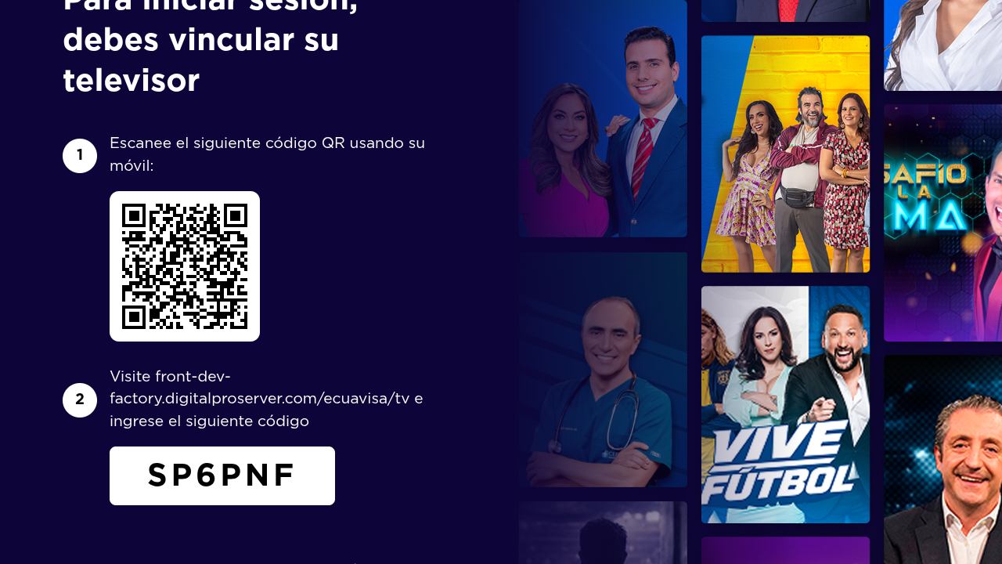
MENU & FUNCTION DESCRIPTION
TV Pairing (activation) — Device code login
1 Step 1 — instructs the user to scan the QR code with a mobile device.
2 QR code including the pairing URL with the current TV code.
3 Step 2 — the user opens the linking site and enters the 6-digit code.
1
4 Pairing code displayed on the TV. The app polls the status and signs in automatically once the code is validated on the web.
2
3
4
Ecuavisa – Application Description | Digital Pro Server
10

Slide 11
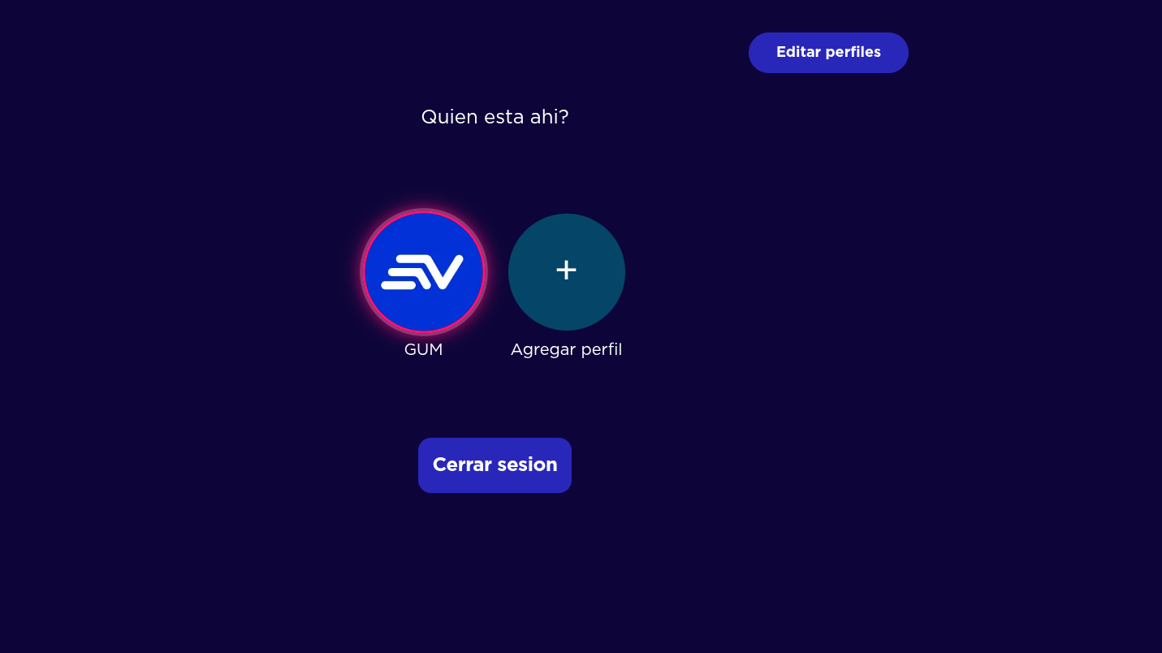
MENU & FUNCTION DESCRIPTION
Profile selection
1 “Editar perfiles” toggle — switches the screen into edition mode (profile cards open the edit screen).
2 Screen title (“¿Quién está ahí?”), displayed after a successful sign-in.
1
3 Existing profile (avatar + name). Pressing OK enters the app with that profile.
2
4 “Agregar perfil” — creates a new profile (maximum 4 profiles per account).
5 “Cerrar sesión” — signs out and returns to the Welcome screen.
3
4
5
Ecuavisa – Application Description | Digital Pro Server
11

Slide 12
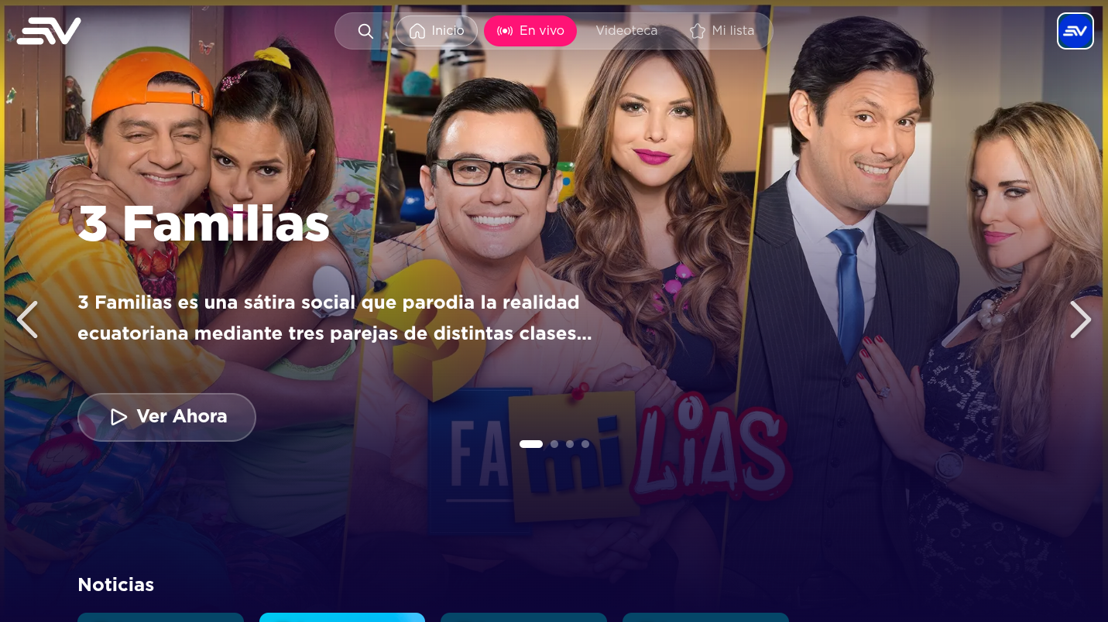
MENU & FUNCTION DESCRIPTION
Home — hero banner
1 Global header: search icon, Inicio, En vivo, Videoteca and Mi lista.
2 Avatar / profile button: opens Mi Cuenta (profile management).
1
2
3 Featured program: title over the hero banner.
4 Short description of the featured program.
3
5 “Ver Ahora” button — starts the featured program.
4
6
6 Carousel arrows to move between featured programs.
7 Next content section (live channels / rows). Moving the focus down scrolls the view.
5
7
Ecuavisa – Application Description | Digital Pro Server
12

Slide 13
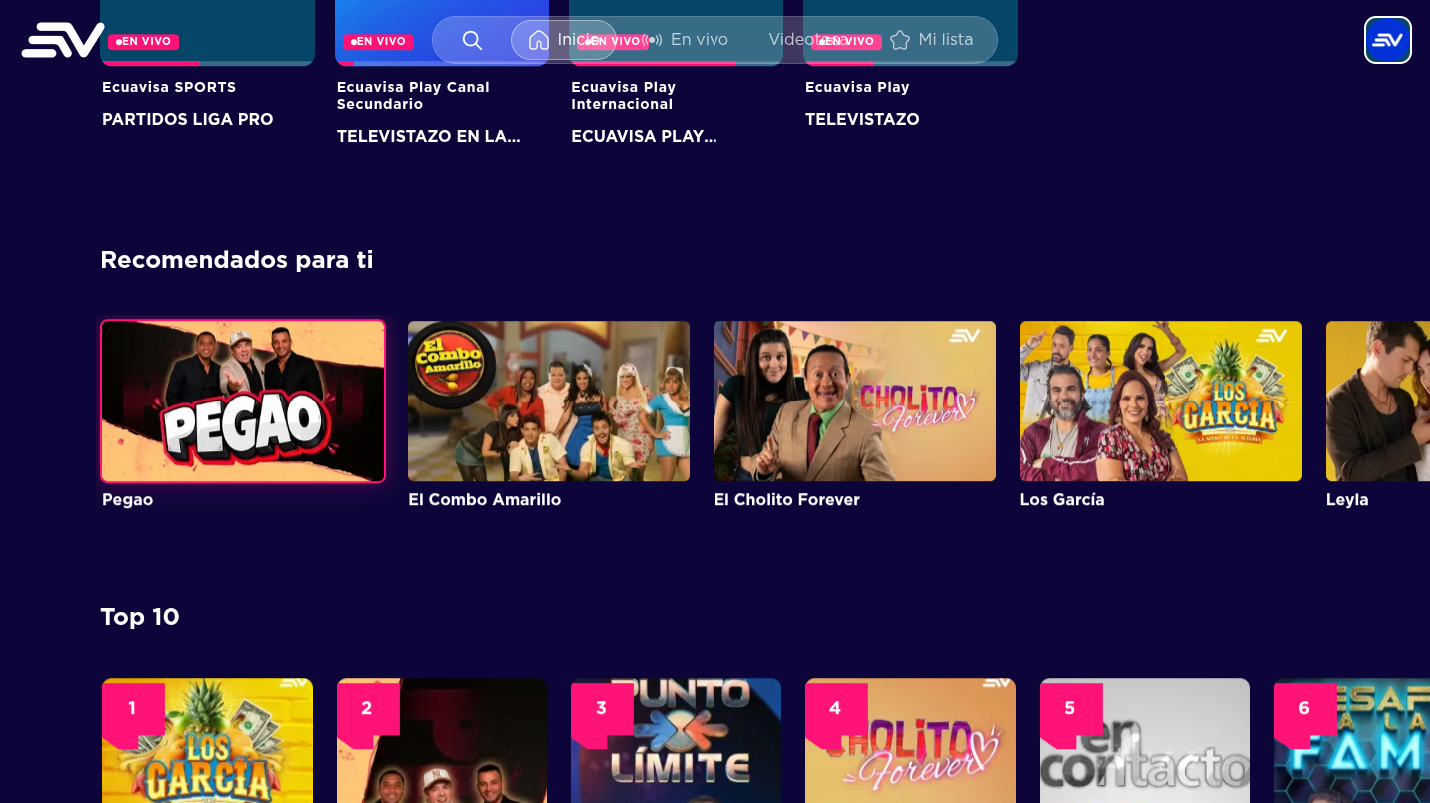
MENU & FUNCTION DESCRIPTION
Home — content rows
1 Live channels row: each card shows the channel and the program on air (“EN VIVO”).
1
2 Program information of the live channel currently on air.
2
3 “Recomendados para ti” carousel.
4 Program cards (poster + title); OK opens the program detail.
3
5 “Top 10” ranking row with position badges.
4
5
Ecuavisa – Application Description | Digital Pro Server
13

Slide 14
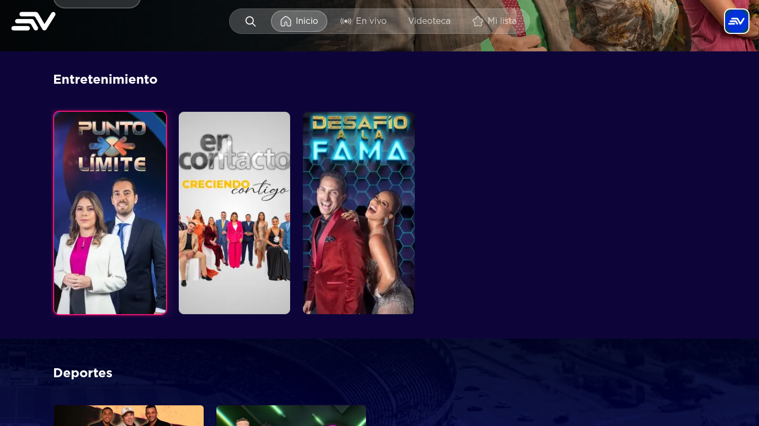
MENU & FUNCTION DESCRIPTION
Home — category rows
1 Category row title (e.g. “Entretenimiento”).
2 Focused card: highlighted with a colored border and a zoom effect.
3 Rest of the row — navigate with the left / right arrows.
1
4 Next category row below (e.g. “Deportes”); the view scrolls automatically when moving the focus.
2
3
4
Ecuavisa – Application Description | Digital Pro Server
14

Slide 15
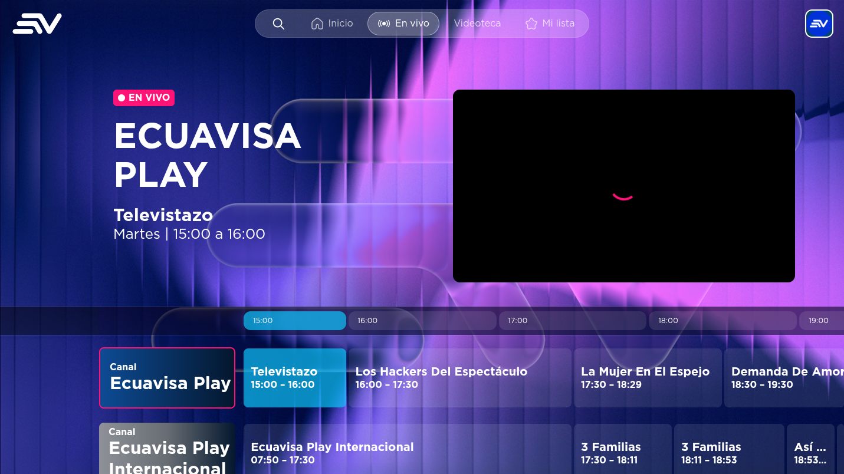
MENU & FUNCTION DESCRIPTION
En vivo — EPG & live playback
1 “EN VIVO” badge of the selected channel.
2 Channel name and current program with its schedule (start / end time).
3 Live player window.
1
4 EPG time ruler: the schedule is browsed by day and time slot.
2
5 Channel column: Ecuavisa, Ecuavisa Play, Ecuavisa Sports, etc.
3
6 Program cells — selecting one plays that channel and shows its information.
4
5
6
Ecuavisa – Application Description | Digital Pro Server
15

Slide 16
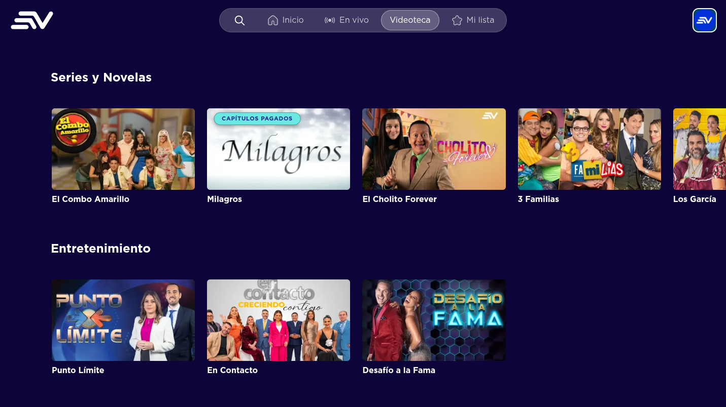
MENU & FUNCTION DESCRIPTION
Videoteca (Programas)
1 Category section title (series, entertainment, sports…).
2 Row arrows to browse the carousel.
1
2
3 Program card: poster, title and short metadata.
4 “Capítulos pagados” badge — program with paid (PPV) chapters.
4
3
5 “Ver Más” — opens the full program list of that category.
5
6 Additional category rows, browsed with the D-pad.
6
Ecuavisa – Application Description | Digital Pro Server
16

Slide 17
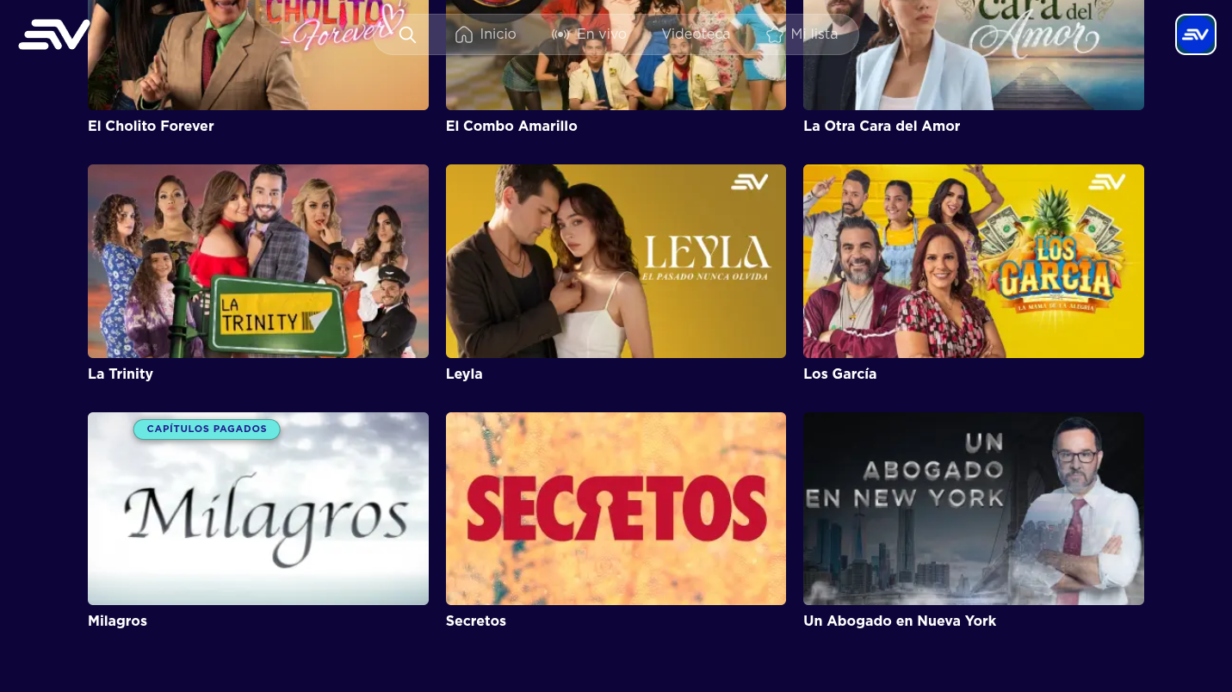
MENU & FUNCTION DESCRIPTION
Category view (“Ver Más”)
1 Grid with all the programs of the selected category.
2 Program card (poster + title) — OK opens the program detail.
3 Paid-content badge (“Capítulos pagados”) when the program has PPV chapters.
1
4 The grid scrolls automatically while moving the focus with the D-pad.
2
3
4
Ecuavisa – Application Description | Digital Pro Server
17

Slide 18
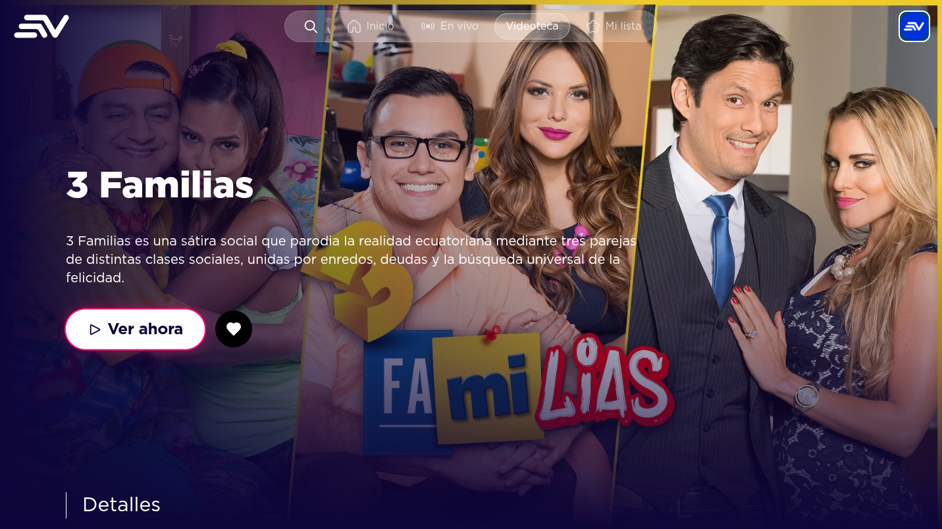
MENU & FUNCTION DESCRIPTION
Program detail — Program / series page
1 Program title over the main artwork.
2 Synopsis of the program.
3 “Ver ahora” — starts playback of the first available chapter.
4 “Add to Mi lista” button (heart icon).
1
5 Detail tabs (Detalles / Capítulos) with the metadata and the episode list.
2
3
4
5
Ecuavisa – Application Description | Digital Pro Server
18

Slide 19
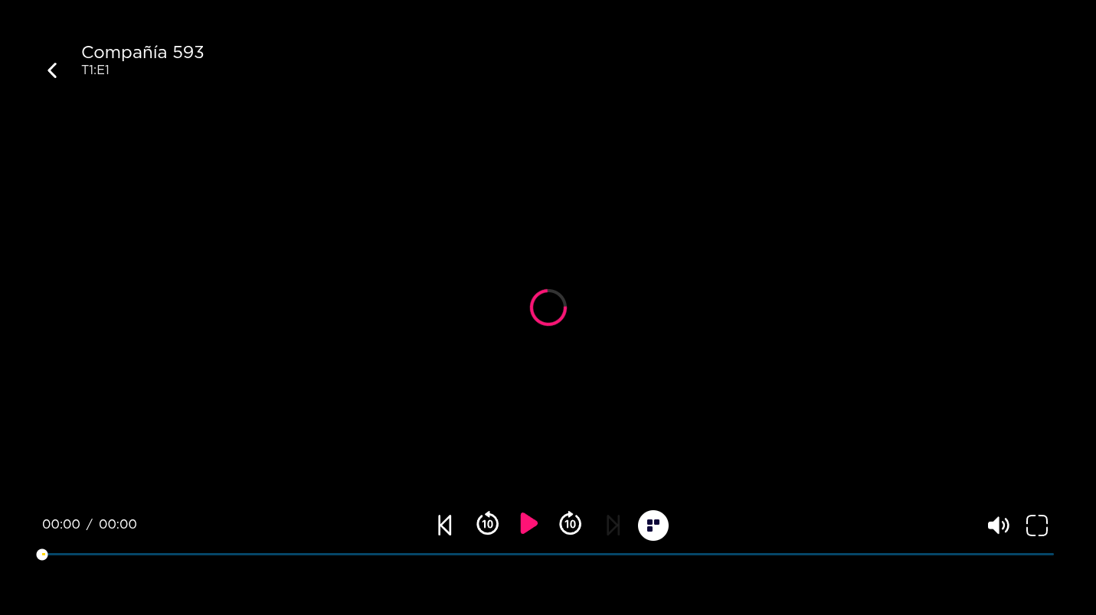
MENU & FUNCTION DESCRIPTION
VOD Player
1 Program / episode title and season:episode indicator.
2 Back button — returns to the program detail (RETURN key as well).
2
1
3 Elapsed time / duration.
4 Seekbar — appears when the UI is visible; the arrows move the position.
5 “Restart chapter” button.
6 Rewind 10 seconds / forward 10 seconds.
7 Play / Pause (also with the media Play-Pause key or OK).
8 Next chapter (enabled when a next episode exists).
3
5
7
9
10
6
8
9 “Ver todos los capítulos” — opens the chapter panel of the program.
4
10 Mute and fullscreen buttons.
Ecuavisa – Application Description | Digital Pro Server
19

Slide 20
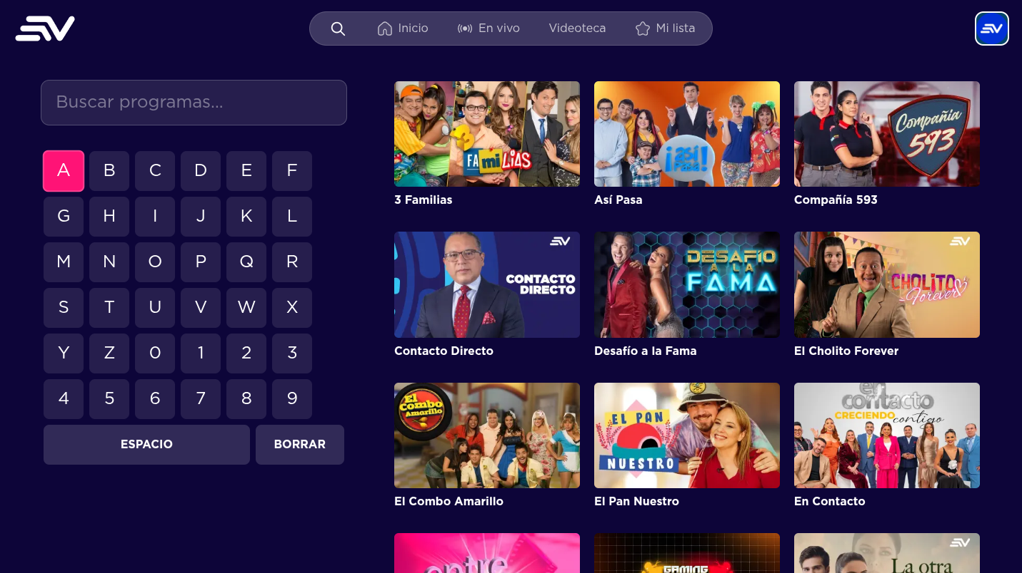
MENU & FUNCTION DESCRIPTION
Search — Virtual keyboard & results
1 Search field (“Buscar programas…”).
2 On-screen keyboard, fully navigable with the remote (D-pad).
3 Focused key — press OK to type the letter.
1
4 ESPACIO (space) and BORRAR (backspace) actions.
3
5
5 Results grid: it is updated while the user types; OK opens the selected program.
2
4
Ecuavisa – Application Description | Digital Pro Server
20

Slide 21
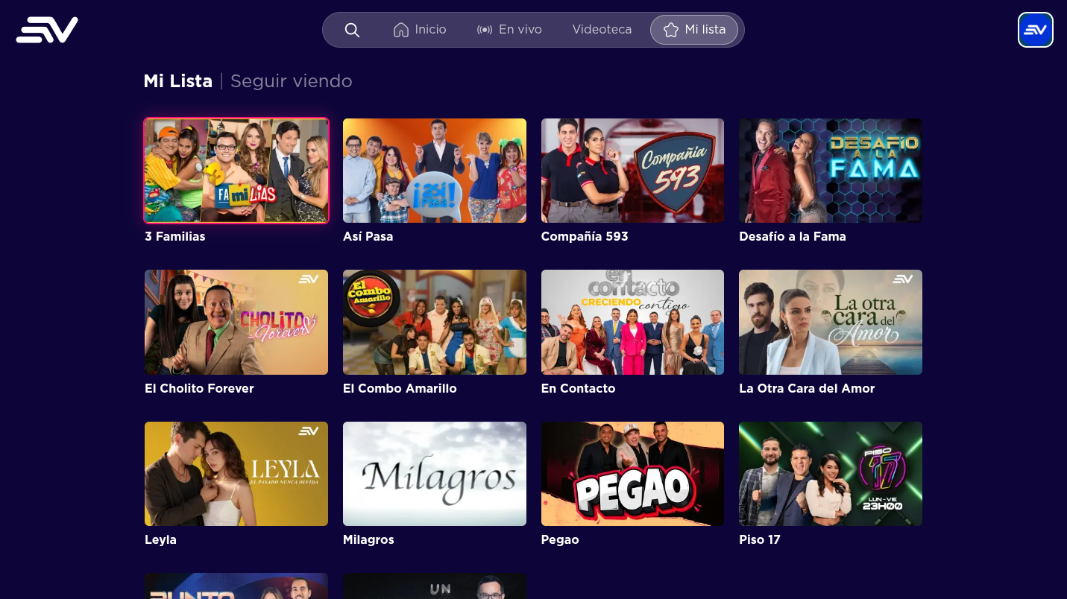
MENU & FUNCTION DESCRIPTION
Mi lista — Favorites
1 Tabs: “Mi Lista” (favorites) and “Seguir viendo” (continue watching).
2 Favorite program, highlighted with the focus style.
1
3 Grid with all the saved programs.
2
4 OK opens the program; the list is updated from the program detail page (heart button).
4
3
Ecuavisa – Application Description | Digital Pro Server
21

Slide 22
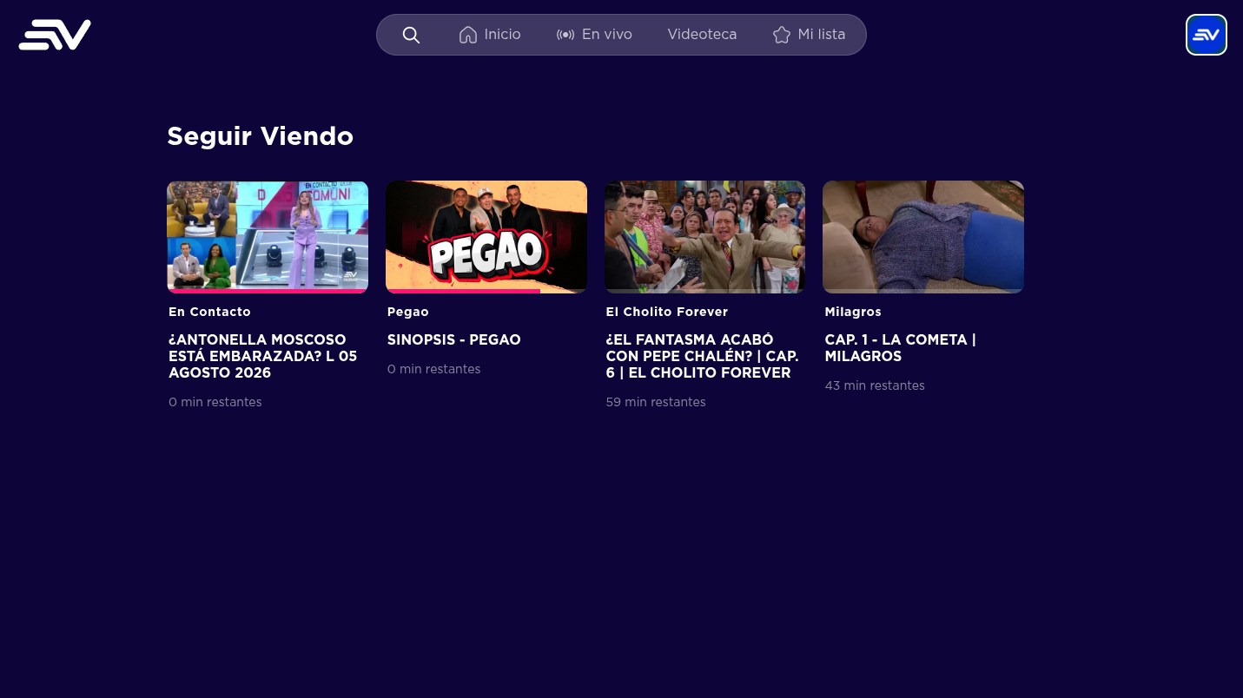
MENU & FUNCTION DESCRIPTION
Seguir viendo — Continue watching
1 “Seguir Viendo” history with the content the user started.
2 Card with the thumbnail and the chapter title of each item.
3 Remaining time of the chapter; OK resumes playback from that position.
1
2
3
Ecuavisa – Application Description | Digital Pro Server
22

Slide 23
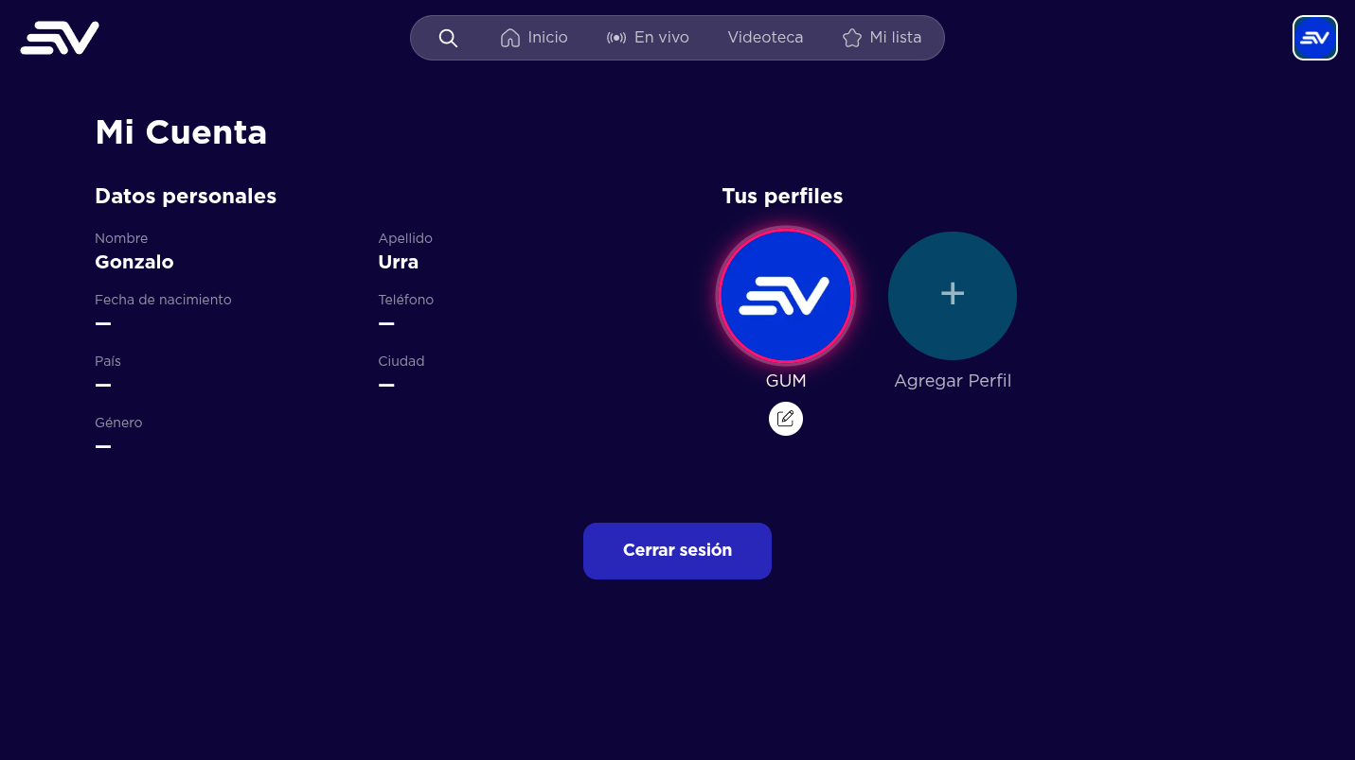
MENU & FUNCTION DESCRIPTION
Mi Cuenta — User data & profiles
1 User data (name, last name, birthdate, phone, country, city, gender).
2 Profiles associated with the account.
3 Profile card (avatar + name) — the focused profile can be edited or selected.
4 Edit-profile shortcut over the profile card.
2
5 “Agregar Perfil” — creates a new profile (maximum 4).
1
3
5
6 “Cerrar sesión” — signs out of the account.
4
6
Ecuavisa – Application Description | Digital Pro Server
23

Slide 24
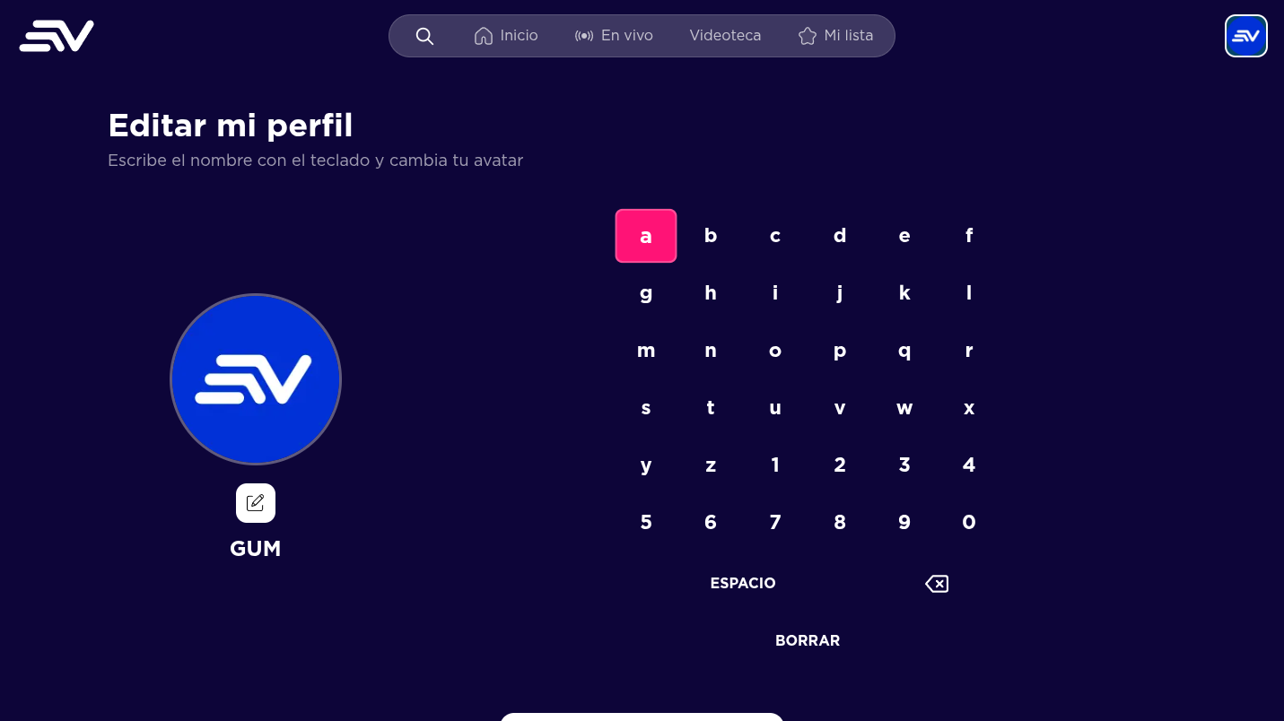
MENU & FUNCTION DESCRIPTION
Edit profile — Name & avatar
1 Screen title (“Editar mi perfil”).
2 Instruction text: type the name with the keyboard and change the avatar.
1
3 Current avatar — opens the “Elegir avatar” screen.
2
4 On-screen keyboard to edit the profile name (D-pad navigation).
5
5 Focused key of the keyboard.
3
4
6 ESPACIO / BORRAR actions; the save button confirms the changes.
6
Ecuavisa – Application Description | Digital Pro Server
24

Slide 25
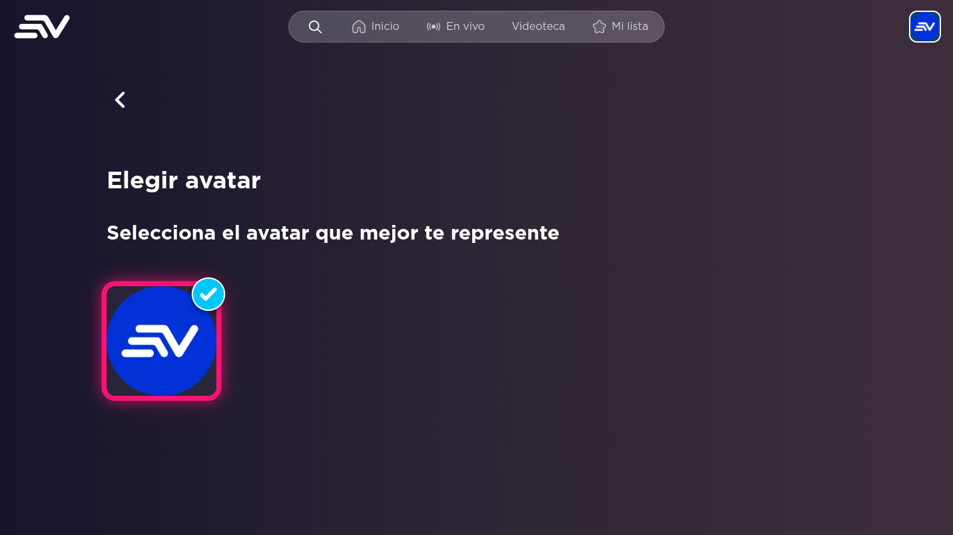
MENU & FUNCTION DESCRIPTION
Choose avatar
1 Back button — returns to the profile edition screen.
2 Screen title (“Elegir avatar”).
3 Instructions to select the avatar of the profile.
1
4 Available avatars; the selected one shows a check mark. Pressing OK confirms the selection.
2
3
4
Ecuavisa – Application Description | Digital Pro Server
25

Slide 26
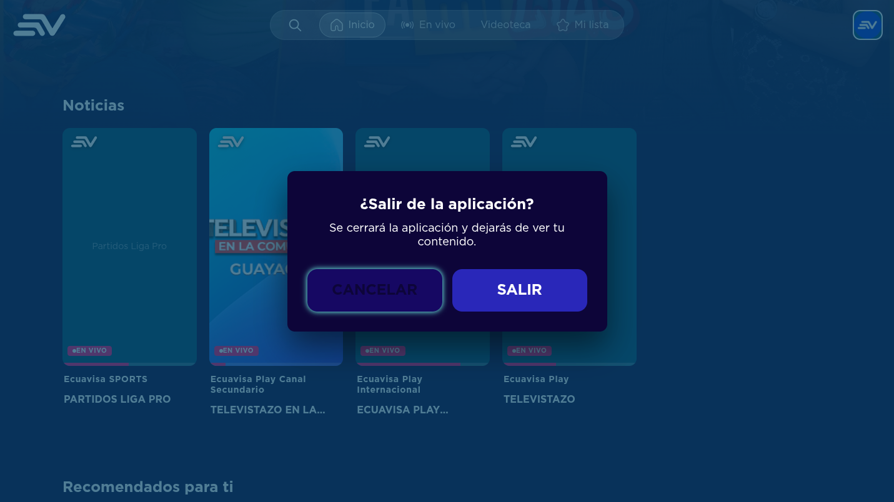
MENU & FUNCTION DESCRIPTION
Exit dialog — Back behaviour on Home
1 Exit dialog: shown when pressing Back (RETURN / ESC / Backspace) on the Home screen.
2 “Cancelar” — closes the dialog and returns to the app.
3 “Salir” — closes the application using the native TV API (Tizen: application exit; webOS: window.close / platformBack).
1
2
3
Ecuavisa – Application Description | Digital Pro Server
26

Slide 27
KEY POLICY
Key Policy
Button | Action | Remarks
Directional keys (D-pad) | Moves the focus between cards, rows and buttons. The view scrolls automatically to keep the focused element visible. | Spatial navigation (focus zones per screen).
OK / Enter | Selects the focused element (same behaviour as a mouse click). | In the virtual keyboard, types the focused key.
RETURN (Back) | Moves to the previous screen (one level up). On the Home screen it shows the exit dialog. In the VOD player it returns to the program detail. | Samsung mandatory. Tizen: keyCode 10009 / XF86Back. LG: 461 / GoBack. Browser: Backspace / Escape.
EXIT | Closes the app and returns to the TV broadcast. | Samsung mandatory. Implemented with the TV native API (Tizen application.exit(), webOS window.close + platformBack).
Play / Pause | Toggles playback on the live or VOD player. | Standard media keys (MediaPlayPause / Space).
Left / Right arrows (player) | Shows the player UI and moves the seekbar position (hold to seek) on VOD content. | Live content has no seekbar.
Channel keys | Reserved for the live EPG navigation on TV remotes. | Not required by the current certification scope.
Ecuavisa – Application Description | Digital Pro Server
27

Slide 28
LANGUAGES
How to change languages
Items
Contents
How to change languages
The application is delivered in a single language (Spanish – es-EC). All the UI strings and contents are shown in Spanish.
There is no in-app language selector and multiple languages are not supported in this version; therefore no language-change flow is required for certification.
Ecuavisa – Application Description | Digital Pro Server
28

