Slide 1
Latina Description
DigitalProServer

Slide 2
Revision History
Version | Date | Description | Author
1.0 | 2025.10.24 | Initial Document, app versión 1.0.0 | Digital Pro Server

Slide 3
Contents
UI Structure
Usage Scenario
Menu & function description
Key policy
How to change languages

Slide 4
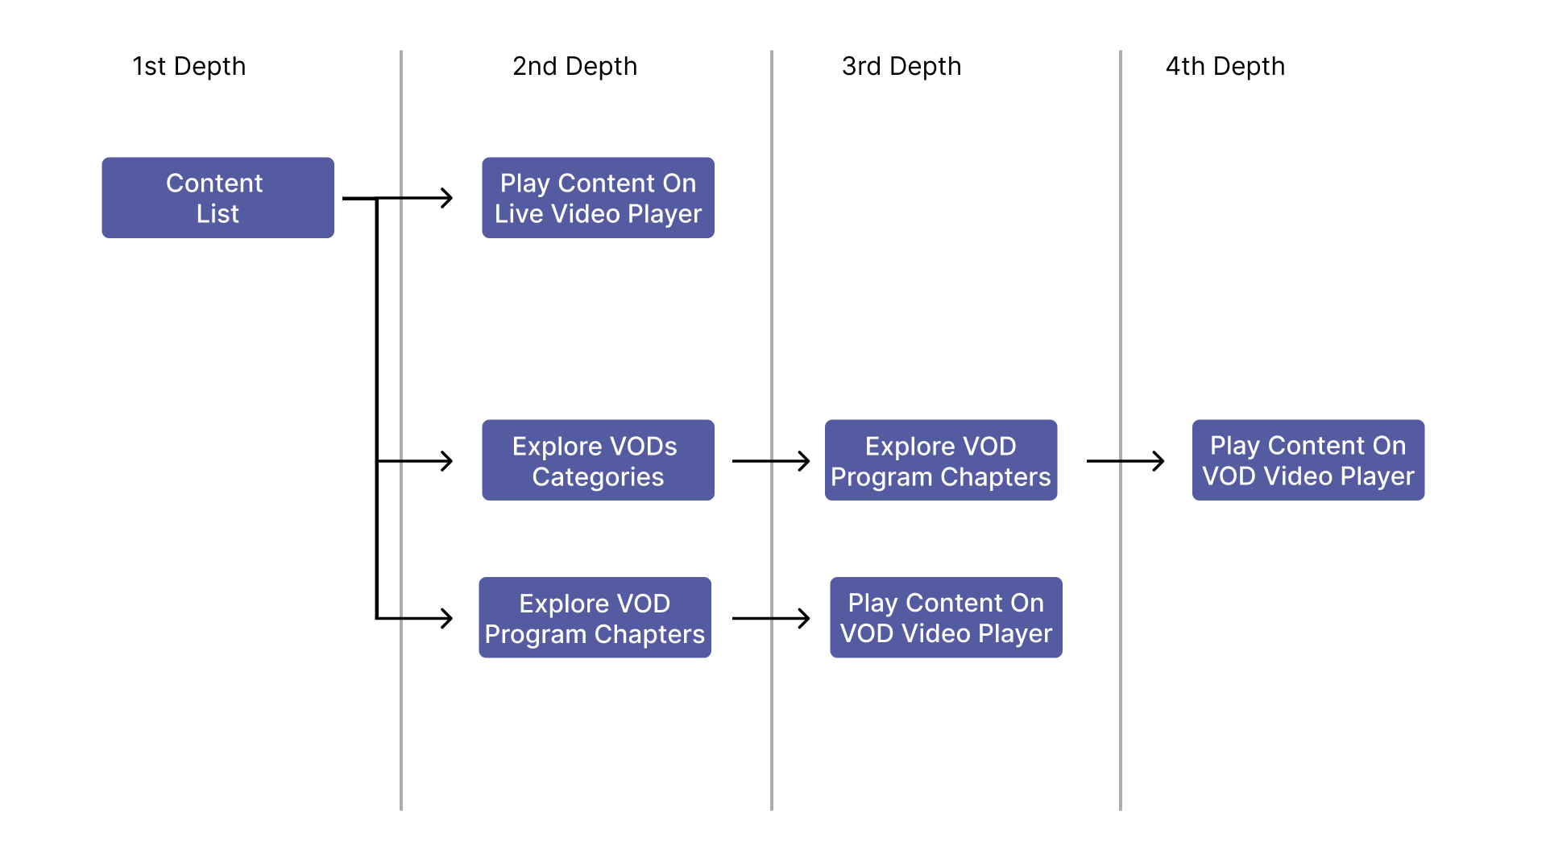
UI Structure
Whole UI Structure

Slide 5
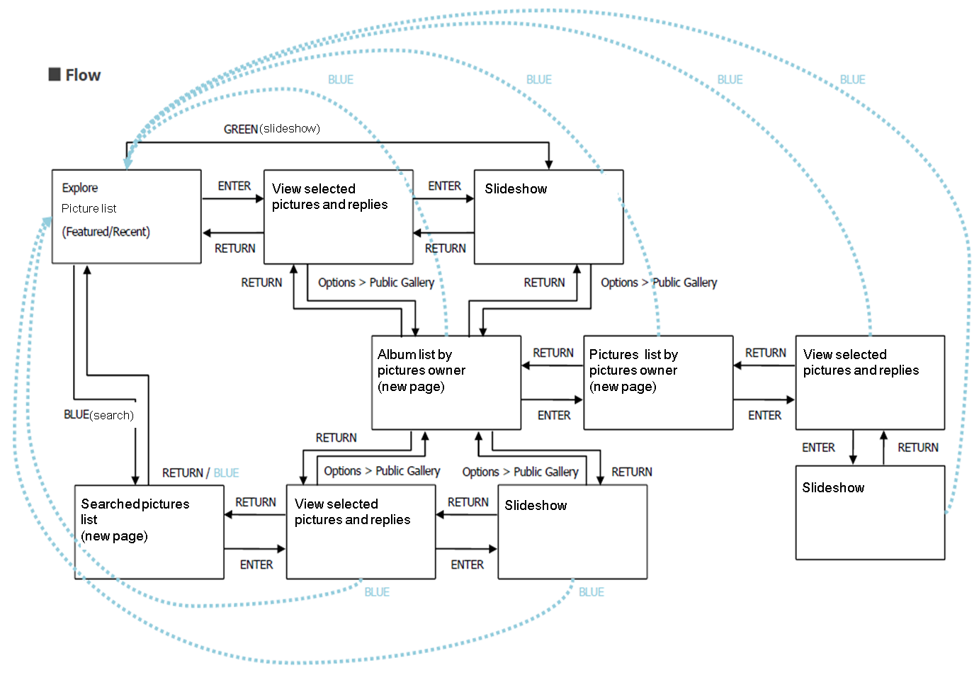
UI structure – sample1(flow graph)

Slide 6
UI Structure – sample2(depth navi.)
1st depth
2nd depth
3rd depth
4th depth
5th depth
Picture list
View selected pictures and replies
Slideshow
Album list by pictures owner
Picture list by pictures owner
View selected pictures and replies
Slideshow
Searched pictures list
View selected pictures and replies
Slideshow

Slide 7
Usage Scenario
All steps for using app should be described.
Especially, if you have log-in system on your app, it should be handled on usage scenario. Testers will refer the scenario and it will be very helpful to test.

Slide 8
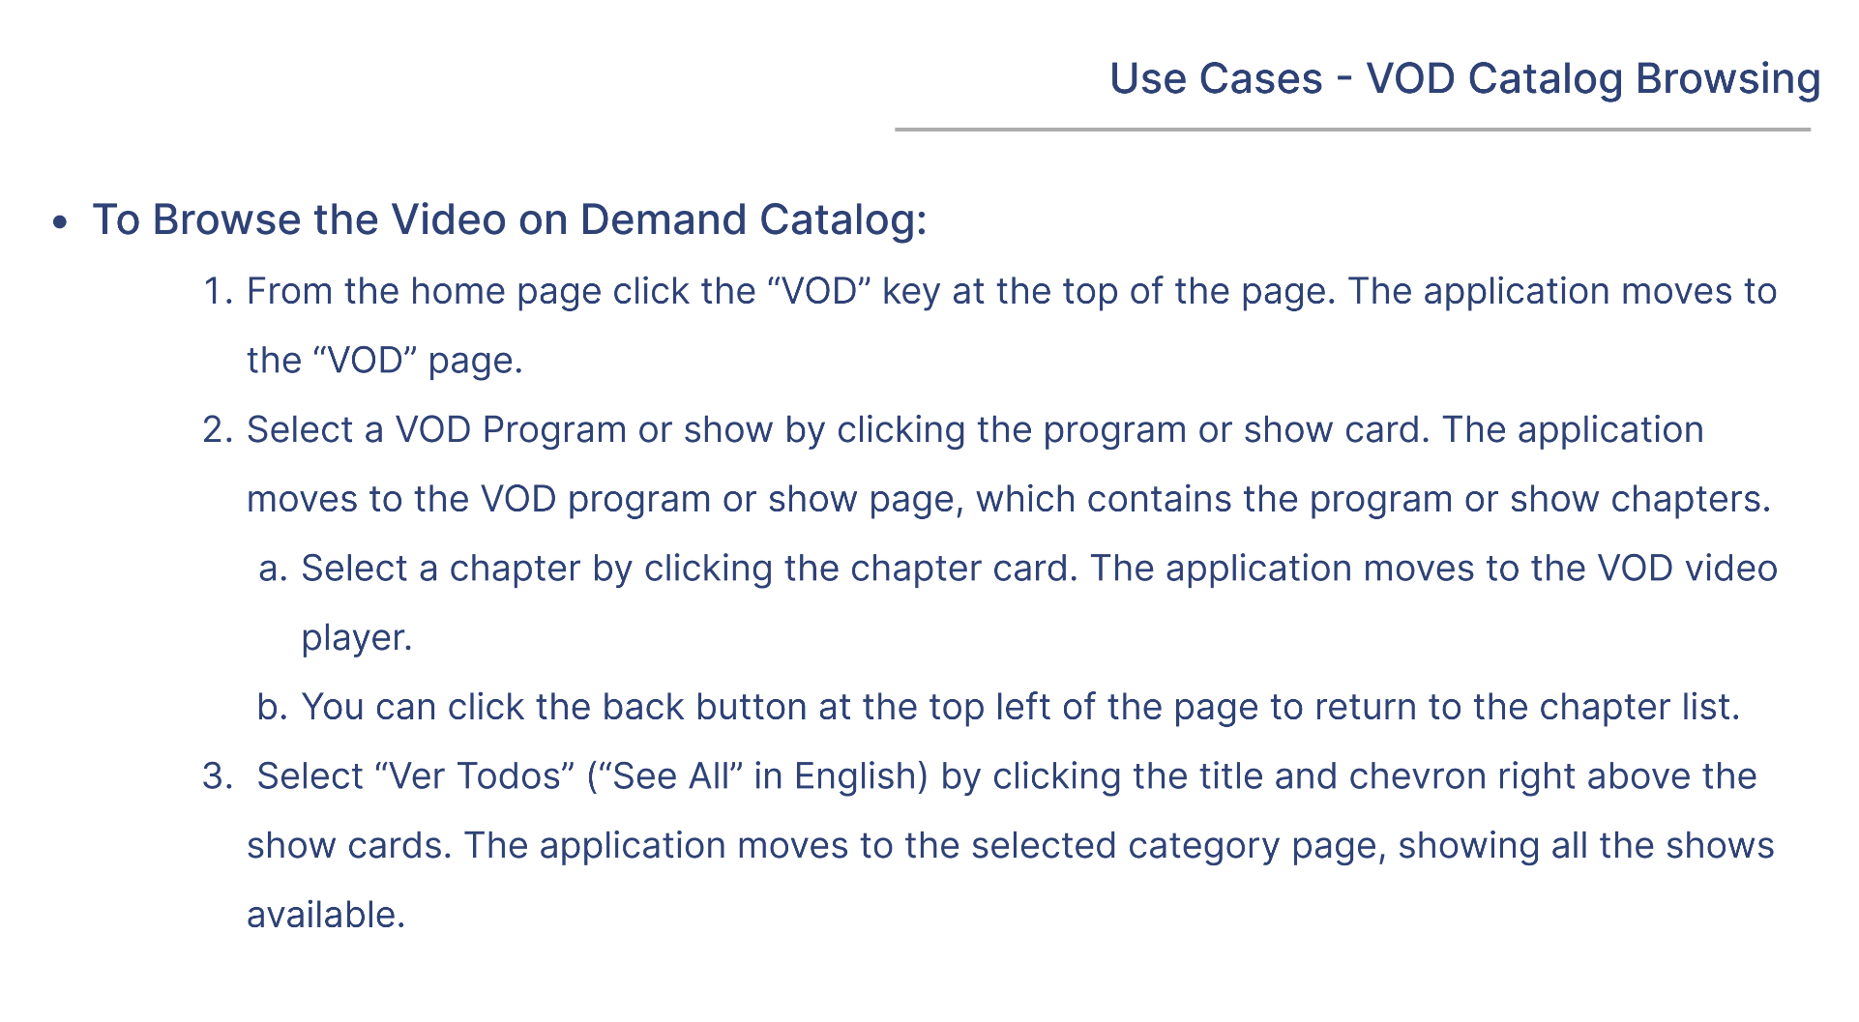
Usage Scenario

Slide 9
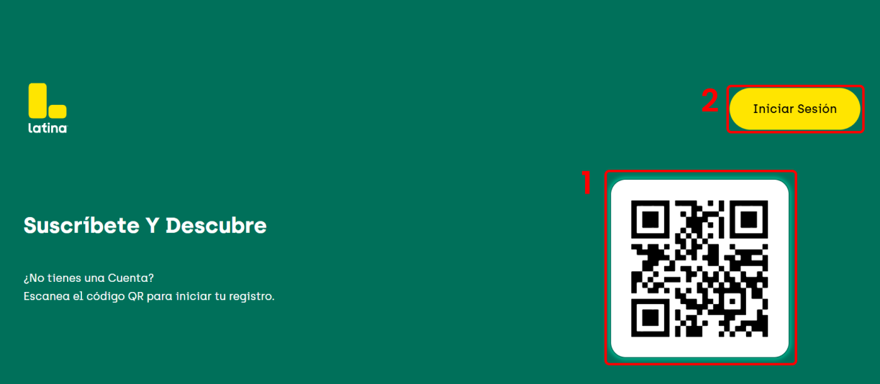
Menu & function description
N° | Description
1 | Redirects to the view where the activation code is
2 | QR code to direct you to the activation page

Slide 10
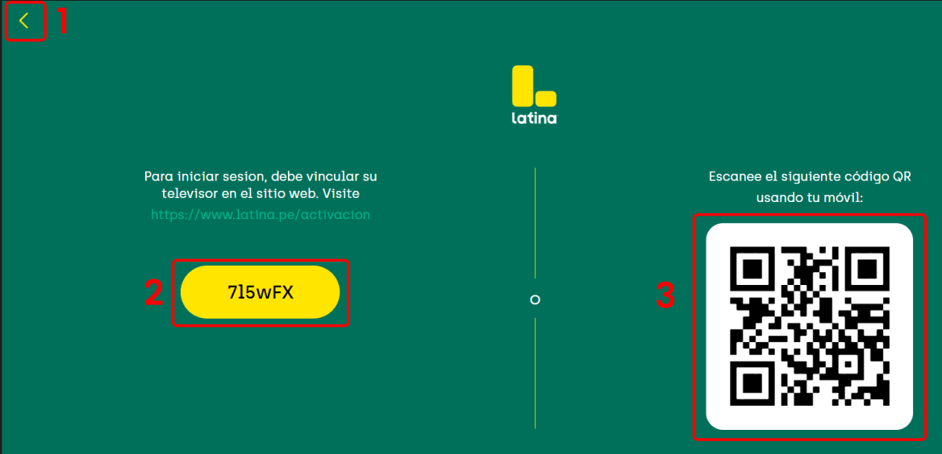
Menu & function description
N° | Description
1 | Return to the previous view
2 | Displays the activation code
3 | QR code to direct you to the activation page

Slide 11

Menu & function description
Numeration | Description
1 | Redirects to the “En vivo” view
2 | Redirects to the “Inicio” view
3 | Redirects to the “Buscar” view
4 | Redirects to the “Programas” view
5 | Redirects to the “Mi lista” view
6 | Redirects to the “Perfiles” view

Slide 12
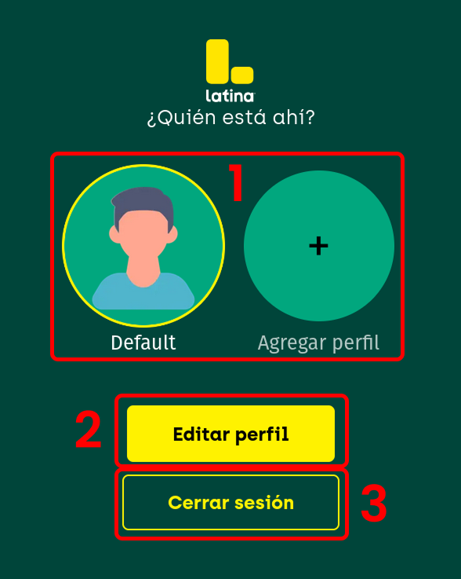
Menu & function description
N° | Description
1 | Profiles and adding a profile
2 | Button that activates profile editing
3 | Sign Out

Slide 13
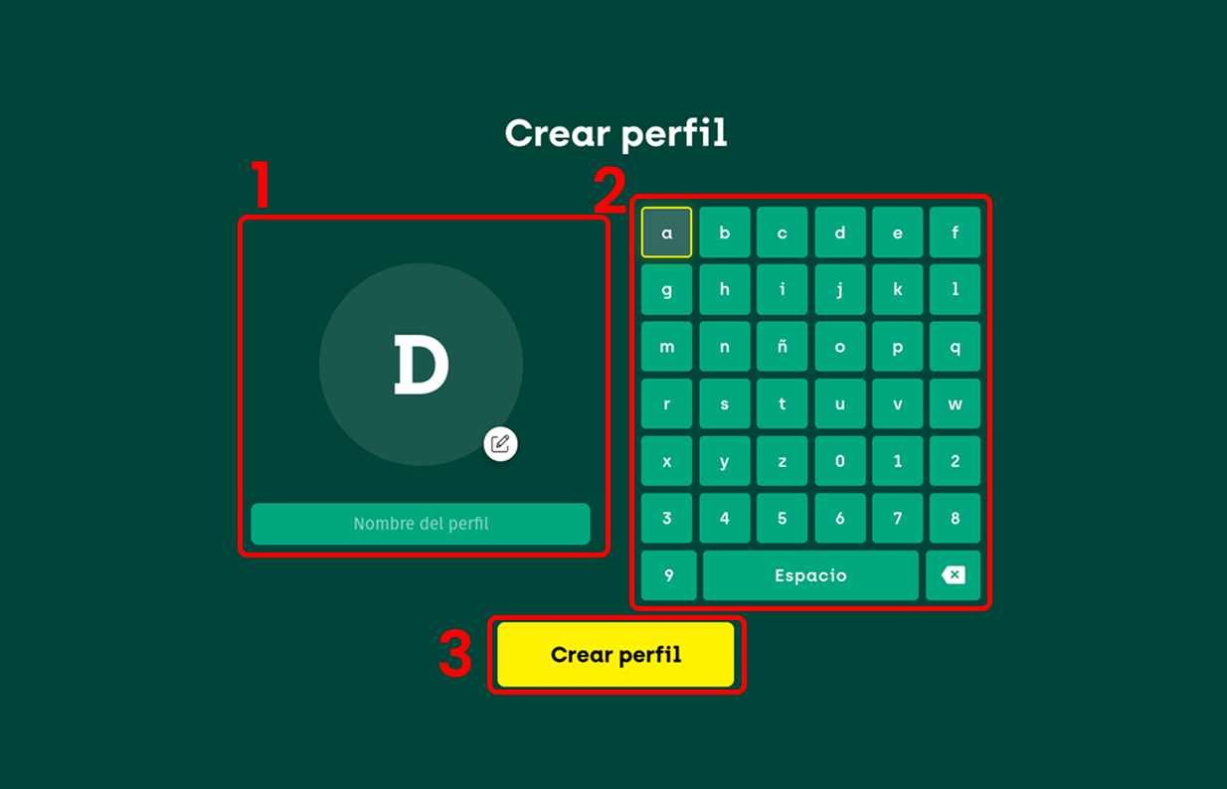
Menu & function description
N° | Description
1 | Current avatar and select avatar button
2 | keyboard to edit name
3 | Create profile

Slide 14
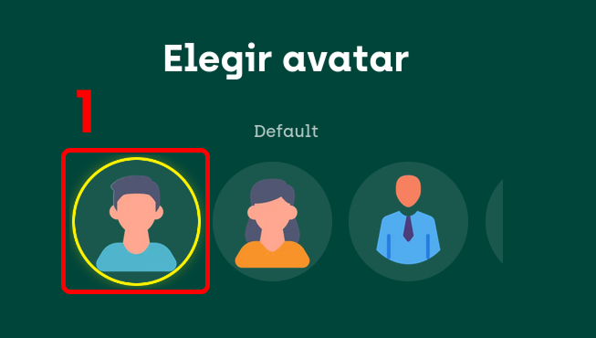
Menu & function description
N° | Description
1 | Avatar to select from the list

Slide 15
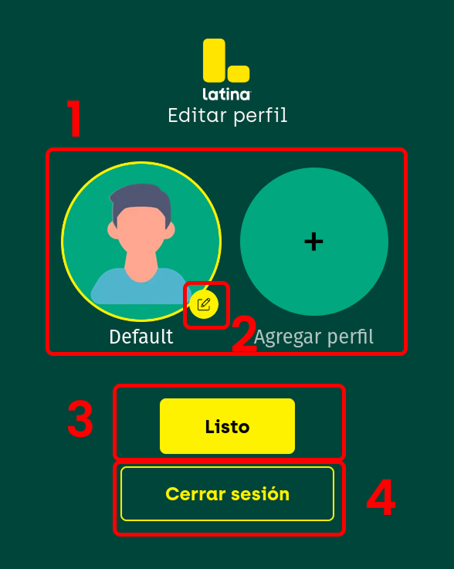
Menu & function description
N° | Description
1 | Profiles and adding a profile
2 | Edit profile
3 | Finished edit
4 | Sign Out

Slide 16
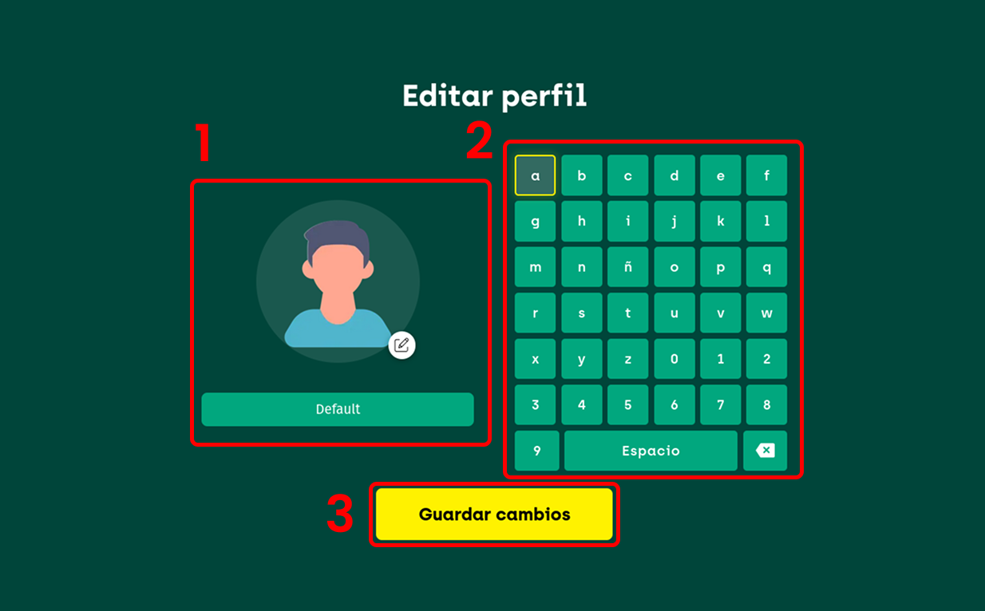
Menu & function description
N° | Description
1 | Current avatar and select avatar button
2 | keyboard to edit name
3 | Save changes

Slide 17
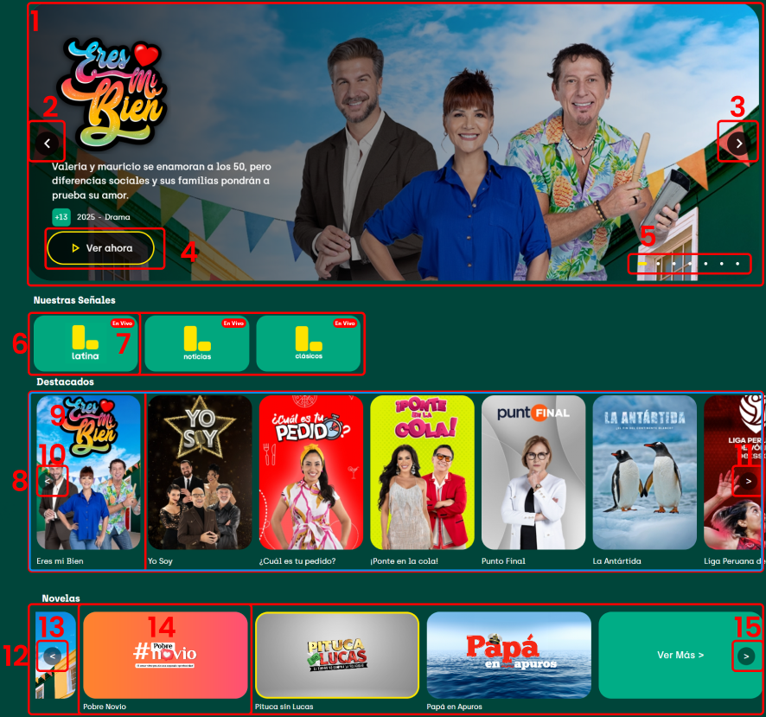
Menu & function description
N° | Description
1 | Banner – Displays the program and its information
2 | Visual guide arrow
3 | Visual guide arrow
4 | Redirects the view to the program
5 | Show your position in the program list banner
6 | List of Live programs
7 | When you enter one, it will play the live that is in focus.
8 | List of featured programs
9 | When entering a redirects to the view of the program that is in focus
10 | Visual guide arrow
11 | Visual guide arrow
12 | List of normal programs, each showing its categorization
13 | When entering one it redirects to the view of the program that is in focus
14 | Visual guide arrow
15 | Visual guide arrow

Slide 18
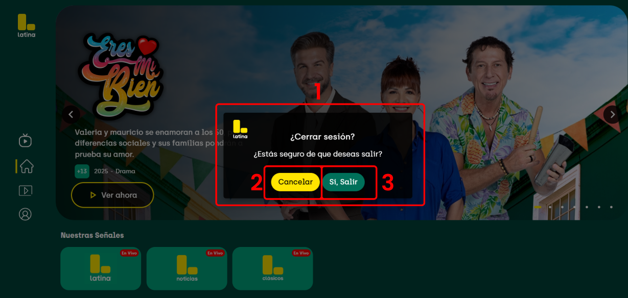
Menu & function description
N° | Description
1 | Pressing the back button will show the exit or return buttons.
2 | Close the modal
3 | Exit the app

Slide 19
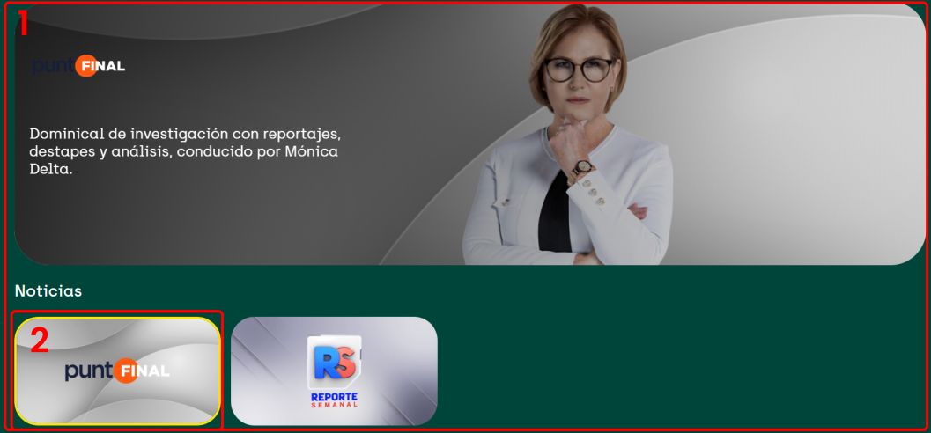
Menu & function description
N° | Description
1 | View more (only shows the category the view more was in) with its programs banner
2 | When you enter the program this spotlight will redirect you to the program view

Slide 20
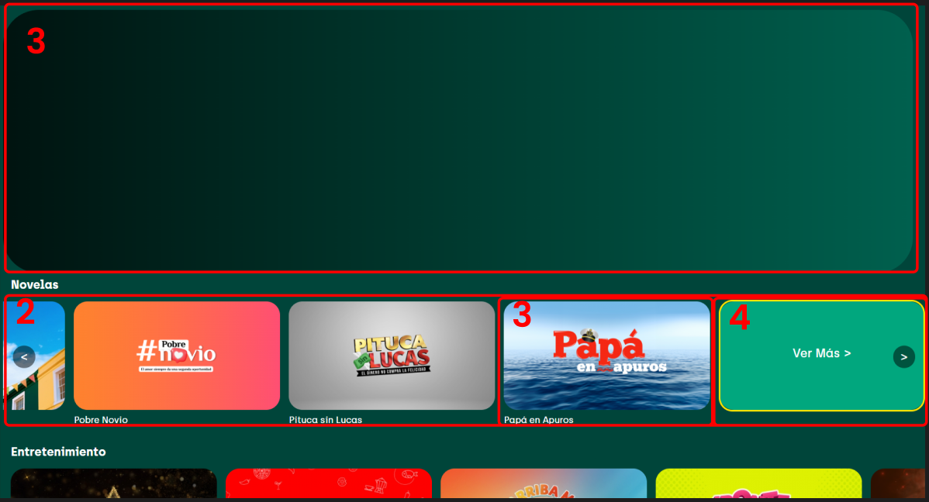

Menu & function description
N° | Description
1 | Banner for programs, when passing through a program it will show its information
2 | Carousel of programs
3 | When entering a program it will redirect you to the program in question
4 | Allows you to view all programs in that category (Novela, Entertainment or others)

Slide 21

Menu & function description
N° | Description
1 | Return to the previous view
2 | Activates the view of the segments when pressed
3 | Going down to this view will activate the segment view.

Slide 22
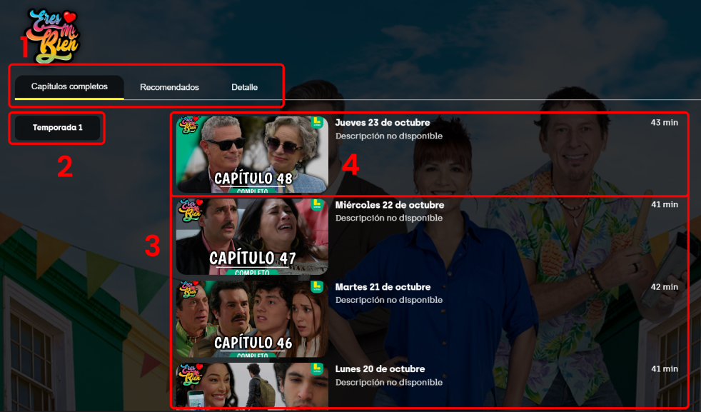
Menu & function description
N° | Description
1 | Segment carousel, moving between them will change the view
2 | List of seasons, it will show the seasons of the program, if it has more than one season you can press between them to show the chapters of the season in question
3 | List of program chapters.
4 | If you press on a chapter it will play and you will go to the player view.

Slide 23
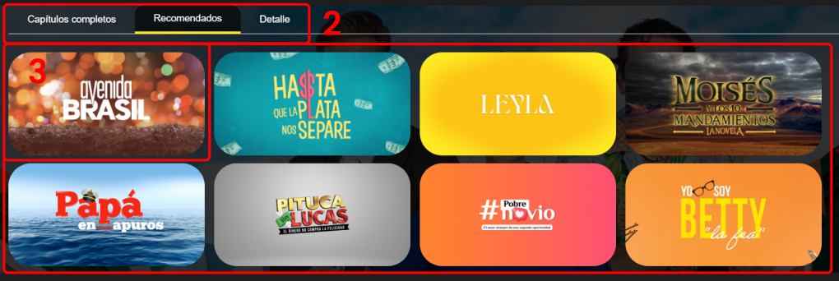
Menu & function description
N° | Description
1 | Container of recommended programs
2 | Segment carousel, moving between them will change the view
3 | When entering a program, it will redirect you to the program view.

Slide 24
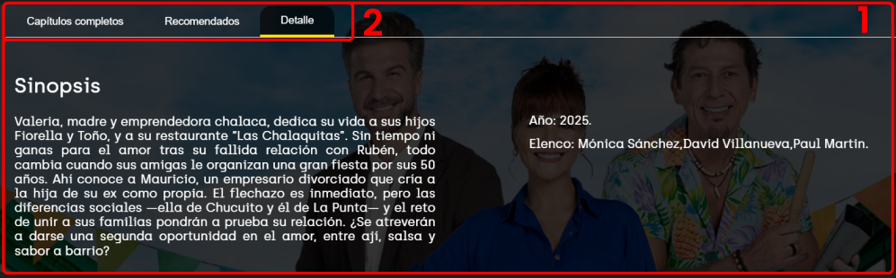
Menu & function description
N° | Description
1 | Container of Detail programs
2 | Segment carousel, moving between them will change the view
3 | When entering a program, it will redirect you to the program view.

Slide 25
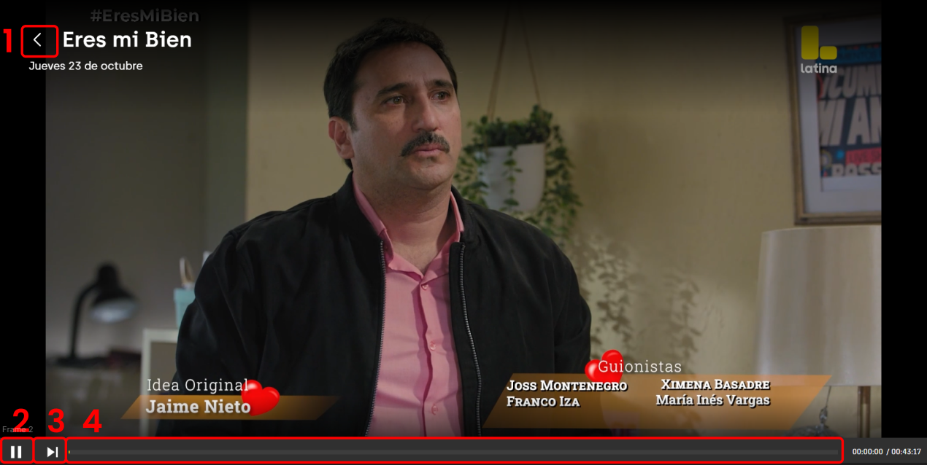
Menu & function description
N° | Description
1 | Return to the previous view
2 | Pauses the program, if it is already paused you can put it in play
3 | Play the next chapter
4 | Show the progress of the program

Slide 26
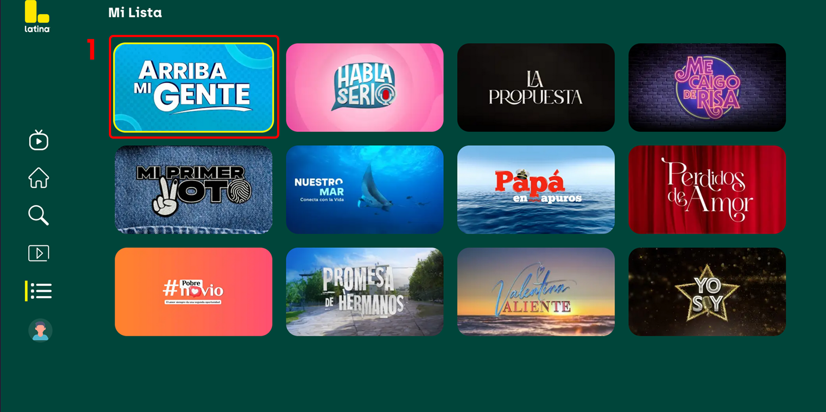
Menu & function description
N° | Description
1 | Mi list programs favorites and focus

Slide 27
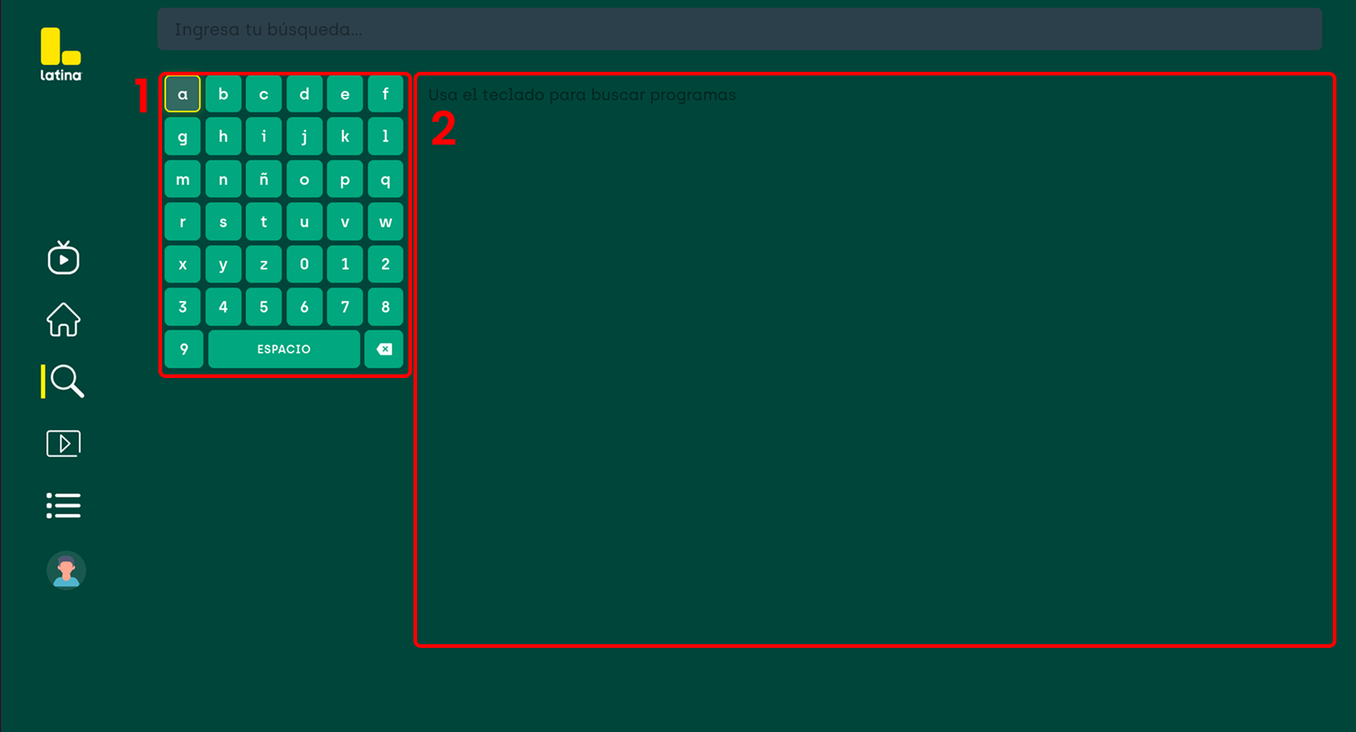
Menu & function description
N° | Description
1 | Keyboard to search for programs
2 | Program container; programs will be displayed as the program title is typed.

Slide 28
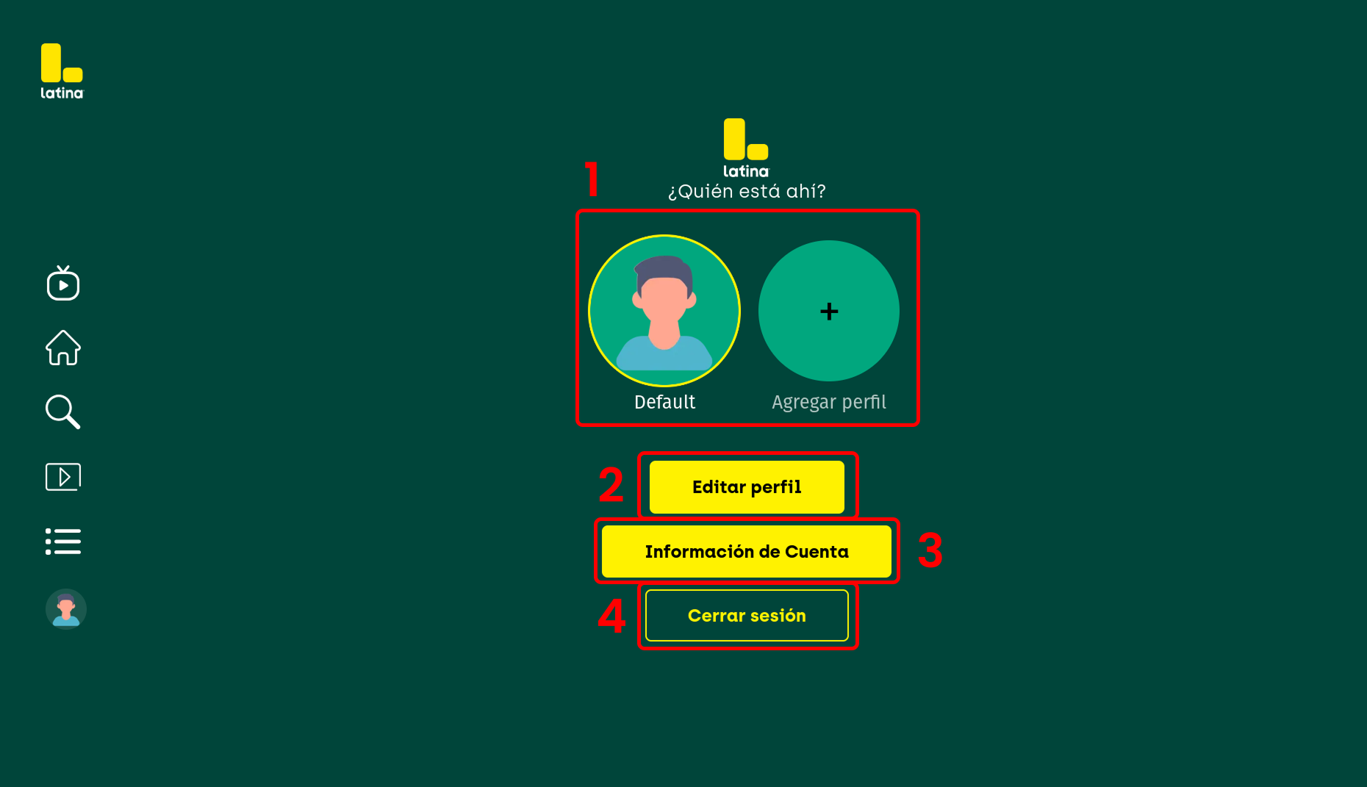
Menu & function description
N° | Description
1 | Profiles and adding a profile
2 | Edit profile
3 | Profile information
4 | Sign Out

Slide 29
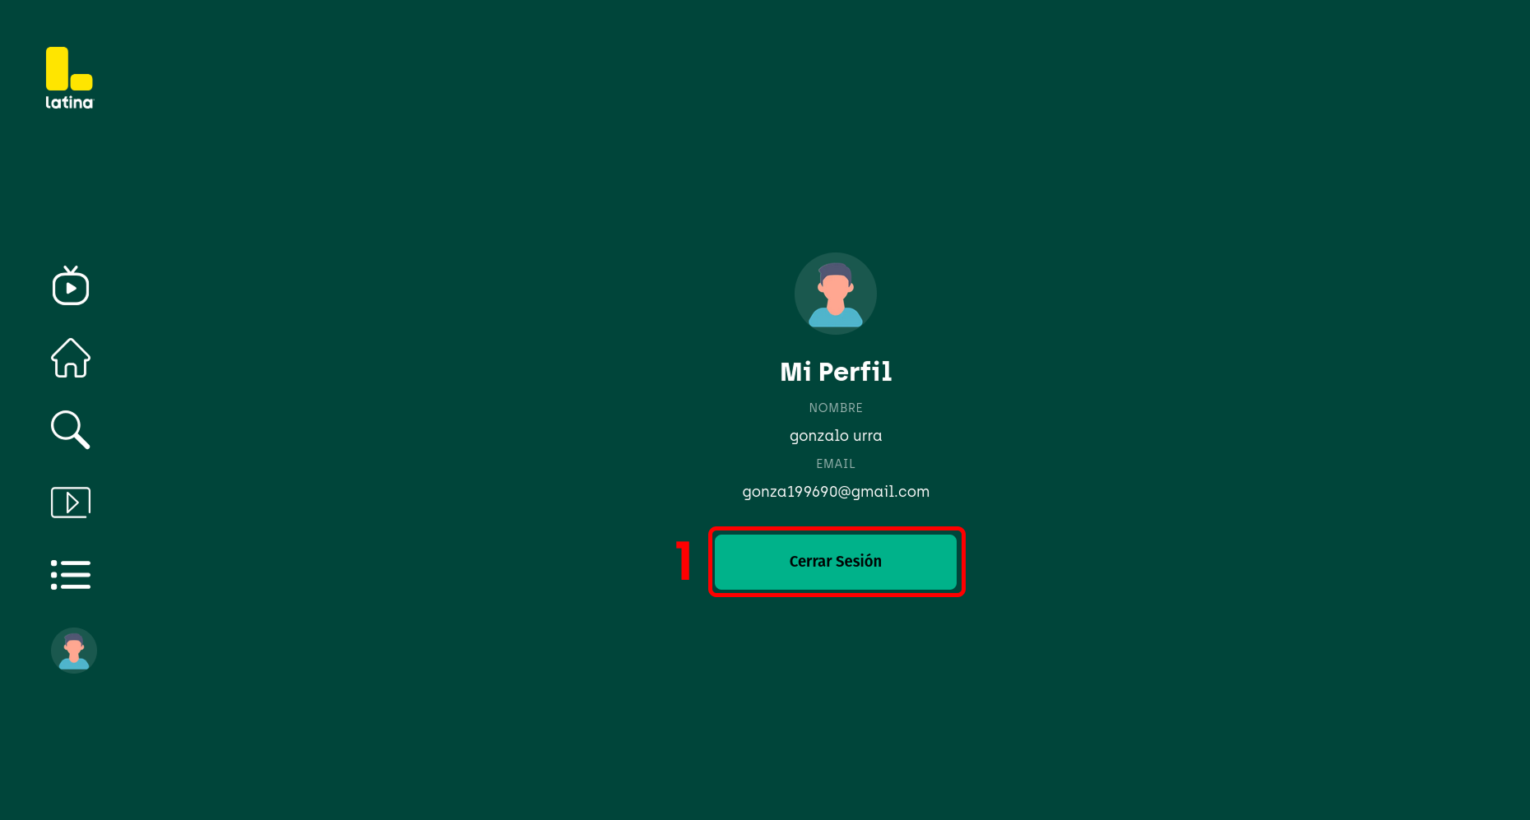
Menu & function description
N° | Description
1 | Sign Out

Slide 30
Key Policy
Button | Action | Remarks
Play/Pause | Play and Pause on live or VOD video player.
RETURN | Move to previous page | Samsung Mandatory
EXIT | Close the app and show broadcasting channel | Samsung Mandatory
RETURN/EXIT | In case of Game App, if game is terminated, the exit popup should be displayed. | Samsung Mandatory

Slide 31
How to change languages
Items | Contents
How to change languages | If multi languages are supported, describe how to check multi languages on the App. If not, ignore this box. (e.g.) change country setting to Spain on SMART HUB (e.g.) change OSD Language setting to German etc..

