Slide 1
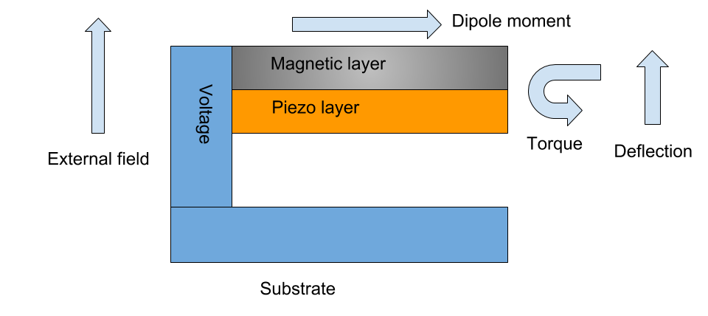
Biomimetic microfabricated magnetic gradiometer
University of Florida| Dr. Jenshan Lin | Budget:$2,054,392 | Subcontractors: Texas Tech University
Innovative Claims
Team organization, cost, milestones and schedule
Biomagnetic fields are weak, sensors are swamped by ambient fields
The existing state-of-the-art sensing methods require heavy shielding, and cryogenic sensors (ie, SQUID, SERF)
Our approach is to mimic the sensing used by biological organisms using microfabricated structures
Electromagnetic design: Dr. Lin, Dr. Joaquin Casanova
Microfabrication: Dr. YK Yoon
Circuit design: Dr. Changzhi Li
Cost/Milestones/Deliverables by phase:
Phase 1 - $799,629 - Simulated design, Microfabricated prototype, PCB-based circuit
Phase 2 - $618,336 - Revised design, Microfabricated array, integrated circuit
Phase 3 - $636,427 - Revised design, Microfabricated array, fully integrated system
Technical Rationale and Approach
Impact
Detect very weak magnetic fields by mimicking nature
Using simulation-guided design, create microscopic structures that respond to magnetic fields, in the same way certain bacteria do
Fundamental trade-off between sensitivity and size
Requires very small, very powerful magnetic materials, in the correct geometry
Potential risks:
Sensitive to vibrations - employ extra sensors to cancel
Difficult to manufacture - work with reliable processes
Insufficiently sensitive - pursue multiple design variants
Manufacturing variation/mismatch - dynamic element matching in circuit
Could provide a totally new, fully integrated, highly sensitive method for detecting small magnetic fields
Potential DoD technology transfer partners:
Veterans Affairs – prosthetics and rehab
Army, Navy, Air Force – brain-machine control
National Reconnaissance Office - bio/geomagnetic mapping
Can be used for medical diagnostics, brain-machine interfaces, and geomagnetic sensing
SOURCE SELECTION SENSITIVE – SEE FAR 2.101 AND 3.104
<number>

