Slide 1
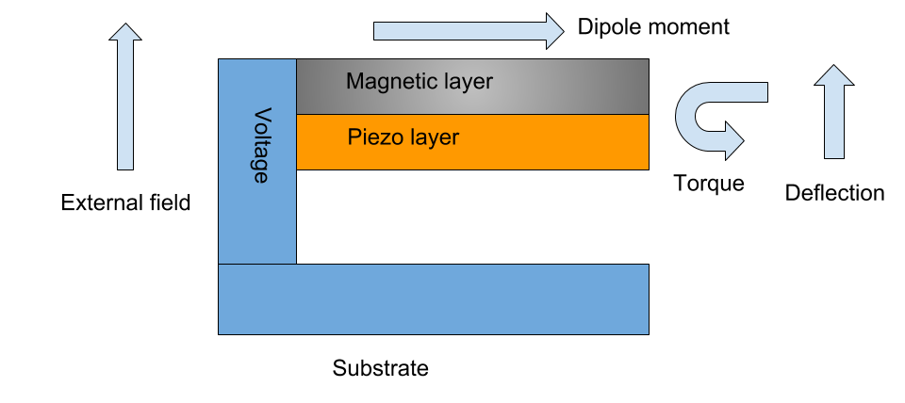
Biomimetic microfabricated magnetic gradiometer University of Florida| Dr. Jenshan Lin | Budget:$2,053,326 | Subcontractors: Texas Tech University
Innovative Claims
Team organization, cost, milestones and schedule
Biomagnetic fields are weak, and sensors are swamped by ambient magnetic fields
The existing sensing methods require heavy shielding, and cryogenic sensors (ie, SQUID, atomic magnetometers)
Our approach is to mimic the sensing used by biological organisms using microfabricated structures
Electromagnetic design: Dr. Lin, Dr. Joaquin Casanova
Microfabrication: Dr. YK Yoon
Circuit design: Dr. Changzhi Li
Cost/Milestones/Deliverables by phase:
Phase 1 - $798557 - Simulated design, Microfabricated prototype, PCB-based circuit
Phase 2 - $618338 - Revised design, Microfabricated array, integrated circuit
Phase 3 - $636430 - Revised design, Microfabricated array, fully integrated system
Technical Rationale and Approach(es)
Impact
Detect very weak magnetic fields by mimicking nature
Using simulation-guided design, create microscopic structures that respond to magnetic fields, in the same way certain bacteria do
Fundamental trade-off between sensitivity and size
Requires very small, very powerful magnetic materials, in the correct geometry
Fundamental risks:
Sensitive to vibrations - employ extra sensors to cancel
Difficult to manufacture - work with reliable processes
Insufficiently sensitive - pursue multiple design variants
Manufacturing variation/mismatch - dynamic element matching in circuit
Could provide a totally new, fully integrated, highly sensitive method for detecting small magnetic fields
Potential DoD technology transfer partners:
Veterans Affairs – prosthetics and rehab
Army, Navy, Air Force – brain-machine control
National Reconnaissance Office - bio/geomagnetic mapping
Can be used for medical diagnostics, brain-machine interfaces, and geomagnetic sensing

